Slide 1
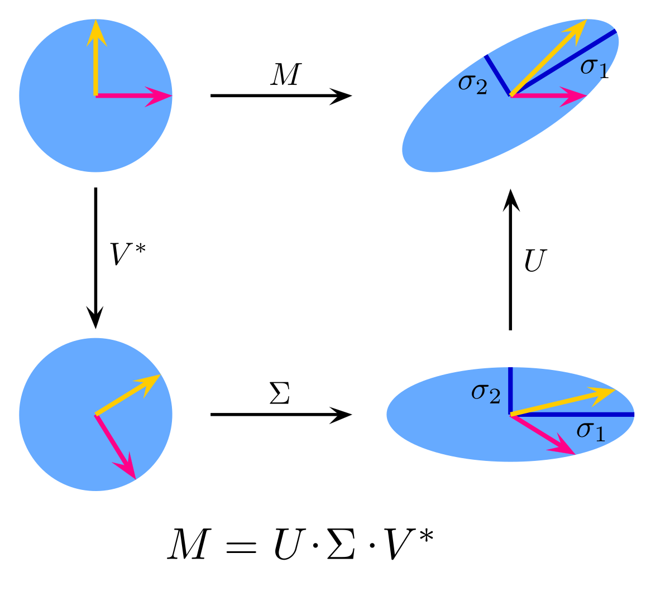
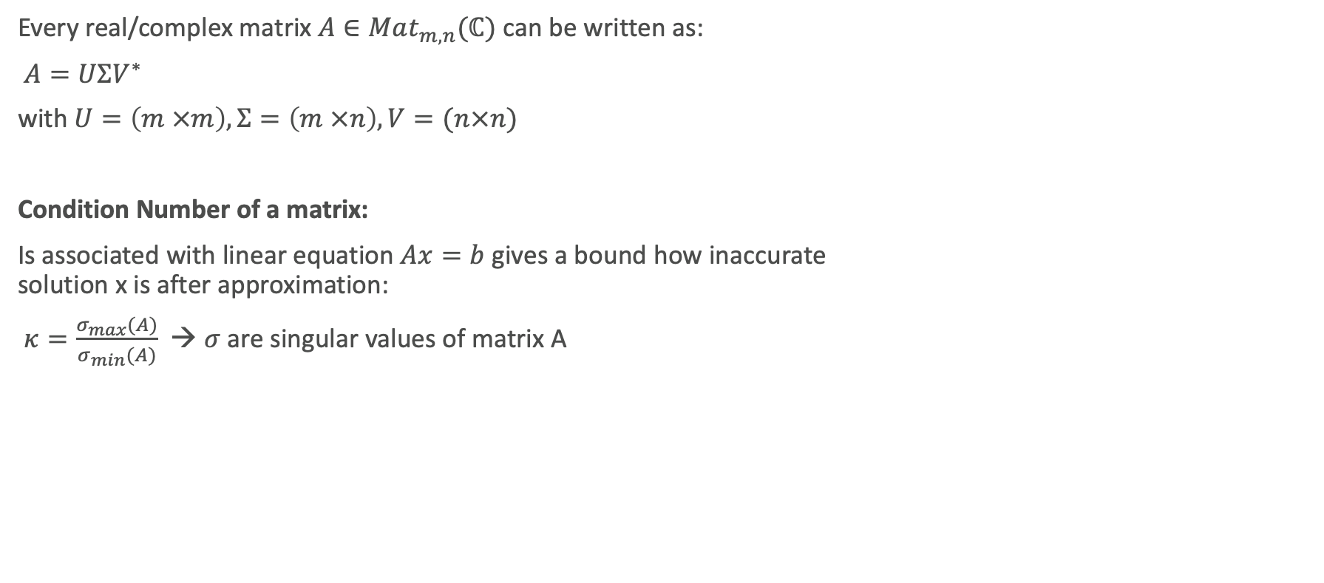
SVD of B Matrix
Every real/complex matrix $A∈Mat_{m,n}(ℂ)$ can be written as:
$A=UΣV^{∗}$
with $U=\left(m ×m\right), Σ=\left(m ×n\right),V=(n×n)$
Condition Number of a matrix:
Is associated with linear equation $Ax=b$ gives a bound how inaccurate solution x is after approximation:
$κ=\frac{σ_{max}(A)}{σ_{min}(A)}$ → $σ$ are singular values of matrix A

Slide 2
Application:

