Slide 1
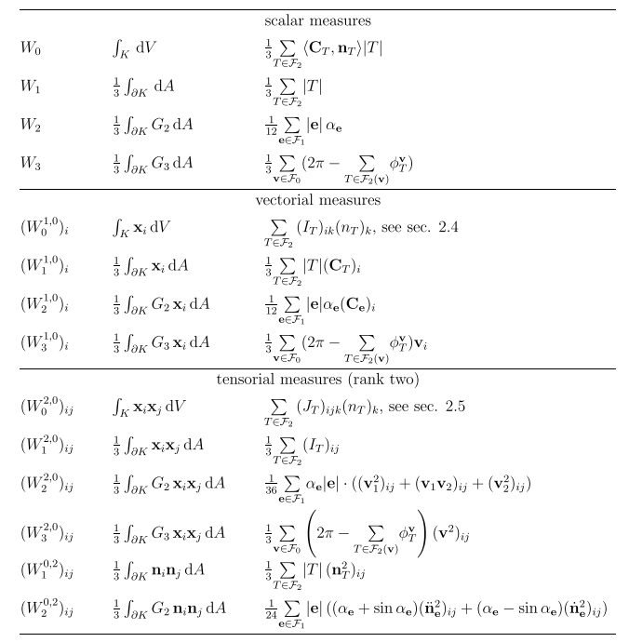
Minkowski Functionals - Integral Formulation

Slide 2
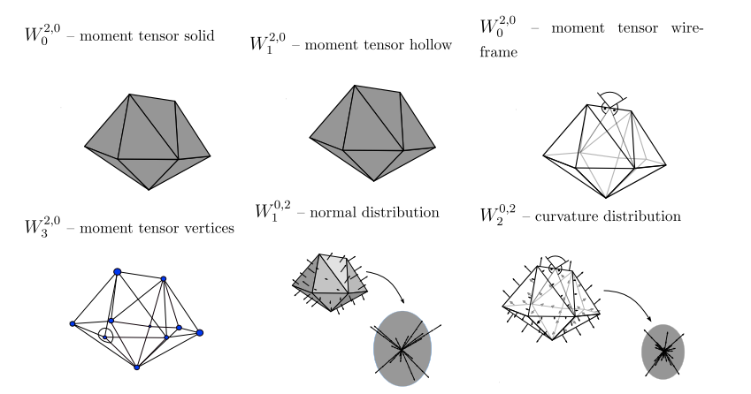
Minkowski Tensor Visualization

Slide 3
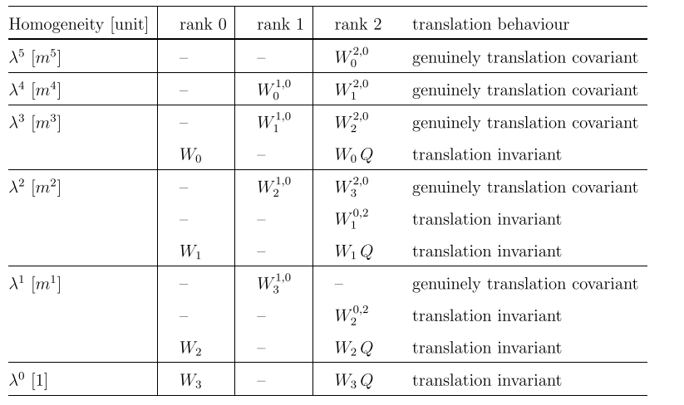
Minkowski Functionals – Translation Behavior

