Slide 1
Statistical Characterisation of Porous Media at the Pore Scale
Parametric Models
Student:
Lukas Mosser
Supervisors:
Professor Olivier Dubrule
Professor Martin Blunt

Slide 2
Presentation Outline
Plane Surface
Bundle of Tubes
Array of Spheres
Asymmetric Array of Spheres

Slide 3




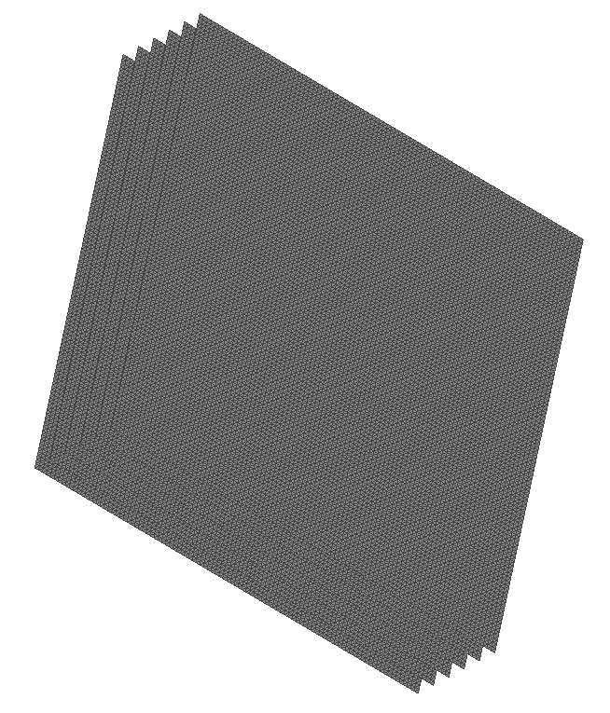


Plane Surfaces

Slide 4









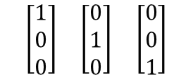


Minkowski Tensors – Plane Surface

Slide 5



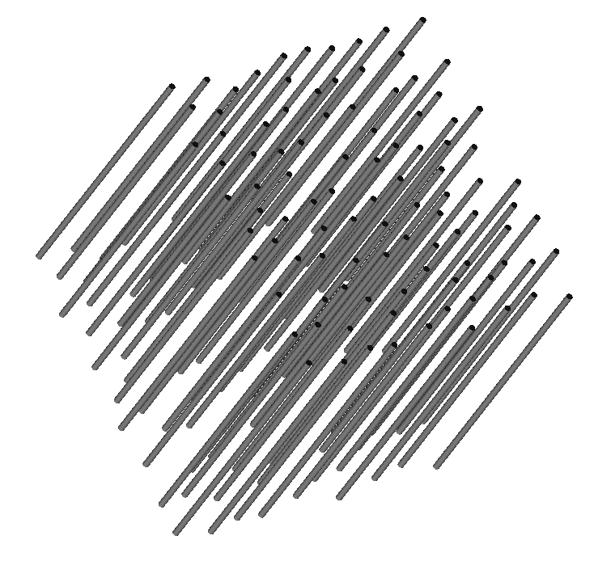

Bundle of Tubes

Slide 6






Minkowski Tensors – Bundle of Tubes

Slide 7
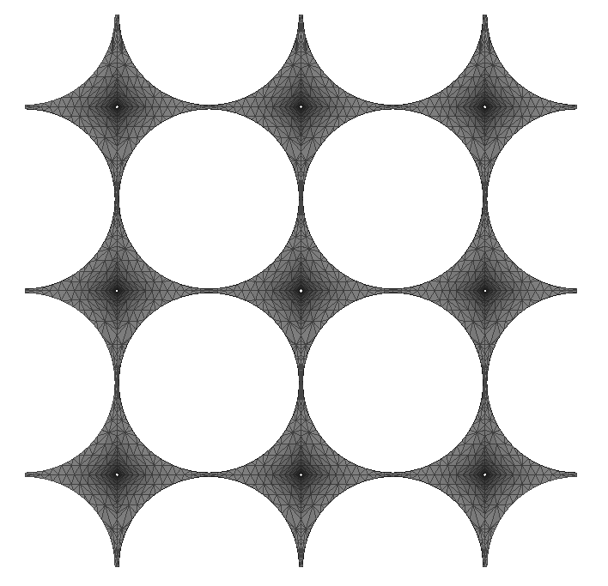
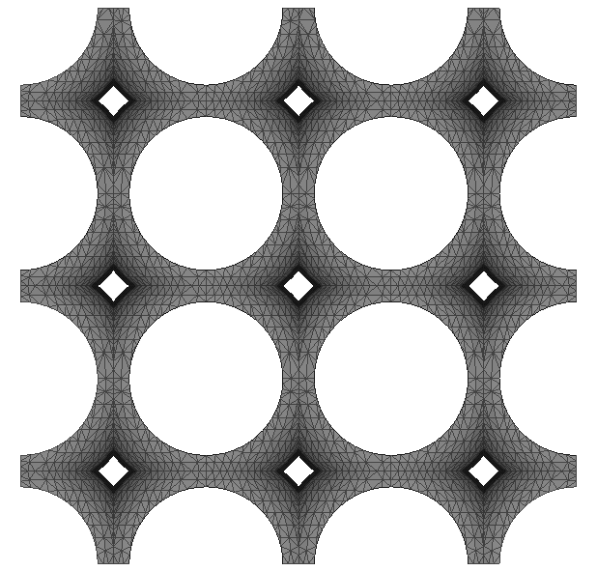


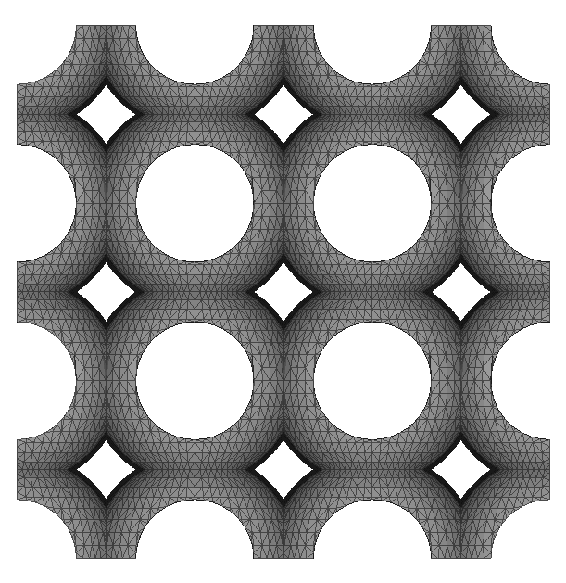
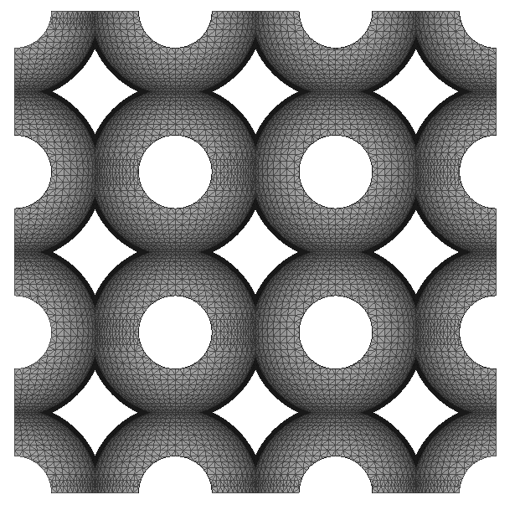


Symmetric Parametric Pore

Slide 8





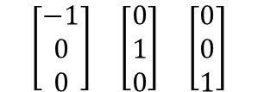


Minkowski Tensors – Radius 1.4

Slide 9




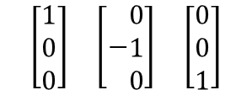

Minkowski Tensors – Radius 1.3

Slide 10






Minkowski Tensors – Radius 1.2

Slide 11



Minkowski Tensors – Radius 1.1

Slide 12
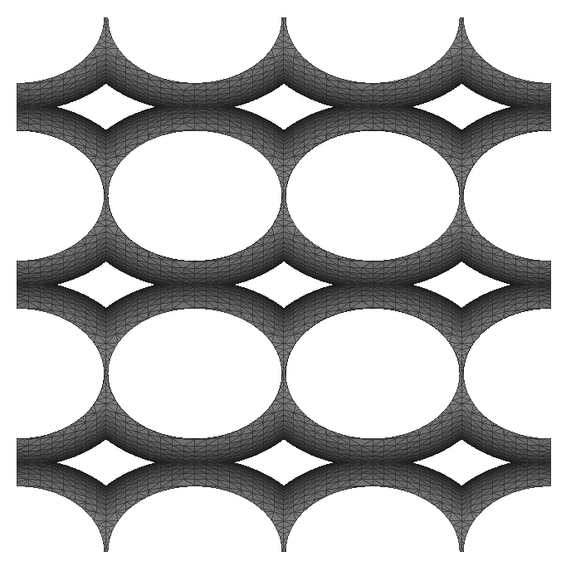
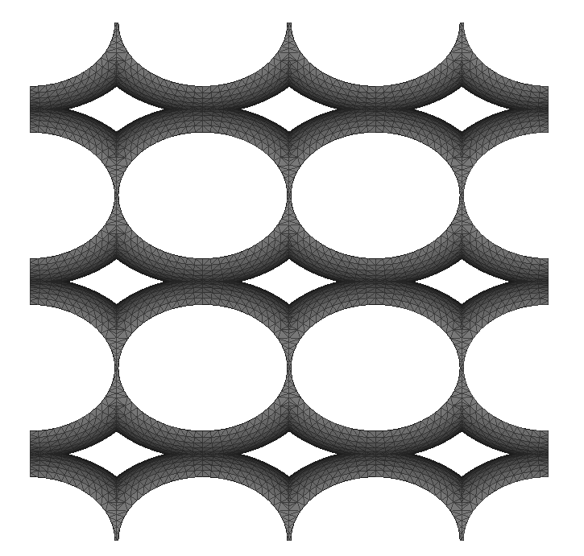
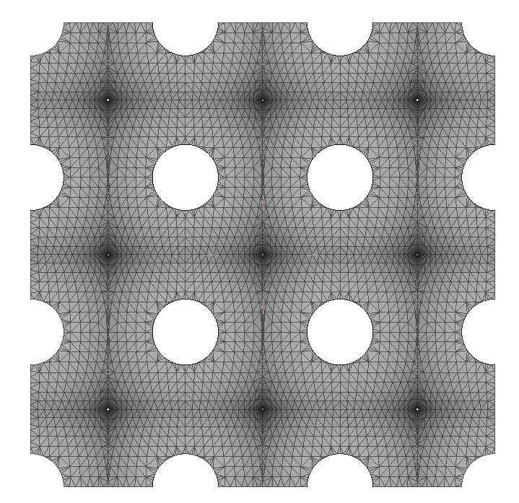
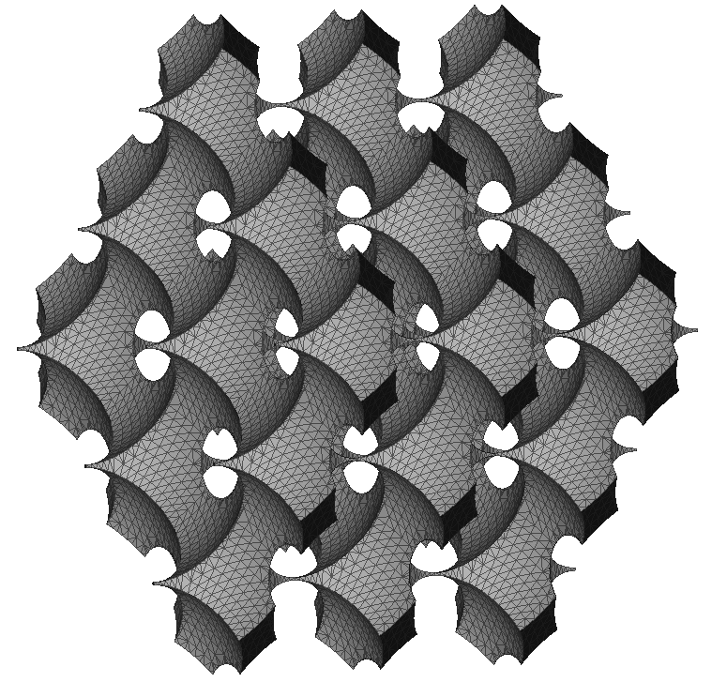
Asymmetric Parametric Pore – R1 = 1.4, R2=1.3

Slide 13

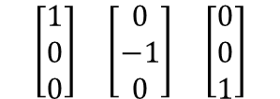





Minkowski Tensors – R1 = 1.4, R2=1.3

