Slide 1
Statistical Characterisation of Porous Media at the Pore Scale Parametric Models
Student:
Lukas Mosser
Supervisors:
Professor Olivier Dubrule
Professor Martin Blunt

Slide 2
Presentation Outline
Plane Surface
Bundle of Tubes
Array of Spheres
Asymmetric Array of Spheres

Slide 3


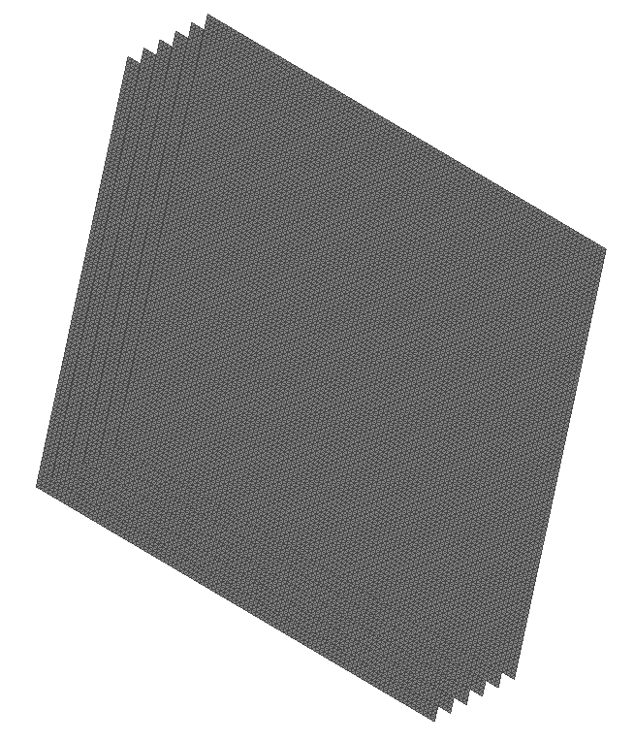
Plane Surfaces
X-Y View
Y-Z View
X-Z View
3D View

Slide 4
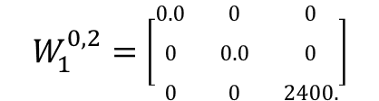



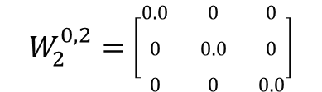
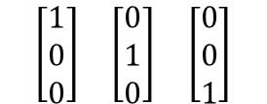


Minkowski Tensors – Plane Surface
Minkowski Tensor
Eigenvectors
Eigenvalues
Anisotropy Index

Slide 5

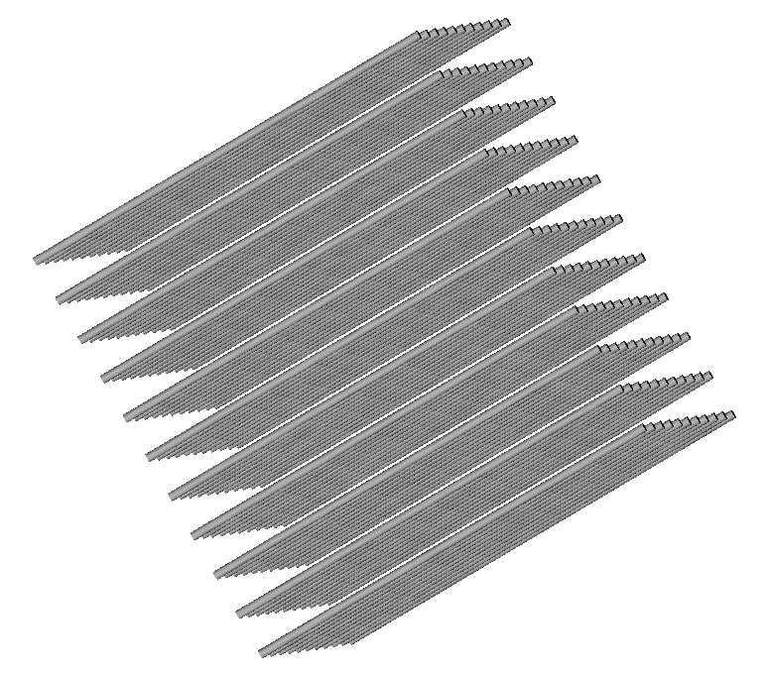
Regular Bundle of Tubes
X-Z View
Y-Z View
3D View

Slide 6
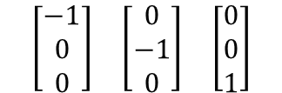
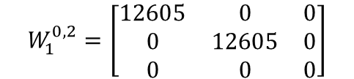
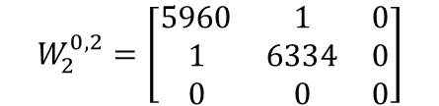



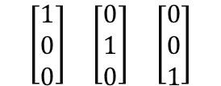

Minkowski Tensors – Regular Bundle of Tubes
Minkowski Tensor
Eigenvectors
Eigenvalues
Anisotropy Index
$$W_{1}^{0,2}=\left[\begin{matrix}12605 & 0 & 0 \\ 0 & 12605 & 0 \\ 0 & 0 & 0\end{matrix}\right]$$
$$\begin{matrix}\left[\begin{matrix}1 \\ 0 \\ 0\end{matrix}\right] & \left[\begin{matrix}0 \\ 1 \\ 0\end{matrix}\right] & \left[\begin{matrix}0 \\ 0 \\ 1\end{matrix}\right]\end{matrix}$$
$$\left\{\begin{matrix}12605 & 12605 & 0\end{matrix}\right\}$$
$$β_{1}^{0,2}=not def.$$
$$W_{2}^{0,2}=\left[\begin{matrix}5960 & 1 & 0 \\ 1 & 6334 & 0 \\ 0 & 0 & 0\end{matrix}\right]$$
$$\begin{matrix}\left[\begin{matrix}−1 \\ 0 \\ 0\end{matrix}\right] & \left[\begin{matrix}0 \\ −1 \\ 0\end{matrix}\right] & \left[\begin{matrix}0 \\ 0 \\ 1\end{matrix}\right]\end{matrix}$$
$$\left\{\begin{matrix}5960 & 6334 & 0\end{matrix}\right\}$$
$$β_{2}^{0,2}=not def.$$

Slide 7
Regular Bundle of Tubes – High Mesh Resolution
X-Z View
Y-Z View
3D View

Slide 8
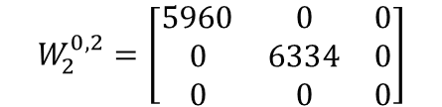
Minkowski Tensors – Regular Bundler – High Mesh Res.
Minkowski Tensor
Eigenvectors
Eigenvalues
Anisotropy Index
$$W_{1}^{0,2}=\left[\begin{matrix}12605 & 0 & 0 \\ 0 & 12605 & 0 \\ 0 & 0 & 0\end{matrix}\right]$$
$$\begin{matrix}\left[\begin{matrix}1 \\ 0 \\ 0\end{matrix}\right] & \left[\begin{matrix}0 \\ 1 \\ 0\end{matrix}\right] & \left[\begin{matrix}0 \\ 0 \\ 1\end{matrix}\right]\end{matrix}$$
$$\left\{\begin{matrix}12605 & 12605 & 0\end{matrix}\right\}$$
$$β_{1}^{0,2}=not def.$$
$$W_{2}^{0,2}=\left[\begin{matrix}5960 & 0 & 0 \\ 0 & 6334 & 0 \\ 0 & 0 & 0\end{matrix}\right]$$
$$\begin{matrix}\left[\begin{matrix}−1 \\ 0 \\ 0\end{matrix}\right] & \left[\begin{matrix}0 \\ −1 \\ 0\end{matrix}\right] & \left[\begin{matrix}0 \\ 0 \\ 1\end{matrix}\right]\end{matrix}$$
$$\left\{\begin{matrix}5960 & 6334 & 0\end{matrix}\right\}$$
$$β_{2}^{0,2}=not def.$$

Slide 9

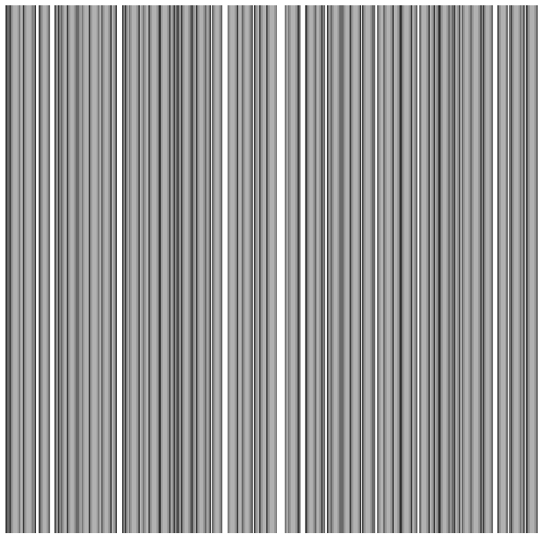
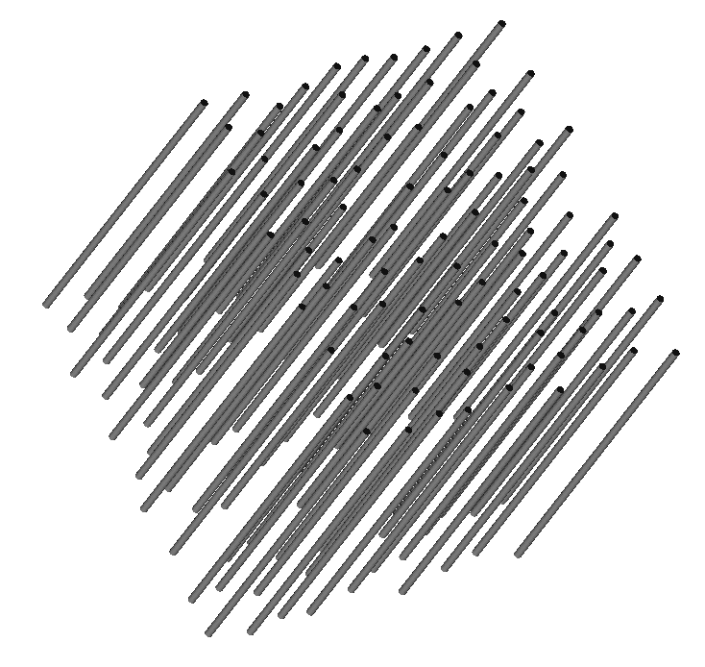
Random Bundle of Tubes
X-Z View
Y-Z View
3D View

Slide 10
Minkowski Tensors – Regular Bundler – High Mesh Res.
Minkowski Tensor
Eigenvectors
Eigenvalues
Anisotropy Index
$$W_{1}^{0,2}=\left[\begin{matrix}12605 & 0 & 0 \\ 0 & 12605 & 0 \\ 0 & 0 & 0\end{matrix}\right]$$
$$\begin{matrix}\left[\begin{matrix}1 \\ 0 \\ 0\end{matrix}\right] & \left[\begin{matrix}0 \\ 1 \\ 0\end{matrix}\right] & \left[\begin{matrix}0 \\ 0 \\ 1\end{matrix}\right]\end{matrix}$$
$$\left\{\begin{matrix}12605 & 12605 & 0\end{matrix}\right\}$$
$$β_{1}^{0,2}=not def.$$
$$W_{2}^{0,2}=\left[\begin{matrix}5960 & 0 & 0 \\ 0 & 6334 & 0 \\ 0 & 0 & 0\end{matrix}\right]$$
$$\begin{matrix}\left[\begin{matrix}−1 \\ 0 \\ 0\end{matrix}\right] & \left[\begin{matrix}0 \\ −1 \\ 0\end{matrix}\right] & \left[\begin{matrix}0 \\ 0 \\ 1\end{matrix}\right]\end{matrix}$$
$$\left\{\begin{matrix}5960 & 6334 & 0\end{matrix}\right\}$$
$$β_{2}^{0,2}=not def.$$

Slide 11
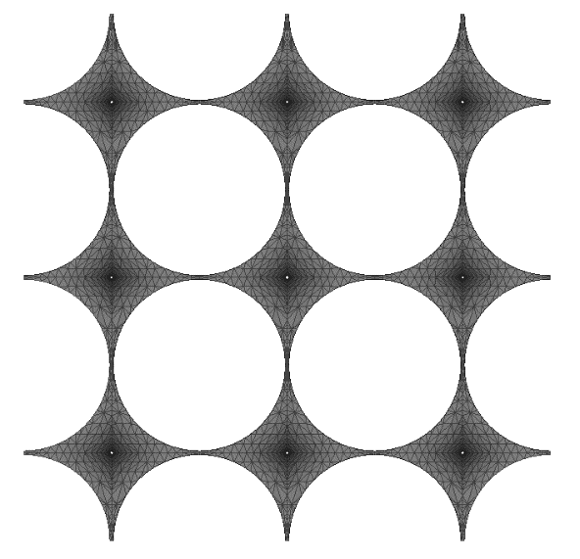
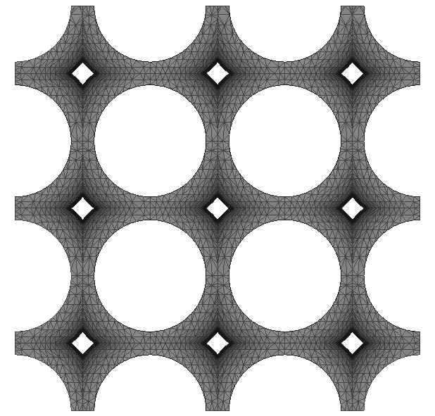
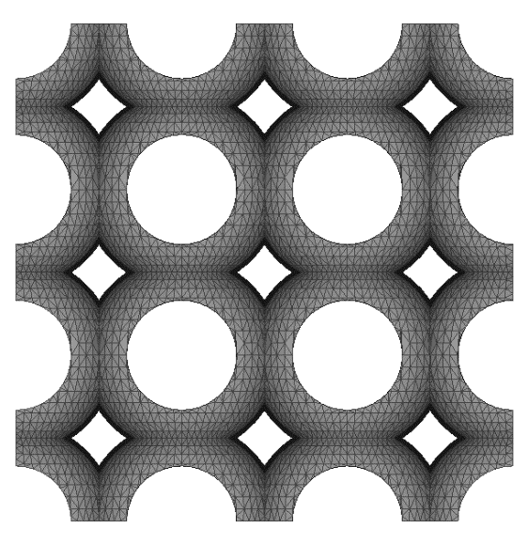
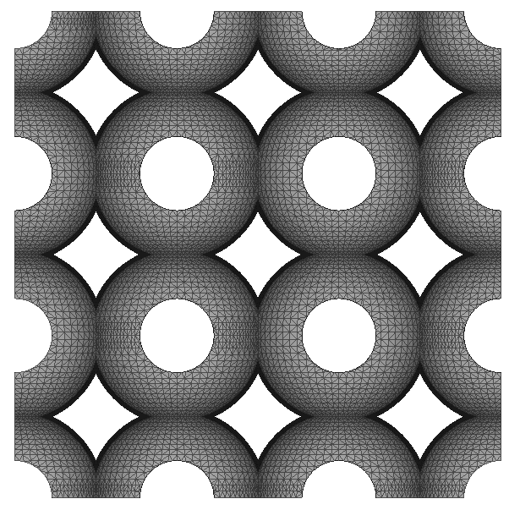
Symmetric Parametric Pore
Radius 1.4
Radius 1.3
Radius 1.2
Radius 1.1

Slide 12
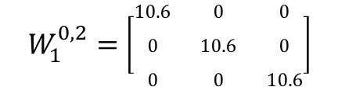



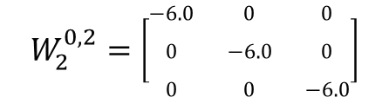
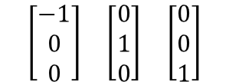


Minkowski Tensors – Radius 1.4
Minkowski Tensor
Eigenvectors
Eigenvalues
Anisotropy Index

Slide 13
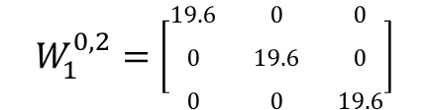


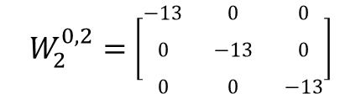
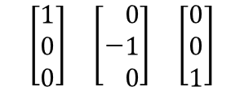

Minkowski Tensors – Radius 1.3
Minkowski Tensor
Eigenvectors
Eigenvalues
Anisotropy Index

Slide 14
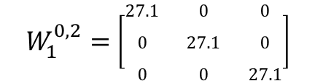


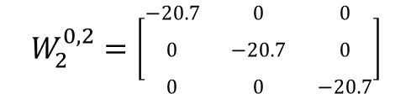
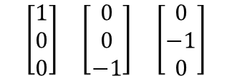

Minkowski Tensors – Radius 1.2
Minkowski Tensor
Eigenvectors
Eigenvalues
Anisotropy Index

Slide 15
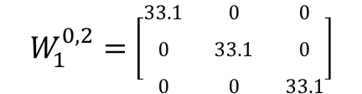


Minkowski Tensors – Radius 1.1
Minkowski Tensor
Eigenvectors
Eigenvalues
Anisotropy Index

Slide 16
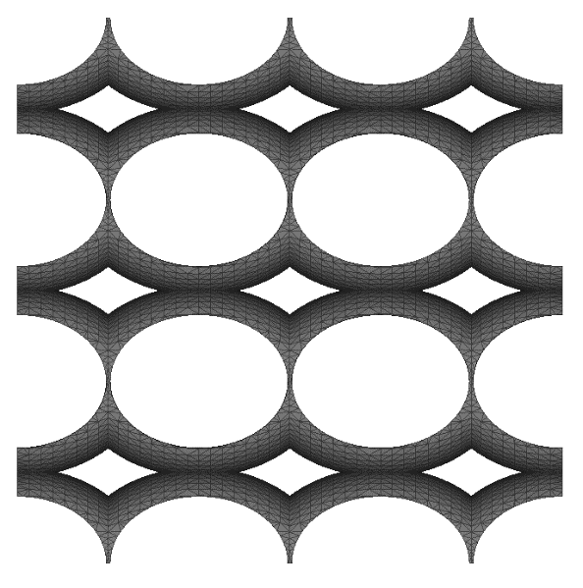
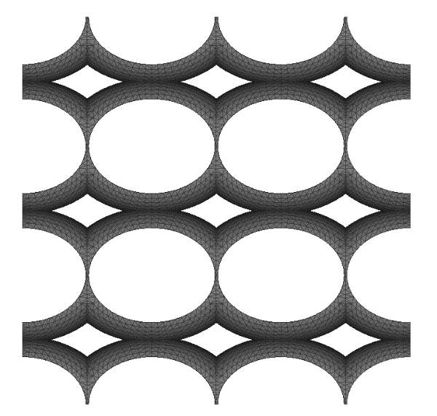
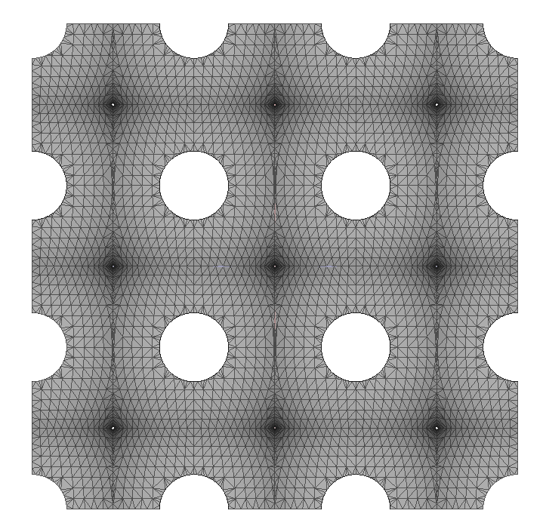
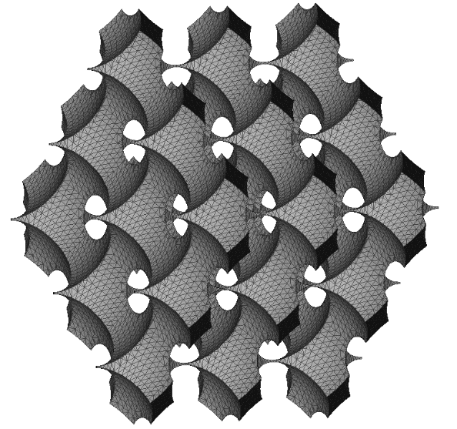
Asymmetric Parametric Pore – R1 = 1.4, R2=1.3
X-Y View
Y-Z View
X-Z View
3D View

Slide 17
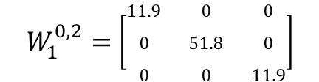
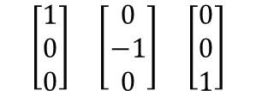


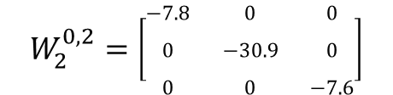


Minkowski Tensors – R1 = 1.4, R2=1.3
Minkowski Tensor
Eigenvectors
Eigenvalues
Anisotropy Index

