Slide 1
Statistical Characterisation of Porous Media at the Pore Scale Parametric Models
Student:
Lukas Mosser
Supervisors:
Professor Olivier Dubrule
Professor Martin Blunt

Slide 2
Presentation Outline
Plane Surface
Regular Bundle of Tubes
Regular Bundle of Tubes – High Mesh Res.
Random Bundle of Tubes
Array of Spheres
Array of Ellipsoids
Gaussian Porous Medium
Beadpack: Anisotropy(r)
Ketton: Anisotropy(r)
Comparison Beadpack - Ketton

Slide 3


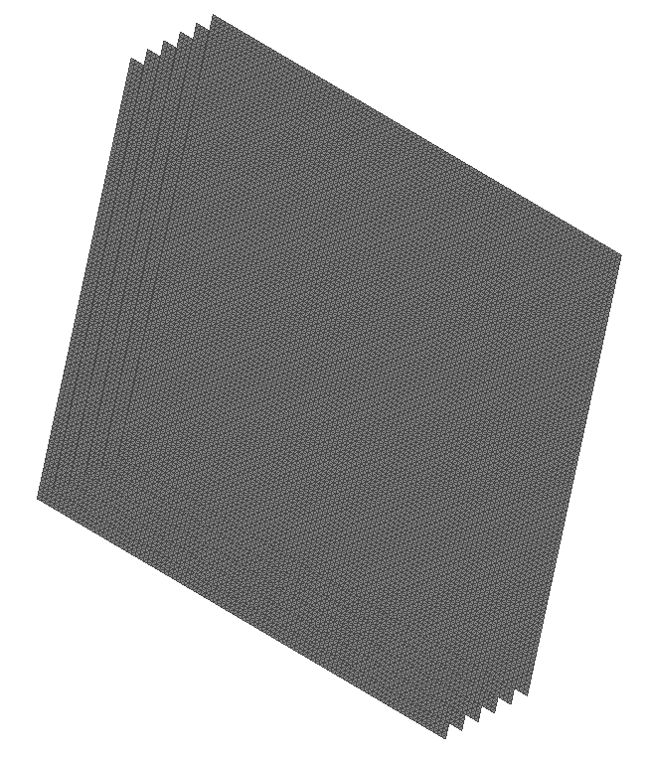
Plane Surfaces
X-Y View
Y-Z View
X-Z View
3D View

Slide 4
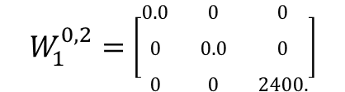



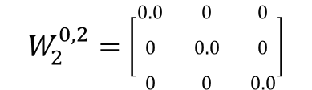
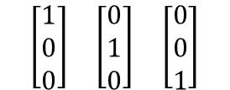


Minkowski Tensors – Plane Surface
Minkowski Tensor
Eigenvectors
Eigenvalues
Anisotropy Index

Slide 5

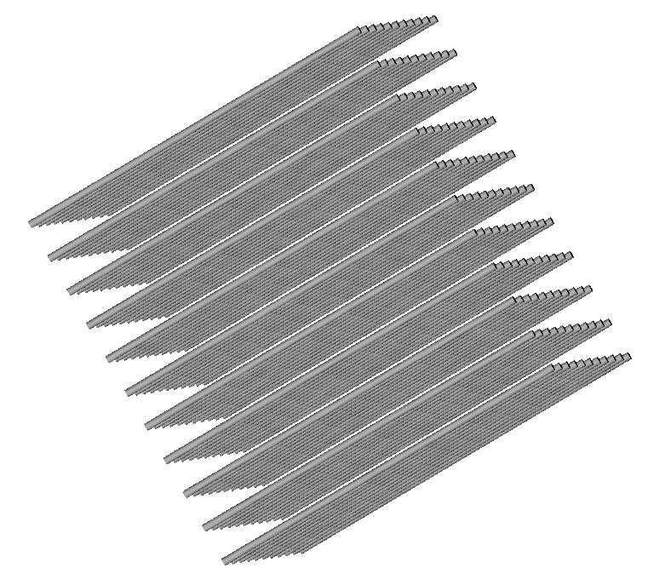
Regular Bundle of Tubes
X-Z View
Y-Z View
3D View

Slide 6
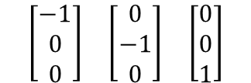
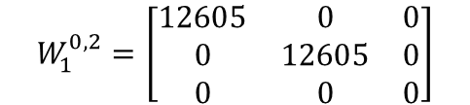
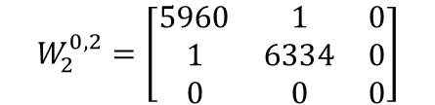



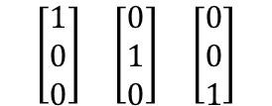

Minkowski Tensors – Regular Bundle of Tubes
Minkowski Tensor
Eigenvectors
Eigenvalues
Anisotropy Index
$$W_{1}^{0,2}=\left[\begin{matrix}12605 & 0 & 0 \\ 0 & 12605 & 0 \\ 0 & 0 & 0\end{matrix}\right]$$
$$\begin{matrix}\left[\begin{matrix}1 \\ 0 \\ 0\end{matrix}\right] & \left[\begin{matrix}0 \\ 1 \\ 0\end{matrix}\right] & \left[\begin{matrix}0 \\ 0 \\ 1\end{matrix}\right]\end{matrix}$$
$$\left\{\begin{matrix}12605 & 12605 & 0\end{matrix}\right\}$$
$$β_{1}^{0,2}=not def.$$
$$W_{2}^{0,2}=\left[\begin{matrix}5960 & 1 & 0 \\ 1 & 6334 & 0 \\ 0 & 0 & 0\end{matrix}\right]$$
$$\begin{matrix}\left[\begin{matrix}−1 \\ 0 \\ 0\end{matrix}\right] & \left[\begin{matrix}0 \\ −1 \\ 0\end{matrix}\right] & \left[\begin{matrix}0 \\ 0 \\ 1\end{matrix}\right]\end{matrix}$$
$$\left\{\begin{matrix}5960 & 6334 & 0\end{matrix}\right\}$$
$$β_{2}^{0,2}=not def.$$

Slide 7
Regular Bundle of Tubes – High Mesh Resolution
X-Z View
Y-Z View
3D View

Slide 8
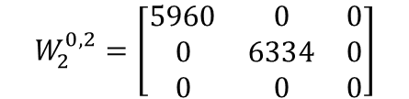
Minkowski Tensors – Regular Bundle – High Mesh Res.
Minkowski Tensor
Eigenvectors
Eigenvalues
Anisotropy Index
$$W_{1}^{0,2}=\left[\begin{matrix}12605 & 0 & 0 \\ 0 & 12605 & 0 \\ 0 & 0 & 0\end{matrix}\right]$$
$$\begin{matrix}\left[\begin{matrix}1 \\ 0 \\ 0\end{matrix}\right] & \left[\begin{matrix}0 \\ 1 \\ 0\end{matrix}\right] & \left[\begin{matrix}0 \\ 0 \\ 1\end{matrix}\right]\end{matrix}$$
$$\left\{\begin{matrix}12605 & 12605 & 0\end{matrix}\right\}$$
$$β_{1}^{0,2}=not def.$$
$$W_{2}^{0,2}=\left[\begin{matrix}5960 & 0 & 0 \\ 0 & 6334 & 0 \\ 0 & 0 & 0\end{matrix}\right]$$
$$\begin{matrix}\left[\begin{matrix}−1 \\ 0 \\ 0\end{matrix}\right] & \left[\begin{matrix}0 \\ −1 \\ 0\end{matrix}\right] & \left[\begin{matrix}0 \\ 0 \\ 1\end{matrix}\right]\end{matrix}$$
$$\left\{\begin{matrix}5960 & 6334 & 0\end{matrix}\right\}$$
$$β_{2}^{0,2}=not def.$$

Slide 9
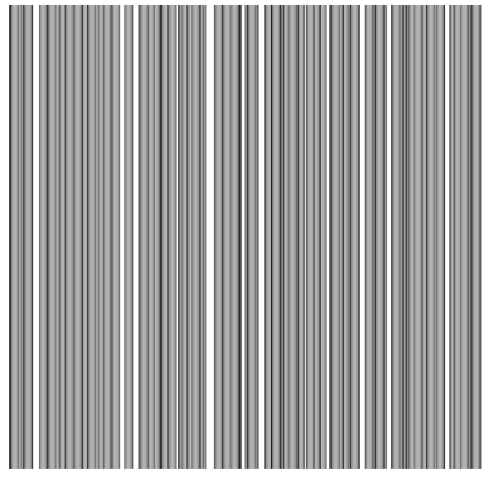
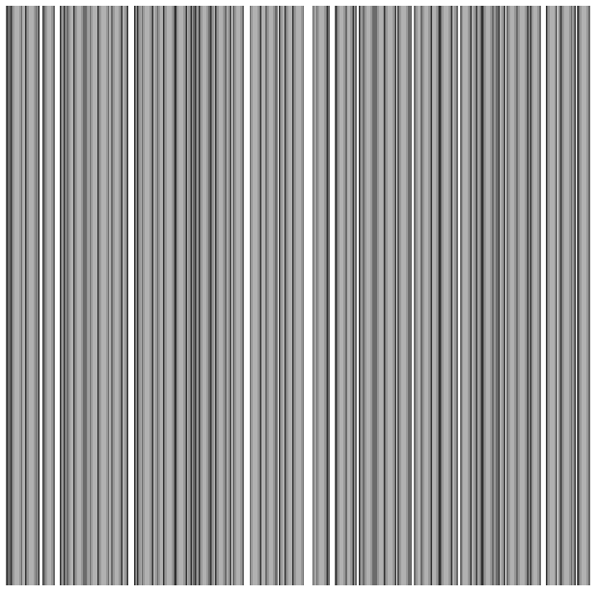
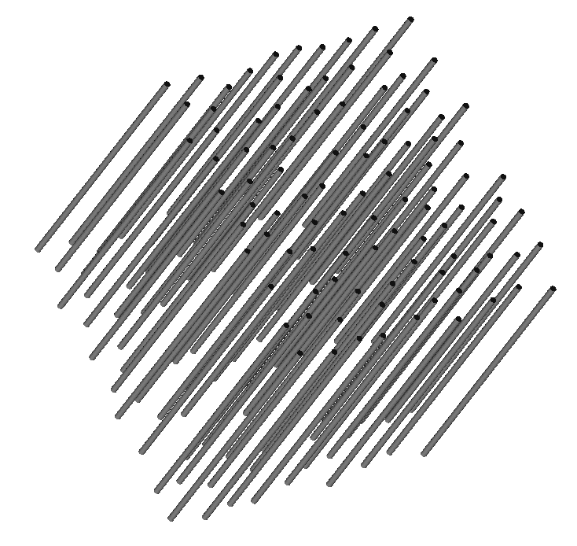
Random Bundle of Tubes
X-Z View
Y-Z View
3D View

Slide 10
Minkowski Tensors – Random Bundle of Tubes
Minkowski Tensor
Eigenvectors
Eigenvalues
Anisotropy Index
$$W_{1}^{0,2}=\left[\begin{matrix}12605 & 0 & 0 \\ 0 & 12605 & 0 \\ 0 & 0 & 0\end{matrix}\right]$$
$$\begin{matrix}\left[\begin{matrix}1 \\ 0 \\ 0\end{matrix}\right] & \left[\begin{matrix}0 \\ 1 \\ 0\end{matrix}\right] & \left[\begin{matrix}0 \\ 0 \\ 1\end{matrix}\right]\end{matrix}$$
$$\left\{\begin{matrix}12605 & 12605 & 0\end{matrix}\right\}$$
$$β_{1}^{0,2}=not def.$$
$$W_{2}^{0,2}=\left[\begin{matrix}5960 & 0 & 0 \\ 0 & 6334 & 0 \\ 0 & 0 & 0\end{matrix}\right]$$
$$\begin{matrix}\left[\begin{matrix}−1 \\ 0 \\ 0\end{matrix}\right] & \left[\begin{matrix}0 \\ −1 \\ 0\end{matrix}\right] & \left[\begin{matrix}0 \\ 0 \\ 1\end{matrix}\right]\end{matrix}$$
$$\left\{\begin{matrix}5960 & 6334 & 0\end{matrix}\right\}$$
$$β_{2}^{0,2}=not def.$$

Slide 11
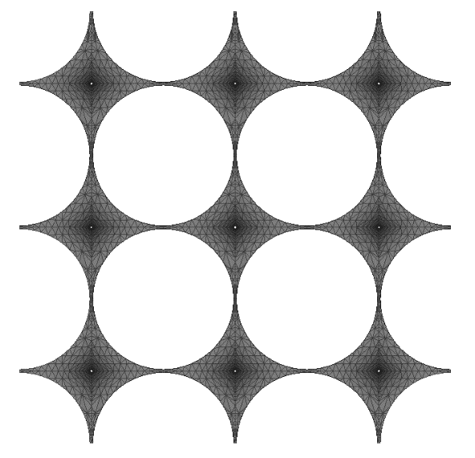
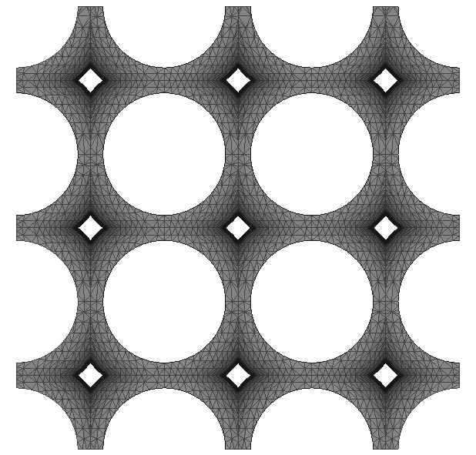
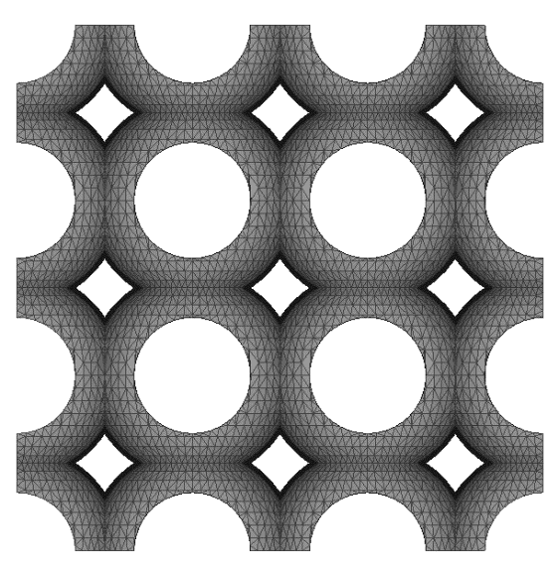
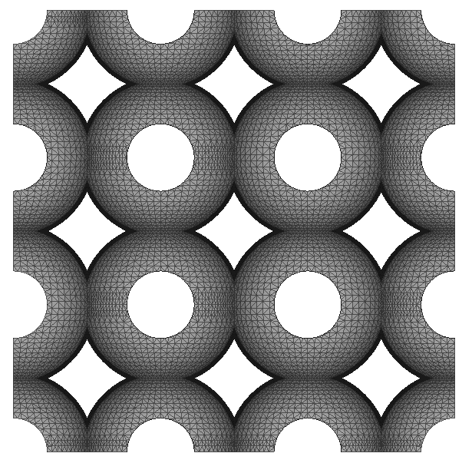
Symmetric Parametric Pore
Radius 1.4
Radius 1.3
Radius 1.2
Radius 1.1

Slide 12
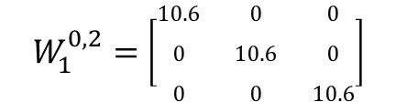



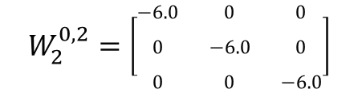
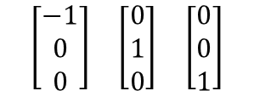


Minkowski Tensors – Radius 1.4
Minkowski Tensor
Eigenvectors
Eigenvalues
Anisotropy Index

Slide 13
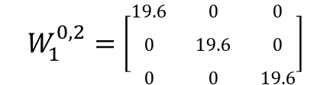


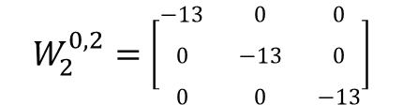
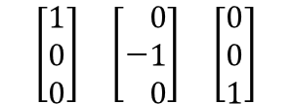

Minkowski Tensors – Radius 1.3
Minkowski Tensor
Eigenvectors
Eigenvalues
Anisotropy Index

Slide 14
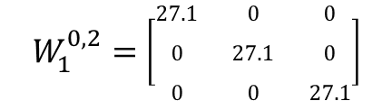


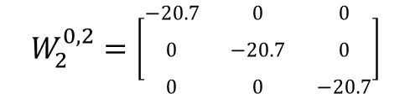
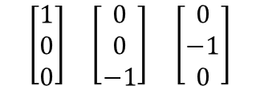

Minkowski Tensors – Radius 1.2
Minkowski Tensor
Eigenvectors
Eigenvalues
Anisotropy Index

Slide 15
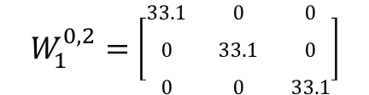


Minkowski Tensors – Radius 1.1
Minkowski Tensor
Eigenvectors
Eigenvalues
Anisotropy Index

Slide 16
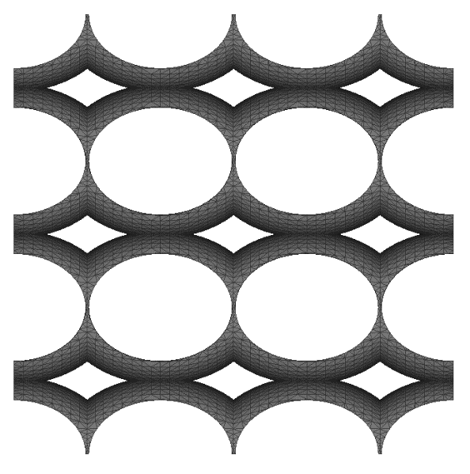
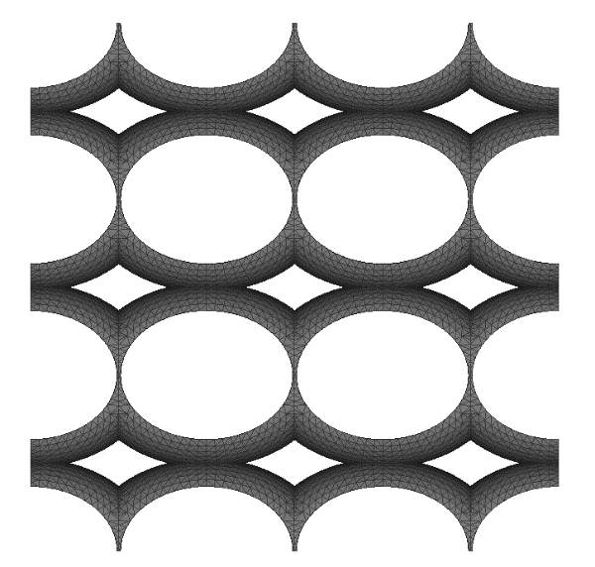
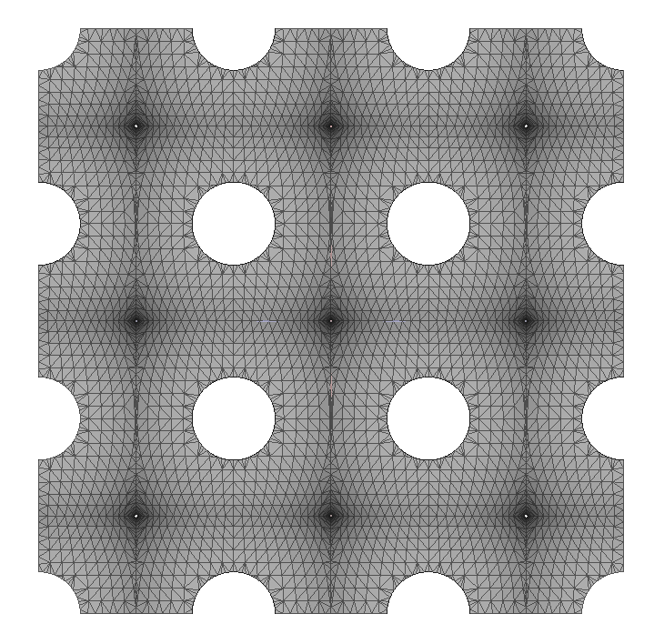
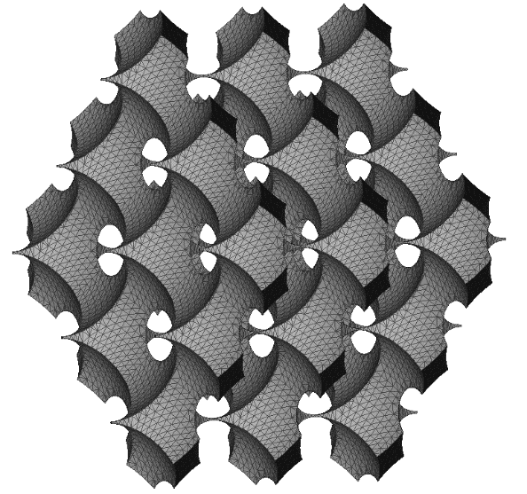
Asymmetric Parametric Pore – R1 = 1.4, R2=1.3
X-Y View
Y-Z View
X-Z View
3D View

Slide 17
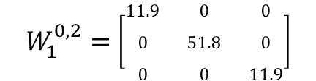
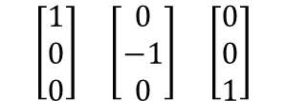


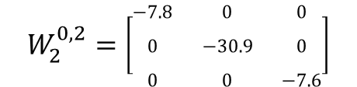


Minkowski Tensors – R1 = 1.4, R2=1.3
Minkowski Tensor
Eigenvectors
Eigenvalues
Anisotropy Index

Slide 18
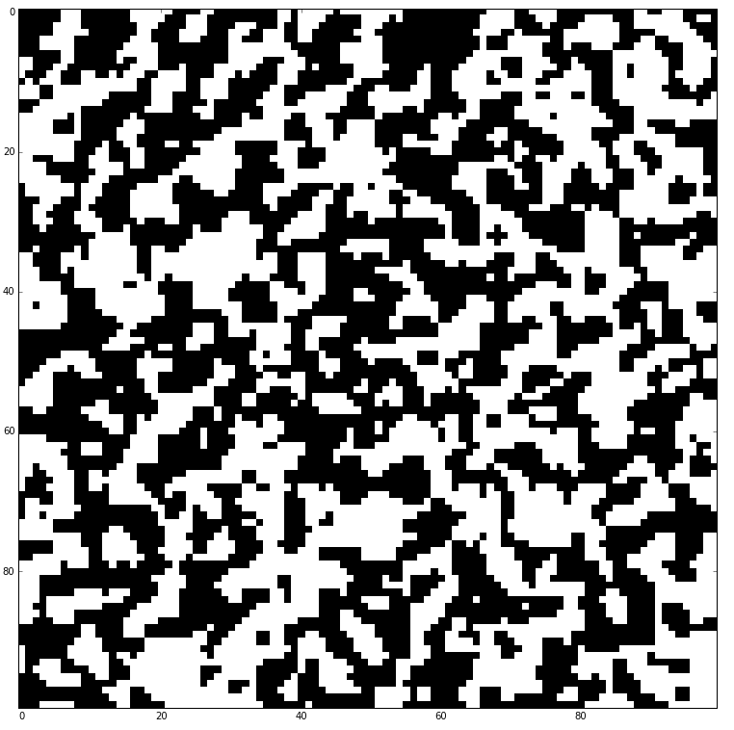
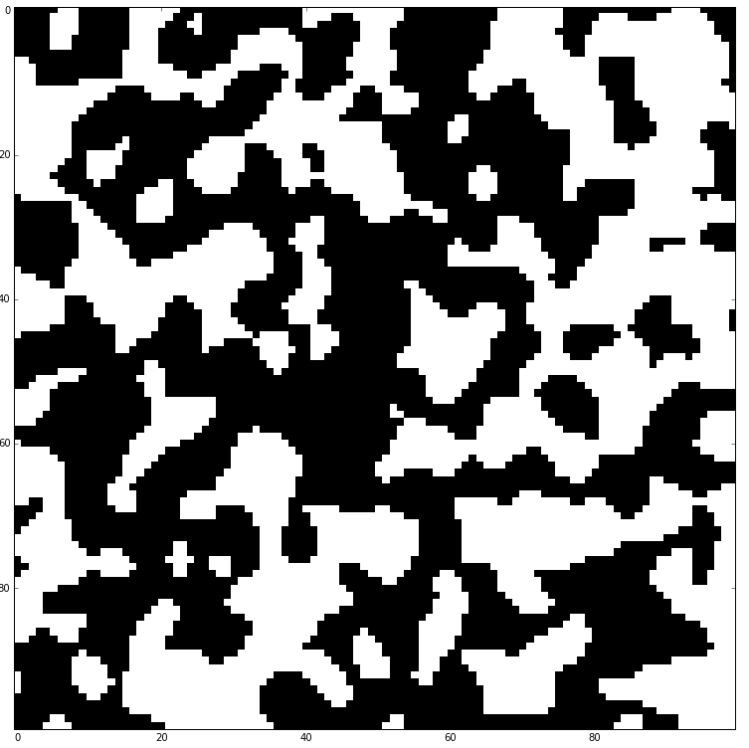
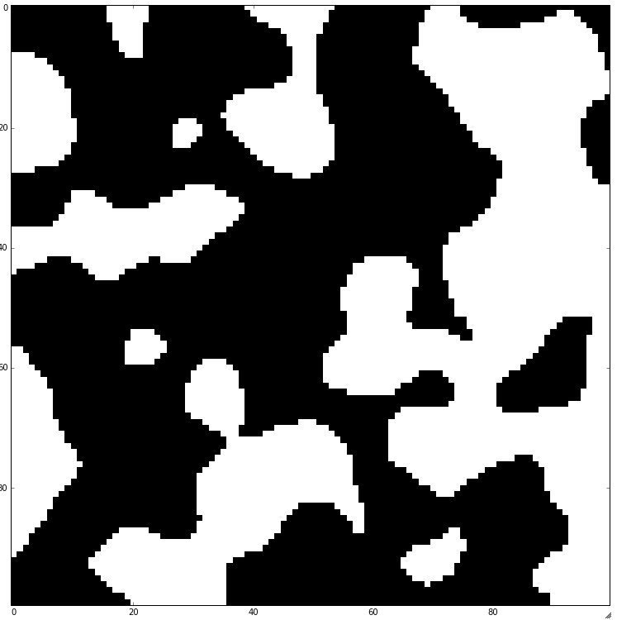
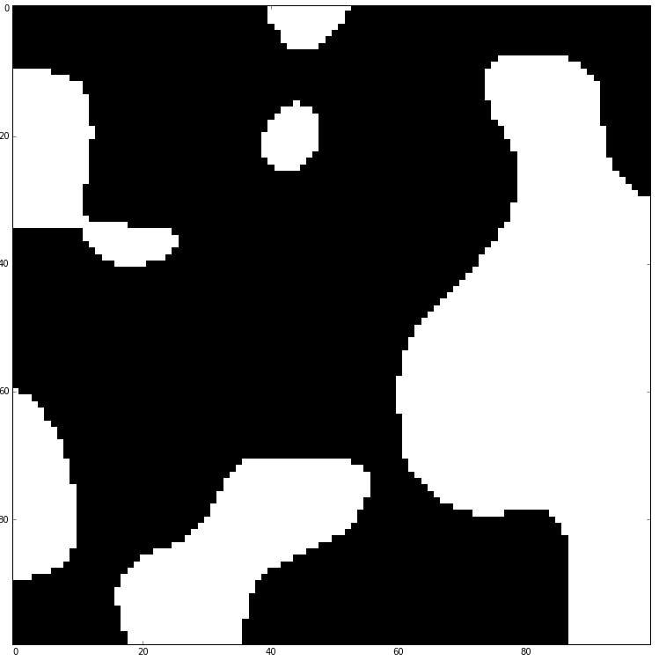




Gaussian Porous Medium – 100^3
$$σ=1.0$$
$$σ=2.0$$
$$σ=4.0$$
$$σ=8.0$$

Slide 19
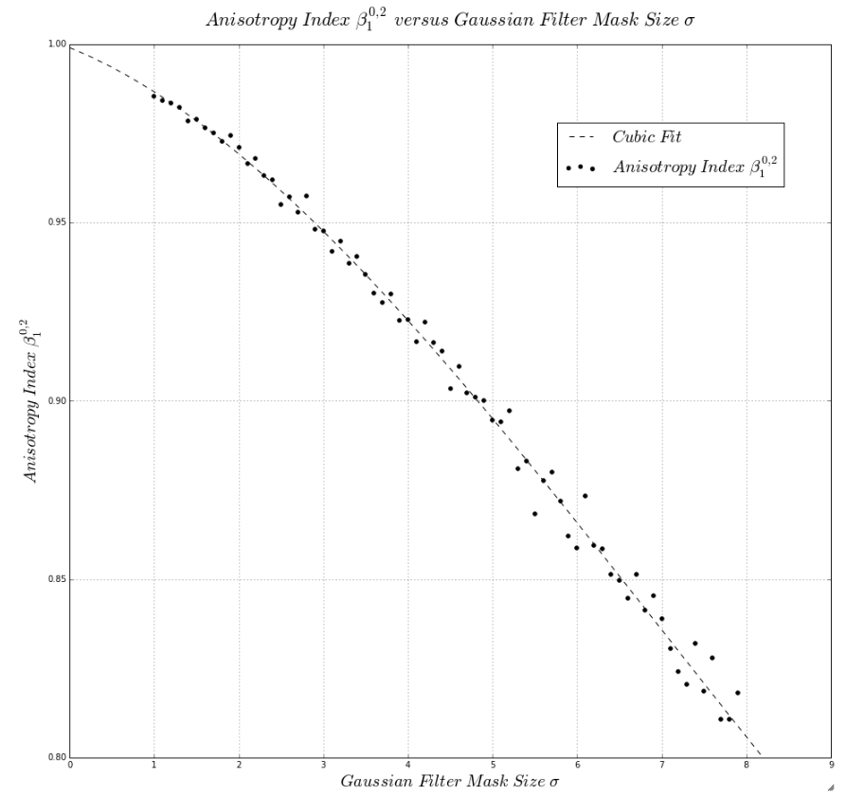
Anisotropy Index as function of filter size (W102)

Slide 20
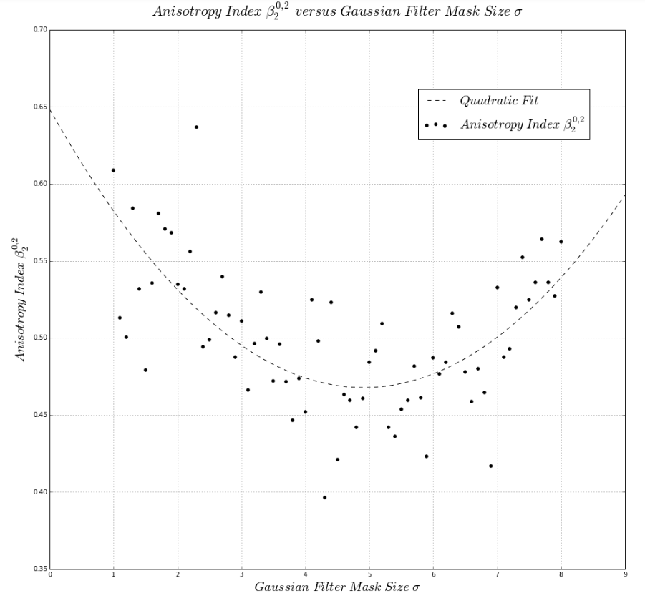
Anisotropy Index as function of filter size (W202)

Slide 21
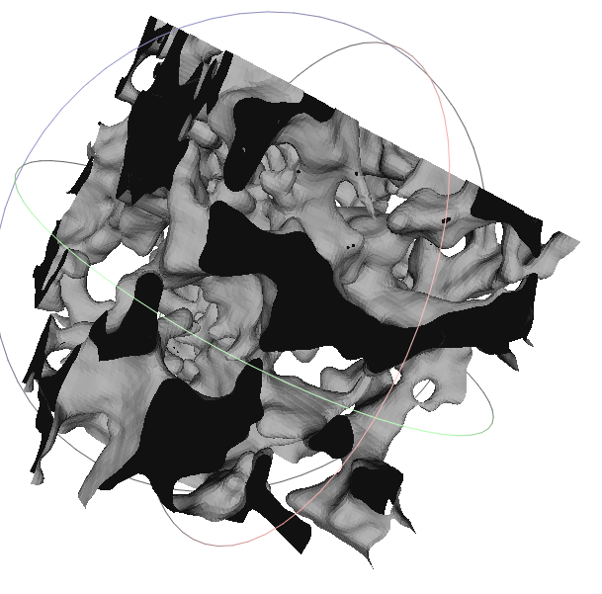
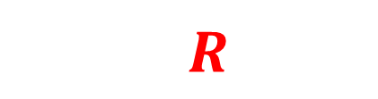


Beadpack/Ketton Centered Expanding Window => REV – 500^3
$$Increasing Window of radius r$$
$$R$$
$$Cubic Volume used$$
$$Determine Anisotropy as function of Window Size$$

Slide 22
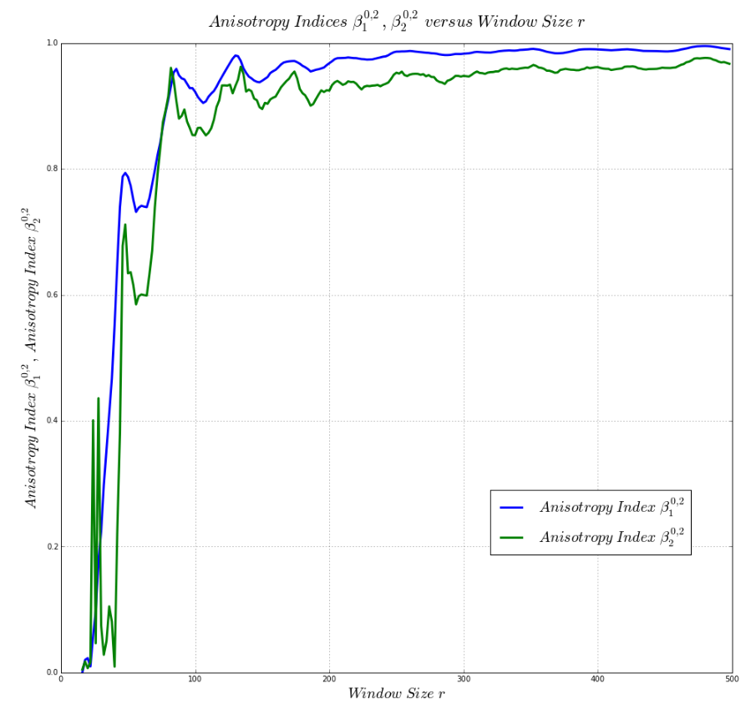
Beadpack – Centered Expanding Window => REV – 500^3

Slide 23
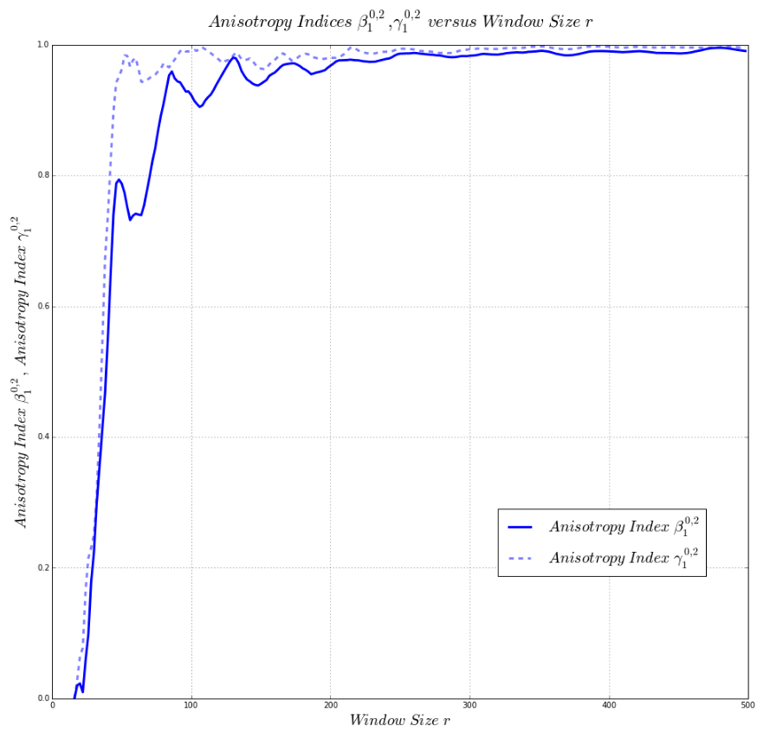
Beadpack – Centered Expanding Window => REV – 500^3

Slide 24
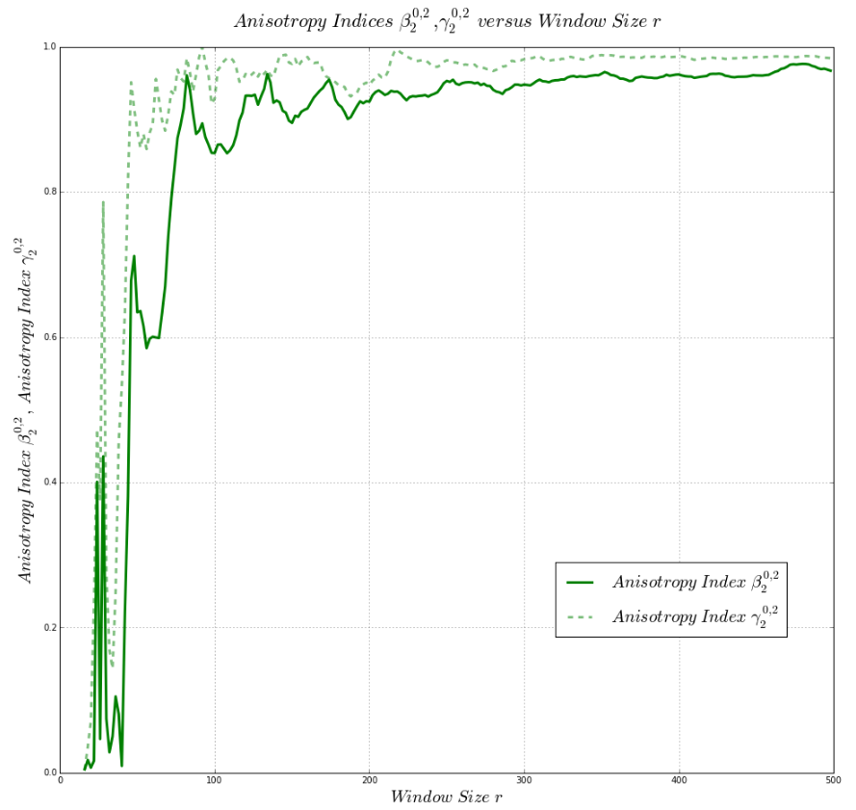
Beadpack – Centered Expanding Window => REV – 500^3

Slide 25
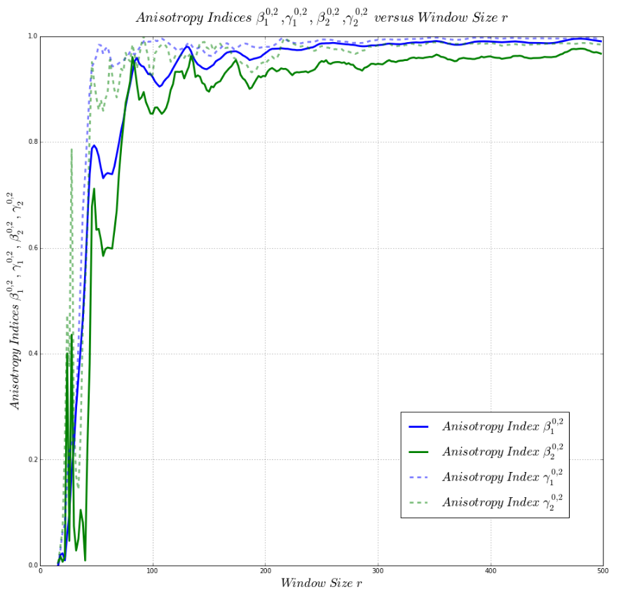
Beadpack – Centered Expanding Window => REV – 500^3

Slide 26
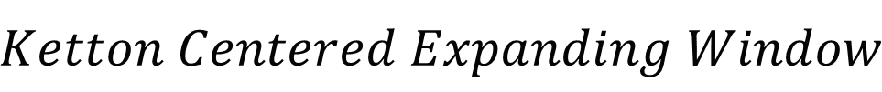
Ketton – Centered Expanding Window
$$Ketton Centered Expanding Window$$

Slide 27
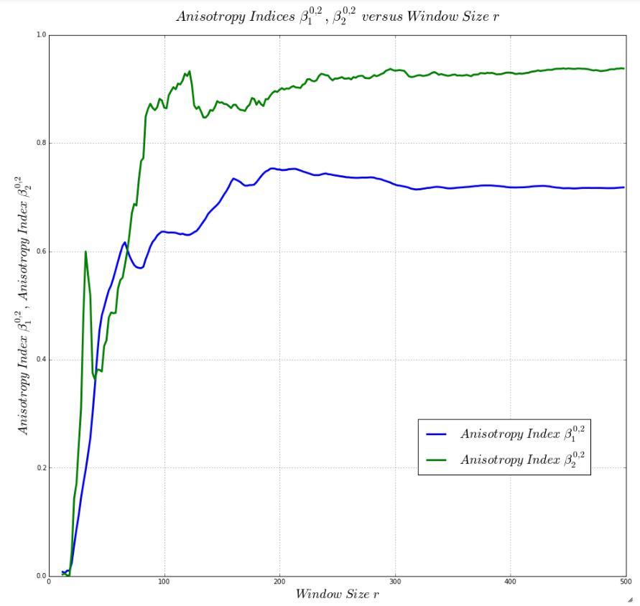

Ketton – Comparison Anisotropy Indices B102, B202
$$REV=320 voxels?$$

Slide 28
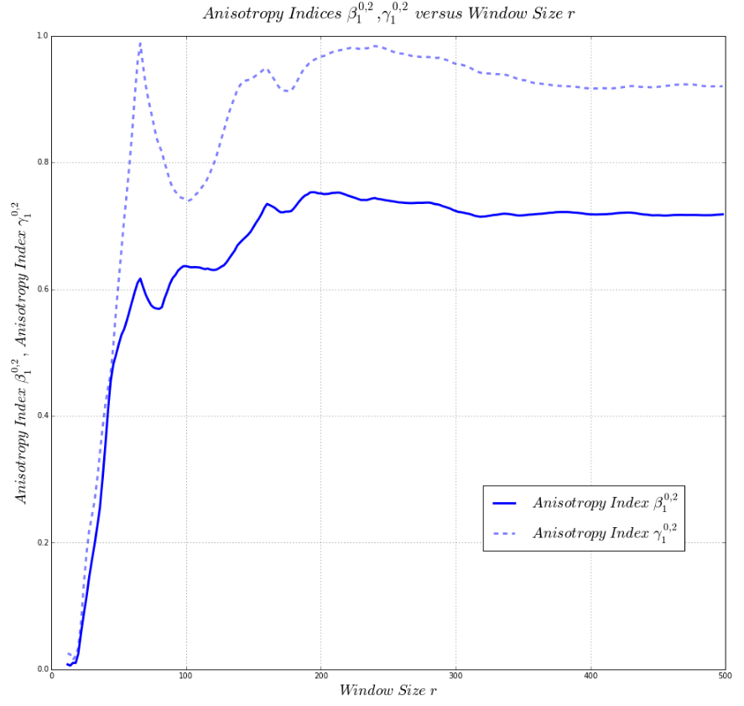

Ketton – Centered Expanding Window => REV – 500^3
$$REV=400 voxels?$$

Slide 29
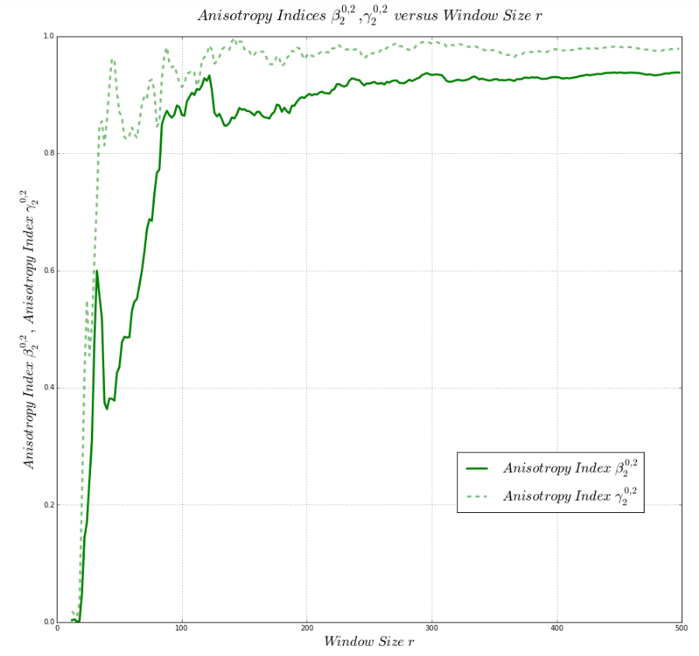

Ketton – Centered Expanding Window => REV – 500^3
$$REV=250 voxels?$$

Slide 30


Ketton – Centered Expanding Window => REV – 500^3
$$REV=400 voxels$$

Slide 31
Comparison Beadpack/Ketton
$$Comparison Ketton and Beadpack Results$$

Slide 32

Comparison Beadpack/Ketton – Beta 102

Slide 33

Comparison Beadpack/Ketton – Beta 202

Slide 34

Comparison Beadpack/Ketton – Gamma 102

Slide 35

Comparison Beadpack Ketton – Gamma 202

