Slide 1
Statistical Characterisation of Porous Media at the Pore Scale
Student:
Lukas Mosser
Supervisors:
Professor Olivier Dubrule
Professor Martin Blunt

Slide 2
Presentation Outline
Introduction
Aims & Objectives
Workflow
Industry Impact
Timeline and Milestones
Risks and Mitigation

Slide 3
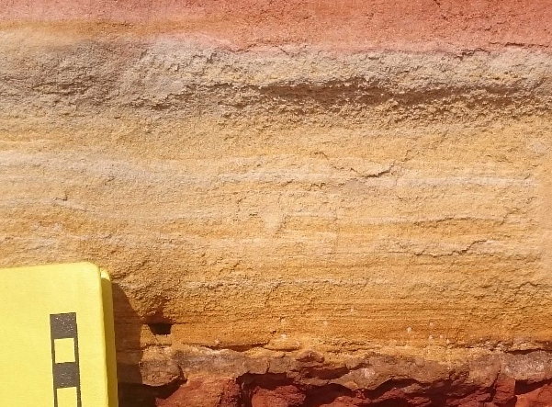
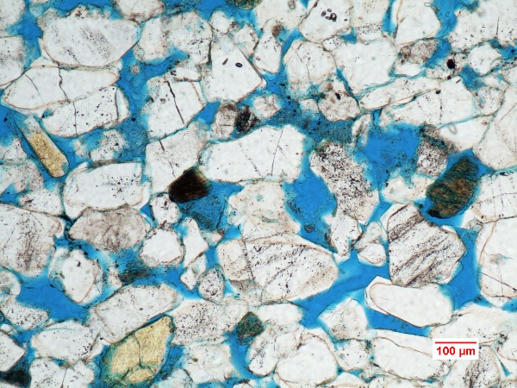
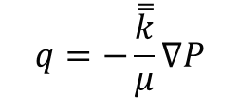
Introduction
Reservoir rocks are random materials that
often consist of siliciclastic grains or
a carbonate matrix which are deposited and
have been subjected to diagenetic processes.
Porous Media such as reservoir, seal or source rocks can be described as spatial realizations of a distribution of material and void space arising from an underlying physical and stochastic process.
Often the macroscale behavior is of interest,
but many key properties such as permeability and porosity are governed by the spatial distribution of grains and pores on the pore scale.

Slide 4
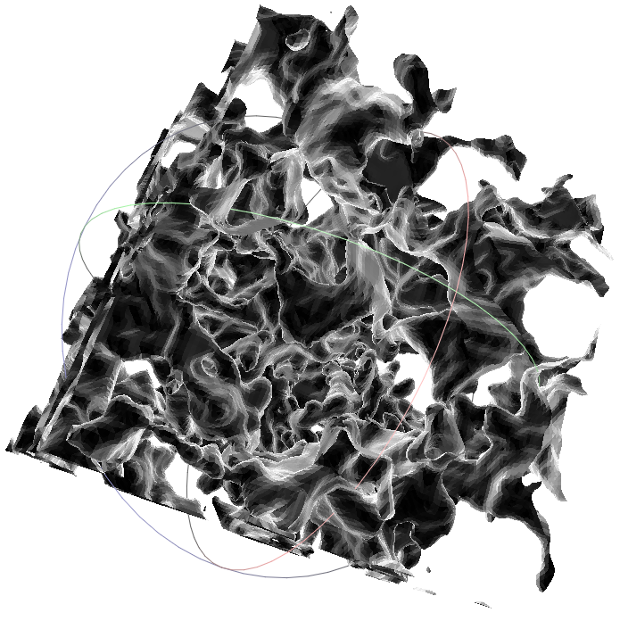
Aims and Objectives
Micro-CT imaging allows characterization of pore space based on image morphological measures.
Available resources at Imperial allow in-situ transient imaging of pore and fluid distribution under various displacement processes leading to a rich set of available data.
A large variety of methods to quantify random materials have been proposed in the literature to describe porous media. Methods often not able to capture heterogeneity and anisotropy as well as provide a link to critical material properties.
This thesis aims to evaluate the application of tensorial Minkowski functionals as an improved method to describe pore space structure and anisotropy and investigate possible application as a proxy for properties of porous media.
Image
Morphology
N-Point
Statistics
Percolation Theory
Minkowski
Tensors
Material Laws
Material
Properties

Slide 5
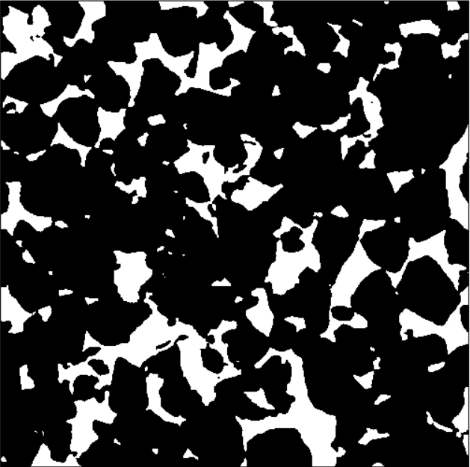


Workflow
Voxel Image
Critical literature:
  pore scale imaging
  image morphology
  random materials
Collection and screening of available datasets.
Development of workflow to facilitate
computation of tensorial Minkowski functionals
based on voxel Micro-CT images:
  Extraction of iso-surfaces based on image segmentation
  Computation of tensorial functionals on triangulated surface
Computation of tensorial functionals on available datasets
Evaluation of tensorial Minkowski functionals
as proxies for material properties and as classifiers
of pore scale structures of porous media
Iso-Surface
Proxy Model

Slide 6
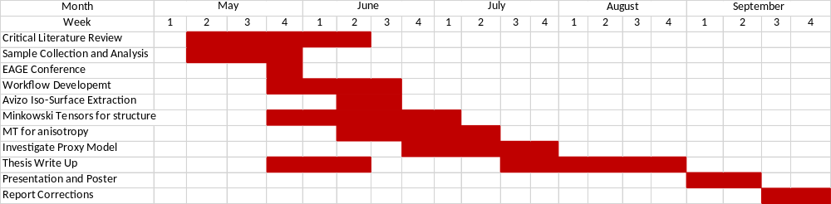
Timeline
Milestones
Outline Presentation: 31st of May
Bi-Weekly Reports: June 8, June 22, July 6, July 20, August 3, and August 17
Report Deadline: August 31st, 16:00
Presentation: 13-14th September
Final Corrections: September 30th, 16:00

Slide 7
Industry Impact
Evaluate application of tensorial Minkowski functionals to describe pore space topology and anisotropy of reservoir rock samples
Provide new workflow to determine Minkowski functionals from gray-scale or binary voxel Micro-CT images
Evaluate tensorial Minkowski functionals as proxies to material properties of porous media e.g. permeability
  Tensorial nature allows to include anisotropy of pore space in proxy model
Interdisciplinary approach to pore-scale analysis taking into account applications and results from a variety of different fields related to random materials and their properties.
  Minkowski Tensors previously applied to:
    Astronomy: Shape description of galaxy star distributions
    Chemical Engineering: Chemical Reaction Patterns
    Material Science: Orientation of grain phases

Slide 8
Risks and Mitigation
Risks
Mitigation
Limited Data and Sample count
Applicability of Minkowski Tensors
Availability of software and documentation
Supervisor Availability
Time Constraints
Classification and grouping of available samples. Begin with “homogeneous” samples continue with heterogeneous datasets.
Investigate variety of links in material texture and material properties.
Base thesis on previous applications then move forward to breaking new ground
Utilize available software where possible.
Implement algorithms where no software available.
Continuous documentation of methods
Supervisor availability awareness
Preparation for meetings and discussions
Pro-active communication
Bi-weekly report and updates on progress
Continuous report writing
Allocate 4 weeks for thesis write-up
Deadline awareness
Time management

Slide 9
Thank you!
Questions?

Slide 10
Minkowski Scalars vs. Minkowski Tensors
Extension of scalar Minkowski measures to Tensorial measures.
Determination of eigenvalues of Minkowski tensors allows characterization of anisotropic behavior of distributions of geometrical objects.
Has been applied to spherical bead packs and evolving anisotropy in material stiffness and permeability due to shear loading of pore space.
Available software and algorithms to measure Minkowski tensors on triangulated representations of periodic and non-periodic samples.

Slide 11
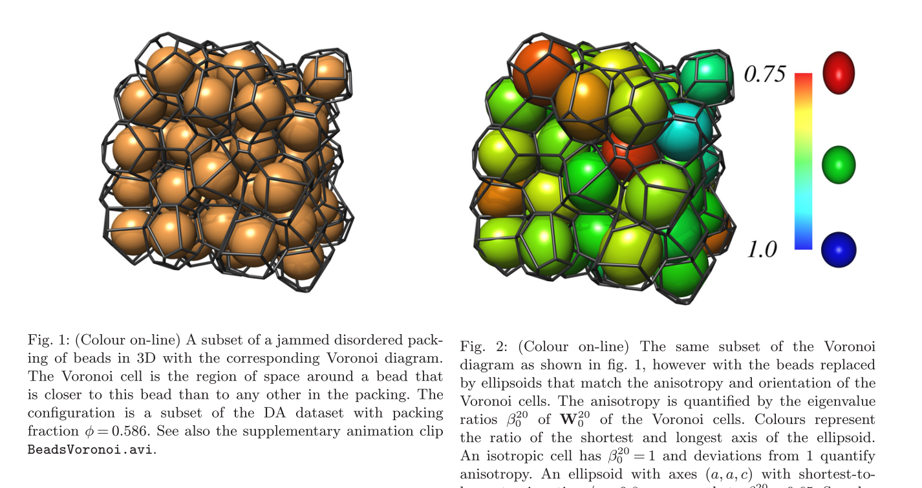
Example: Spherical Bead Packs
G. E. Schröder-Turk et. al
Disordered spherical bead packs are anisotropic
“Understanding why anisotropic shapes fill space more tightly than spheres is an open question whose answer lies in the complex geometrical properties of disordered packings.”
Discretization of space into voronoi cells and measurement of minkowski tensors allowed them to study the anisotropy of these emerging voronoi grids and insights in how the anisotropy changes based on a variety of different packing models for isotropic and anistropic beads.

