Slide 1
Statistical Characterisation of Porous Media at the Pore Scale
“Scoping it out”
Student:
Lukas Mosser
Supervisors:
Professor Olivier Dubrule
Professor Martin Blunt

Slide 2
Presentation Outline
Review Workflow
Approach
Setup
Results
Next Steps

Slide 3
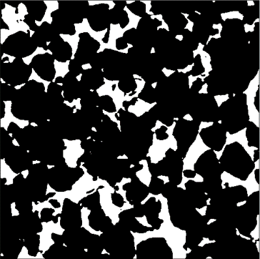
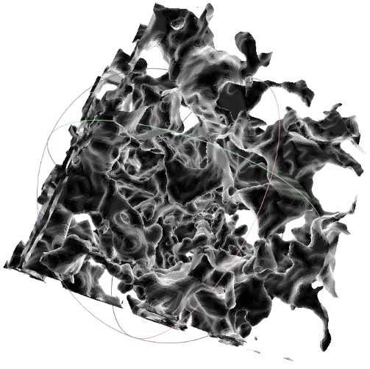

Review Workflow
Voxel Image
Critical literature:
  pore scale imaging
  image morphology
  random materials
Collection and screening of available datasets.
Development of workflow to facilitate
computation of tensorial Minkowski functionals
based on voxel Micro-CT images:
  Extraction of iso-surfaces based on image segmentation
  Computation of tensorial functionals on triangulated surface
Computation of tensorial functionals on available datasets
Evaluation of tensorial Minkowski functionals
as proxies for material properties and as classifiers
of pore scale structures of porous media
Iso-Surface
Proxy Model

Slide 4
Approach
Start with simple image – Dr. Bijeljic: Ketton most resemblance to bead pack
Use available software for Minkowski Tensor calculation:
  Karambola: University of Erlangen, Link
Create Input file writer for Karambola software:
  Mesh Vertices, Faces to .poly file
  Use simple sphere mesh to test functionality
Extract Isosurface of pore space from 3D image
Select largest connected pore space: Isolated vugs disregarded for now
Output Isosurface to Karambola software
Run Karambola
Read back results
Plot anisotropy measures:
  Eigenvalues of Tensors W102 and W202 (translation invariant)

Slide 5
Setup
Three Central Parts:
  Karambola -> Calculate Tensors
  Jupyter Notebook (former ipython notebook) -> File Handling, Results
  ImageJ -> Create input image
ImageJ:
  Convert Image from raw to tif, easier to read and smaller file
Jupyter notebook:
  Load image
  Apply 3D Gaussian filter to image (scikit-image)
  Subdivide image into nx by ny by nz subvolumes (100x100x100 => 64 regions)
  Extract Isosurface at levelset and output to .off file and write to Karambola
  Find largest connected surface (most triangles)
  Run Karambola (Ubuntu machine)
  Read results for each subvolume (Pandas read_csv and custom class)
  Do this for all images (Ketton, Berea, Bentheimer, Estaillades)
  Plot Results

Slide 6
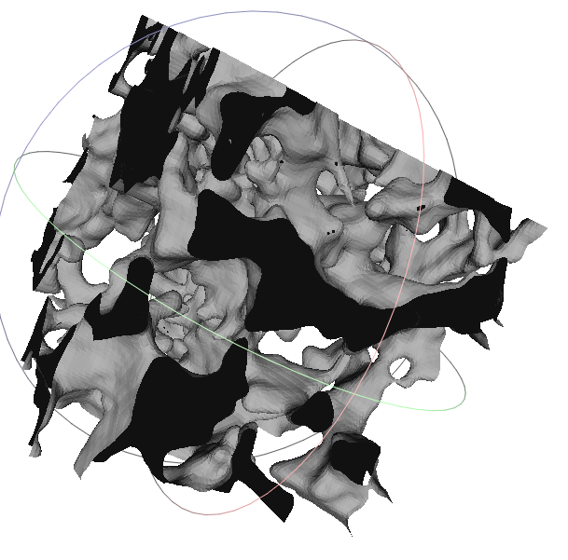
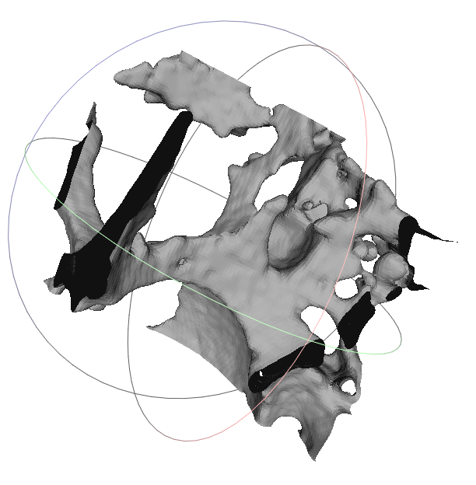


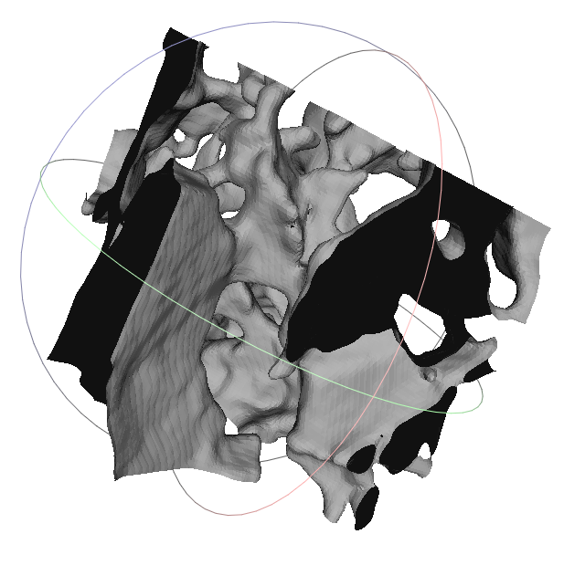
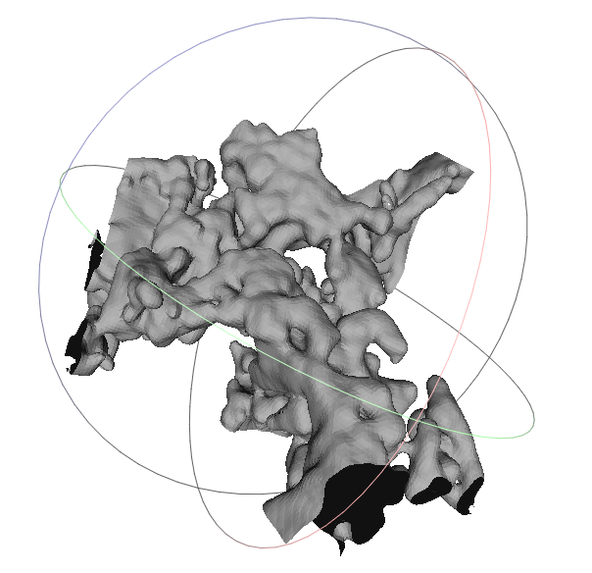


Results 1: Subvolume Isosurfaces @ 0.8 level (100^3)

Slide 7
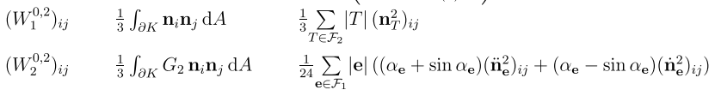
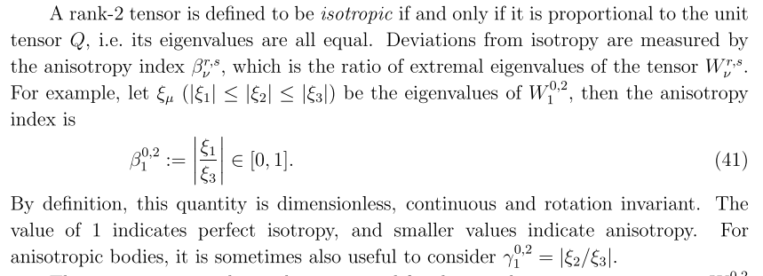

Results 2: Tensors Invariant to translation

Slide 8
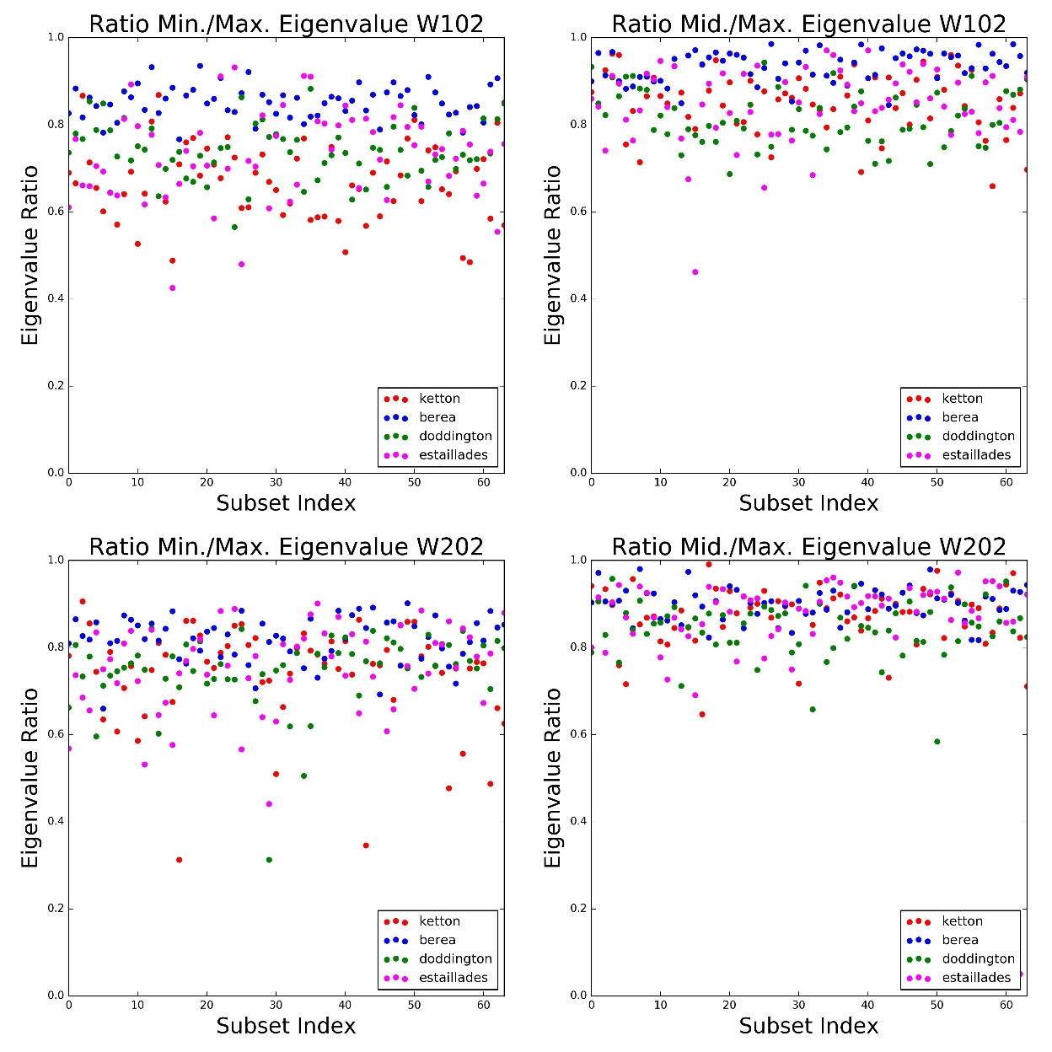
Results 3: Raw Data for each subvolume Beta, Gamma
Most data between 0.6 and 1.0
Berea has highest values
Ketton seems lowest
Some seperation seen between ketton berea and doddington
Estaillades greatest spread
Plot not very indicative

Slide 9
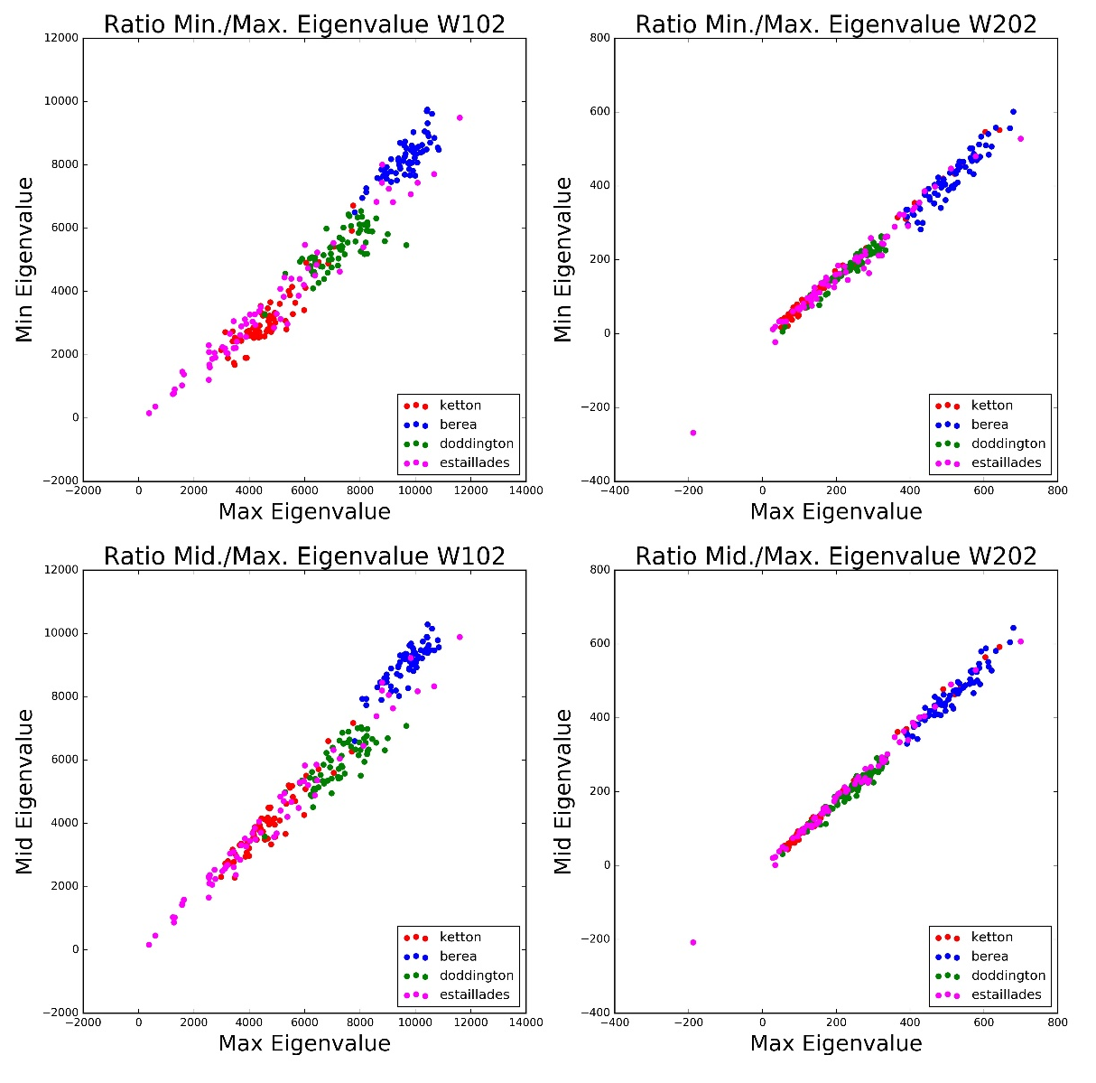
Results 4: Crossplot Min/Mid vs. Max Eigenvalue
Separation between rock samples is much more pronounced
Estaillades again large spread
Separation due to magnitude of eigenvalues, is this an intrinsic property or dependent on each sample volume (to-check!)

Slide 10
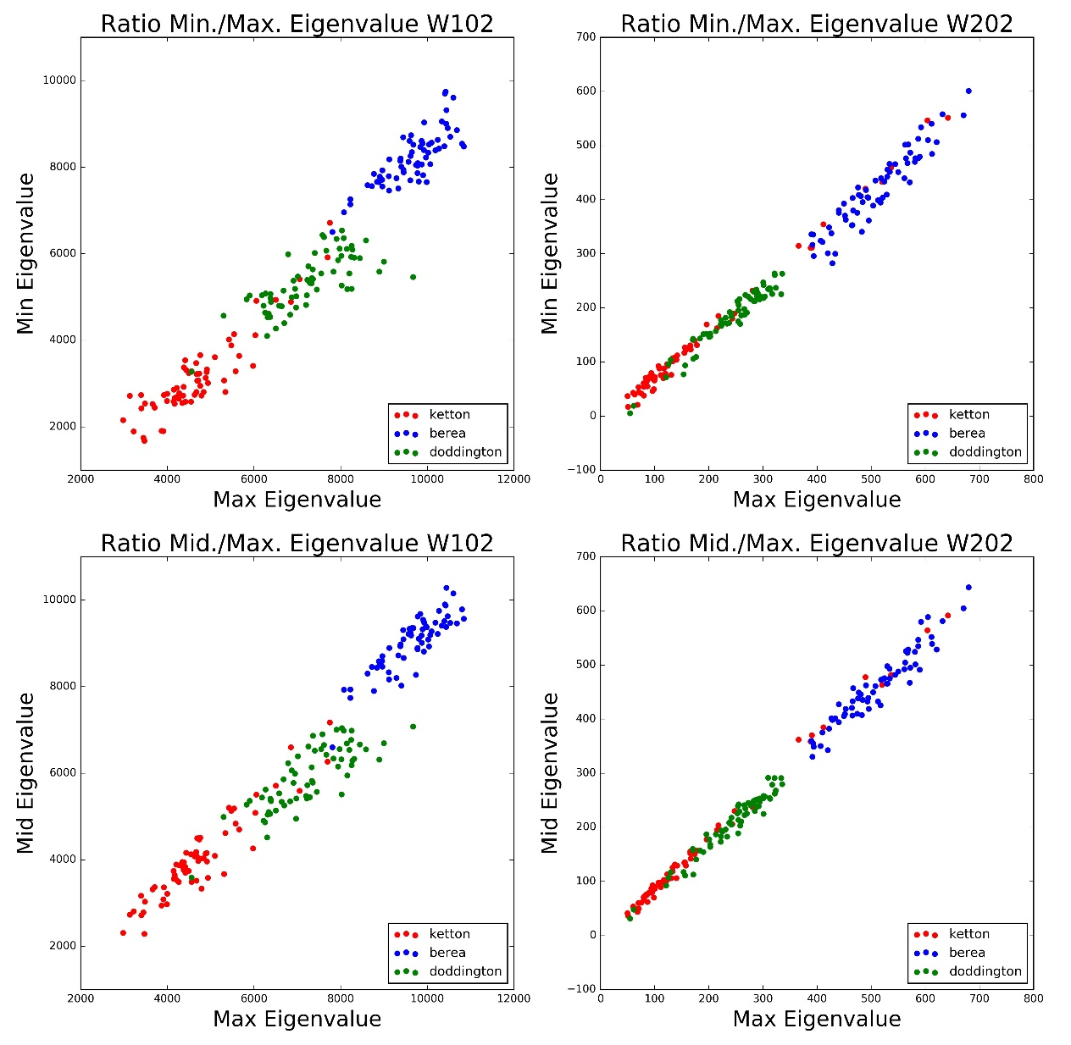
Results 5: Crossplot Min/Mid vs. Max Eigenvalue (w/o estailades)
Clear seperation of samples
But may be false positive due to
requirement of normalisation
Not yet clear based on literature
Things to check next
But nevertheless interesting as each image same voxel counts
Worth investigating!

Slide 11
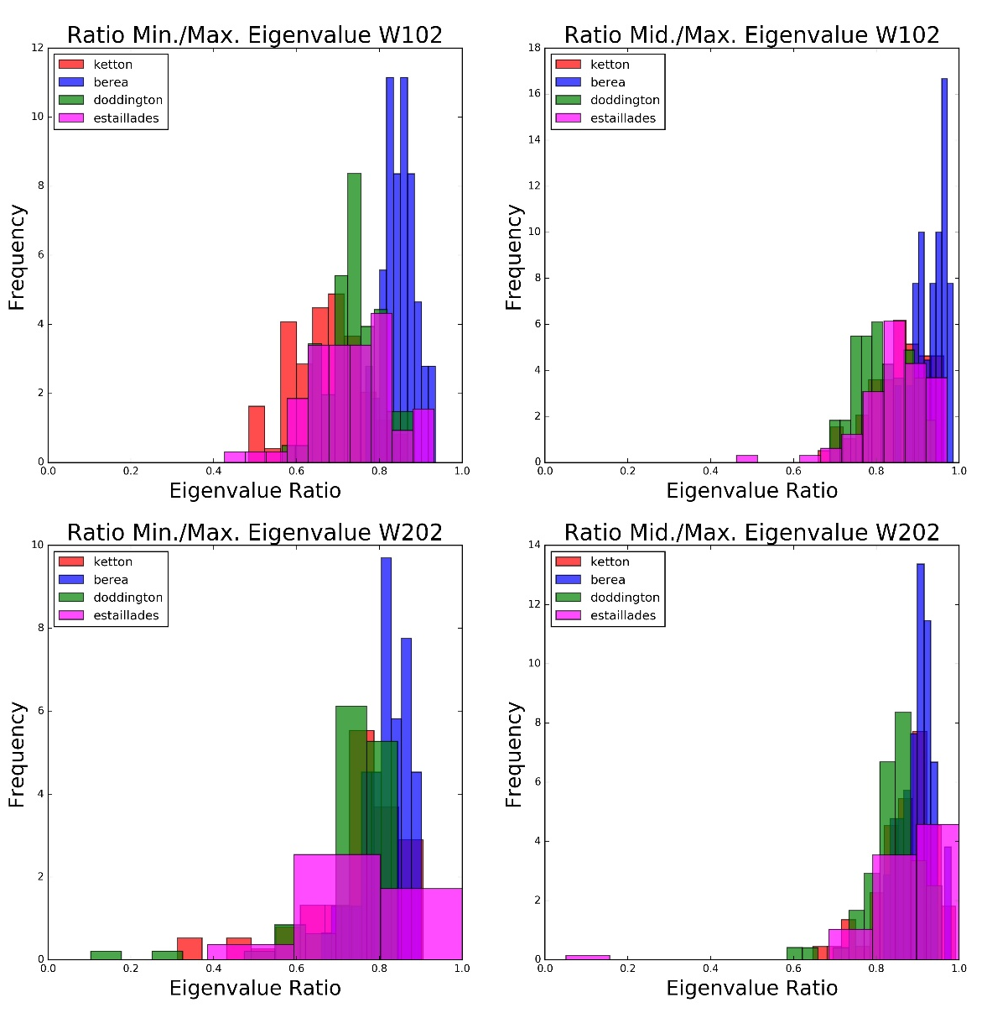
Results 3: Histograms of Anisotropy measures
Histograms of Anisotropy measures
Show distinct families of values
According to literature:
anisotropy measures are dimensionless -> actual behavior
Can Identify spread in estaillades
Very focused peak in berea

Slide 12
Next Steps
Dependency of results on segmentation level
Check for false positiveness, are results supposed to be normalized?
  Will check previous applications and compare treatment
Extract isosurface using Avizo
Compare Boolean model (can be generated in python or rhino 3D)
Run larger and smaller subvolume runs
  Currently limited to memory of laptop
  100^3 largest laptop can handle
Eigenvector plots exist but no good way of visualizing main directions yet found
  Possibly use stereonets and mean poles

