Slide 1
The role of attention in computational models of binocular rivalry
Phenomenon :
Background:
Scientific questions:
What is the computational role of attention in binocular rivalry?
What did we do?
Replication of the model from matlab into a object-based environment in python
Two different ideas how to implement voluntary attention

Slide 2
Repitition: Saliency / sensory-based attention
Saliency: The stimulus with stronger sensory responses attracts greater share of attention and reduces the attention allocated to the other stimulus.
The facilitated orientation on sensory level boosts the excitation to the summation neurons.
Therefore, attention has an influence on mutual inhibition in the model.

Slide 3
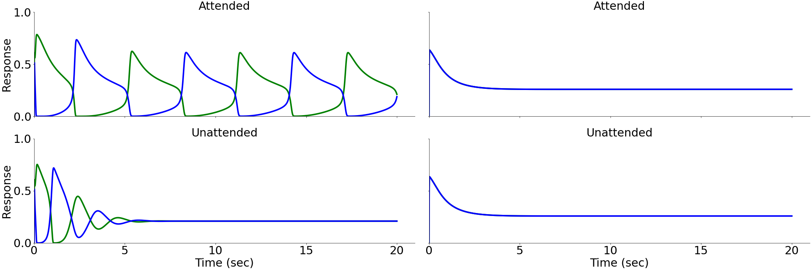
Replication of Fig.2

Slide 4

1st attention manipulation:
facilitation & supression of the excitatory attention drive
Change in the excitatory drive
of the attention population:
$Ea1=(Rb1−Rb2+external drive$)^{n}

Slide 5
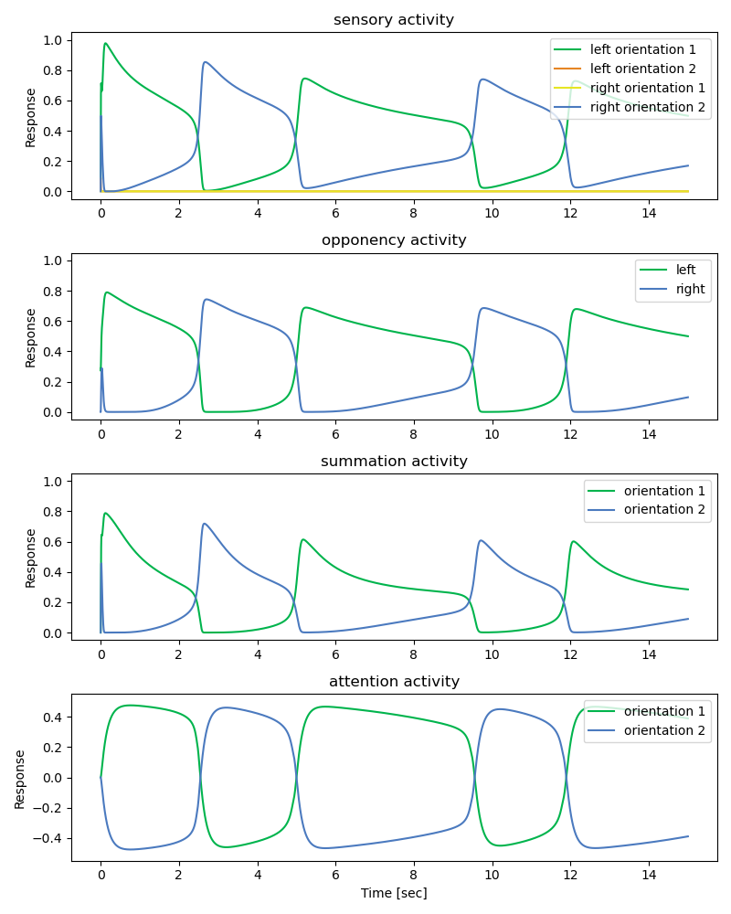

1st attention manipulation:
facilitation & supression of the excitatory attention drive
$Ea1=(Rb1−Rb2+external drive$)^{n}
external drive: 0.06; -0.06

Slide 6
Repitition: Saliency / sensory-based attention
Saliency: The stimulus with stronger sensory responses attracts greater share of attention and reduces the attention allocated to the other stimulus.
The facilitated orientation on sensory level boosts the excitation to the summation neurons.
Therefore, attention has an influence on mutual inhibition in the model.

Slide 7


1) Goal-driven facilitation of a specific orientation implemented as additional weight
$$El1=\left[Dl1n −woor\right]+[1+wa Ra1]$$
$$El1=\left[Dl1n −woor\right]+[1+wa1 wa2 Ra1]$$
Open question: what happens for the other orientation? $wa2$ = 0 or $wa2$= - $wa2$

Slide 8
How to implement goal-driven facilitation?
2) Goal-driven facilitation of a specific percept (orientation) implemented as excitatory and inhibitory drive from the attention layer
Here I stopped to work on it today!!
ToDos:
Needs the important formulas from attention layer.
And how they would be changed!

Slide 9
1-starting point: „our intution“
The goal is to hold onto/focus on a pre-defined orientation (it‘s percept) independent of the sensory strength.
How to implement goal-driven attention /voluntary attention in the model? What is the simplest intrinsic cortical computational solution to increase the firing rate of a neuron for a pre-defined orientation?
implemented as additional weight
implemented as inhibitory and exitiatory input
Why not a attentional drive on summation neurons to change the percept?
The following slides are based on „our intution“
2-starting point: From Hancock & Andrews (2007):
„The voluntary attention influences the ongoing changs in perceptual dominance that accompany longer periods of binocular rivalry. Voluntary attention didnot increase the mean dominance period of the attended grating, but rather decreased the mean dominance period of the non-attended grating. This pattern is analgogous to increasing the perceived contrast of the attended grating.“

Slide 10
Why not goal-driven facilitation on the summation level?
2) Goal-driven facilitation of a specific percept (orientation) implemented as excitatory and inhibitory drive from the attention layer

Slide 11
Spatial attention
Spatial attention: facilitation of a sensory input for one eye

Slide 12
Does the voluntary attention and sensory-based attention interact?

