Slide 1



The role of attention in a neural rate model of binocular rivalry
Neuromatch summer school project
July 2020
Gerion Nabbefeld
Lukas Neugebauer
Kristin Kaduk
We would like to thank our mentor, Xaq Pitkow for his time and his great explanations and drawings to bifurcation.

Slide 2
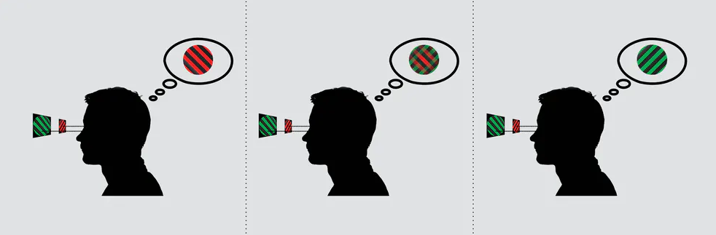
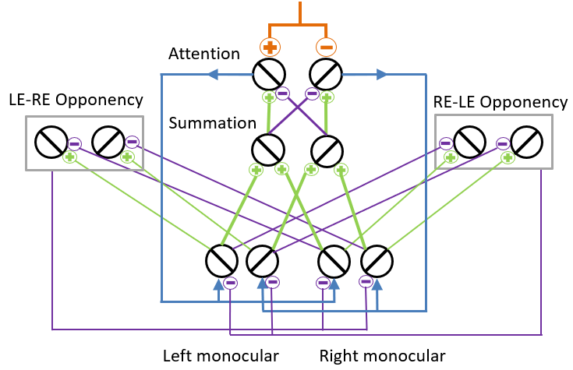
The role of attention in a computational model of binocular rivalry
Binocular rivalry is the alternation between incompatible monocular images presented to the two eyes.
Binocular rivalry depends on attention.
Can voluntary attention be incorporated into this model?
Luke Smillie (2017): People with creative personalities really do see the world differently
Li et al. (2016) modelled binocular rivalry as an interplay of mutual inhibition and saliency driven attention.

Slide 3
Neural rate model with mutual inhibition & attention
Mutual inhibition: The interocular conflict between two percepts is here mediated through opponency neurons.
Excitatory
Inhibitory
LE-RE Opponency
RE-LE Opponency
Summation
Input:
Left monocular
Right monocular

Slide 4
Neural rate model with mutual inhibition & attention
Mutual inhibition: The interocular conflict between two percepts is here mediated through opponency neurons.
Excitatory
Inhibitory
LE-RE Opponency
RE-LE Opponency
Summation
Left monocular
Right monocular

Slide 5
Neural rate model with mutual inhibition & attention
Mutual inhibition: The interocular conflict between two percepts is here mediated through opponency neurons.
Saliency driven Attention: The stimulus with stronger sensory responses attracts greater share of attention and reduces the attention allocated to the other stimulus.
Attention
LE-RE Opponency
RE-LE Opponency
Summation
Excitatory
Inhibitory
Left monocular
Right monocular

Slide 6


Model Alteration I: External input to attention population
$Ea1=(Rb1−Rb2+external drive$)^{n}
Change in the excitatory drive
of the attention population:
$Ea2=(Rb2−Rb1−external drive$)^{n}
Attention
LE-RE Opponency
RE-LE Opponency
Summation
Left monocular
Right monocular

Slide 7
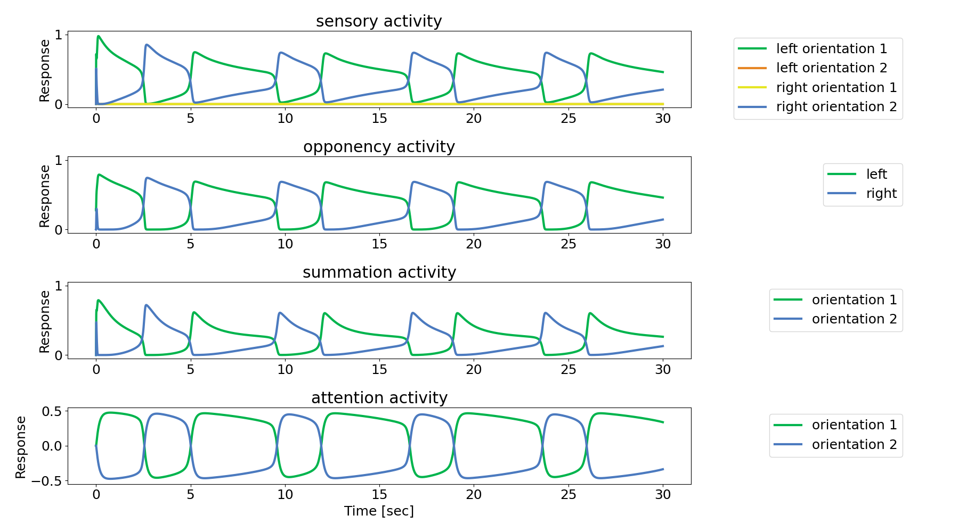
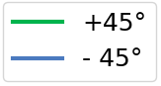
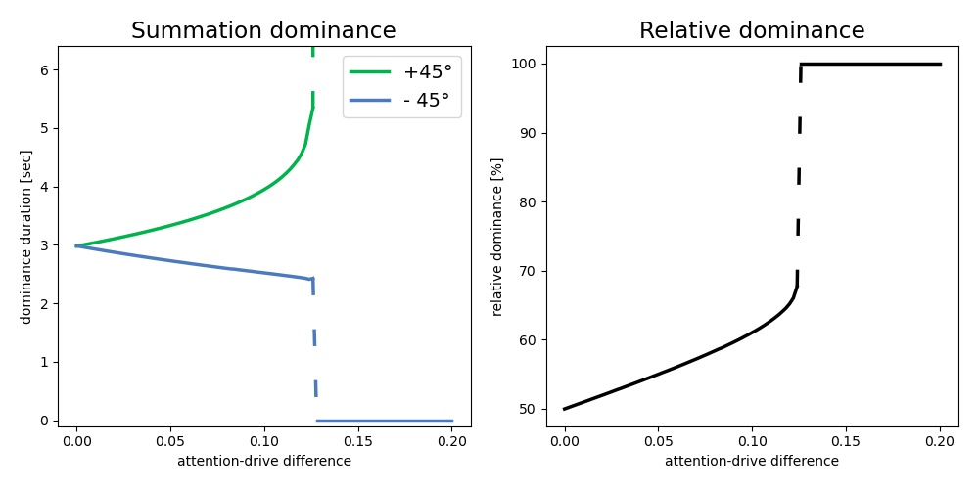


Model Alteration: External input to attention population
Change in the excitatory drive
of the attention population:
$Ea1=(Rb1−Rb2+external drive$)^{n}
$Ea2=(Rb2−Rb1−external drive$)^{n}
Results
Adding external input to attention neurons prolonged dominance periods of the excited representation and shortened periods of the suppressed ones.

Slide 8
Conclusion
General:
We were able to reimplement the model in an object-oriented framework in python
Model alteration:
Direct excitatory input to attention neurons prolongs dominance durations
For input strengths of > ~12.4% of normal excitatory drive leads to a Winner-takes-all condition
Outlook:
Compare the observed changes in dominance duration to experimental findings
Test alternative alteration by weight changes

Slide 9


Neuromatch summer school project TEAM:
“We’re usually modelling for Victoria’s secret”
I really enjoyed this project work.
It took use some time to find a project everyone was interested in, but once we had a plan it was pretty straight forward.
The project work was an inspiring adventure for me with the exploration how to implement object-based programming in python and how a well-defined scope of a project improves motivation and success. It was fun working in an interdisciplinary team and in the end,
my dream to explore a cortical mechanism without data became true.
While it has been really interesting to implement a model that goes a lot deeper than I’m used to as a cognitive neuroscientist, the most helpful aspect for me has been the project-based work in a team. It’s been a really enjoyable journey and I take a lot away from it.
We would like to thank our mentor, Xaq Pitkow for his time and his great explanations and drawings to bifurcation.

Slide 10
Thank you for your attention.

Slide 11
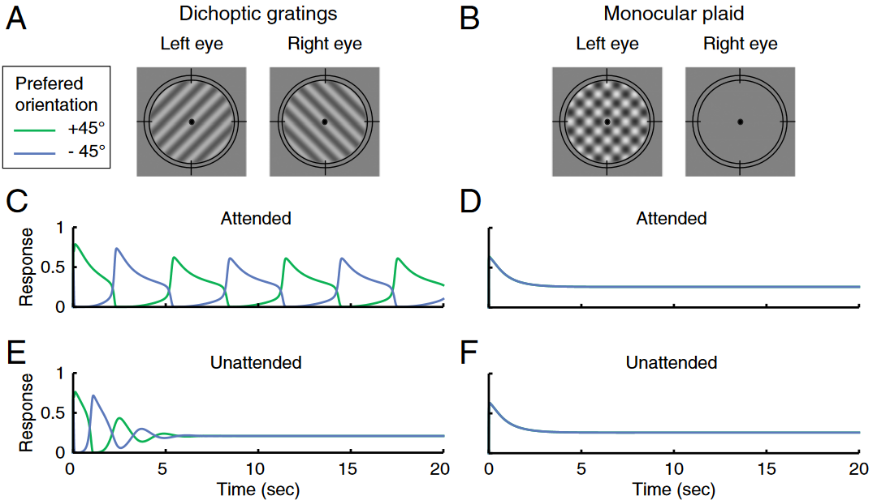
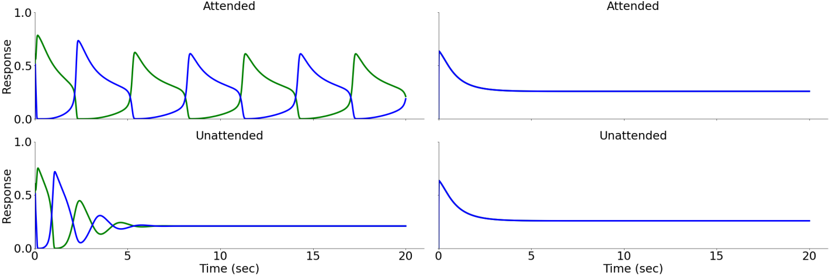
Simulated dynamic of binocular rivalry depends on attention
Original Publikation
Our Replication

Slide 12

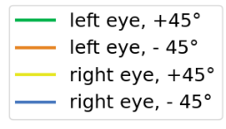




Model Alteration I: External input to attention population
Change in the excitatory drive
of the attention population:
$Ea1=(Rb1−Rb2+external drive$)^{n}
$Ea2=(Rb2−Rb1−external drive$)^{n}

Slide 13
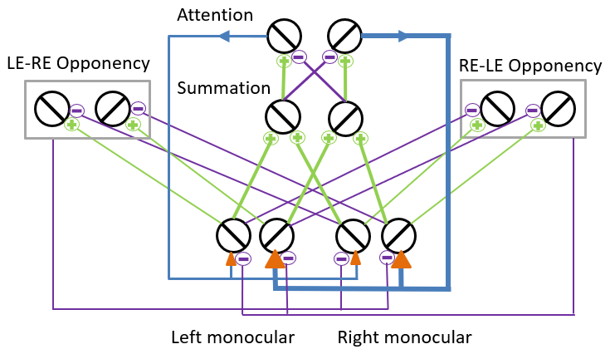
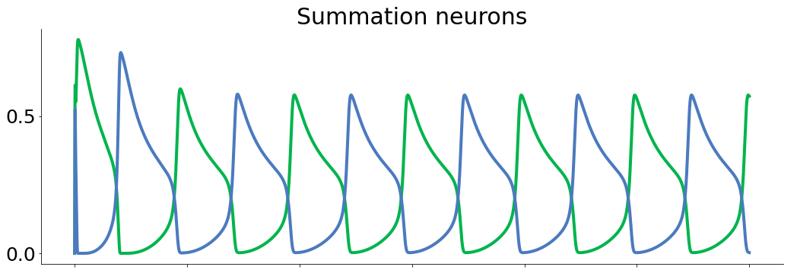
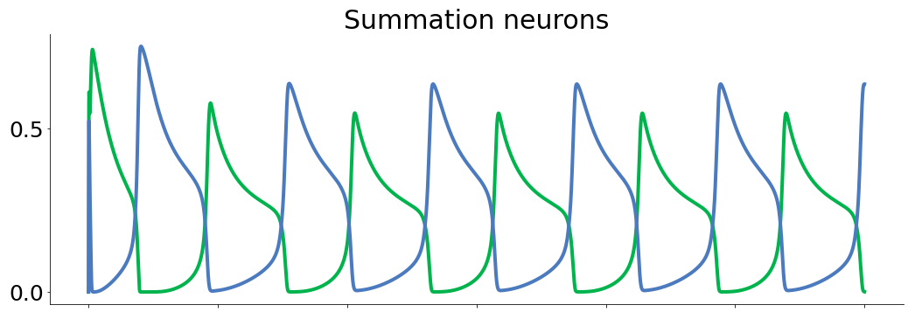
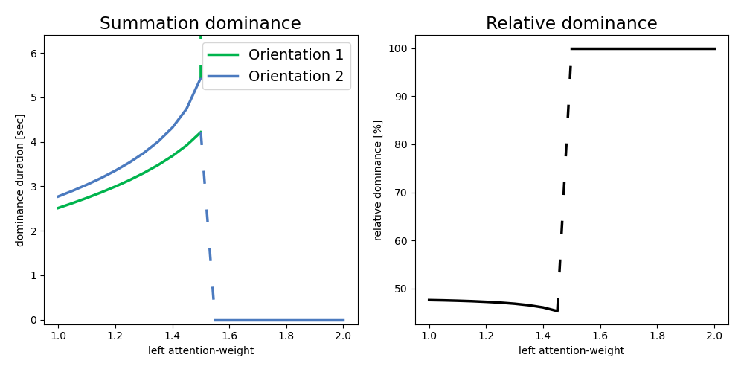
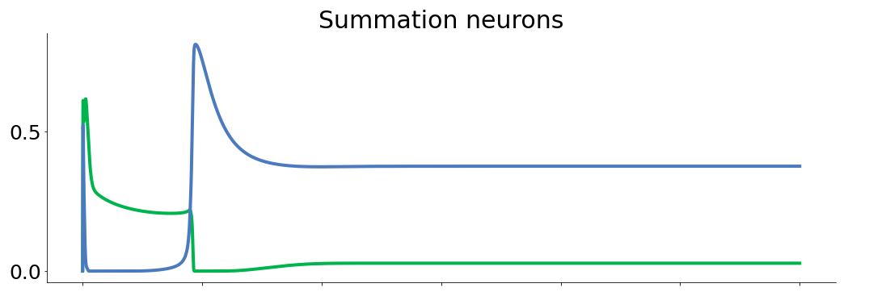
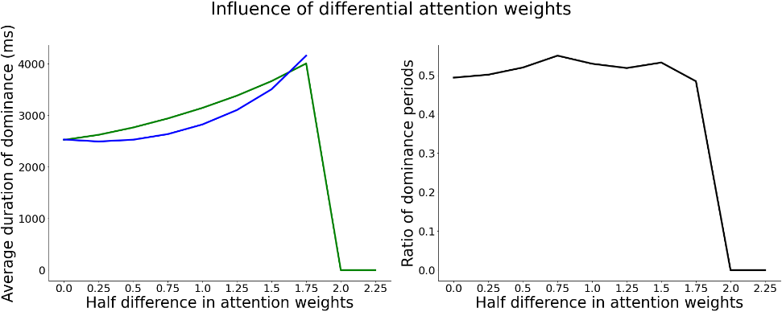
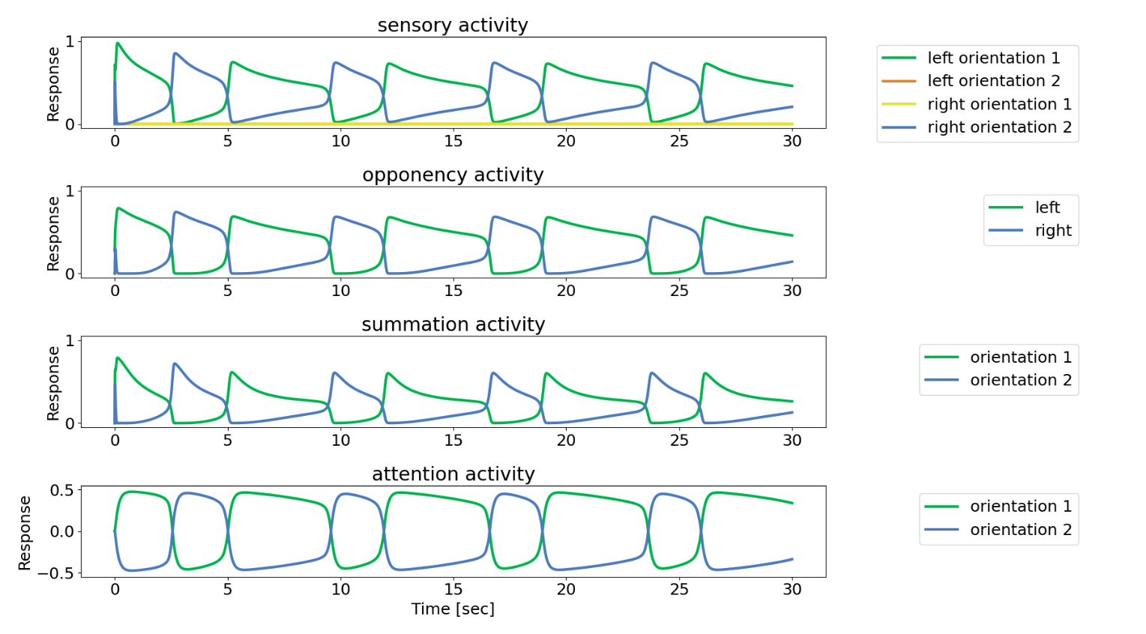
Model Alteration I: External input to attention population
Conclusion:
Adding differential external input to the attention neurons prolongs dominance periods of the excited representation, while reducing the duration for the inhibited representation, over the entire network.
This holds for additional inputs with a strength of up to ~12.4% of the maximum excitatory drive by summation neurons to the attention neurons. For stronger inputs the excited representation becomes persistent.

