Slide 1



The role of attention in a neural rate model of binocular rivalry
Neuromatch summer school project
July 2020
Gerion Nabbefeld
Lukas Neugebauer
Kristin Kaduk
We would like to thank our mentor, Xaq Pitkow for his time and his great explanations and drawings to bifurcation.

Slide 2
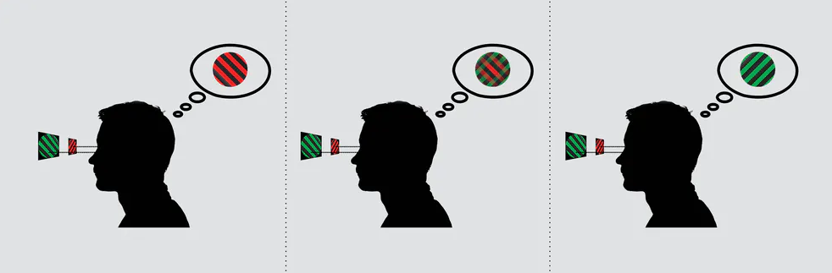
The role of attention in a computational model of binocular rivalry
Binocular rivalry is the alternation between incompartible monocular images presented to the two eyes.
Experimental evidence has shown that binocular rivalry also depends on attention. The neural network model from Li et al. (2016) explains the intrinsic cortical interactions between mutual inhibition and attention in visual perception.
Our scientific questions: What is the computational role of saliency and voluntary attention in binocular rivalry?
What did we do?
Replication of the published model (Li et al. 2016) from matlab into a object-based environment in python
Two different ideas how to implement voluntary attention
Luke Smillie (2017): People with creative personalities really do see the world differently

Slide 3
Neural rate model with mutual inhibition & attention
Mutual inhibition: The interocular conflict between two percepts is here mediated through opponency neurons.
Saliency: The stimulus with stronger sensory responses attracts greater share of attention and reduces the attention allocated to the other stimulus.
Attention
LE-RE Opponency
RE-LE Opponency
Summation
Left monocular
Right monocular
Sensory Input??

Slide 4
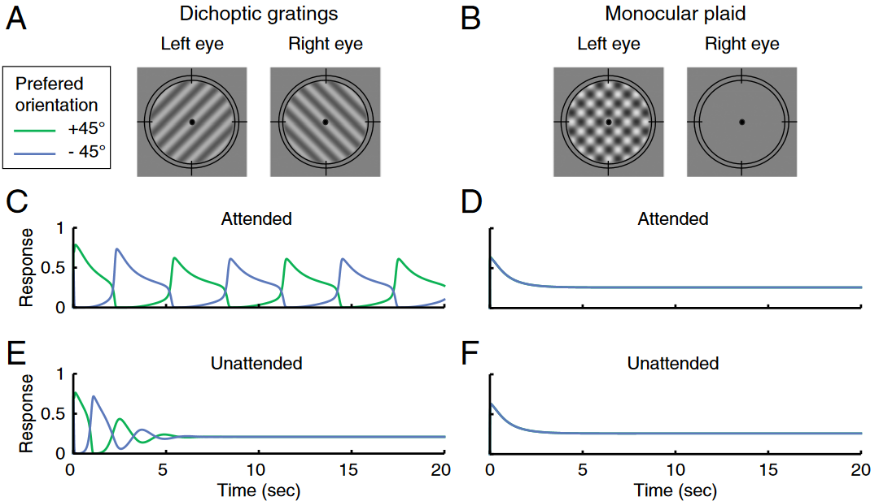
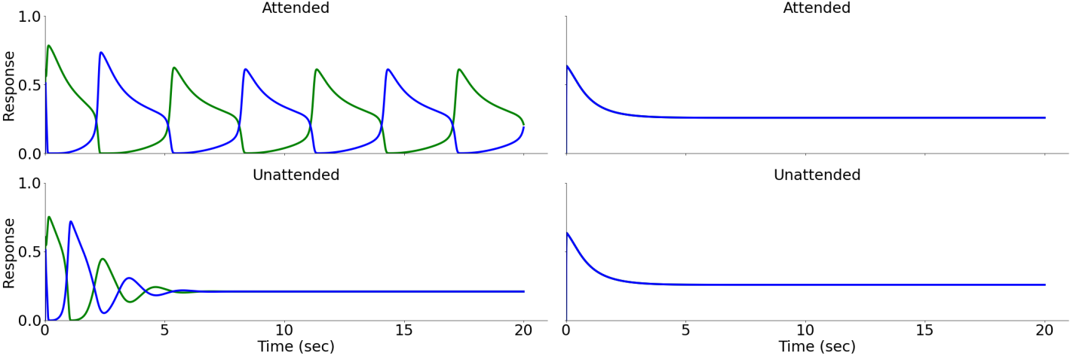
Simulated dynamic of binocular rivalry depends on attention
Original Publikation
Our Replication

Slide 5
Voluntary attention in relation to binocular rivalry
Voluntary attention is deliberately applied on a pre-defined orientation. Therefore, attention should bias the intraocular changes in perceptual dominance towards the pre-defined orientation.
Two ideas how to implement „voluntary attention“ in the model:
Facilitation of one attention neuron vs. suppression the other one
Weight change
Hancock & Andrews (2007): „Voluntary attention did not increase the mean dominance period of the attended grating, but rather decreased the mean dominance period of the non-attended grating. This pattern is analogous to increasing the perceived contrast of the attended grating.“

Slide 6


Model Alteration I: External input to attention population
$Ea1=(Rb1−Rb2+external drive$)^{n}
Change in the excitatory drive
of the attention population:
$Ea2=(Rb2−Rb1−external drive$)^{n}
Attention
LE-RE Opponency
RE-LE Opponency
Summation
Left monocular
Right monocular

Slide 7
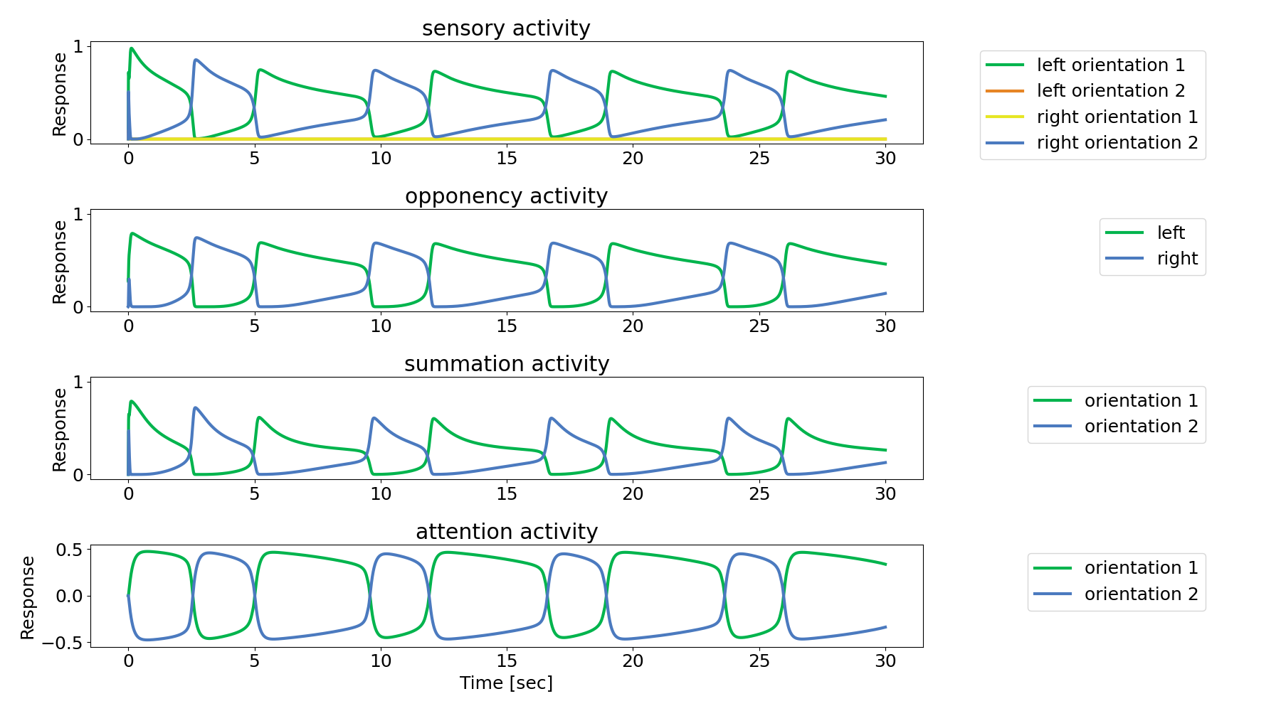

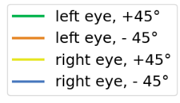




Model Alteration I: External input to attention population
Change in the excitatory drive
of the attention population:
$Ea1=(Rb1−Rb2+external drive$)^{n}
$Ea2=(Rb2−Rb1−external drive$)^{n}

Slide 8
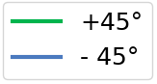
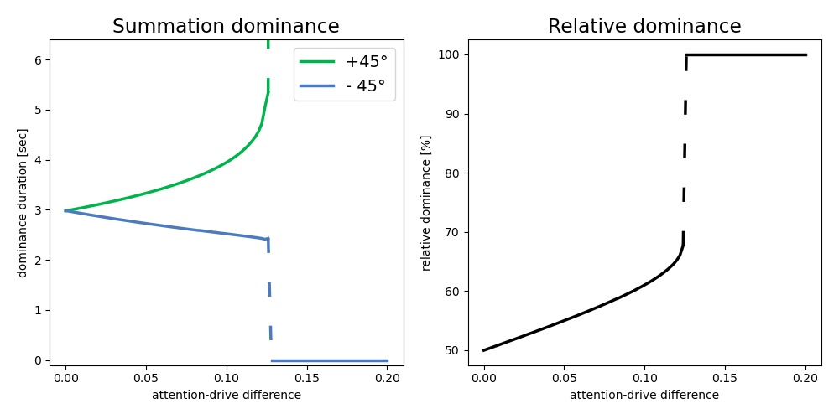
Model Alteration I: External input to attention population
Change in the excitatory drive
of the attention population:
$Ea1=(Rb1−Rb2+external drive$)^{n}
$Ea2=(Rb2−Rb1−external drive$)^{n}
Conclusion
After adding external input to the attention neurons:
the excited summation representation displays longer dominance periods
the inhibited representation shorter periods
Effect spreads over entire network
Inputs strengths > ~12.4% of maximum Rb-drive cause a persistent representation (Winner-take-all)
Conclusion:
Adding differential external input to the attention neurons prolongs dominance periods of the excited representation, while reducing the duration for the inhibited representation, over the entire network.
This holds for additional inputs with a strength of up to ~12.4% of the maximum excitatory drive by summation neurons to the attention neurons. For stronger inputs the excited representation becomes persistent.

Slide 9

Model Alteration II: Changing attention weight
Change in the weight for the attentional
neural response:
$$El1=\left[Dl1n −woor\right]+[1+ wa1 Ra1]$$
Attention
LE-RE Opponency
RE-LE Opponency
Summation
Left monocular
Right monocular

Slide 10
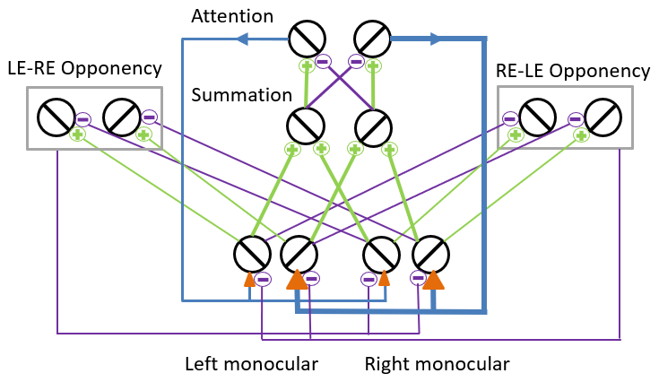
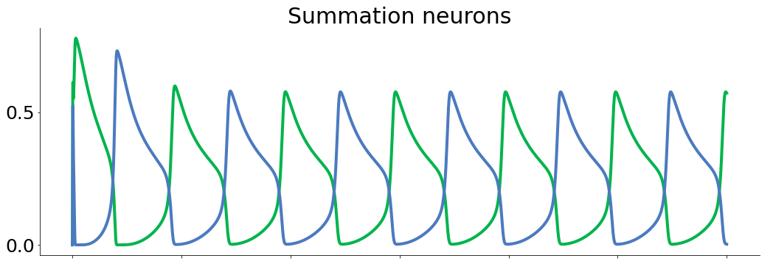
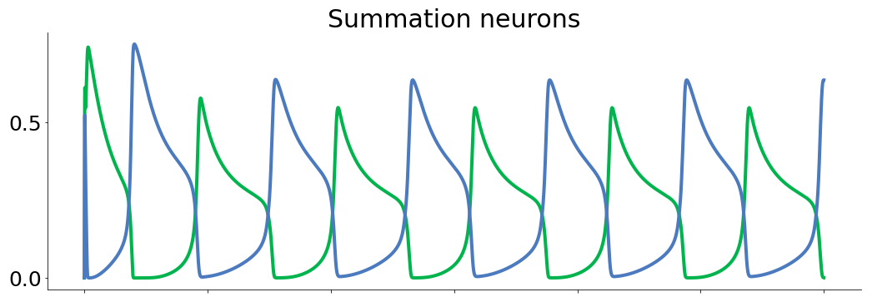
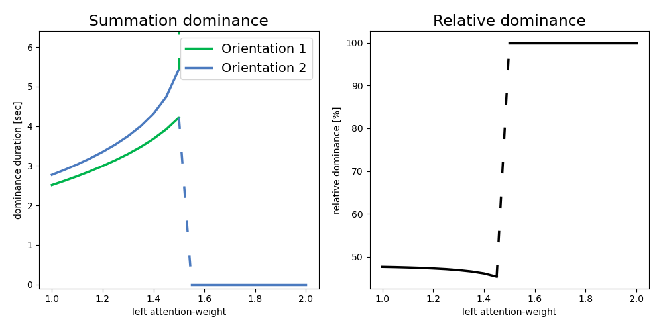
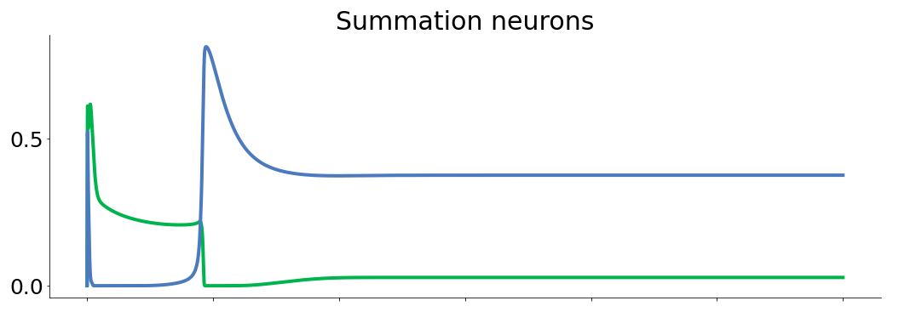
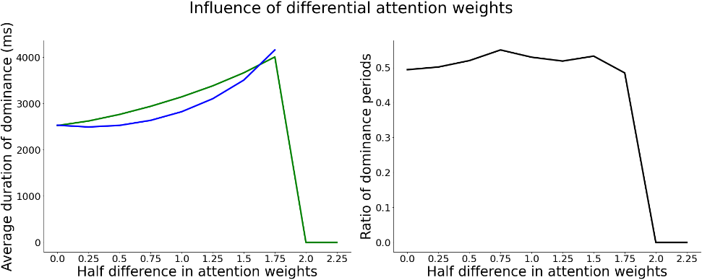
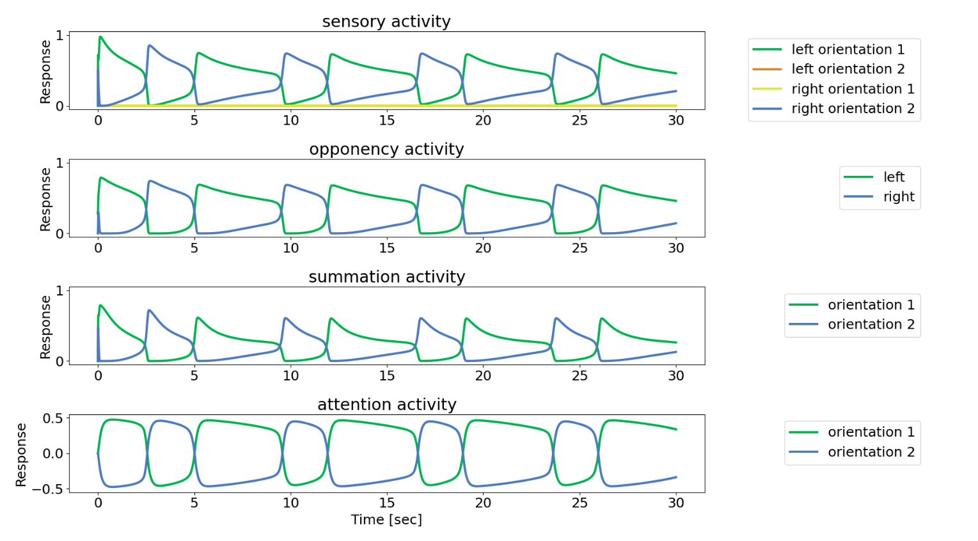
Model Alteration I: External input to attention population
Conclusion:
Adding differential external input to the attention neurons prolongs dominance periods of the excited representation, while reducing the duration for the inhibited representation, over the entire network.
This holds for additional inputs with a strength of up to ~12.4% of the maximum excitatory drive by summation neurons to the attention neurons. For stronger inputs the excited representation becomes persistent.

Slide 11
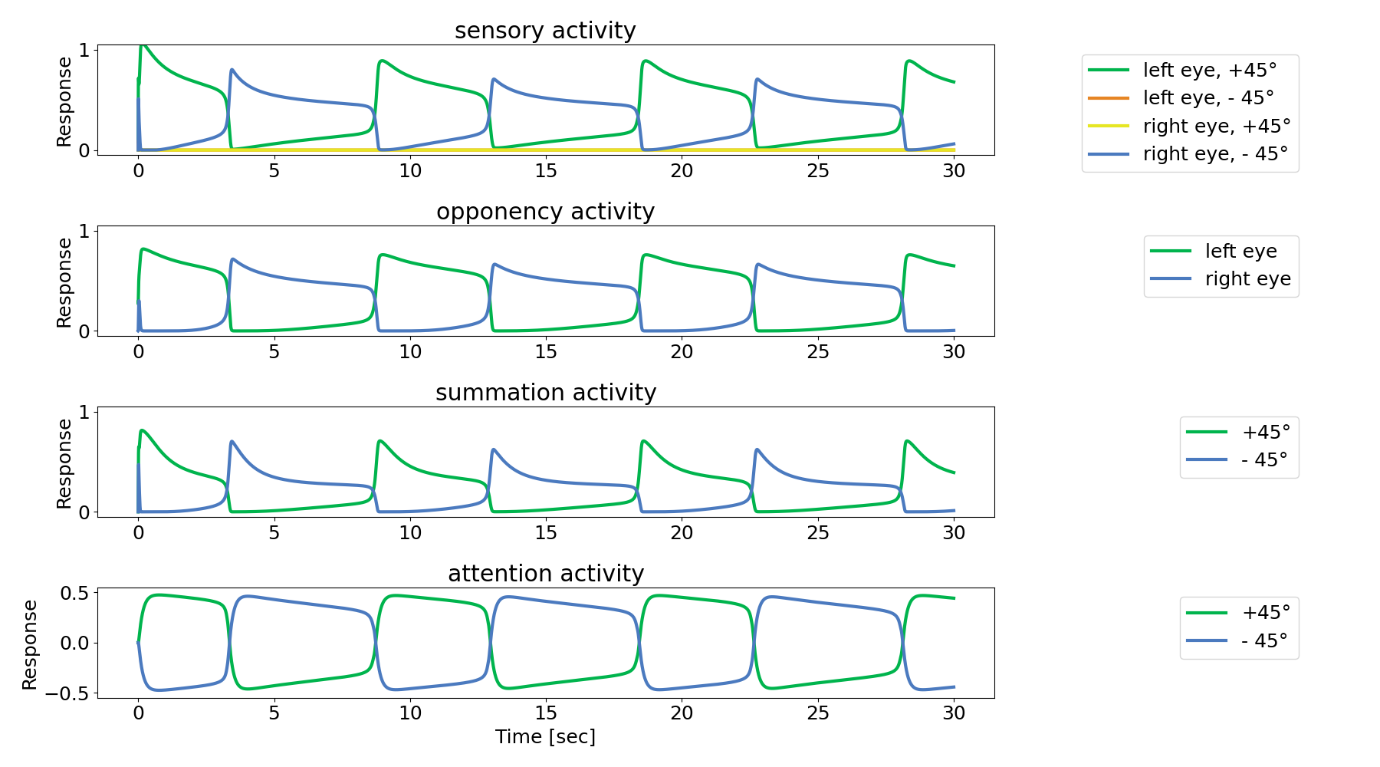

Slide 12
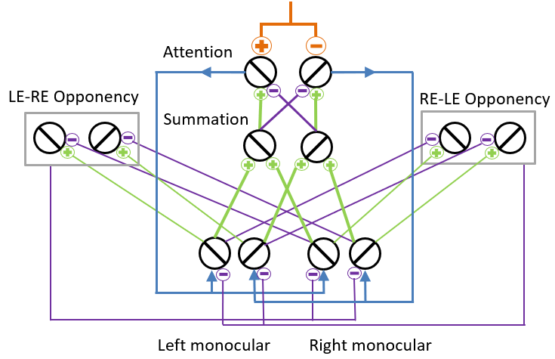
Conclusion
General:
We were able to reimplement the model in an object-oriented framework in python
Model alteration I:
Direct excitatory input to attention neurons prolongs dominance durations
For input strengths of > ~12.4% of normal excitatory drive leads to a Winner-takes-all condition
Model alteration II:
Increasing attention weights of sensory neurons reduces dominance duration
Finally, leads to winning in Winner-take-all

Slide 13


I really enjoyed this project work.
It took use some time to find a project everyone was interested in, but once we had a plan it was pretty straight forward.
The project work was an inspiring adventure for me with the exploration how to implement object-based programming in python and how a well defined scope of a project improves motivation and success. It was fun working in an interdisciplinary team and in the end,
my dream to explore a cortical mechanism without data became true.
While it has been really interesting to implement a model that goes a lot deeper than I’m used to as a cognitive neuroscientist, the most helpful aspect for me has been the project-based work in a team. It’s been a really enjoyable journey and I take a lot away from it.

