Slide 1
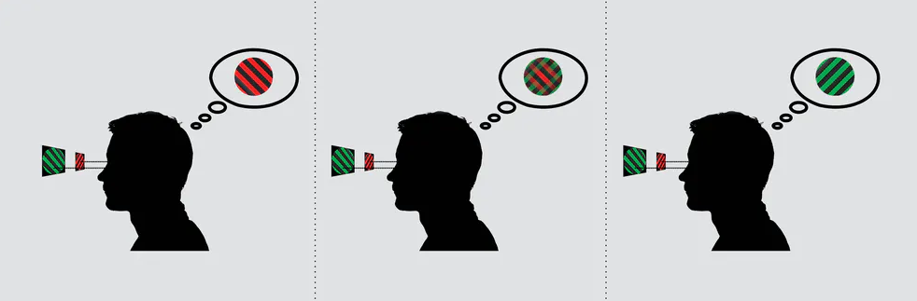
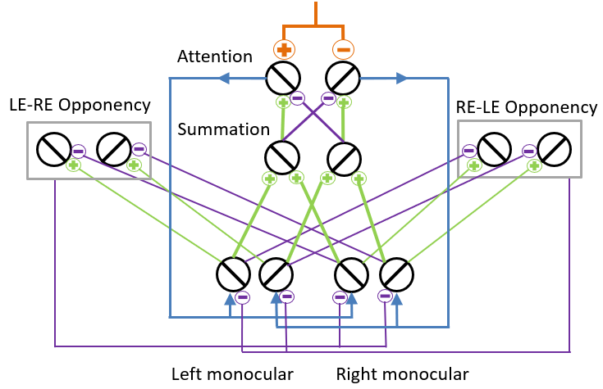
The role of attention in a computational model of binocular rivalry
Binocular rivalry is the alternation between incompatible monocular images presented to the two eyes.
Binocular rivalry depends on attention.
Can voluntary attention be incorporated into this model?
Luke Smillie (2017): People with creative personalities really do see the world differently
Li et al. (2016) modelled binocular rivalry as an interplay of mutual inhibition and saliency driven attention.

Slide 2
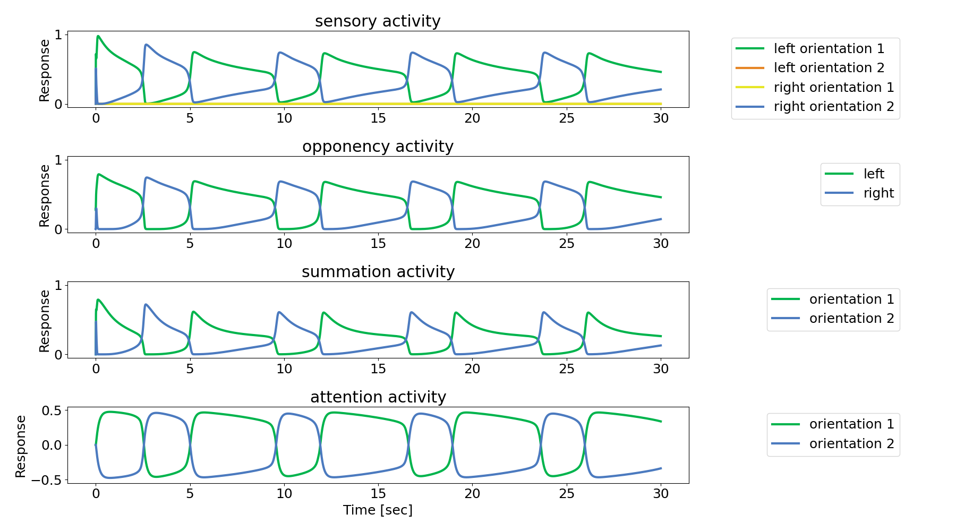
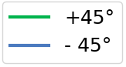
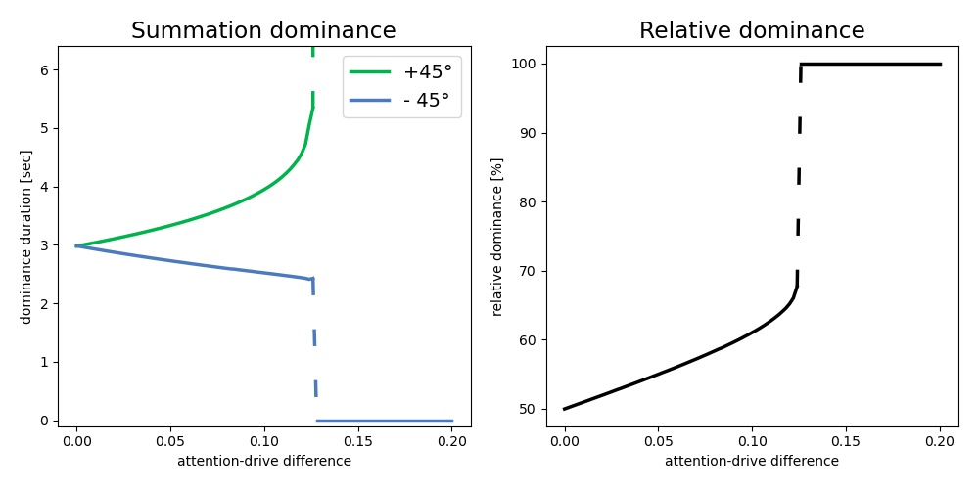


Model Alteration: External input to attention population
Change in the excitatory drive
of the attention population:
$Ea1=(Rb1−Rb2+external drive$)^{n}
$Ea2=(Rb2−Rb1−external drive$)^{n}
Results
Adding external input to attention neurons prolonged dominance periods of the excited representation and shortened periods of the suppressed ones.

Slide 3
Conclusion
General:
We were able to reimplement the model in an object-oriented framework in python
Model alteration:
Direct excitatory input to attention neurons prolongs dominance durations
For input strengths of > ~12.4% of normal excitatory drive leads to a Winner-takes-all condition
Outlook:
Compare the observed changes in dominance duration to experimental findings
Test alternative alteration by weight changes

Slide 4
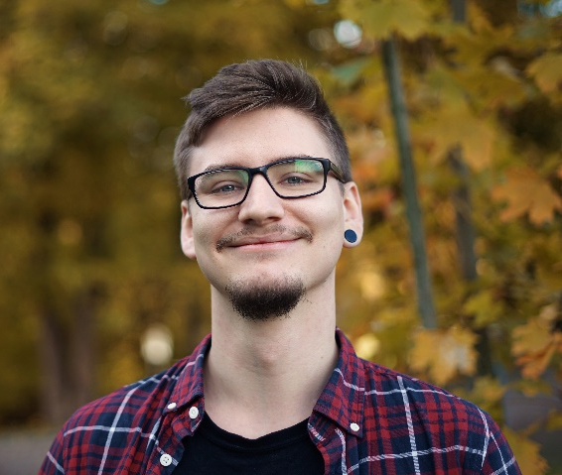
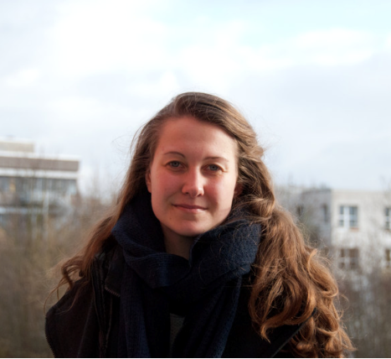
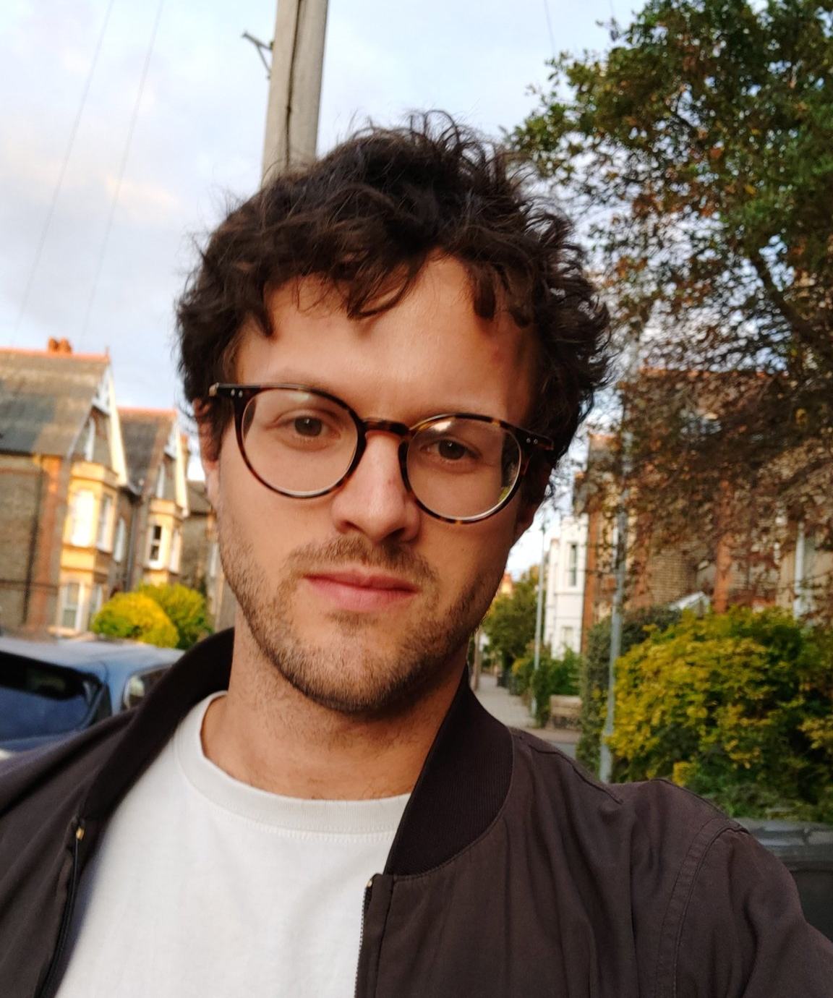
Neuromatch summer school project TEAM:
“We’re usually modelling for Victoria’s secret”
I really enjoyed this project work.
It took use some time to find a project everyone was interested in, but once we had a plan it was pretty straight forward.
The project work was an inspiring adventure for me with the exploration how to implement object-based programming in python and how a well-defined scope of a project improves motivation and success. It was fun working in an interdisciplinary team and in the end,
my dream to explore a cortical mechanism without data became true.
While it has been really interesting to implement a model that goes a lot deeper than I’m used to as a cognitive neuroscientist, the most helpful aspect for me has been the project-based work in a team. It’s been a really enjoyable journey and I take a lot away from it.
We would like to thank our mentor, Xaq Pitkow for his time and his great explanations and drawings to bifurcation.

