Slide 1
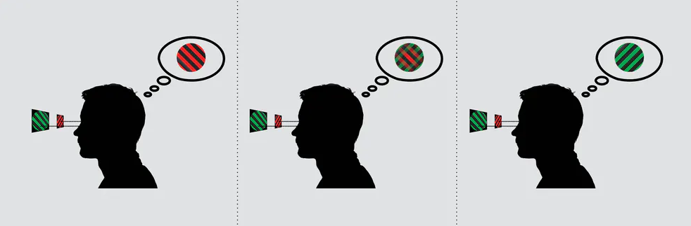
The role of attention in a computational model of binocular rivalry
Binocular rivalry is the alternation between incompartible monocular images presented to the two eyes.
Experimental evidence has shown that binocular rivalry also depends on attention. The neural network model from Li et al. (2016) explains the intrinsic cortical interactions between mutual inhibition and attention in visual perception.
Our scientific questions: What is the computational role of saliency and voluntary attention in binocular rivalry?
What did we do?
Replication of the published model (Li et al. 2016) from matlab into a object-based environment in python
Two different ideas how to implement voluntary attention
Luke Smillie (2017): People with creative personalities really do see the world differently

Slide 2
Neural rate model with mutual inhibition & attention
Mutual inhibition: The interocular conflict between two percepts is here mediated through opponency neurons.
Saliency: The stimulus with stronger sensory responses attracts greater share of attention and reduces the attention allocated to the other stimulus.
Attention
LE-RE Opponency
RE-LE Opponency
Summation
Left monocular
Right monocular
Sensory Input??

Slide 3
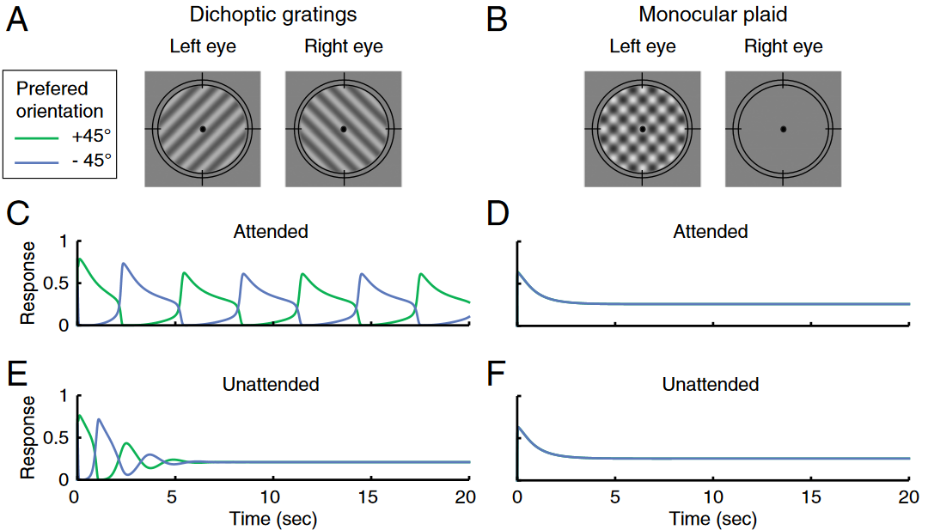
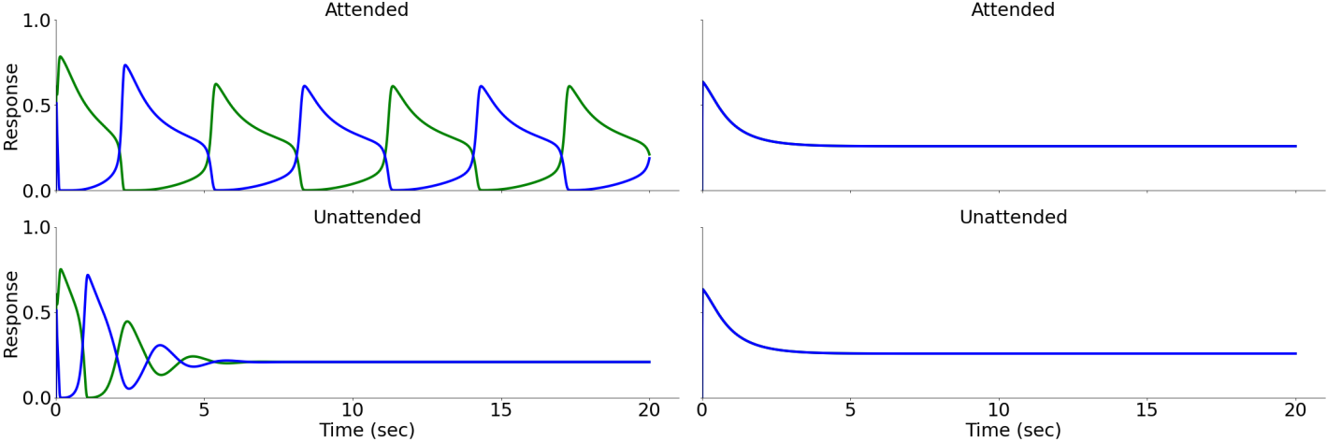
Simulated dynamic of binocular rivalry depends on attention
Our replication of Fig. 2

Slide 4
1-starting point: „our intution“
The goal is to hold onto/focus on a pre-defined orientation (it‘s percept) independent of the sensory strength.
How to implement goal-driven attention /voluntary attention in the model? What is the simplest intrinsic cortical computational solution to increase the firing rate of a neuron for a pre-defined orientation?
implemented as additional weight
implemented as inhibitory and exitiatory input
Why not a attentional drive on summation neurons to change the percept?
The following slides are based on „our intution“
2-starting point: From Hancock & Andrews (2007):
„The voluntary attention influences the ongoing changs in perceptual dominance that accompany longer periods of binocular rivalry. Voluntary attention didnot increase the mean dominance period of the attended grating, but rather decreased the mean dominance period of the non-attended grating. This pattern is analgogous to increasing the perceived contrast of the attended grating.“

Slide 5


Model Alteration I: Voluntary attention as facilitation by external attentional drive
Model Alteration I: Voluntary attention as facilitation & suppression of the excitatory attentional drive
$Ea1=(Rb1−Rb2+external drive$)^{n}
Change in the excitatory drive
of the attention population:
$Ea2=(Rb2−Rb1−external drive$)^{n}
Attention
LE-RE Opponency
RE-LE Opponency
Summation
Left monocular
Right monocular

Slide 6
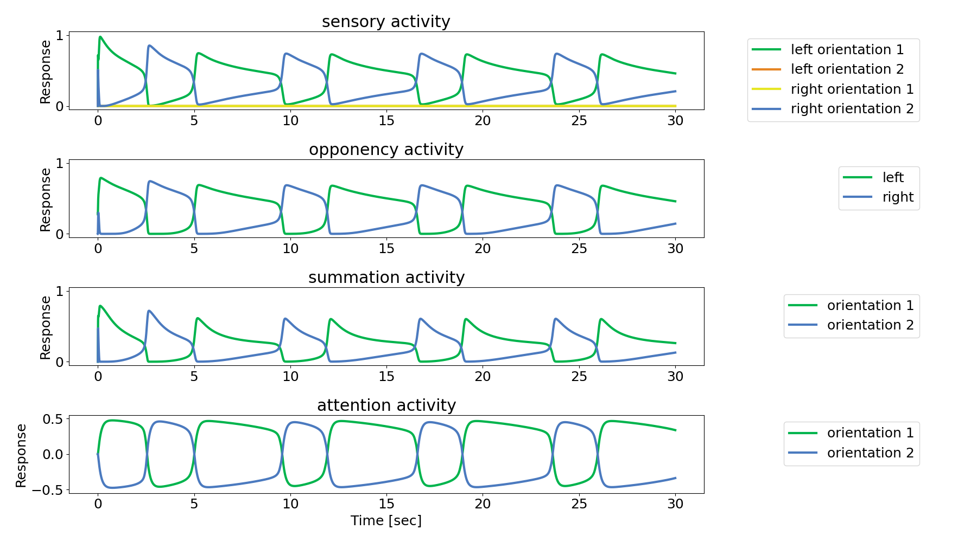

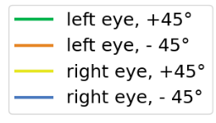


Model Alteration I: Voluntary attention as facilitation by external attentional drive
$Ea1=(Rb1−Rb2+external drive$)^{n}
Change in the excitatory drive
of the attention population:
Result:
$Ea2=(Rb2−Rb1−external drive$)^{n}

Slide 7
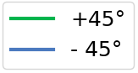
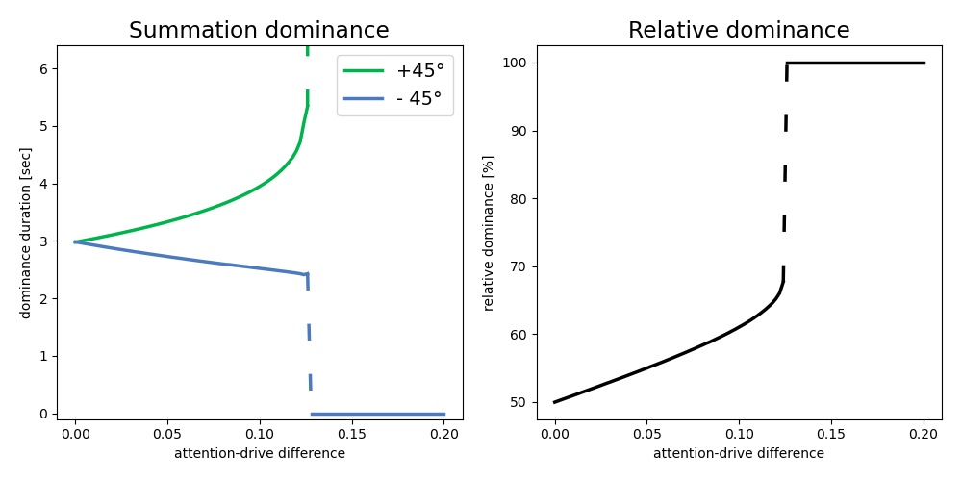

Model Alteration I: Voluntary attention as facilitation by external attentional drive
$Ea1=(Rb1−Rb2+external drive$)^{n}
Change in the excitatory drive
of the attention population:
$Ea2=(Rb2−Rb1−external drive$)^{n}
Conclusion:
Adding differential external input to the attention neurons prolongs dominance periods of the excited representation, while reducing the duration for the inhibited representation, over the entire network.
This holds for additional inputs with a strength of up to ~12.4% of the maximum excitatory drive by summation neurons to the attention neurons. For stronger inputs the excited representation becomes persistent.
Conclusion:
Excited representation displays longer dominance periods
Inhibited representation shorter periods
Effect over entire network
Inputs strengths > ~12.4% of maximum Rb-drive cause a persistent representation (Winner-take-all)

Slide 8

Model Alteration II: Voluntary attention as facilitation altering attention weights
Change in the weight for the attentional
neural response:
$$El1=\left[Dl1n −woor\right]+[1+ wa1 Ra1]$$
Attention
LE-RE Opponency
RE-LE Opponency
Summation
Left monocular
Right monocular

Slide 9

Personal experiences & Fazit
I really enjoyed this project work.
It took use some time to find a project everyone was interested in, but once we had a plan it was pretty straight forward.
Voluntary attention can be implemented in the model
Conceptual comparision with experimental data suggest that...

Slide 10
Repitition: Saliency / sensory-based attention
The facilitated orientation on sensory level boosts the excitation to the summation neurons.
Therefore, attention has an influence on mutual inhibition in the model.

Slide 11


1) Goal-driven facilitation of a specific orientation implemented as additional weight
$$El1=\left[Dl1n −woor\right]+[1+wa Ra1]$$
$$El1=\left[Dl1n −woor\right]+[1+wa1 wa2 Ra1]$$
Open question: what happens for the other orientation? $wa2$ = 0 or $wa2$= - $wa2$

Slide 12
How to implement goal-driven facilitation?
2) Goal-driven facilitation of a specific percept (orientation) implemented as excitatory and inhibitory drive from the attention layer
Here I stopped to work on it today!!
ToDos:
Needs the important formulas from attention layer.
And how they would be changed!

Slide 13
Why not goal-driven facilitation on the summation level?
2) Goal-driven facilitation of a specific percept (orientation) implemented as excitatory and inhibitory drive from the attention layer

Slide 14
Spatial attention
Spatial attention: facilitation of a sensory input for one eye

Slide 15
Does the voluntary attention and sensory-based attention interact?

