Slide 1
~$
Linus Torvalds

Slide 2
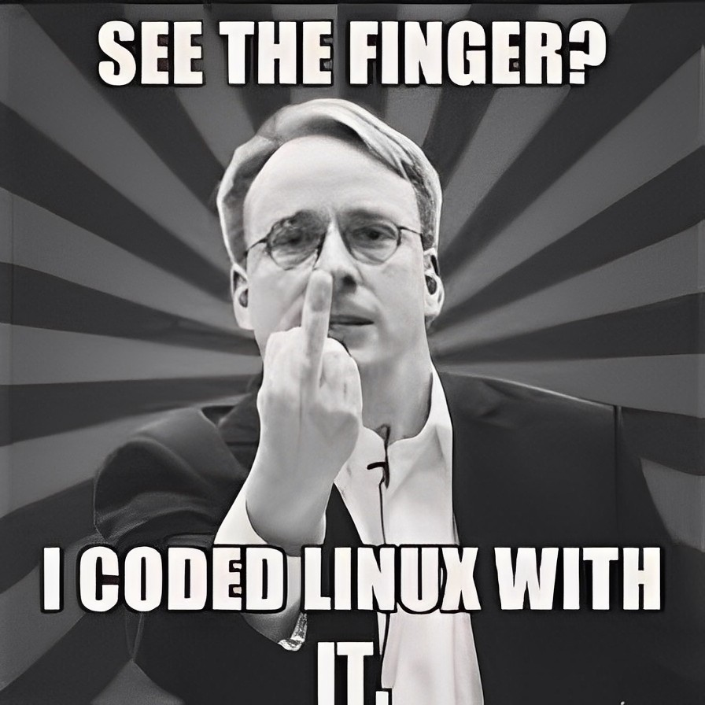
General info
~$

Slide 3
General info
~$
-> 53 years old
-> Finnish-American
-> Software engineer
-> Creator and developer of ㅤ Linux and Git

Slide 4
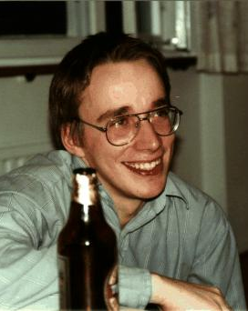
Early years
~$

Slide 5

Early years
~$
-> Lived in Helsinky
-> He was named after Linus ㅤ Pauling
-> Started programming at 11
-> Joined Finnish Navy

Slide 6

~$
Linux

Slide 7

Linux
~$
-> Began in 1991
-> Powerful command-line
-> Variety of distributions
-> GPL license

Slide 8
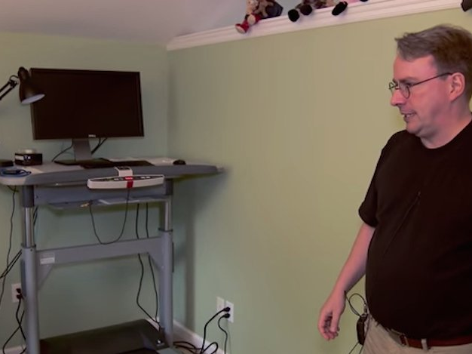
Personal life
~$

Slide 9
Personal life
~$
-> Strange habits
-> Married with 3 childs
-> Invested in Red Hat
-> Shy for public speaking

Slide 10
Quotes
~$

Slide 11
„Software is like sex: it‘s better when it‘s free.“

Slide 12
„My name is Linus, and I‘m your god“

Slide 13
The end
~$

