Slide 1
An Information-Theoretical Approach to Internal Models in a Partially Observable Markov Decision Process
By Lukas Prader
Supervisor: Alexander Vining Group: Quantum Information & Computation

Slide 2
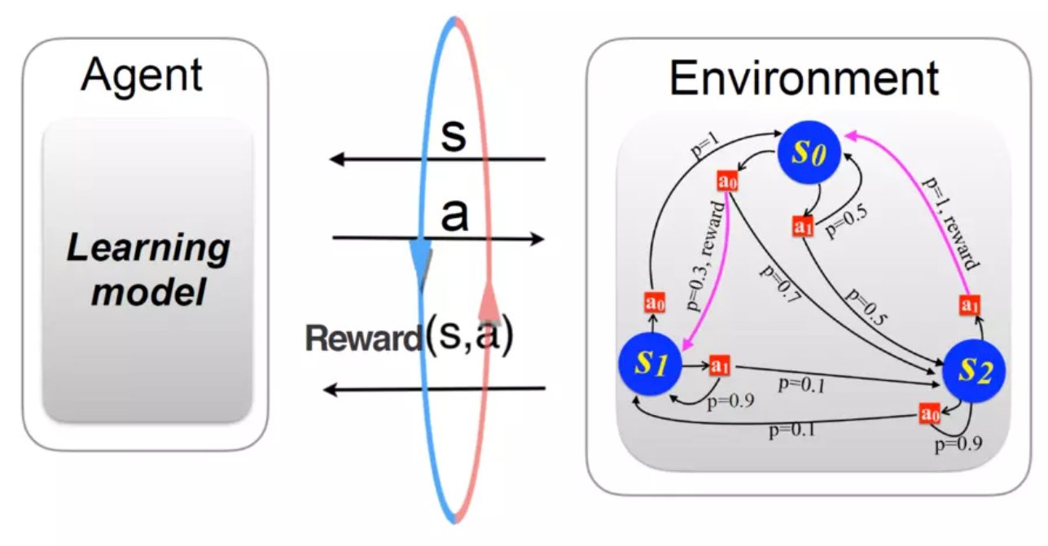
How can an agent learn about the structure of its environment?
https://www.uibk.ac.at/th-physik/qic-group/research/topics/ai-and-science/

Slide 3
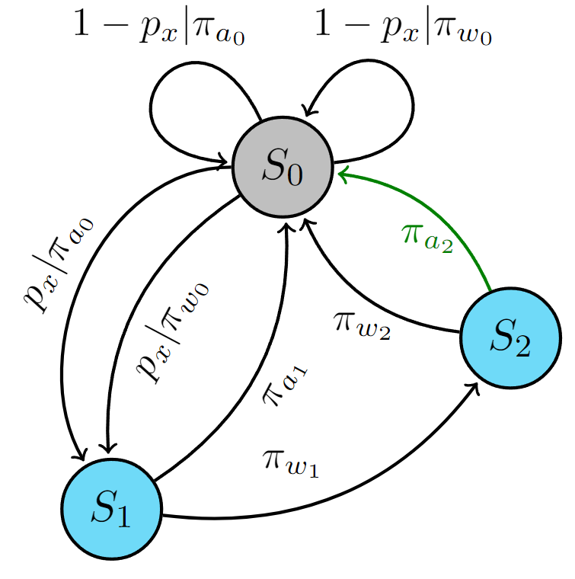
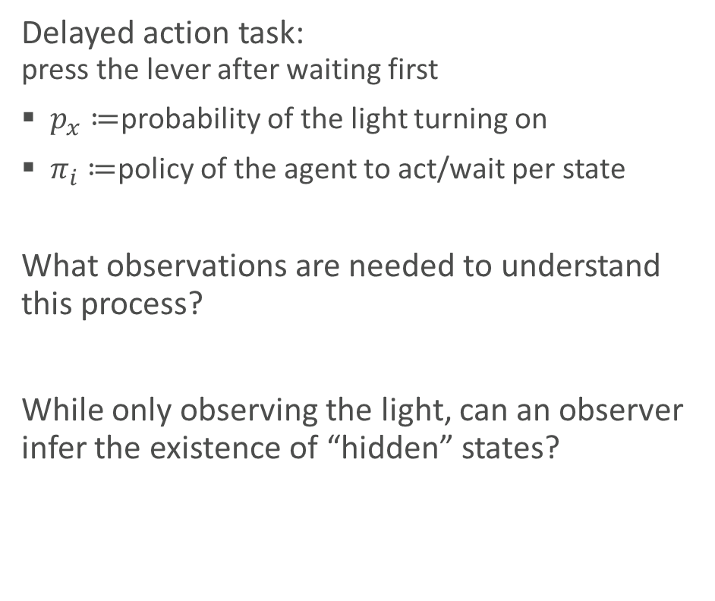
The environment as a Partially Observable Markov Decision Process
Delayed action task: press the lever after waiting first
$p_{x}≔$probability of the light turning on
$π_{i}≔$policy of the agent to act/wait per state
What observations are needed to understand this process?
While only observing the light, can an observer infer the existence of “hidden” states?

Slide 4
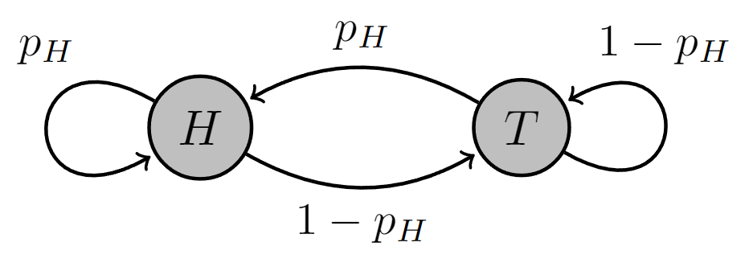

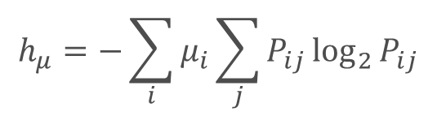
Markov Processes and Information Theory
Markov property
State transition matrix $P$
Stationary distribution $μ$:
$μ=μP$
Entropy rate $h_{μ}$:
Example, biased coin flip:
$P=\left[\begin{matrix}p_{H} & 1−p_{H} \\ p_{H} & 1−p_{H}\end{matrix}\right]$
$μ=[\begin{matrix}p_{H} & 1−p_{H}\end{matrix}]$
$h_{μ}={−[p}_{H}\log_{2}{p_{H}}+\left(1−p_{H}\right)\log_{2}\left(1−p_{H}\right)]=H\left(p_{H}\right)→$ Entropy of one flip
Use in physics:
Micro-state transitions (statistical physics)
Time evolution of quantum states
Brownian motion
Particle decay
$$h_{μ}=−\sum_{i}{μ_{i}\sum_{j}{P_{ij}\log_{2}{P_{ij}}}}$$
Cover & Thomas, Elements of Information Theory

Slide 5
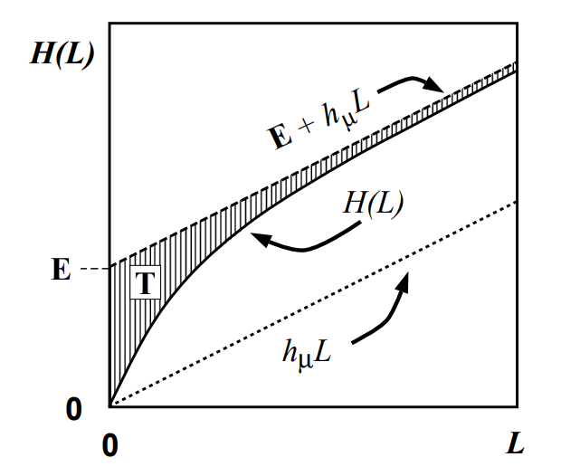
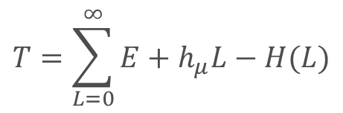
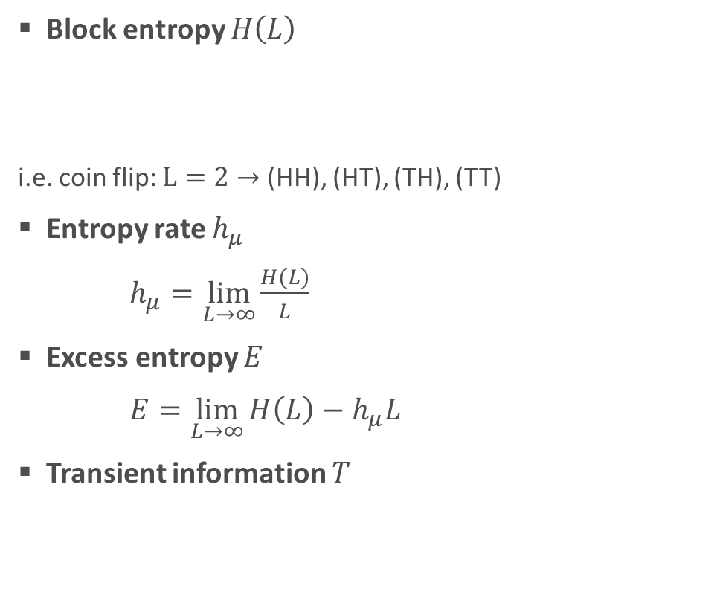
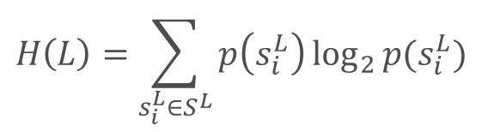
Markov Processes and Information Theory cont.
Block entropy $H\left(L\right)$
S
i.e. coin flip: $L=2→$ (HH), (HT), (TH), (TT)
Entropy rate $h_{μ}$
$h_{μ}=\lim_{L→∞}{\frac{H(L)}{L}}$
Excess entropy $E$
$E=\lim_{L→∞}{H\left(L\right)−h_{μ}L}$
Transient information $T$
Learning as “synchronization” to the environment
$$H\left(L\right)=\sum_{s_{i}^{L}∈S^{L}}{p\left(s_{i}^{L}\right)\log_{2}{p(s_{i}^{L})}}$$
$$T=\sum_{L=0}^{∞}{E+h_{μ}L−H(L)}$$
Crutchfield & Feldman, 2003

Slide 6
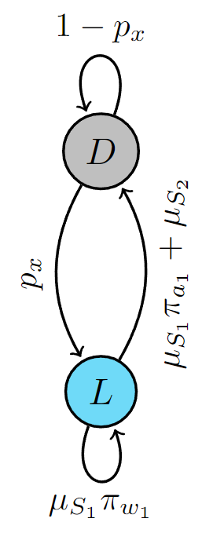
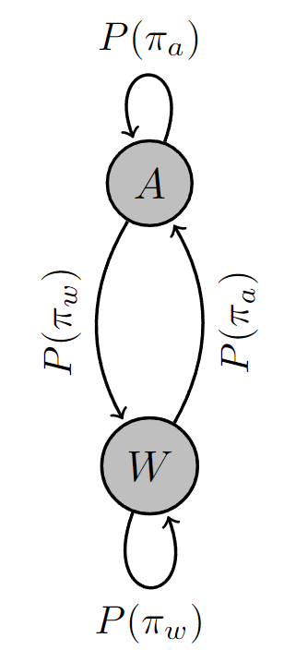
Reducing the delayed action MDP
Only parts of the process can be observed
The process is assumed to already be in stationarity
MDP MP1 MP2

Slide 7
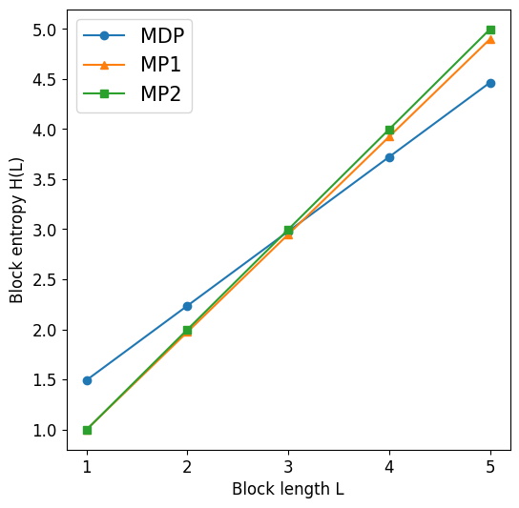

Analysing the reduced MDP
Calculate stationary distributions
Compare block entropies and entropy rates
Parameters: ${[p}_{x},π_{a0},π_{a1},π_{a2}]=[0.6, 0.5, 0.3, 0.7]$
What is wrong?

Slide 8
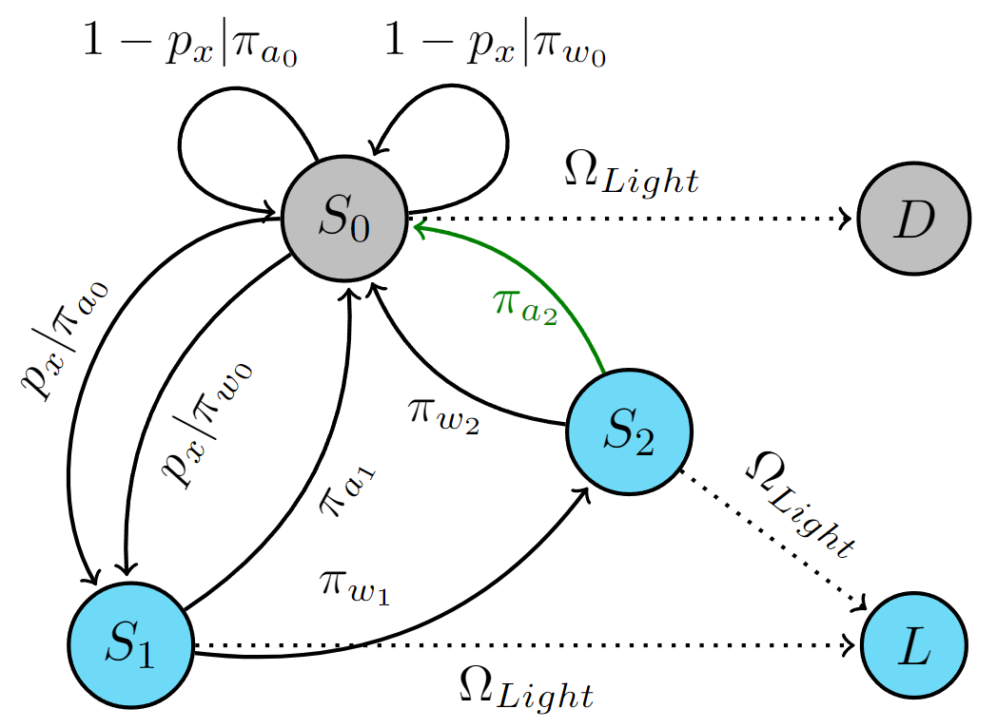
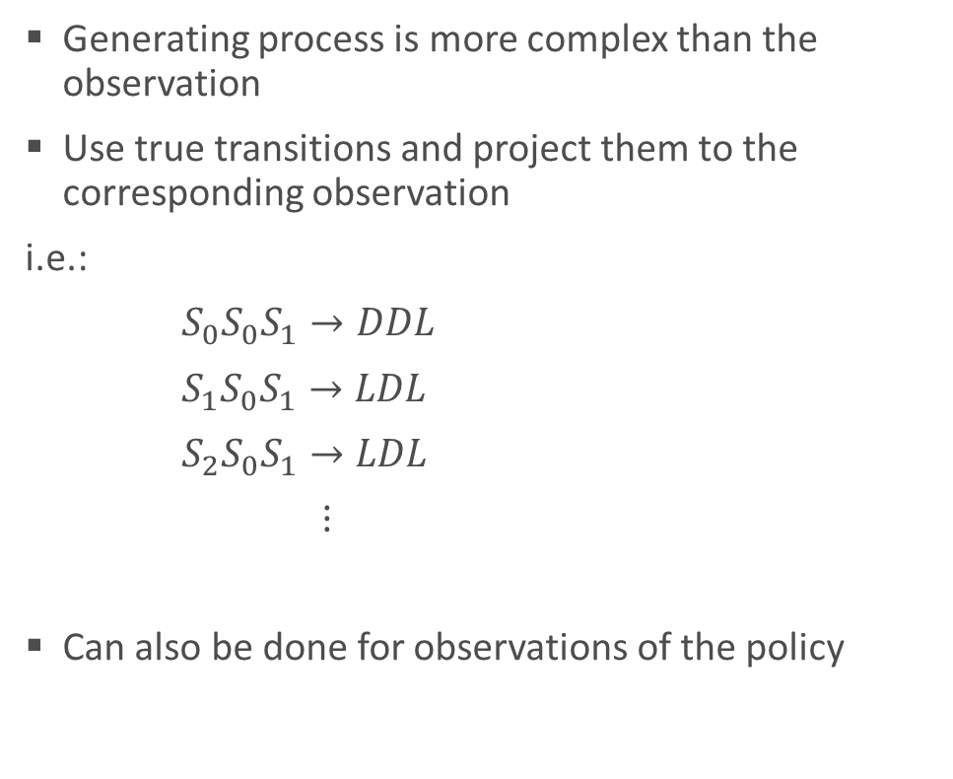
Hidden Markov Model approach
Generating process is more complex than the observation
Use true transitions and project them to the corresponding observation
i.e.:
$S_{0}S_{0}S_{1}→DDL$
$S_{1}S_{0}S_{1}→LDL$
${ S}_{2}S_{0}S_{1}→LDL$
$⋮$
Can also be done for observations of the policy

Slide 9
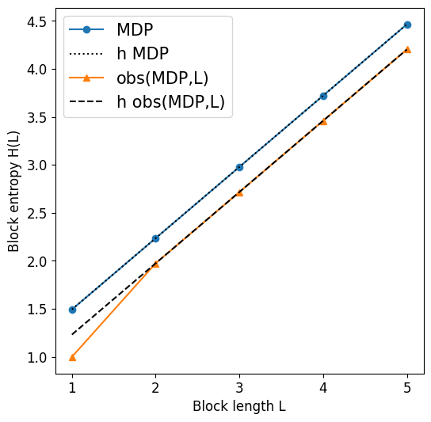
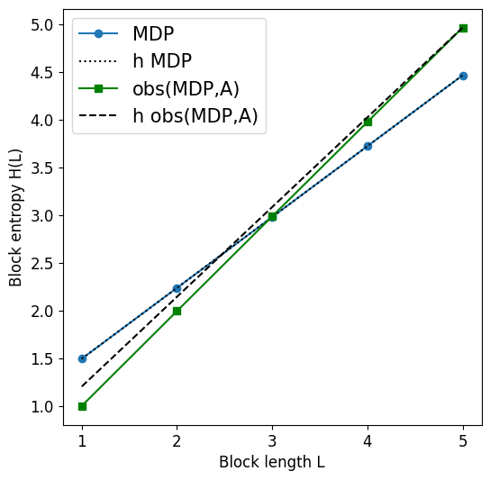
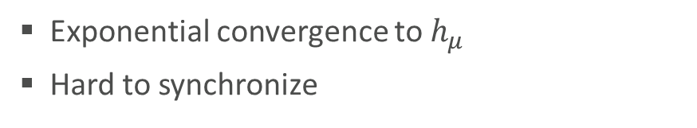
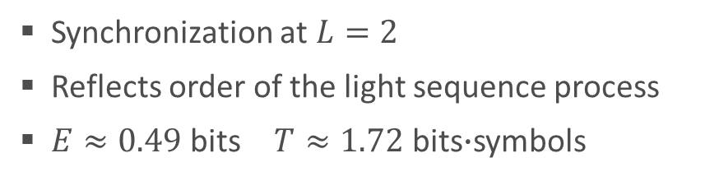
Analysing the observed MDP
Synchronization at $L=2$
Reflects order of the light sequence process
$E≈0.49$ bits $T≈1.72$ bits$∙$symbols
Exponential convergence to $h_{μ}$
Hard to synchronize

Slide 10
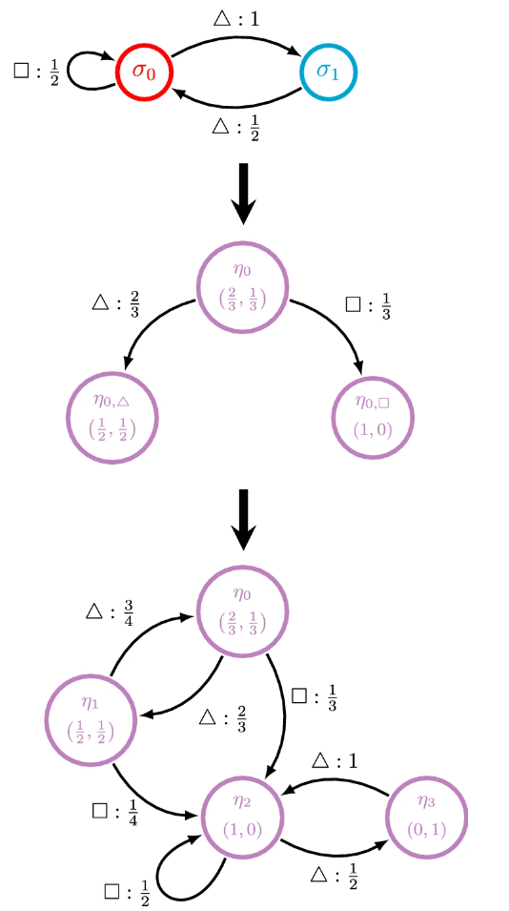
Use for internal model generation
Synchronization as an indicator for sufficient information
Creation of an “ϵ-machine” using the recurrent part of a mixed-state system
Using the information to optimize the policy, relating to reward
Jurgens & Crutchfield, 2021

Slide 11
Conclusion
The necessary length of observations for understanding the delayed action task is L=2, when observing the Light.
Information theoretical measures can be used to understand the process of internal model formation.

Slide 12
Sources
Cover & Thomas: Elements of Information Theory, 1999
Crutchfield & Feldman: Regularities Unseen, Randomness Observed: Levels of Entropy Convergence, 2003
Jurgens & Crutchfield: Shannon entropy rate of hidden Markov processes, 2021

