Slide 1





How well can you predict outcomes of scientific replication attempts?
Play now, beat your colleagues’ high score, and get your own GutheR-certificate!
How well can you predict outcomes of scientific replication attempts?
Play now, beat your colleagues’ high score, and get your own GutheR-certificate!

Slide 2
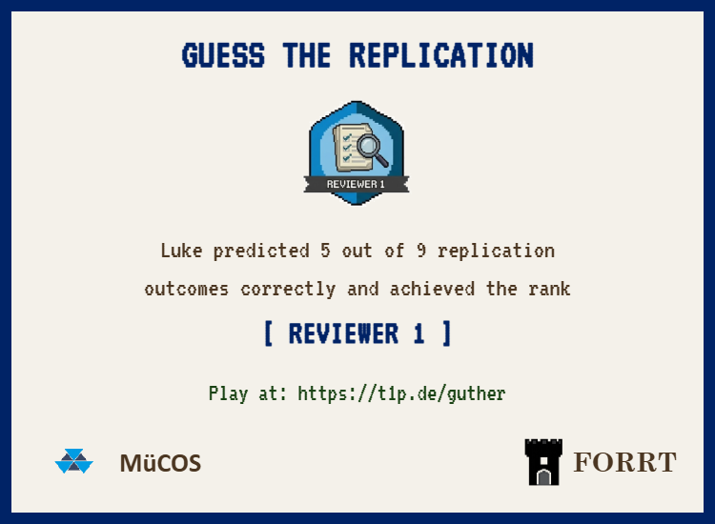
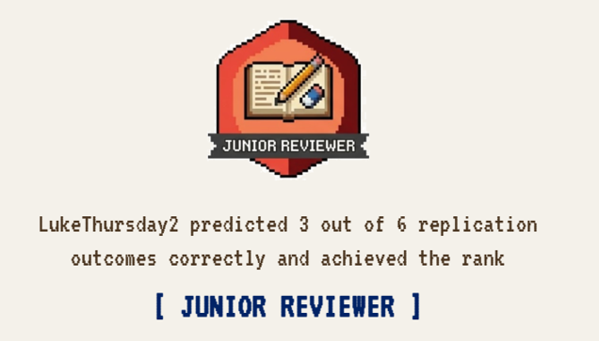
Mary predicted 5 out of 9 replication outcomes correctly and achieved the rank
Finn predicted 3 out of 6 replication outcomes correctly and achieved the rank

