Slide 1



Topology Resolution Dominates Dispatch Accuracy in District Heating Networks with industrial loads:
A Five-Level MILP Comparison
L1 - Copperplate | L2 - 7 aggregated Nodes | L3/L3⁺/L3^{NL} - 15 Nodes
HP
CHP
CHP
HP
Boiler
Boiler
Transport delay, Pressure drop,
Temperature gradient
CHP
Heat losses, Spatial structure
Boiler
HP
aggregated heat demand
Full topolpgy resolution,
Different thermo-hydraulic physics
No losses, no spatial structure
Key findings
This study isolated 5 modeling dimensions for DH dispatch (topology and thermo-hydraulics). Casestudy for a heating grid (12MW, 8760h) and 36 synthetic grids.
topology dominates thermo-hydraulics
Copperplate underestimate cost by 13%
cumulative cost deviation from L1
74 t CO₂
underestimated
+ 13,0%
+ 13,1%
+ 13,5%
+ 10,5%
CO₂
L1 | L2 | L3 | L3⁺ | L3^{NL}

Slide 2
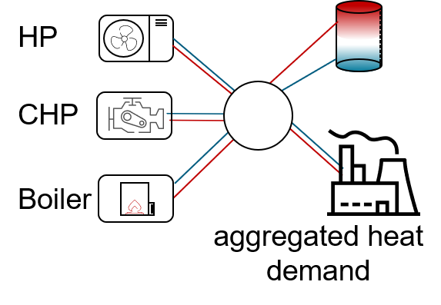
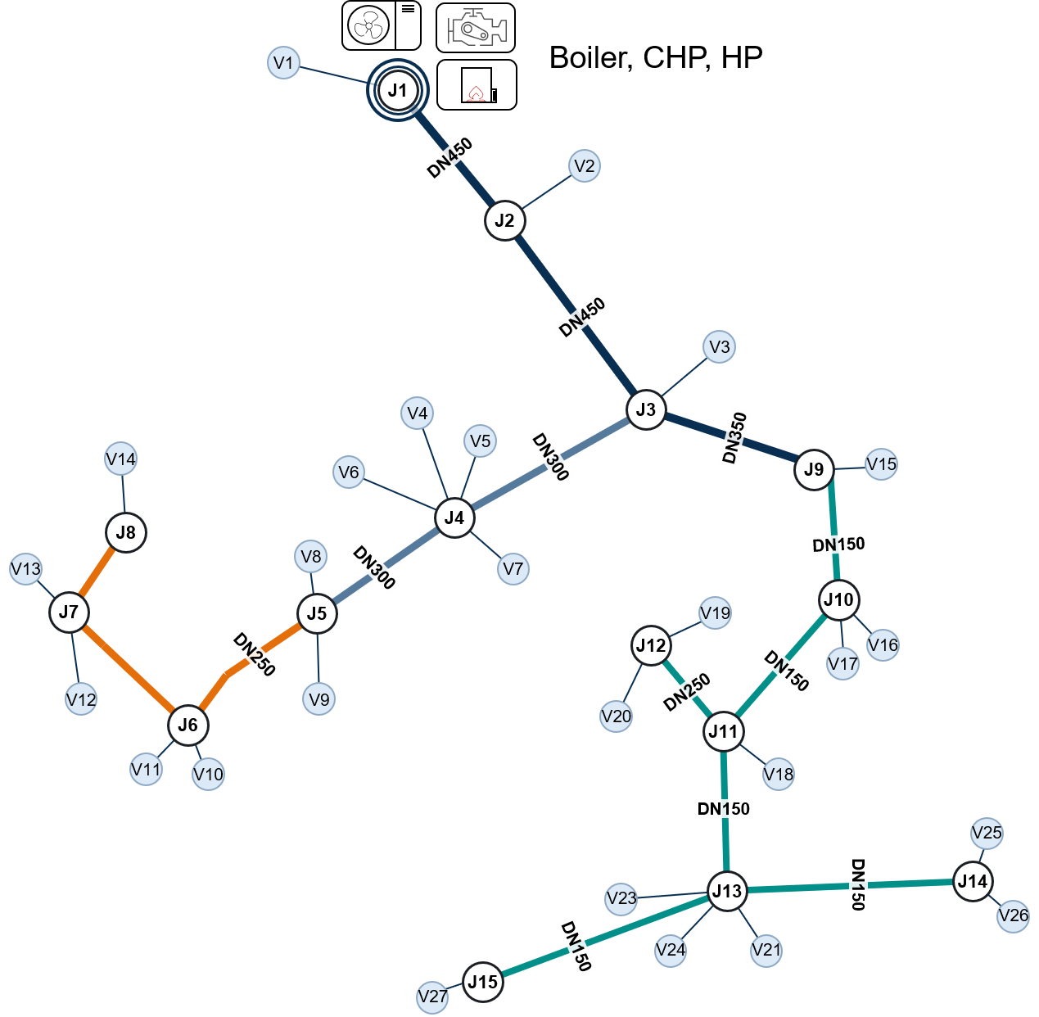
Estimation Bias versus Decision Regret in industrial District-Heating Dispatch Optimisation
CP - Copperplate | ZN - 7 aggregated Zones | L1/L2/L3 - 15 Nodes | L4/L5/L6 - 174 Stations
Loss visibility
Spatial topology
Loss and topology interaction
Tem.p propagation
Pres. drop & pumping
Station res.
Dynamic pressure
Trans. delay
Key Findings: Loss visibility, not spatial layout, is decisive: the copperplate-to-detailed cost gap is 95.8 % a loss effect and only 4.7 % a topology effect. On operating cost a copperplatescores -15.1 % against the detailed model, but +46.1 % once its schedule is run: a biased estimatorand an unreliable controller at once.

Slide 3
Estimation Bias versus Decision Regret in industrial District-Heating Dispatch Optimisation
CP - Copperplate | ZN - 7 aggregated Zones | L1/L2/L3 - 15 Nodes | L4/L5/L6 - 174 Stations
Key Findings: Loss visibility, not spatial layout, is decisive: the copperplate-to-detailed cost gap is 95.8 % a loss effect and only 4.7 % a topology effect. On operating cost a copperplatescores -15.1 % against the detailed model, but +46.1 % once its schedule is run: a biased estimatorand an unreliable controller at once.

