Slide 1
Tabular-Model for Financial Reporting
https://github.com/LukasSteindl/tabularmodelforfinance
Custom Workshop
Lukas Steindl, 16.10.2020
Notes:
Vergleich Tabular Model und Multidimensional Modelling (Vorteile, Nachteile, Limitierungen)
Row Level Security im SQL Server und im Tabular Model
Direct Query Vs InMemory
Processing Options
Deployment Optionen (OnPrem Dienst / Azure)
Eine kurze Einführung in DAX

Slide 2
Agenda
Comparing Tabular Model (InMemory) to Multidimensional Modelling (MOLAP)
dynamic row level security
Direct Query vs Inmemory
Processing Options
Deployment
Short Introduction to DAX

Slide 3
Comparing Tabular Model (InMemory) to Multidimensional Modelling (MOLAP)
Tabular-Model for Financial Reporting
Custom Workshop
Lukas Steindl, 16.10.2020
Notes:
Vergleich Tabular Model und Multidimensional Modelling (Vorteile, Nachteile, Limitierungen)
Row Level Security im SQL Server und im Tabular Model
Direct Query Vs InMemory
Processing Options
Deployment Optionen (OnPrem Dienst / Azure)
Eine kurze Einführung in DAX
https://docs.microsoft.com/en-us/analysis-services/comparing-tabular-and-multidimensional-solutions-ssas?view=asallproducts-allversions

Slide 4
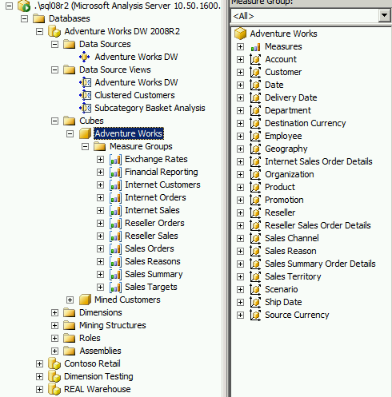
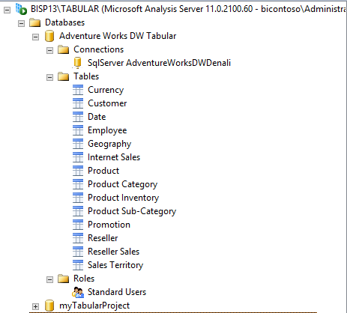
Tabular Model vs Multidimensional Model
Notes:
Tabular model hat eigentlich nur Tabellen, Beziehungen, Measure Definitionen, Calculated Columns und Calculation Groups

Slide 5
Development
Tabular Model
Speaks DAX and MDX (for Queries)
Requires clean single column surrogate keys
No Dimensions, no Members, Model consists of tables and relationships
Uses Filters instead of using Hierarchies
Multidimensional Model
Speaks MDX only
Can also work with composite keys
Model defines a multidimensional space
Hierarchies & Scope are critical concepts
Notes:
Some people say DAX is easier than MDX. That’s probably true regarding simple things. More complex things are also hard to implement.
Scope in MD tells you what filter is in context that allows you to compute a different measure

Slide 6
Scalability
Tabular Model
Can Store Large Amounts of Data
In-Memory Technology
No Aggregations. Column-Based Storage.
Data Compression 10x
Multidimensional Model
Can Store Very Large Amounts of Data
Pre-Aggregated Data From Disk
Uses Aggregations to Increase Query Performance
Data Compression 3x

Slide 7
Performance
Tabular Model
will perform faster in general
Does not Require a Great Deal of Performance Tuning
Great for Low Granularity Data analysis
Multidimensional Model
Pre-Aggregated Data From Disk
Uses Aggregations to Increase Query Performance
Sometimes Faster than Tabular When pulling data from warm Cache
Notes:
As the tabular model holds all data compressed in memory (in a very cache optimized format) it usually performs much faster than Multidimensional model.
Also the multidimensional Model holds Data in Memory.
Accessing leave levels of hierarchies often requires IO. Multidimensional models are based on the concept of hierarchies and preaggregated data along these hierarchies.
That’s not the case in Tabular model – that is just a column store engine that can do very fast scans, late materialization, etc.

Slide 8
dynamic row level security
Tabular-Model for Financial Reporting
Custom Workshop
Lukas Steindl, 16.10.2020
Notes:
Vergleich Tabular Model und Multidimensional Modelling (Vorteile, Nachteile, Limitierungen)
Row Level Security im SQL Server und im Tabular Model
Direct Query Vs InMemory
Processing Options
Deployment Optionen (OnPrem Dienst / Azure)
Eine kurze Einführung in DAX

Slide 9
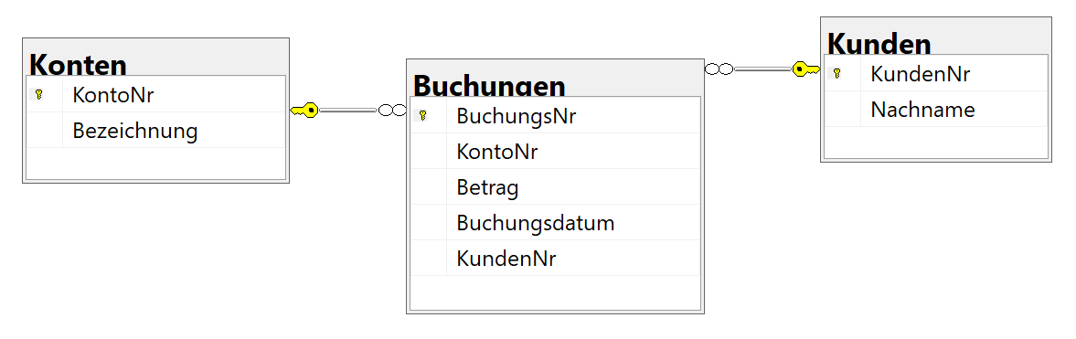
Operatives Systeme
Filiale Purbach
Filiale Bruck

Slide 10
Beispielbuchungen
Create Database BankPurbach
GO
Use BankPurbach
GO
Create Table Kunden (KundenNr int primary key identity, Nachname varchar(255))
Insert Into Kunden values ('Mayer'), ('Huber')
Drop Table if exists Konten
Create Table Konten (KontoNr int primary key identity, Bezeichnung varchar(255))
Insert Into Konten Values ('Anlagevermögen')
Insert Into Konten Values ('Barmittel')
Insert Into Konten Values ('Beteiligungen')
Insert Into Konten Values ('Forderungen Kreditnehmer')
Insert Into Konten Values ('Verbindlichkeiten Kreditnehmer')
Insert Into Konten Values ('Zinsertrag')
Insert Into Konten Values ('Eigenkapital')

Slide 11
Beispielbuchungen
Create Table Buchungen (BuchungsNr int primary key identity, KontoNr int references Konten, Betrag int, Buchungsdatum date, KundenNr int references Kunden)
--vergabe eines Kredits: Buchungssatz Forderungen Kreditnehmer an Verbindlichkeiten Kreditnehmer:
Insert Into Buchungen values (4,3500, '2020-01-01',1)
Insert Into Buchungen values (5,-3500,'2020-01-01‘,1)
--auszahlung eines Kredits Verbindlichkeit Kreditnehmer an Barmittel
Insert Into Buchungen values (5,3500, '2020-01-01',1)
Insert Into Buchungen values (2,-3500,'2020-01-01',1)
--Zinsertrag: Forderung an Zinsertrag
Insert Into Buchungen values (5,300, '2020-06-30',1)
Insert Into Buchungen values (6,-300,'2020-06-30',1)

Slide 12
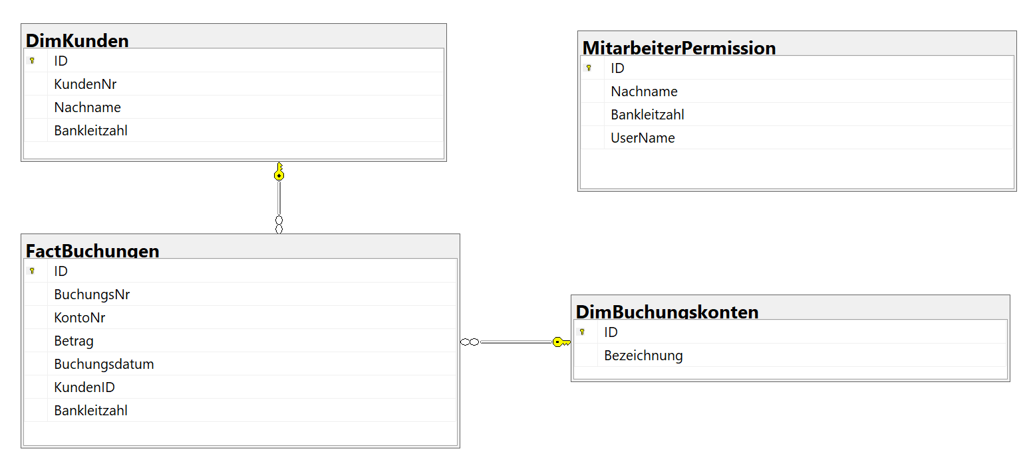
Relationales Datawarehouse

Slide 13
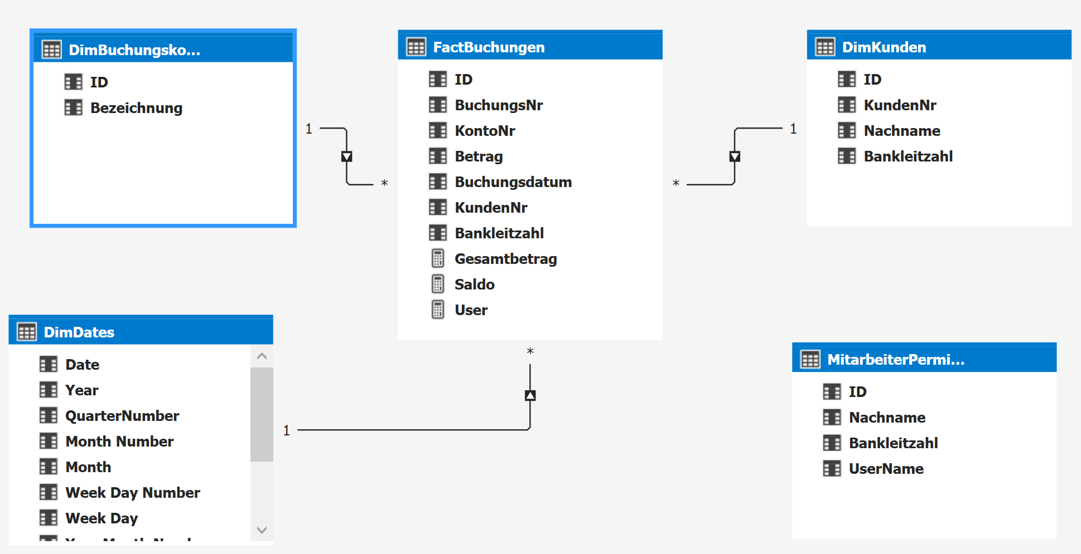
Tabular Model

Slide 14
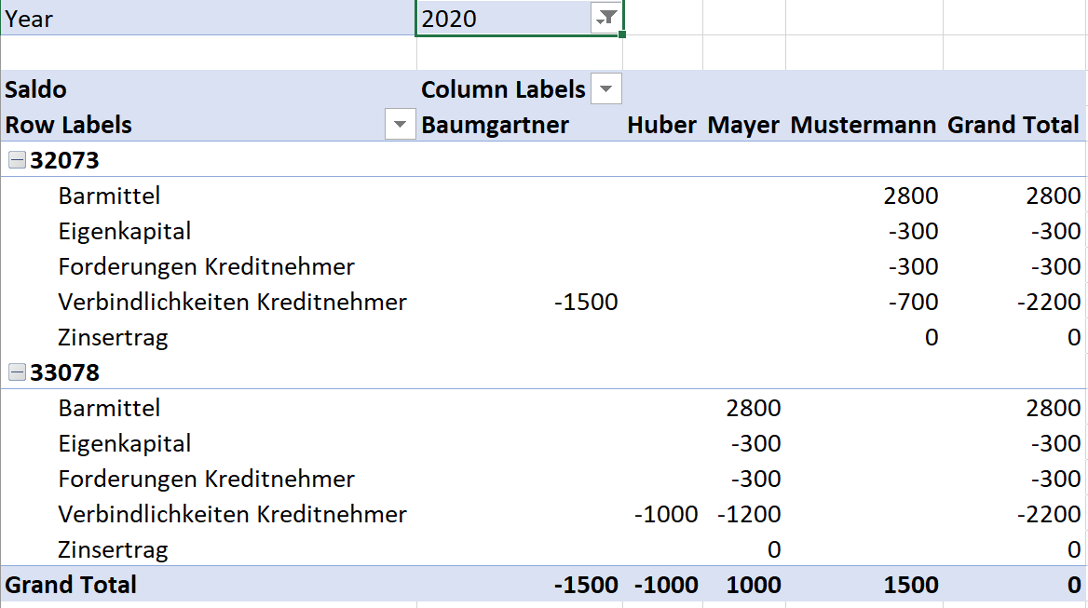
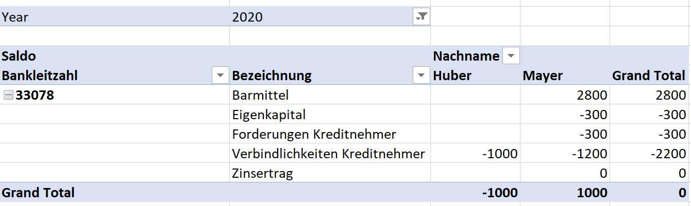
Implementing Row Level Security in TM
Beispielanforderung: Es sollen Bankangestellte nur auf Daten ihrer jeweiligen Filiale zugreifen können
Eingeschränkte Sicht

Slide 15
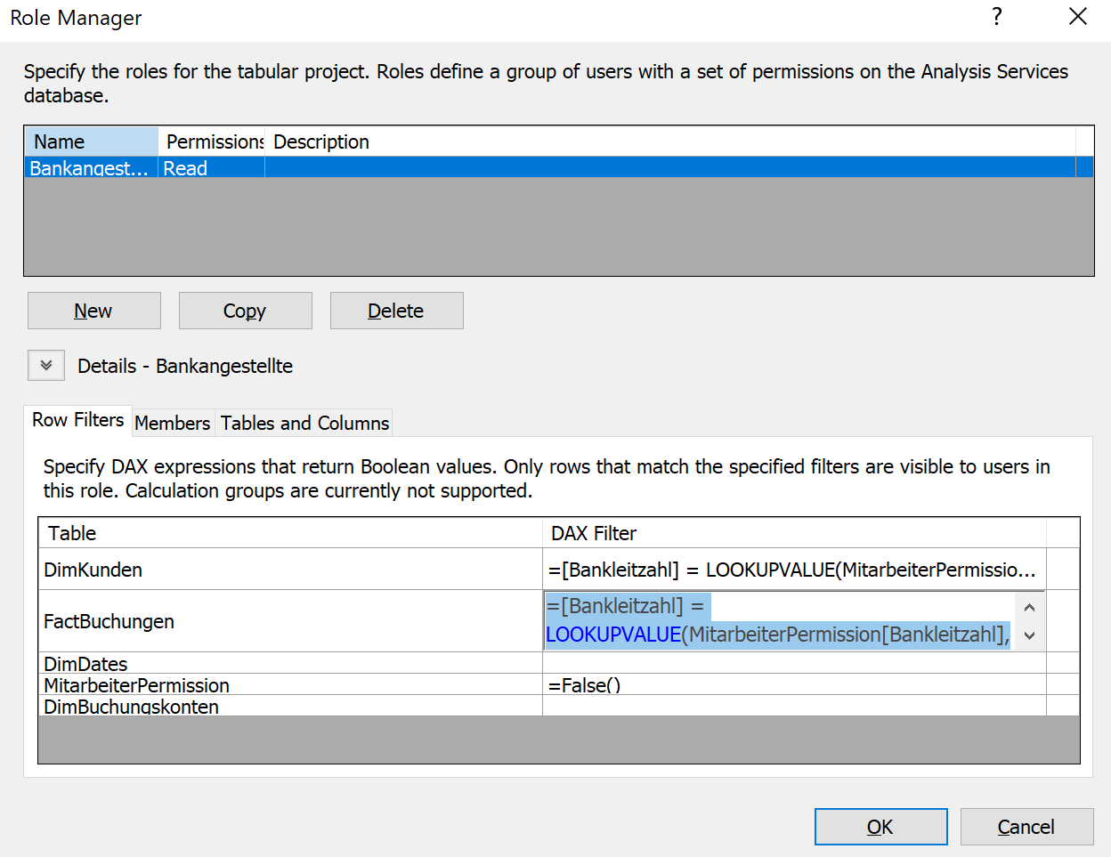
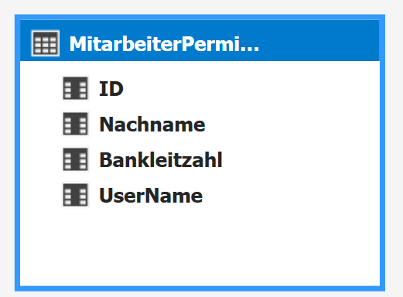
Implementing Row Level Security in TM
Lösung:
Abbildung der Organisationsstruktur in einer Tabelle
Anlegen einer Rolle „Bankangestellter“ im Tabular Model
Dax-Ausdruck der die lesbaren Zeilen für den aktuellen Benutzer auf TRUE evaluiert

Slide 16
Implementing Row Level Security in TM
Lösung:
Abbildung der Organisationsstruktur in einer Tabelle
Anlegen einer Rolle „Bankangestellter“ im Tabular Model
Dax-Ausdruck der die lesbaren Zeilen für den aktuellen Benutzer auf TRUE evaluiert
=[Bankleitzahl] = LOOKUPVALUE(MitarbeiterPermission[Bankleitzahl], MitarbeiterPermission[UserName], USERNAME())

Slide 17
Implementing Row Level Security in SQL Server
CREATE SCHEMA Security;
GO
Create FUNCTION Security.fn_securitypredicate(@BLZ AS int)
RETURNS TABLE
WITH SCHEMABINDING
AS
RETURN
SELECT 1 as 'fn_securitypredicate' where exists
(Select 1 from dbo.MitarbeiterPermission
where UserName = USER_NAME() and Bankleitzahl = @BLZ
or USER_NAME() = 'dbo'
)
;
GO
Notes:
https://docs.microsoft.com/en-us/sql/relational-databases/security/row-level-security?view=sql-server-ver15

Slide 18
Implementing Row Level Security in SQL Server
CREATE SECURITY POLICY OnlyWithSameBLZ
ADD FILTER PREDICATE Security.fn_securitypredicate(Bankleitzahl)
ON dbo.FactBuchungen
WITH (STATE = ON);
Notes:
https://docs.microsoft.com/en-us/sql/relational-databases/security/row-level-security?view=sql-server-ver15

Slide 19
Demo!
Notes:
User: Sa
Passwort: demo

Slide 20
Direct Query vs Inmemory
Tabular-Model for Financial Reporting
Custom Workshop
Lukas Steindl, 16.10.2020
Notes:
Vergleich Tabular Model und Multidimensional Modelling (Vorteile, Nachteile, Limitierungen)
Row Level Security im SQL Server und im Tabular Model
Direct Query Vs InMemory
Processing Options
Deployment Optionen (OnPrem Dienst / Azure)
Eine kurze Einführung in DAX

Slide 21
Direct Query vs Inmemory
InMemory-Mode loads all records to a columnar-datastructure in Memory
New Data only after processing
Much faster at query time & more features supported
Direct Query Mode speaks to the datasource on every model interaction
E.g eg Filter action in the front-end causes a SQL-Statement (in case of SQL-Backend) to be generated and executed
Similar to Multidimensional ROLAP
Advantage – Near Realtime Reporting possible
Disadvantage – can get slow if the backend-performs poor.

Slide 22
Direct Query vs Inmemory
InMemory-Mode loads all records to a columnar-datastructure in Memory
New Data only after processing
Much faster at query time & more features supported
Direct Query Mode speaks to the datasource on every model interaction
E.g eg Filter action in the front-end causes a SQL-Statement (in case of SQL-Backend) to be generated and executed
Similar to Multidimensional ROLAP
Advantage – Near Realtime Reporting possible
Disadvantage – can get slow if the backend-performs poor.
Combination-Modes where Client may decide:
DirectQuery With In-Memory and In-Memory With DirectQuery
Notes:
One advantage of using a hybrid mode is that you can serve clients that issue MDX queries (most of them) and clients that issue DAX queries (Crescent) from the same model. In Denali, only clients that issue DAX queries can use DirectQuery. Clients such as Excel which issue MDX queries must fetch results from the VertiPaq cache.
One disadvantage – if you have a hybrid mode, you must process the database. If your data doesn’t fit in memory, you have a problem.
The connection string you would use in Excel is something like:
Provider=MSOLAP.5;Integrated Security=SSPI;Persist Security Info=True;Data Source=.;Initial Catalog=DirectQuery test;DirectQueryMode=InMemory;

Slide 23
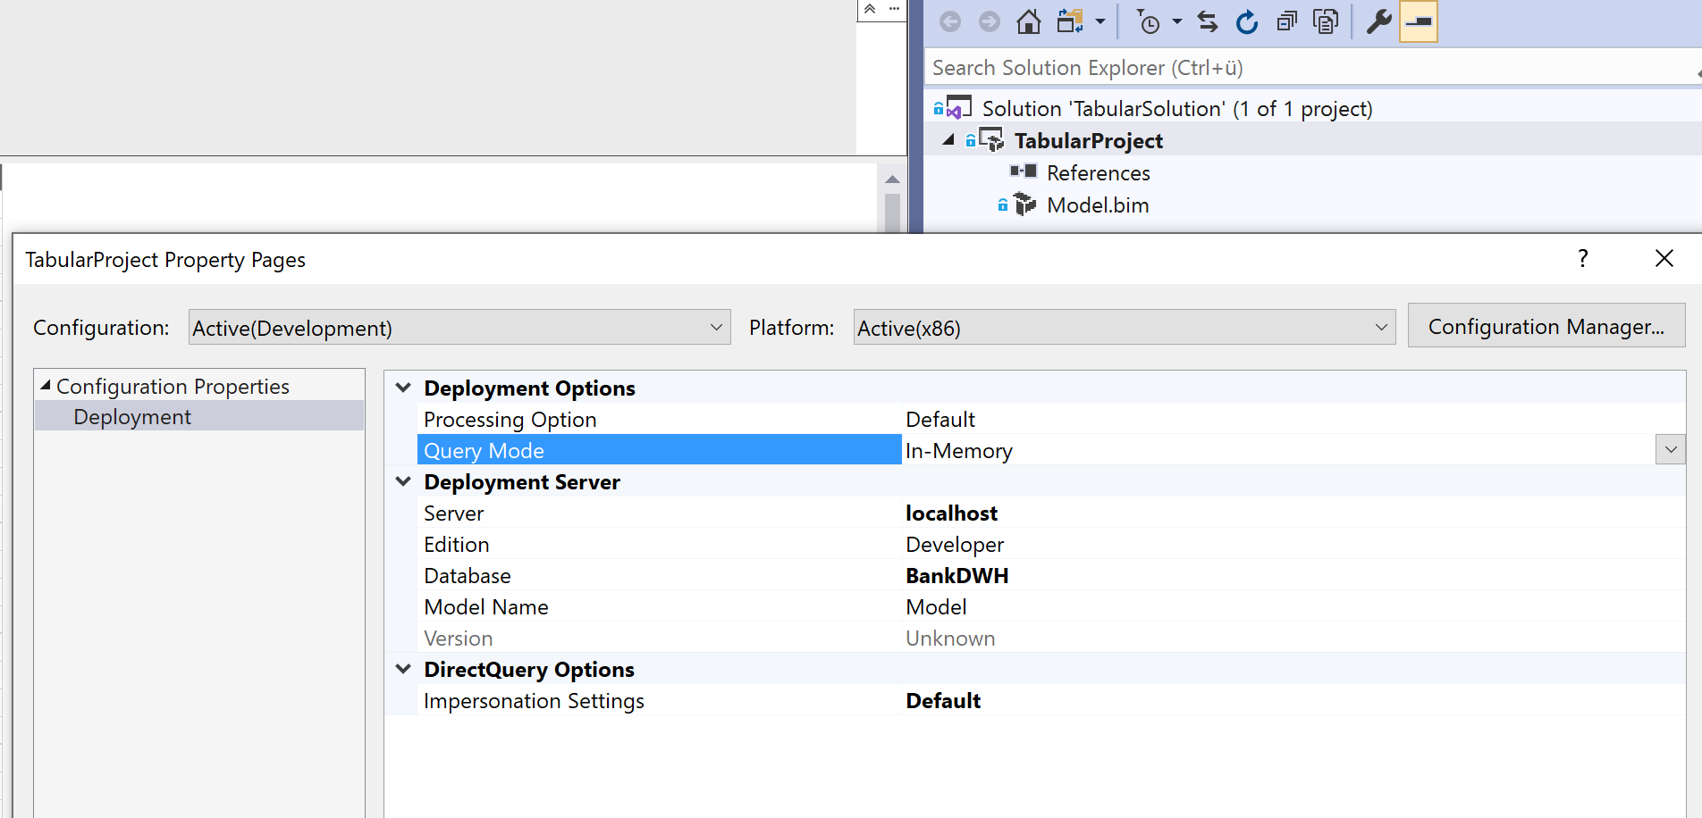

Slide 24
Processing Options
Tabular-Model for Financial Reporting
Custom Workshop
Lukas Steindl, 16.10.2020
Notes:
Vergleich Tabular Model und Multidimensional Modelling (Vorteile, Nachteile, Limitierungen)
Row Level Security im SQL Server und im Tabular Model
Direct Query Vs InMemory
Processing Options
Deployment Optionen (OnPrem Dienst / Azure)
Eine kurze Einführung in DAX

Slide 25
Processing Options
Processing possible at 3 Levels of granularity
Processing Option | Database | Table | Partition
Process Add |  |  | Not in UI
Process Clear | Available | Available | Available
Process Data |  | Available | Available
Process Default | Available | Available | Available
Process Defrag | Not in UI | Available
Process Full | Available | Available | Available
Process Recalc | Available
Notes:
The Process Full operation at a database level is the easiest way to refresh all the tables and the related structures of a Tabular model inside a transaction so that the existing data is queryable during the whole process, and new data will not be visible until the process completes.
Process Add
The Process Add operation adds new rows to a partition.
Can be used only in a programmatic way;
And you must specify the query returning only new rows that have to be added to the partition.
Process Clear
Process Clear drops all the data in the selected object (Database, Table, or Partition). The affected objects are no longer queryable after this command.
Process Data
Process Data loads data in the selected object (Table or Partition).
Only the dictionary is computed, and dependently related structures (calculated columns, relationships, and indexes) are not updated.
The affected objects are no longer queryable after this command.
After Process Data, you should execute Process Recalc or Process Default to make the data queryable.
Process Default
The Process Default operation performs the necessary operations to make the target object queryable (except when it is done at Partition level)
Process Defrag
The Process Defrag operation rebuilds the table dictionary without the need to access the data source to read data again.
It is exposed in the SSMS user interface only for tables.
This operation is useful only when you remove partitions from your table or you refresh some partitions and, as a result, some values in columns are no longer used.

Slide 26
Deployment
Tabular-Model for Financial Reporting
Custom Workshop
Lukas Steindl, 16.10.2020
Notes:
Vergleich Tabular Model und Multidimensional Modelling (Vorteile, Nachteile, Limitierungen)
Row Level Security im SQL Server und im Tabular Model
Direct Query Vs InMemory
Processing Options
Deployment Optionen (OnPrem Dienst / Azure)
Eine kurze Einführung in DAX

Slide 27
Deployment
Analysis Services on Premise
Analysis Services Service in Azure
https://youtu.be/m1jnG1zIvTo?t=325
Power BI Premium Service
https://docs.microsoft.com/en-us/analysis-services/deployment/deploy-from-visual-studio-tabular?view=asallproducts-allversions
https://docs.microsoft.com/en-us/azure/analysis-services/analysis-services-gateway-install?tabs=azure-portal
Notes:
https://docs.microsoft.com/en-us/azure/analysis-services/analysis-services-gateway-install?tabs=azure-portal

Slide 28
Short Introduction to DAX
Tabular-Model for Financial Reporting
Custom Workshop
Lukas Steindl, 16.10.2020
Source: Definite Guide to Dax – Marco Russo & Alberto Ferrari

Slide 29
Syntax
To reference a column in a table Sales
‘Sales’[Amount]
To define a calculated Column Sales[GrossMargin] = …
To reference a Measure
[Sales Amount]
To define a new Measure [Sales Amount] := SUM(‘Sales’[Amount])
Comments with // or –
Notes:
Die Hochkomma kann man sich beim Tabellen namen sparen wenn keine Leerzeichen drinnen sind
Quantity ist der Spaltenname

Slide 30
Dax operators
Precedence order and grouping of arguments: ()
Arithmetic: +, -, *, /
Comparison: =, <, >, <=, =>
Text Concatination: &
Logical: &&, ||, IN, NOT

Slide 31
Data Types and type handling
Try to guess the resulting data type:
= Sales[Order Date]+7
= Sales[Unit Price] > Sales[Unit Cost]
= IF([measure] > 0, 1, “N/A”)
= “10” + 32
=“10” & 32
Integer
Decimal
Currency
Datetime
Boolean
String
Variant
Binary

Slide 32
Empty or Missing Values
Both handled as BLANK
Not a real value
Different from empty String
BLANK() function can be used in Expressions
=IF(Sales[DiscountPerc] = 0, BLANK(), Sales[DiscountPerc]*Sales[Amount])
BLANK() = 0 returns TRUE as well as BLANK() = “”
BLANK() * 10 = BLANK()
BLANK() + 10 = 10
TRUE && BLANK() = FALSE
TRUE || BLANK () = TRUE

Slide 33
Calculated Columns vs Measures
Stored in Memory
Can be used as Fields in a pivot table
Uses the current row as context
Example:
Sales[GrossMargin] = Sales[SalesAmount] – Sales[TotalProductCost]
Evaluated at runtime
Can be used as values in a pivot table
always Operates on aggregations of data under an evaluation context
Example:
GrossMargin :=
SUM(Sales[SalesAmount]) – SUM(Sales[TotalProductCost])

Slide 34
Evaluation Context
Row Context
Filter Context
“The filter context filters the model the row context iterates one table.”

Slide 35
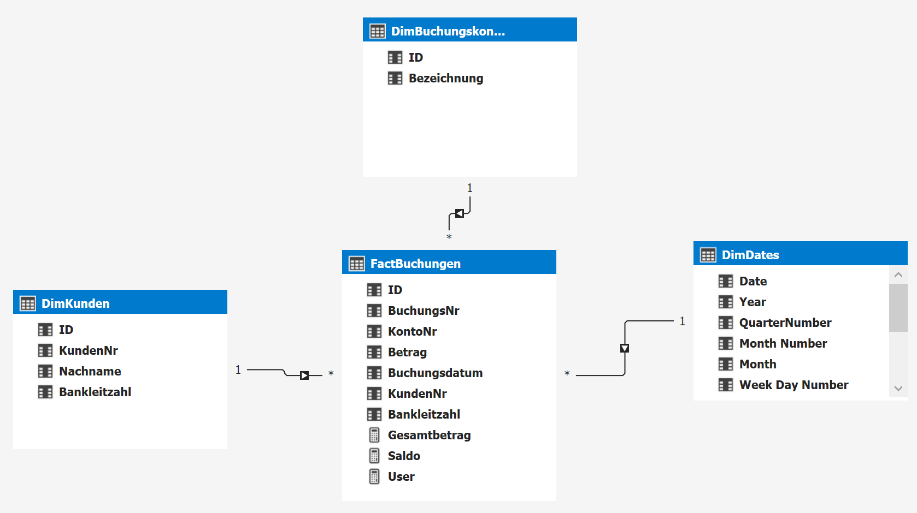
Looking at our example again…

Slide 36
Row Context
is an iterator (like a cursor)
It scans a table and for each row allows an expression to access each column in that row.
Example Expression:
= if ([Bankleitzahl] = 33078; "Purbach";"Bruck")
Besides calculated columns in tables also many functions create iterators (row contexts)!
For example all aggregators like SUM (, MIN, MAX, AVG,…) that is syntax sugar for SUMX (<table>, ‘table‘[Column])

Slide 37
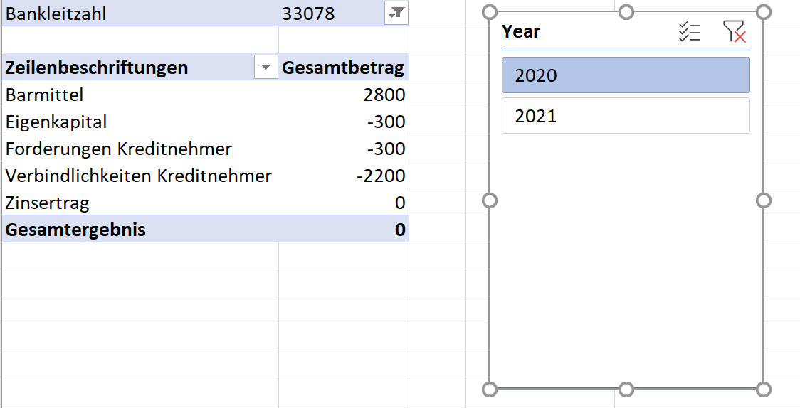
Filter Context
Filter Context for this cell:
From Table DimBuchungskonten tuple: Column Bezeichnung: “Eigenkapital”
From Table FactBuchungen Column Bankleitzahl: 33078
From table DimDates Column Year: 2020
Filter Context for this cell:
From Table FactBuchungen Column Bankleitzahl: 33078
From table DimDates Column Year: 2020

Slide 38
CALCULATE to overwrite the FILTER-Context
CALCULATE (Experession, Filtercondition)
Eigenkapital:= CALCULATE([Gesamtbetrag];'DimBuchungskonten'[Bezeichnung] = "Eigenkapital")*-1

Slide 39
Calculation Groups
To define generic calculation
Can be seen as a template where the measure gets replaced at querytime.
Example:
Timeintelligence
Calculation Item: Current - Expression: SELECTEDMEASURE()
Calculation Item: LY – Expression: CALCULATE(SELECTEDMEASURE();PREVIOUSYEAR('DimDates'[Date]))

Slide 40
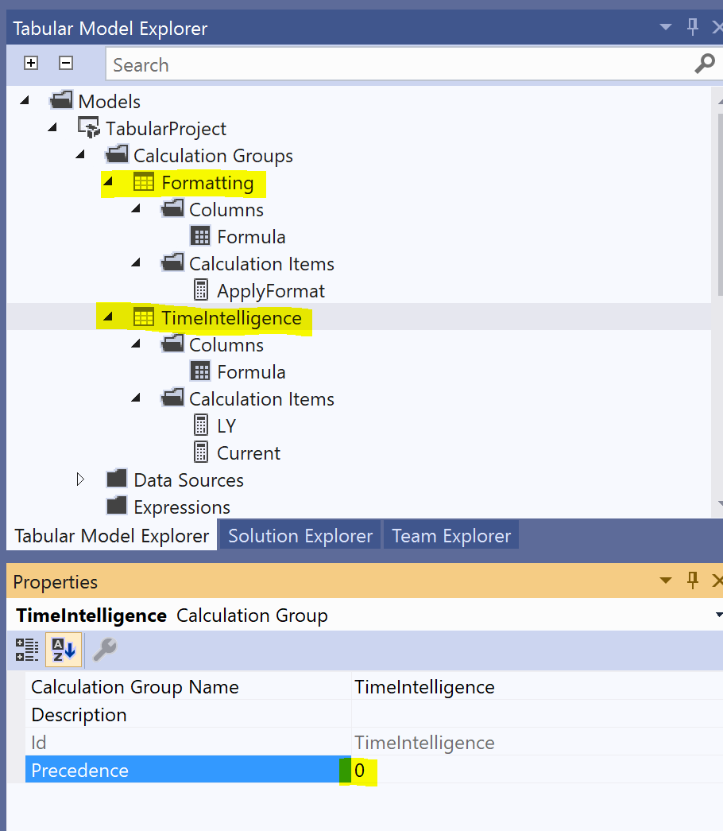
Combinations of Calculation Groups are possible
Consider precedence property!

Slide 41
Demo – Reporting Services
Calling the model with DAX
Calling the model with MDX

