Slide 1

PSY4013 Seminars
Week 3: Thinking & writing
Lukas Wallrich (l.wallrich@gold.ac.uk) | October 2020 .
Notes:
Content first – find something you want to communicate

Slide 2
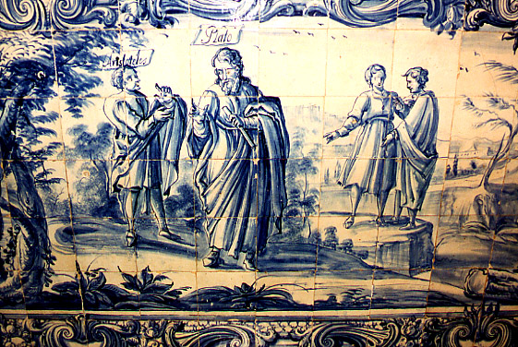
Thinking helps
In global affairs: The March of Folly: from Troy to Vietnam
In democratic politics (pick your own examples)
In the academy:
In life.

Slide 3
Critical thinking is not about …
… being smart
… being always right
It is about:
Habits that can be practiced
Baron’s (1996) actively open-minded thinking
“In good thinking:
search is sufficiently thorough for the question;
search and inference are fair to all possibilities under consideration [including ones other than our initial/preferred position]; and
confidence is appropriate to the amount of search that has been done and the quality of the inferences made.”

Slide 4

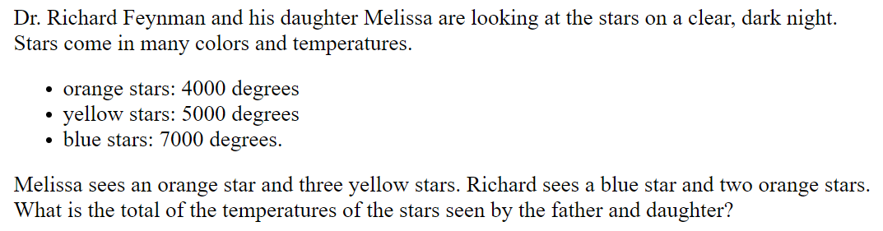

Assumptions and selective reporting
Is Edinburgh above Manchester?

Slide 5
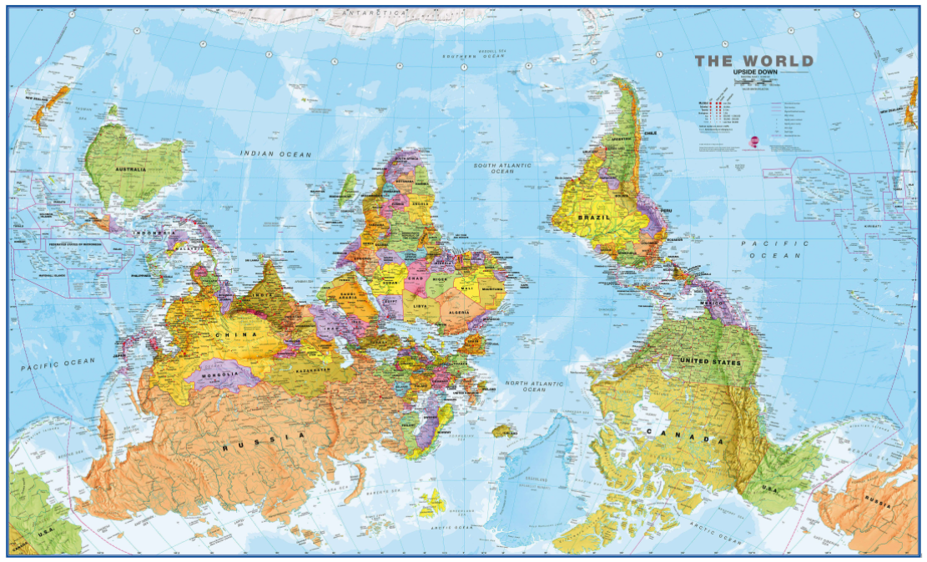


Slide 6
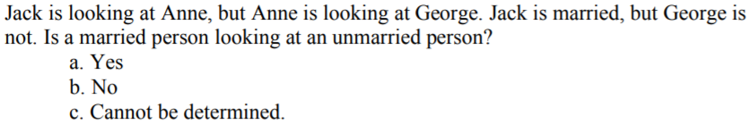
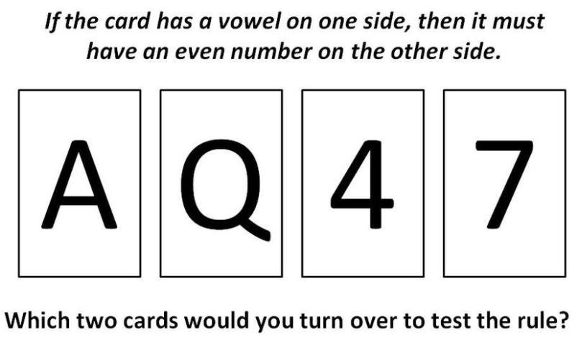
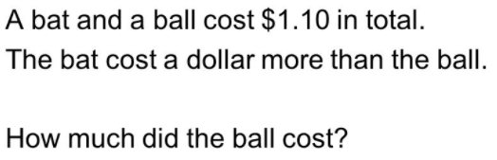
Three little quizzes

Slide 7
Explore this further
Thinking is hard. https://magazine.utoronto.ca/research-ideas/culture-society/why-people-are-irrational-kurt-kleiner/
Disagreement is essential for science. https://www.ted.com/talks/margaret_heffernan_dare_to_disagree

Slide 8

Notes:
Humans communicate through stories … if you think of academic writing as a special form of storytelling, you have a great starting point

Slide 9
Good stories …
Have clear characters – limited number with specific roles to play
Heroes and villains
Have elements that are connected clearly, and that connect with the audience
Follow a clear structure, and repeat the most important elements
Do not demonstrate the author’s skill by being hard to understand
Notes:
Tolkien pushed the limit by building whole universe – but still, focused on the 9 – and developed huge maps in background to coordinate elements (i.e. a good structure is not always highlighted explicitly, but you are well served to do so)

Slide 10
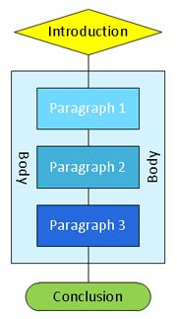
Structure
Answer the questions of the reader
Introduction
Why should I care/read on? (hook)
What is your answer? (thesis)
How are you going to convince me? (roadmap)
Body
Why should I be convinced by your answer?
What is the evidence?
Conclusion
So what? (summary + implications)

Slide 11
Introduction practice
Discuss whether physical university campuses should be a thing of the past in the digital and Covid age.
Hook:
Relevant
Brief
Engaging
Thesis:
Specific
Targeted
Disputable
Roadmap:
Clear
Connected
Free from overlaps

Slide 12
Introductions & definitions
Need to clearly show that you have understood the question – might require defining terms that are:
technical: assume reader is intelligent but no expert
ambiguous: ‘beneficial’ / ‘good’ / ‘bad’
controversial: ‘rape culture’ / ‘racism’
BUT: your argument needs to be dominant
often you can do without explicit definitions or introduce them in the body

Slide 13
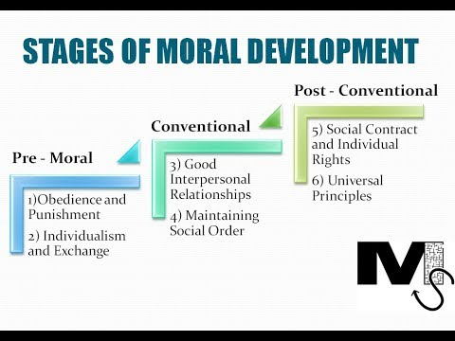
Definition practice
Discuss whether stages of moral development are a good foundation for explaining ethno-chauvinism
(Kohlberg, 1958)

Slide 14
How long should an introduction be?
Depends on the length of your essay, your overall word count and your personal style.
A rough guide:
allocate approximately 10% for the introduction and 10% for the conclusion
If essay is 1,500 words, around 150 words for the intro and 150 words for the conclusion.
This leaves 1200 words for the main body of the essay.

Slide 15
Some first thoughts on writing
“I didn’t have time to write a short letter, so I wrote a long one instead.”
-- Mark Twain

Slide 16
Some first thoughts on writing
Many academic authors choose their words carefully, using big words where small ones would do, and difficult words where possible, rather than where necessary.
We should not expect of readers that they will be willing to engage in intellectual gymnastics, contorting their minds and exerting themselves beyond comprehension, simply to work out what we are saying.
-- Gavin Fairnbarn

Slide 17

Notes:
Writing can be hard

Slide 18
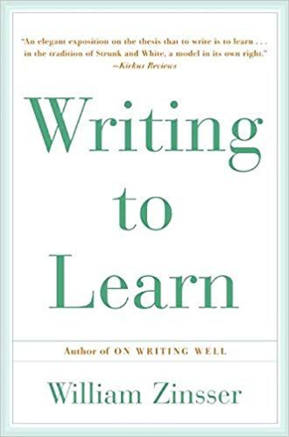
How can I make this happen?
Most efficient: plan, outline, write, revise, edit
Equally effective: write, delete, organise, revise, edit
“Writing is a way to explore a question and gain control over it” – William Zinnser
Introduction needs to be revised last – needs to introduce the essay you wrote, not the one you planned – and it creates the first impression

Slide 19
The University of Manchester Academic Phrasebank http://www.phrasebank.manchester.ac.uk/
Being Critical
Being Cautious
Classifying and Listing
Compare and Contrast
Defining Terms
Describing Trends
Describing Quantities
Explaining Causality
Giving Examples
Signalling Transition
Example: Being Critical
“The main weakness with this theory is that …”
“One question that needs to be asked, however, is whether …
“Previous studies of X have not dealt with …”
“The authors challenge the widely held view that…”

Slide 20
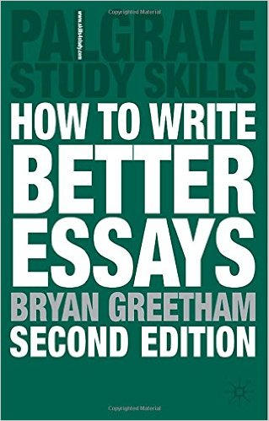
Recommended reading
Greetham (2008):
Ch. 24 - Introductions
Ch. 25 - Paragraphs – Topic sentences
Ch. 26 - Paragraphs – Development and Evidence
Ch. 27 - Conclusions

Slide 21
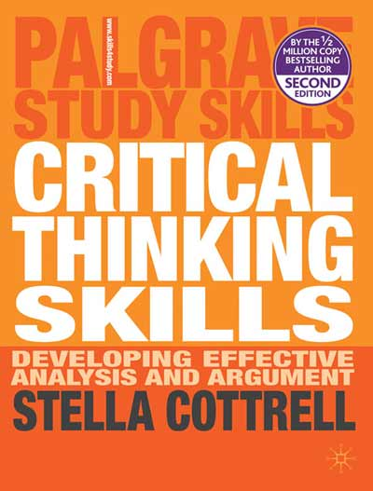
More recommended reading
Cottrell (2005):
Ch. 1 - What is critical thinking?
Ch. 10 - Critical, analytical writing: critical thinking when writing

Slide 22
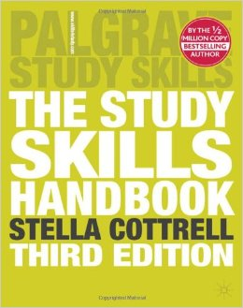
Read, read, read, read, read, read.
Cottrell (2008)
Ch. 9 - Developing your writing
Also: read each others’ work and pay attention to style when reading articles etc.
Notes:
Learning a craft – not just from textbooks

Slide 23
Recap: what you should be able to do
Understand parallels between academic writing and storytelling, and aim for clarity and persuasion rather than ivory tower language
Outline the basic structure of an essay
Explain what terms need defining and why
Write a clear thesis statement and identify ‘hooks’
Know where to get further advice on writing

Slide 24
Reference slides
Created by Catherine Kula, Adjunct Composition Instructor University of Pittsburgh at Bradford
Minimally adjusted by Lukas Wallrich

Slide 25
Regardless of the discipline you are writing in:
Determine the expectations of the writing assignment
Determine audience and purpose
Formulate thesis
Gather evidence and conduct research
Identify required citation style (APA in psychology)

Slide 26
Introductions vs. Thesis Statements
Introductions: general, provide background information, at least one paragraph in length, help set up a writer’s argument
Thesis Statements: specific, precise, usually one or two sentences in length, focus on paper’s purpose, list writer’s position and reasons for it, found in the introduction

Slide 27
Introductions (according to UNC.edu)
A concise, engaging, and well-written introduction will start your readers off thinking highly of you, your analytical skills, your writing, and your paper. This impression is especially important when the audience you are trying to reach (your instructor) will be grading your work. You must capture your reader’s interest.
Your introduction should contain a thesis that will assert your main argument. Your introduction should give your reader a sense of the kinds of information you will use to support your argument along with the organization of the body paragraphs. Think of the introduction as a road map for your reader to follow. Once the introduction has been read, your reader should not be surprised with any information found in the body paragraphs.

Slide 28
Effective Introductions
Think about the question(s) you are trying to answer; don’t ask questions, answer them.
Write your introduction last; it may be easier to write your body paragraphs and argument first so you will know what to state in your introduction.
Start with a hook (a quote, interesting fact, anecdote, etc.).
Make sure your first sentence says something useful!! Write with confidence, and avoid statements like "In this paper, I will suggest that Frederick Douglass valued education." It is more convincing to say “Frederick Douglass valued education” than to tell us you are going to say he did.

Slide 29
Ineffective Introductions: Examples of what does NOT work.
1. The place holder introduction. Essentially, this is weak and contains several sentences that are vague and don't really say much.
2. The restated question introduction. Don’t simply restate what the essay prompt asks you to do. You must answer the question asked.
3. The Webster's Dictionary introduction. Do not begin an essay with a definition from a dictionary; anyone can look a word up and copy down what Webster says. Develop your own definition of the term in the specific context of the assignment, or if you use a definition from one of the sources you've been reading for class.
4. The "dawn of man" introduction. This kind of introduction generally makes broad, sweeping statements about the relevance of this topic since the beginning of time. It is usually very general and fails to connect to the thesis. Example: Since the dawn of man, slavery has been a problem in human history.

Slide 30
Thesis Statements (according to UNC.edu)
Thesis statements present your argument to the reader. Your thesis directly answers the question asked in the prompt. It is an interpretation of a question or subject, not the subject itself.
Depending on the length of the essay, the thesis statement should be one or two sentences in length. It is very specific, and it explains to your reader what the body paragraphs will contain along with the evidence you use to persuade your reader the logic of your interpretation.

Slide 31
How is your thesis? Ask yourself…
Do I answer the question? Re-read the essay prompt; it may help you focus.
Have I taken a position that others might challenge or oppose? If somebody could disagree with your thesis, then you have started your argument. If not, rethink it.
Is my thesis statement specific enough? If your thesis contains words like "good" or "successful," see if you could be more specific: why is something "good"; what specifically makes something "successful"?

Slide 32
Does my thesis pass the "So what?" test? If a reader's first response is, "So what?" then you need to clarify or connect to a larger issue.
Does my essay support my thesis specifically and without wandering? If the body of your essay introduces new ideas not found in your thesis, you need to rewrite. Always reassess and revise your writing as necessary.
Does my thesis pass the "how and why?" test? If a reader's first response is "how?" or "why?" your thesis may be too open-ended and lack guidance for the reader.

Slide 33
Body Paragraphs
1. Topic Sentence
Formulate a controlling idea that relates back to reasons given in the thesis. This idea will direct the paragraph’s development.
2. Explain the controlling idea
Explain how your reader should interpret the information. Explain your thoughts about the topic/idea.
3. Provide multiple examples for support
Provide support or evidence for the idea/explanation. This establishes a relationship between the main idea and the explanation.

Slide 34
4. Explain and analyze the examples
You must explain why each example is relevant to the controlling idea. It shows the reader why you chose the examples for your support.
5. Complete the idea and transition into the next paragraph
Tie up any loose ends in your paragraph and make sure your reader will understand the paragraph’s importance. Transition the reader to your next development in the next paragraph.
Transitions signal relationships between ideas; they establish logical connections between paragraphs; they function as signals for the reader so he/she knows what to do with the given information

Slide 35
Conclusions
DO NOT: state the thesis for the first time; introduce a new idea; end with a rephrased thesis statement; make appeals that are out of sync/tone with the rest of the paper; include evidence/support that should be in the body
DO: ask yourself ‘so what?’ to figure out the importance of your topic; refer back to the introduction; synthesize and show your reader how your argument, examples, and ideas fit together; include provocative insight

Slide 36
Editing and Revising
Once you have a completed draft, you must edit and revise it. Begin with global revisions: thesis, organization, focus, body paragraphs, support, etc.
Revise your essay for proper grammar, punctuation, sentence structure and mechanics, format requirements, citations, etc.

