Slide 1


PSY4003 – Intro to Social Psychology
8: Critical thinking about research
Lukas Wallrich (lukas.wallrich@stmarys.ac.uk) | November 2020

Slide 2
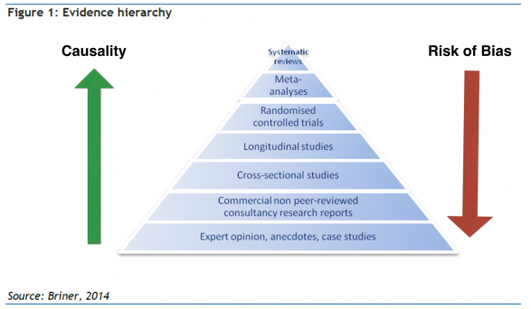

Slide 3
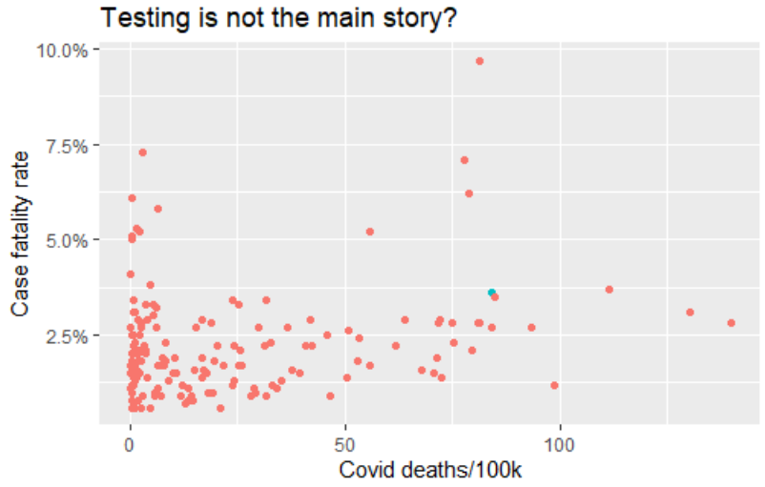
Notes:
pasted <- read.table(file="clipboard", sep="\t")
library(tidyverse)
pasted <- pasted[-1,]
library(magrittr)
pasted$V2 %<>% str_remove_all(",")
pasted$V4 %<>% str_remove("%")
pasted$V3 %<>% str_remove_all(",")
pasted %<>% mutate(across(V2:V5, ~as.numeric(.x)))
ggplot(pasted[pasted$V4<10,] %>% arrange(desc(V1)), (aes(x=V5, y=V4/100, col=V1=="United Kingdom"))) + geom_point() + scale_y_continuous(labels = scales::percent) + labs(x="Covid deaths/100k", y = "Case fatality rate", title = "Testing is not the main story?", source_note = "Data from JHU, excl. Yemen, as of 26/11/2020") + theme(legend.position = "none")

Slide 4
Writing critically about research
Focus on strengths and limitations to say what we can learn from a paper:
Seeking only limitations in a study is criticism and critiquing and criticism are not the same (Sachdeva, 2009)
Select sources that compensate each others’ weaknesses – e.g., lab experiments and field studies

Slide 5

Detailed guidance doc online
Critiquing takes practice – so start now
Discuss papers with others working on same essay

