Slide 1


PSY4003 – Intro to Social Psychology
9: Writing and Editing
Lukas Wallrich (lukas.wallrich@stmarys.ac.uk) | December 2020 .

Slide 2
Your essay plans
Plans need to contain:
State focus & approach
Topic sentence, notes & sources per paragraph
Preliminary conclusion
If anything is missing: plan now before you write
General feedback
Focus – only include what is relevant to your answer
Only use appropriate sources (scientific publications – journal articles > books > webpages)
Engage with research findings, not just conclusions; explicitly compare and contrast different perspectives

Slide 3
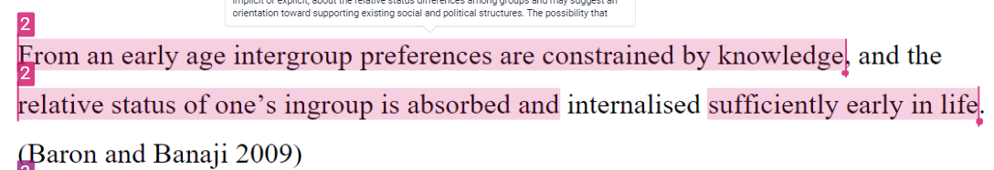

Paraphrasing matters
Not about exchanging words – but about expressing meaning independently to show understanding

Slide 4
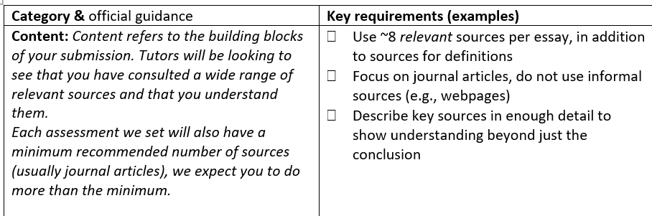
Check marking criteria

Slide 5
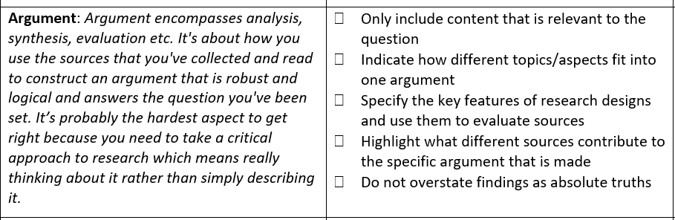

Slide 6
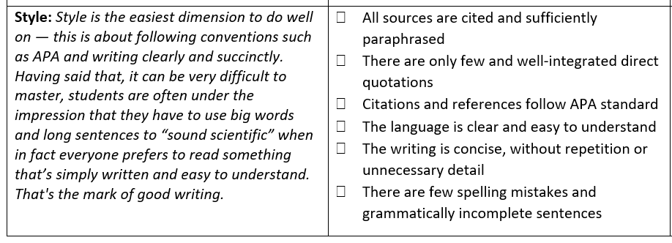

Slide 7
Your peer review task
Everyone will review 4 introductions
3 assigned, 1 freely selected
Deadline: 9 December 2020
Review consists of:
3 rating questions
3 free-text questions
In-text comments (as needed)
Be fair to each other: take the time & submit on time!

Slide 8
What would be good evidence for?
“People universally show obedience to those in authority.”
Early attachment influencing later relationships
Something based on nature or nurture? / Something being caused by genes?
In-group bias being learned, rather than developed independently?

Slide 9
Explain some developmental concepts
Stages of development
What theories do not believe in them?
Operant conditioning
What theory does that belong to? What does it not explain?
Internal Working Model
Who are key figures in behaviourism, nativism, constructivism and psychoanalysis
Strange Situation
Object permanence
Gender identity/gender roles

Slide 10
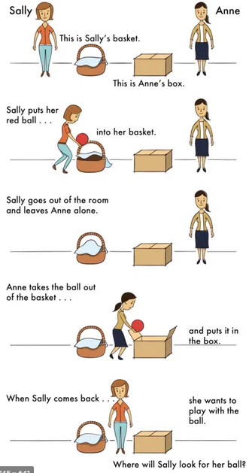
Theory of mind
Sally-Anne task
Next step after object permanence
Verbal task: passed with 4-5 years
Looking time differs by 15 months

