Slide 1

PSY4013 Seminars
Week 1:
Planning & reading
Lukas Wallrich (lukas.wallrich@stmarys.ac.uk) | October 2020.
Notes:
Content first – find something you want to communicate

Slide 2
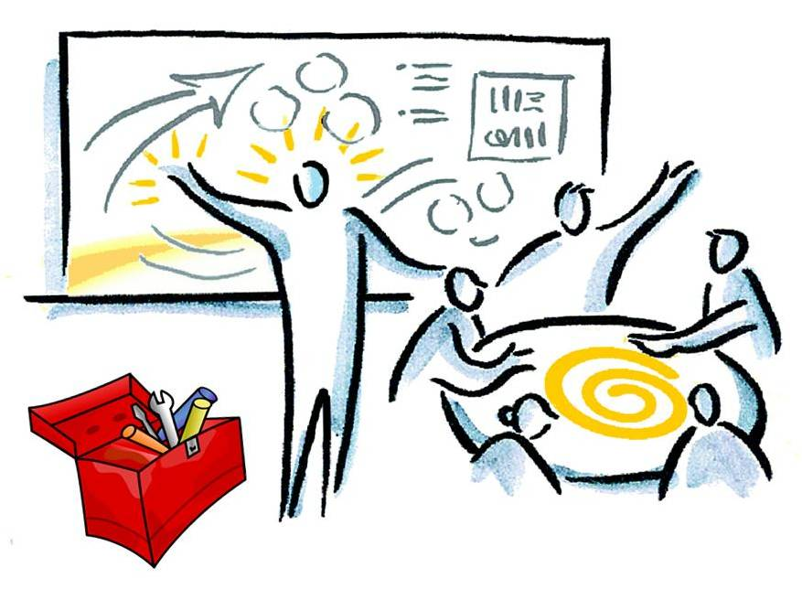
About me
BA Politics & Philosophy
Worked in management consulting
MA Educational Psychology
Now doing PhD in Social Psychology (Goldsmiths)

Slide 3
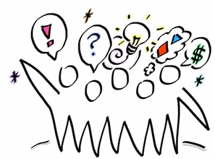
Some requests
Participate and ask questions
Appreciate each others’ contributions and push each other to think further
Minimise distractions – close Messengers, Emails, News etc
Give feedback

Slide 4
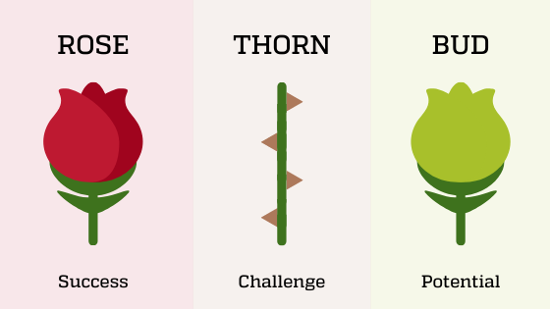
In groups
A highlight from the past week
A frustration/ challenge from the past week
Something you are looking forward to

Slide 5
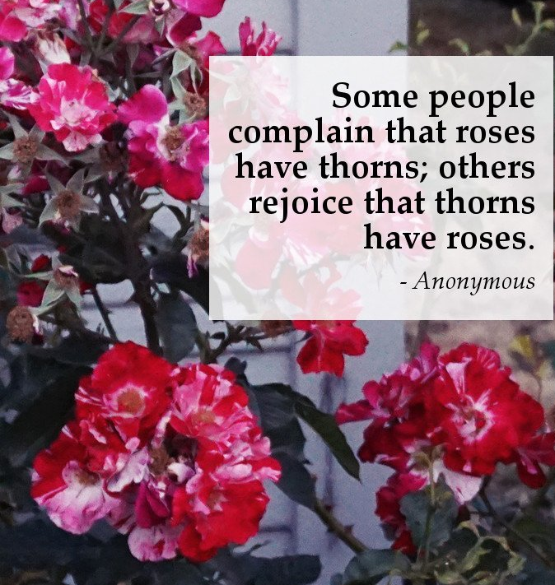
Anything to share?

Slide 6

Three topics for today
Planning your term
Reading effectively and efficiently
Finding and managing readings/sources

Slide 7
Three tips for your first term
Know your deadlines and start thinking early! Good essay answers need to mature.
Set your own learning goals – both regarding skills and knowledge. Makes studying more interesting & improves performance (Hirsh et al., 2010)
Learn actively. Very easy to get distracted – taking notes that highlight connections and prepare to ask questions is most helpful. See link in slide notes!
Notes:
https://info.lse.ac.uk/current-students/Assets/Articles/10-Tips-on-note-taking-during-lectures

Slide 8
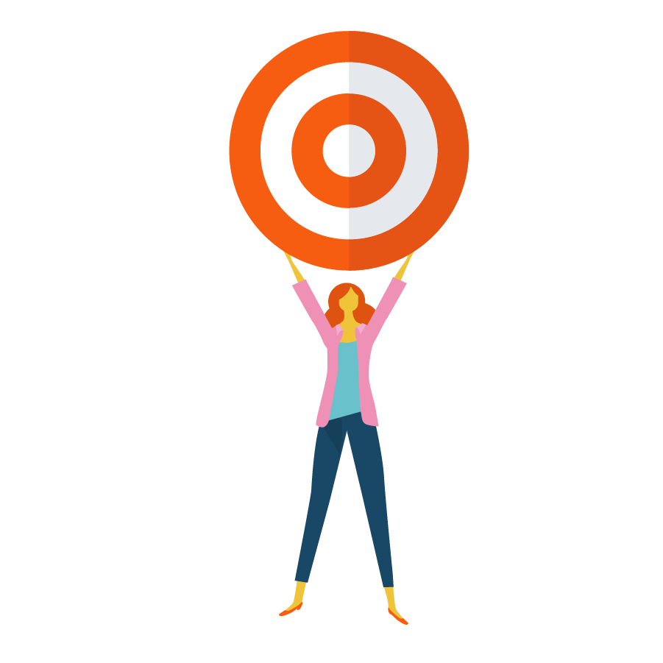
In groups
First reflections on learning goals
3 mins individual reflection
Top 2-3 content questions I want answers to this term
Top 2-3 skills I want to develop
4 mins to share Top 1 in each category

Slide 9
Three tips for your first term
Know your deadlines and start thinking early! Good essay answers need to mature.
Set your own learning goals – both regarding skills and knowledge. Makes studying more interesting & improves performance (Hirsh et al., 2010)
Learn actively. Very easy to get distracted – taking notes that highlight connections and prepare to ask questions is most helpful. See link in slide notes!
Notes:
https://info.lse.ac.uk/current-students/Assets/Articles/10-Tips-on-note-taking-during-lectures

Slide 10


Reading about current research
Good habit to start reading widely – see connections, develop your interests, show interest, recognise real-world relevance of research
Weekly email:
Smartphone App:
Notes:
Email – easy read for educated public: https://digest.bps.org.uk/
App – abstracts of published articles – no need to understand everything: https://www.researcher-app.com/

Slide 11
Three topics for today
Planning your term
Reading effectively and efficiently
Finding and managing readings/sources

Slide 12
Different reading styles
Deep reading
Slowly reading, highlighting/taking summary notes
Textbook / key readings
Can train reading speed, but no real shortcuts
Skimming
Deciding on relevance
Getting main points
Scanning
Getting specific information (e.g., checking citation)

Slide 13
Reading empirical articles
Never start with deep reading
Focus on getting the following first:
Main hypothesis
Motivation for testing it
Approach (experiment/survey/other)
Sample size and nature (random? students? culture?)
Variables: dependent (i.e. predicted) and independent (i.e. predicting)
Main result (significance and effect size)
Notes:
https://www.verywellmind.com/how-to-read-and-understand-a-psychology-journal-article-2795709

Slide 14

In groups
Have someone in your group (who has a Google account) open this document, make a copy and share their screen: http://bit.ly/StM-skim
Notes:
Picture credit: CollegeDegrees360 on Flickr: https://www.flickr.com/photos/83633410@N07/7658272558/

Slide 15
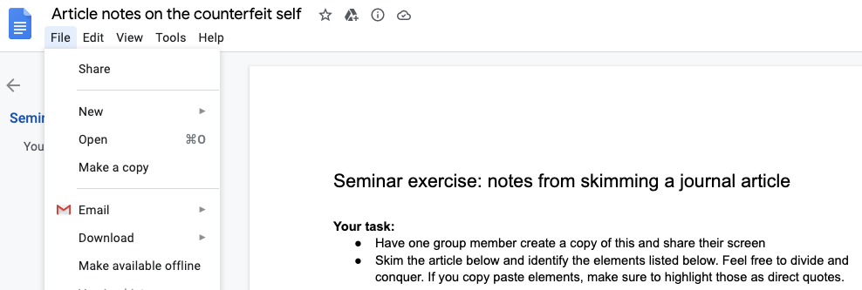

Slide 16
In groups
Have someone in your group (who has a Google account) open this document, make a copy and share their screen: http://bit.ly/StM-skim
Then work together, skimming the article and answering the questions.

Slide 17
Three topics for today
Planning your term
Reading effectively and efficiently
Finding and managing readings/sources

Slide 18
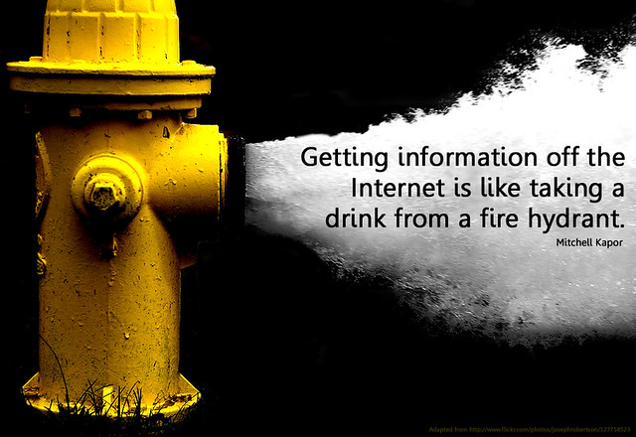


Slide 19

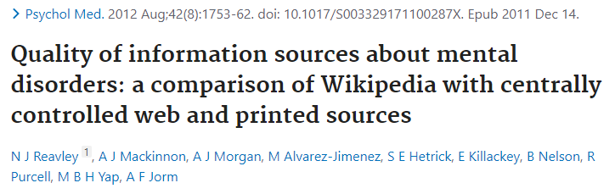
Wikipedia
Not a primary source!
But: often a good secondary source
(You can make it better)
Notes:
Largest encyclopedia in human history

Slide 20
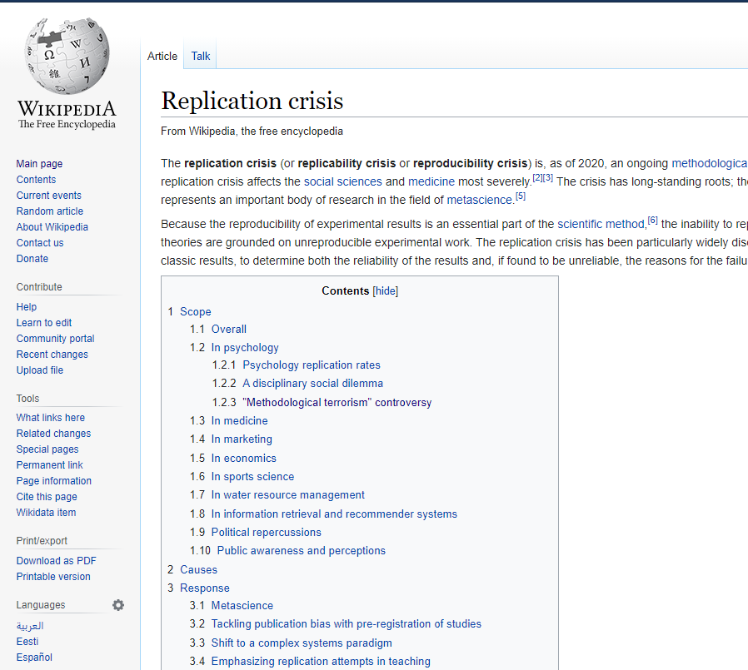
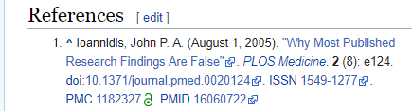
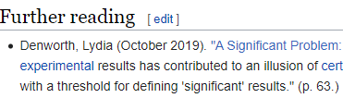
Wikipedia
Notes:
Largest encyclopedia in human history

Slide 21
What to look for?
Evidence from appropriate sources
Scientific books and journals
Focus on peer-reviewed journals
Be very careful with charity reports
Critically consider some open access (i.e. pay-for-publishing) journals – predatoryjournals.com
Where to get started?
Textbooks are not enough, review articles in journals are better
Annual Review of Psychology
Current Directions in Psychological Science
Personality and Social Psychology Review
Notes:
Probleme with Open Access journals – authors pay to publish and at the extreme, they can be “pay for publishing anything” – there are many legimate ones (PLOS ONE, for instance) but worth being sceptical – The International Journal of Social Sciences might be a candidate – see predatoryjournals.com

Slide 22





Google Scholar
A good starting point to explore (particularly, “cited by” and filtering for recent work) – but: includes working papers (not peer-reviewed) and some problematic journals – be critical
Can deal with most operators
Wildcards: relig* for religion, religiosity etc.
OR: apples|bananas or apples OR bananas
NOT: apples –oranges (NOT doesn’t work!)
Phrases: “social identity theory”
Link to St Mary’s Library for easy access
Allows you to set alerts to stay up to date
Has a very helpful Chrome/Firefox plugin
Notes:
https://www.wur.nl/en/article/How-to-use-Google-Scholar.htm
https://scholar.googleblog.com/2020/09/scholar-button-browser-extension-update.html

Slide 23
Library search (http://stmarys.summon. serialssolutions.com/)
Use Summon search – main simmslib search only looks for (physical) books
Consider advanced search (in particular to search for authors)
Use the links & functions attached to the results

Slide 24
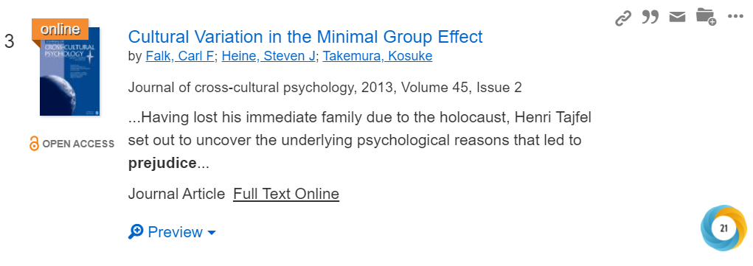
Functions to deal with results
Citation*
Email
Save ☹
Link
* Select APA style, and check output – not always correct!

Slide 25
More library resources
Check the Library’s page for psychology students: https://stmarys.libguides.com/psychology
Start using a reference manager – i.e. a software to save all your references and easily insert them into your writing. The Library recommends RefWorks: https://stmarys.libguides.com/c.php?g=291307&p=4651949

