Slide 1


PSY4003 – Intro to Social Psychology
7: Reviewing essay plans
Lukas Wallrich (lukas.wallrich@stmarys.ac.uk) | November 2020

Slide 2
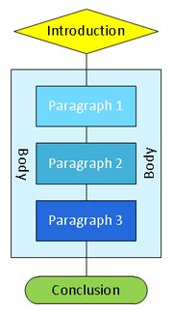
Structure
Answer the questions of the reader (and specifically, the question set!)
Introduction
Why should I care/read on? (hook)
What is your answer? (thesis)
How are you going to convince me? (roadmap)
Body
Why should I be convinced by your answer?
What is the evidence?
Conclusion
So what? (summary + implications)

Slide 3
Introductions need to provide
Hook:
Relevant
Brief
Engaging
Thesis:
Specific
Targeted
Disputable
Roadmap:
Clear
Connected
Free from overlaps

Slide 4
Introductions & definitions
Need to clearly show that you have understood the question – might require defining terms that are:
technical: assume reader is intelligent but no expert
ambiguous: ‘beneficial’ / ‘good’ / ‘bad’
controversial: ‘rape culture’ / ‘racism’
BUT: your argument needs to be dominant
often you can do without explicit definitions or introduce them in the body

Slide 5
Making a clear point: a topic sentence for each paragraph
An opinion rather than a fact:
There are four attachment styles that can influence …
Better: Avoidant attachment styles are the strongest predictor of …
Stated objectively:
I think that avoidant … (hard to develop & insecure)
Can be covered in a single paragraph:
Attachment styles are important for human development
Might feel like the “conclusion” of the paragraph (so what?)

Slide 6
So, let’s have a look
Submit a brief essay plan, including a statement of focus and approach for the entire essay (see materials on writing on Moodle), a topic sentence for each paragraph, a brief list of key points and sources for each paragraph, and some notes on the conclusion. This should be one to two A4 pages (approximately 400 words, bullet points are fine for the details).
Your grade will be based primarily (~70%) on the quality of your structure and argument, and focus on whether you manage to connect all the points in pursuit of a clear and compelling answer to the essay question. The remaining part of your grade is based on the quality of sources you identified beyond those given to you and the level of understanding you show in how you use them in your plan.

Slide 7
Writing well (in science)
Keep sentences short – less can go wrong and its easier to understand
Use clear and consistent terminology (i.e. one name per attachment style)
Beware of abbreviations (AI-attachment is more stable than DI-attachment)
If you must, introduce abbreviations (ABRV) in brackets in capital letters the first time you use them
Notes:
Many ideas in this section from: http://people.exeter.ac.uk/SEGLea/psy6002/writing.htm
Well worth reading!

Slide 8
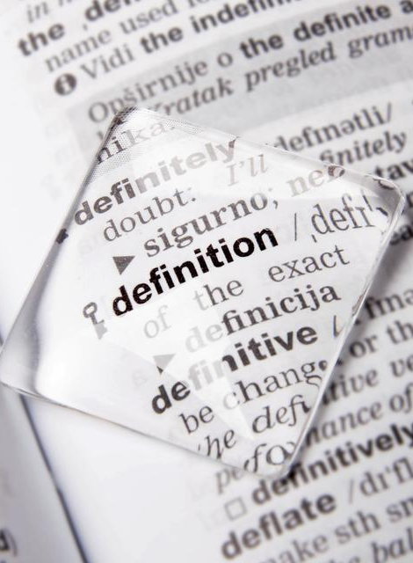
Writing well (in science) words that make trouble
To affect and to effect
To ensure and to insure
Its and it’s (also: whose and who’s)
Further and farther
E.g. and i.e.
Enormity (or the power of Google, define:enormity)
Bottom line: use an online dictionary, spellcheck (Grammarly) and don’t make same mistake twice

Slide 9
Writing well (in science) … let’s find some problems
“A parallel is drawn with Darwin's proposal that it is significant for man to be able to hear his own language (assuming that the words spoken evoke the same reactions in the speaker as in listeners) and Mead's consideration of thinking to be a social act.“
Notes:
From a fairly advanced but good guide: http://people.exeter.ac.uk/SEGLea/psy6002/writing.htm
The wrong preposition has been chosen for the logic of the sentence. "A parallel is drawn with..." should introduce a parallelism between something that has already been mentioned and something that is going to be mentioned: but this sentence is trying to introduce a parallel between two things that have not yet been mentioned, so it should have started "A parallel is drawn between...". This single-word error throws our understanding out completely.
The word "significant" has been linked up to the wrong object. The writer wanted to say that Darwin thought it was significant that people can hear their own speech; the way the sentence has come out, it sounds as though the people find it significant. This again is due to the wrong choice of words: "significant that man can" instead of "significant for man to be able to" would have got it right.
The phrase after "consideration" is not something that can be considered, and therefore cannot logically follow that word. Mead might have had a consideration "that thinking is a social act", or he could have had a consideration of "thinking as a social act", but he could not have had a consideration of "thinking to be a social act"

