Slide 1



Adolescents challenging discrimination: An intervention that boosts self-efficacy
Lukas Wallrich, Sally B. Palmer & Adam Rutland
l.wallrich@gold.ac.uk
@lukaswallrich
Wallrich, L., Palmer, S. & Rutland, A. (2021) Adolescents challenging discrimination: The benefits of a perspective-taking and action-planning intervention on self-efficacy. Under Review
Notes:
Discriminatory behaviour – e.g., name-calling – abounds.
Adolescents from ethnic minorities most affected
Often not challenged – might be due to lack of efficacy
In context of bullying, interventions that increase perspective taking and self-efficacy have been shown to be effective

Slide 2
Context
74% of secondary school students experience victimisation (GLSEN, 2016) – name-calling is most common
Bystander intervention matters, yet often, bystanders stand by
For emergency helping: Recognise emergency, take responsibility, know how to respond, act (Latané & Darley, 1970)
For speaking up, different emphasis: Recognising importance of intervening, feeling self-efficacy
Recent research found role-playing to be effective (Abbot et al., 2020) – we were wondering whether action-planning and perspective taking would be enough – easier to implement
Intervention studies in field are needed
Study with English National Citizen Service
3 week summer-programme in diverse teams of 16-year-olds
639 participants from 131 teams across England (~60% from minority-ethnic backgrounds)

Slide 3


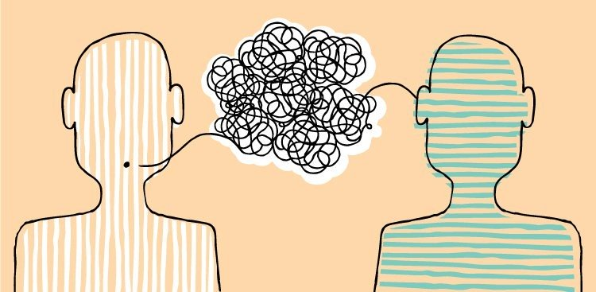
Facilitated discussion sessions (~20-30 mins)
Non-specific Control
Specific Control: Self-disclosure
INTERVENTION: PERSPECTIVE TAKING & ACTION PLANNING
Participants discuss stories of young people who made a difference (e.g., Greta Thunberg)
Participants share positive and negative experiences with ‘being labelled’ – instructed to engage in active listening
Participants writes down one experience with a negative ‘label’
They are presented anonymously, advice and options to act discussed
Notes:
Context: residential summer-camp in rather diverse cohorts
Facilitator survey as implementation check – was implemented faithfully, participants were highly engaged – no differences between conditions
Active controls to control for non-specific intervention effects

Slide 4
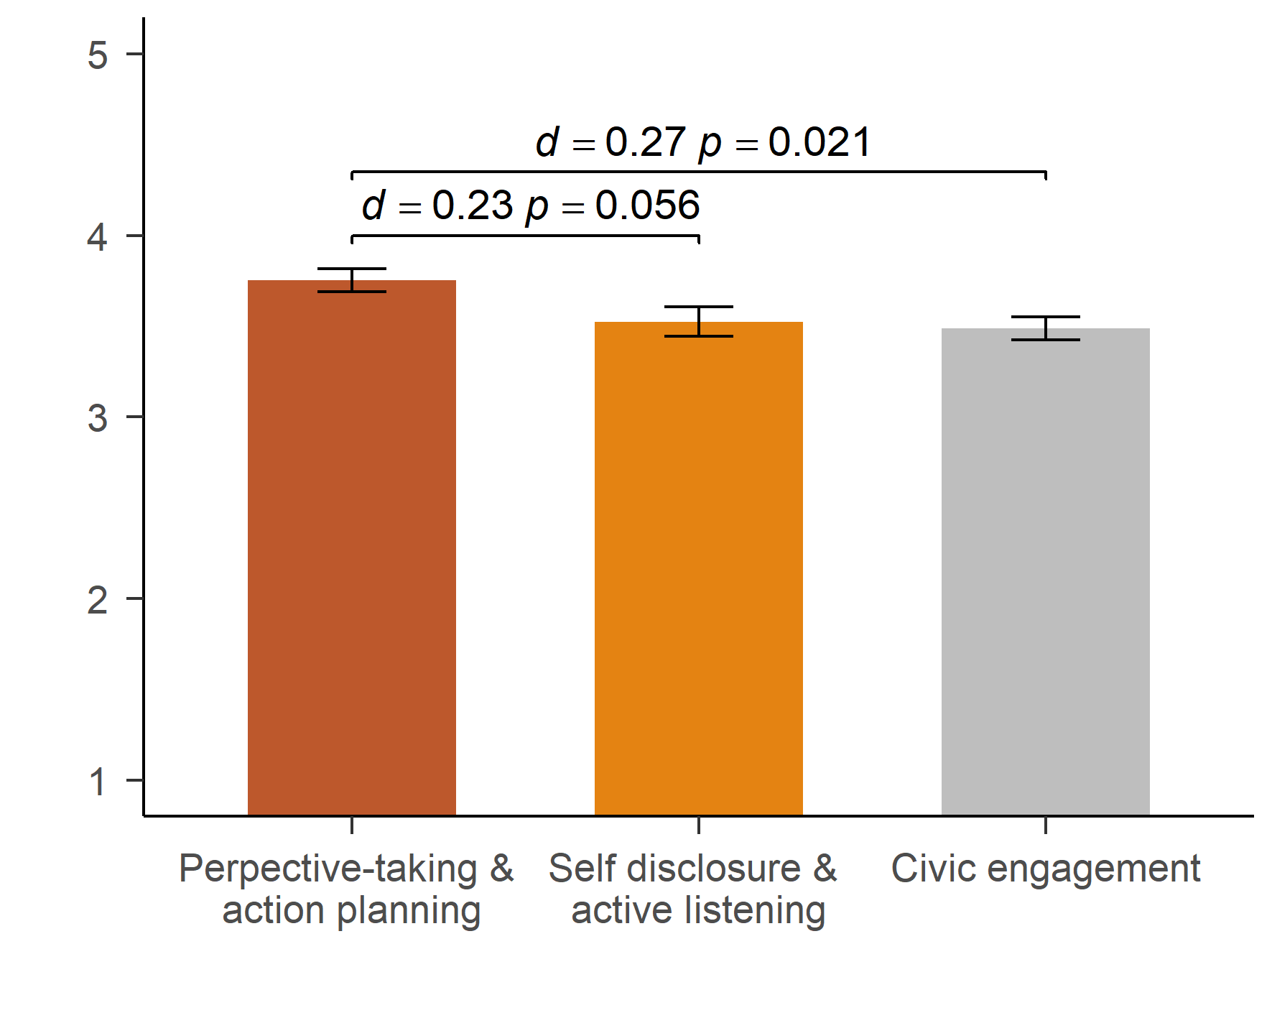
Increase in self-efficacy – three weeks on
Notes:
Delayed impact measure to capture attitude change rather than reactions

Slide 5
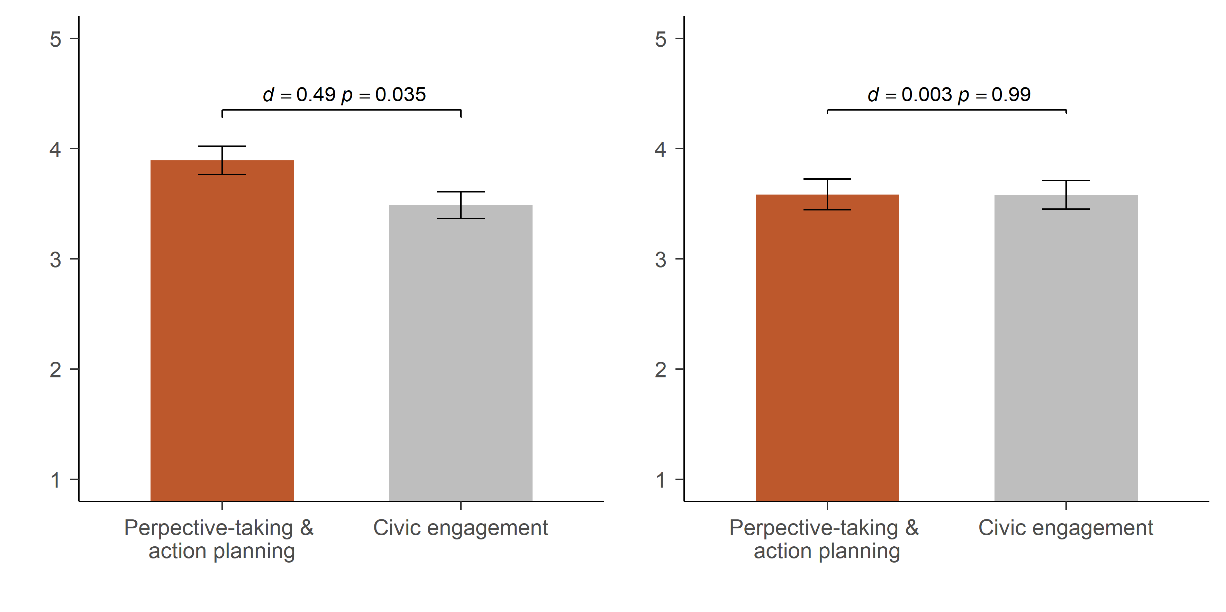
Different patterns by ethnicity (self-efficacy)
WHITE PARTICIPANTS (N = 103)
Minority-ETHNIC (N = 173)
Notes:
Only available for small subgroup – underpowered interaction test, clearly not significant
However, pattern in line with expectations – so cautious conclusion warranted.

Slide 6
Results summary and conclusion
Activity increased self-efficacy, at least among White participants
Also increased perceived importance, among White participants only
Self-disclosure session (specific control) also increased perceived importance among White participants, but perspective-taking and action-planning session appeared more effective overall
Simple, cheap, brief intervention, with small benefits and no adverse impacts – can inform practice
Further research needed into durability of effect, pathways, and into how to affect minority-ethnic participants (who were at identical starting point)

Slide 7
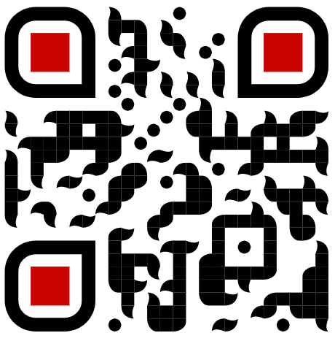
Get our pre-print:
THANK YOU!
https://osf.io/rzvud
Lukas Wallrich, Sally B. Palmer & Adam Rutland
l.wallrich@gold.ac.uk
@lukaswallrich
Wallrich, L., Palmer, S. & Rutland, A. (2021) Adolescents challenging discrimination: The benefits of a perspective-taking and action-planning intervention on self-efficacy. Under Review

