Slide 1
Meta in Digital Advertising: Competitive Landscape
Meta vs Alphabet (Google ads), Amazon (ads), Reddit and ByteDance/TikTok | Data through 2026-06-30 quarter; as of 2026-10-14
Bottom line
Meta is the #2 ad platform globally (TTM ad revenue USD 222,607M) and the fastest-growing at scale: TTM revenue +27.7%, Q2 2026 +28.0%, versus Google advertising +14.0%.
AI ranking (Advantage+ run-rate >USD 75B; Generative Recommender) is converting into both more impressions (+14%) and higher prices (+12%) in Q2 2026 - a rare combination.
Main threats: ByteDance/TikTok for attention and commerce video; Amazon for closed-loop, purchase-verified measurement; Google's AI Mode for intent capture. Reddit is a fast-growing niche, not a scale threat.
Key risk is cost, not demand: R&D at 31.4% of TTM revenue and 2026 capex guidance of USD 130-145B compress margins and FCF while the payoff is still proving out.
Sources: company 10-Q/8-K filings (SEC EDGAR), press releases, Reuters via whbl.com, Sacra, eMarketer. TTM = Q3 2025 to Q2 2026.

Slide 2
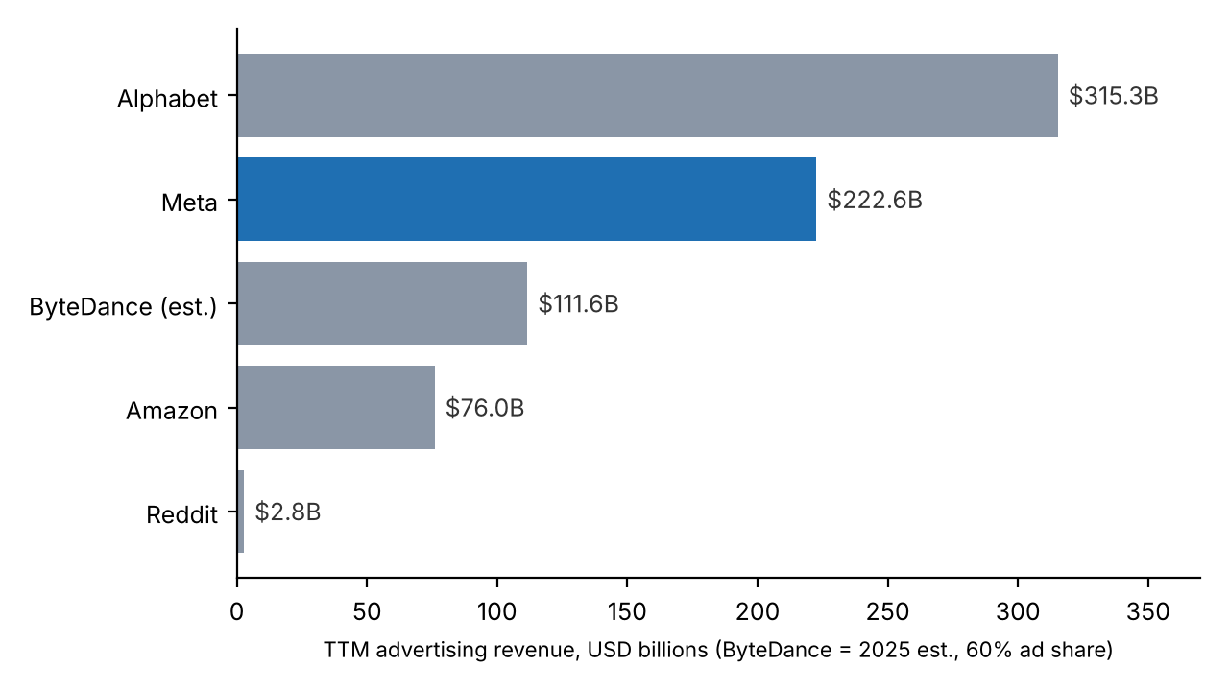
Market scale: five ad platforms, three business models
TTM advertising revenue (USD billions)
Model archetypes
Intent (Alphabet): search query = explicit demand; highest-margin format, now being re-plumbed for AI answers.
Discovery / social graph (Meta, TikTok, Reddit): demand creation in feeds; AI ranking replaces user-declared targeting.
Commerce / closed loop (Amazon, TikTok Shop): ad and purchase on the same platform - best attribution.
Meta is ~0.7x Alphabet's ad revenue and ~2.9x Amazon's; Reddit is ~1% of Meta.
Alphabet = Google advertising line (Search & other + YouTube ads + Network). Amazon = 'Advertising services' segment line. Meta = advertising revenue. Reddit = total revenue (~all ads). ByteDance = Sacra 2025 revenue est. USD 186B x ~60% ad share.

Slide 3
Competitive positioning
 | Meta | Alphabet (Google ads) | Amazon ads | ByteDance / TikTok | Reddit
Core asset | 3.6B daily users across FB, IG, WhatsApp, Messenger, Threads | Search intent + YouTube; Network | Shopper intent + purchase data; Prime Video | Interest graph, short video, live commerce (Douyin/TikTok Shop) | Topic communities; high-intent discussion; search referral traffic
Funnel position | Full-funnel, strongest mid/lower (performance, app, CTW) | Lower funnel (search) + upper (YouTube CTV) | Lowest funnel (sponsored products) + CTV/DSP | Upper/mid funnel moving to lower via Shop | Mid funnel; consideration, research
Advertiser base | Millions of SMBs + large brands; global | Broadest; agencies and SMB | Endemic brands/sellers; growing non-endemic | D2C, apps, e-commerce sellers, brands | Active advertisers +70% y/y; SMB push
Moat | Scale of first-party engagement data + AI ranking + compute | Query intent, Android/Chrome distribution | Closed-loop sales attribution | Engagement intensity; recommendation engine | Unique UGC corpus (also licensed to AI labs)
Key vulnerability | Capex/opex intensity; regulation (EU, youth safety, legal charges) | AI answers reduce clicks; antitrust remedies | Ad load vs shopper experience | US JV governance (ByteDance 19.9%); geopolitics | Dependence on Google search traffic; scale
Sources: Meta Q2 2026 call (DAP 3.6B); Reddit Q2 2026 call; eMarketer 2025-12-19 on TikTok US JV structure; analyst synthesis.

Slide 4
Ad formats and audiences
 | Primary formats | Audience / reach | Recent product moves
Meta | Feed, Stories, Reels, click-to-message (WhatsApp/Messenger), Threads ads, Advantage+ automated campaigns | 3.6B DAP (Q2 2026); broad global demographics | Generative Recommender; Advantage+ >USD 75B run-rate; WhatsApp/Threads monetization ramp
Alphabet | Search text/shopping, Performance Max, AI Max, YouTube (Shorts, CTV), Display Network | Search near-universal; AI Mode >1B MAU (company claim) | AI Max GA (Apr 2026); ads in AI Overviews/AI Mode
Amazon | Sponsored Products/Brands/Display, Amazon DSP, Prime Video ads, Twitch | Prime members; shoppers at point of purchase | Ads Agent expanded to 11 more countries; claims 6% lower CPA
ByteDance | In-feed video, TopView, Spark Ads, Smart+ (automated), Live/Shop ads | TikTok >1B users ex-China; Douyin in China; young skew | US JV closed 2026-01-22; Symphony gen-AI creative
Reddit | Promoted posts, conversation ads, Dynamic Product Ads, shopping listing ads (alpha) | DAUq 130.3M, WAUq 514.6M (Q2 2026) | Reddit Max automation; DPA revenue >2x y/y; dual attribution beta
Sources: company calls and releases Q2 2026; TikTok format names from model knowledge.

Slide 5
Financial comparison
USD millions; TTM = Q3 2025-Q2 2026 unless noted
Metric | Meta | Reddit | ByteDance | Alphabet (Google ads) | Amazon (ads services)
Revenue / ad revenue | 228,247 | 2,778.8 | ~186,000 (FY2025E) | 315,346 | ~76,003
Growth % (TTM y/y) | 27.7% | 66.6% | ~20.0% (FY2025E) | 14.0% | 24.1%
Latest quarter growth (Q2 2026) | 28.0% | 61.1% | n/d | 14.4% | 26.2%
Gross margin % | 81.7% | 91.4% | n/d | n/d (segment) | n/d (segment)
R&D % revenue | 31.4% | 30.0% | n/d | n/d (segment) | n/d (segment)
S&M % revenue | 5.5% | 23.0% | n/d | n/d (segment) | n/d (segment)
SG&A % revenue | 12.3% | 33.2% | n/d | n/d | n/d
Market cap / valuation | ~1,914,859 (2026-09-25) | 30,770 (2026-10-12) | 550,000 (Feb 2026 deal) | Parent-level only | Parent-level only
Meta, Reddit: 10-K FY2025 / 10-Q Q2 2026, TTM derived. Alphabet: Q3 2025 per storyboard18, Q4 2025 release, Q2 2026 10-Q. Amazon: rounded quarterly figures from press coverage. ByteDance: Sacra estimate; Reuters 2026-02-25 valuation. Market caps: Google Finance.

Slide 6
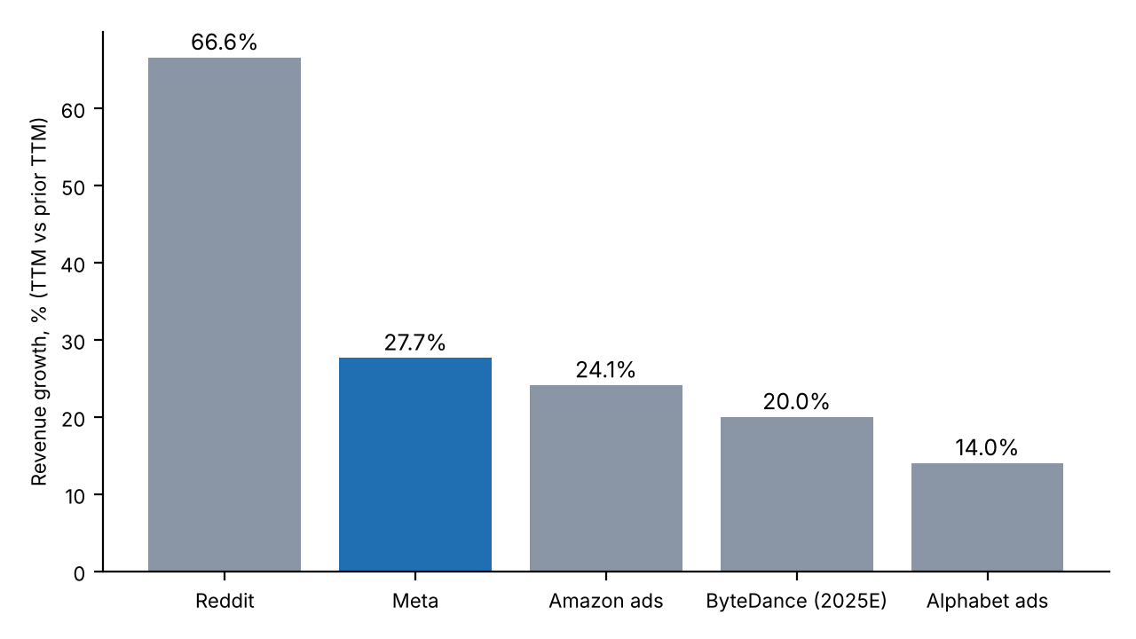
Growth and efficiency: Meta grows like a challenger at incumbent scale
Read-across
Meta added ~USD 49B of TTM revenue y/y - more than Google advertising (~USD 39B) and Amazon ads (~USD 15B).
Cost structure diverges: Meta spends 31.4% of revenue on R&D but only 5.5% on S&M - the product sells itself through self-serve auctions. Reddit spends 23.0% on S&M to build its advertiser base.
Reddit has the best gross margin (91.4%) but is ~1/80th of Meta's revenue.
Meta's Q2 2026 operating income fell y/y (USD 18,775M vs 20,441M) as R&D +67% and legal/severance charges hit.
Growth basis differs: Meta and Reddit total revenue; Alphabet/Amazon ad lines; ByteDance FY2025 vs FY2024 estimate (Sacra).

Slide 7
AI's effect on ad targeting and measurement
 | Targeting / ranking | Creative | Measurement | Net effect
Meta | Generative Recommender (LLM-based); ranking gains: FB ad clicks +8.3%, conversions +15.7% | Advantage+ creative gen-AI; >USD 75B Advantage+ run-rate | Modeled conversions, Conversions API; post-ATT signal loss largely rebuilt | Strongest beneficiary: price/ad +12% and impressions +14% in Q2 2026
Alphabet | AI Max broad-match + query expansion; PMax | Asset generation in PMax | Modeled attribution; Google Analytics | Defensive: AI Mode may cut clicks, offset by higher-value queries; Search & other +16.8% in Q2 2026
Amazon | Shopper signals + Ads Agent | Gen-AI image/video tools | Closed-loop sales attribution (AMC) | Structural measurement advantage; ad growth 26.2% in Q2 2026
ByteDance | Interest-graph recommender (best-in-class) | Symphony gen-AI avatars/video | Shop closed loop; US JV retrains algorithm | Strong, but US algorithm retraining is a wildcard
Reddit | Reddit Max automation; contextual from conversations | Limited | Dual attribution beta; third-party ROAS studies | Gains from automation (Max revenue +150% q/q); risk from AI search reducing referral traffic
Implication: AI shifts advantage from declared targeting to whoever owns the most first-party behaviour data plus the compute to model it - favouring Meta, Google and ByteDance; measurement edge shifts to closed-loop players (Amazon, TikTok Shop).
Sources: Meta Q2 2026 call (nasdaq.com); digitalapplied.com on Alphabet Q2 2026; ecomcrew.com on Amazon Q2 2026; Reddit Q2 2026 call. Some product names from model knowledge.

Slide 8
Strategic synthesis
Where Meta wins
Scale + AI flywheel: more engagement data -> better ranking -> higher ROAS -> higher prices without losing volume.
SMB self-serve depth and automation (Advantage+) lowers the cost of acquiring advertisers; S&M only 5.5% of revenue.
Untapped surfaces: WhatsApp business messaging, Threads, Meta AI assistant monetization.
Where Meta is exposed
Attention: TikTok remains the benchmark for short video; US JV closed 2026-01-22 removes the ban overhang that briefly helped Reels.
Measurement: Amazon and TikTok Shop prove sales directly; Meta relies on modeled conversions.
Cost: 2026 capex guidance USD 130-145B and expense guidance USD 165-169B - margin compression is the main debate.
Regulation/legal: Q2 2026 USD 2.4B legal charge; EU less-personalised-ads remedies.
Watch-list (next 2-4 quarters)
Q3 2026 revenue vs USD 61-64B guide; price-per-ad vs impressions mix; Advantage+ share; TikTok US post-retraining performance; Google AI Mode ad load.
Analyst synthesis based on the sources cited on prior slides.

Slide 9
Sources and notes
Meta 8-K Q4/FY2025 release (2026-01-28); Meta 10-Q Q2 2026 (sec.gov/.../meta-20260630.htm); Q2 2026 call highlights (nasdaq.com).
Reddit Q4/FY2025 release (businesswire, 2026-02-05); Reddit Q2 2026 8-K release (2026-07-30); Q2 2026 call (webull.com).
Alphabet 10-Q Q2 2026; Q4 2025 earnings release; Q3 2025 figures via storyboard18.com.
Amazon advertising: ppc.land and ecomcrew.com (Q2 2026); storyboard18.com (Q3 2025). Q3 2024-Q2 2025 comparatives from model knowledge.
ByteDance: Sacra (revenue estimates), Reuters via whbl.com 2026-02-25 (USD 550B valuation), augment.market 2026-06-23 (USD 600B secondary, gray-market quotes), eMarketer 2025-12-19 (TikTok US JV).
Prices: Google Finance (META close 2026-09-25 snapshot; RDDT close 2026-10-12).
Reddit H1 2024 revenue (USD 524.2M) and Meta H1 2024 revenue (USD 75,526M) used for prior-TTM growth are from model knowledge.

