Slide 1
QA PROJECT 2 – OOP LIBRARY
Lukas Rygh

Slide 2
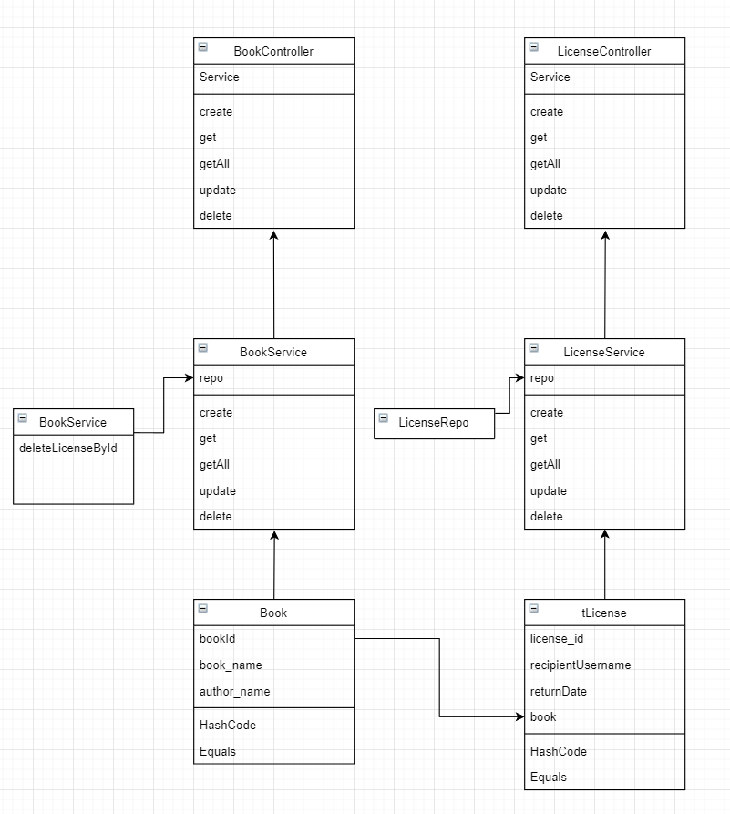
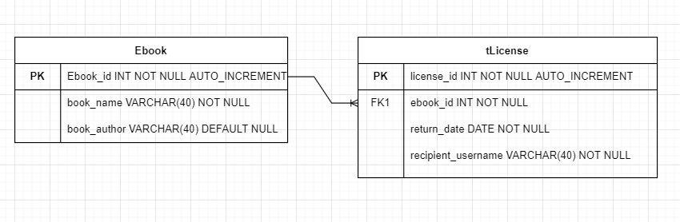
Technologies Used
Java (Spring), Maven, Junit+Selenium
MySQL Database connected through spring
HTML/JS application hosted locally

Slide 3
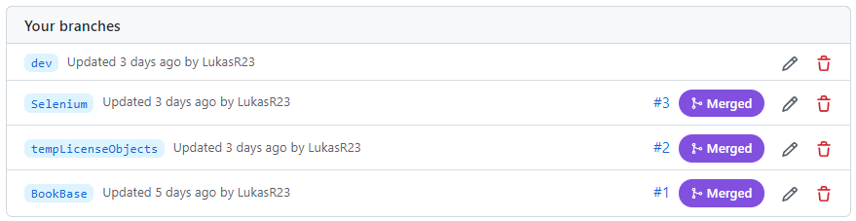
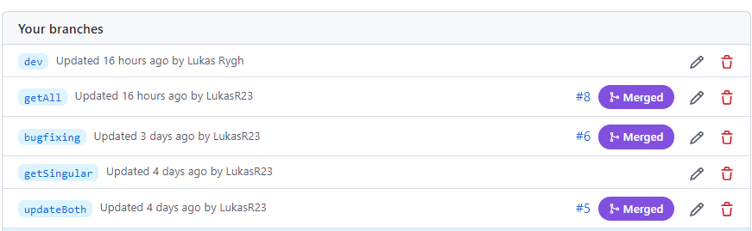
Version Control and Feature-Branch Model
One branch for each major feature or class across each repository.
All branches are merged into dev, and will be merged into main upon completion and final checks.

Slide 4
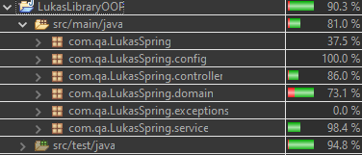
Testing
Junit
All tests pass, coverage 81%.
Every method successfully tested except one, which is partially tested and proven to work.
Unit testing is separate from integration testing and marked as such.
Selenium
All pages tested, each test targets a feature on that page.
No testing of data here, only errors.

Slide 5
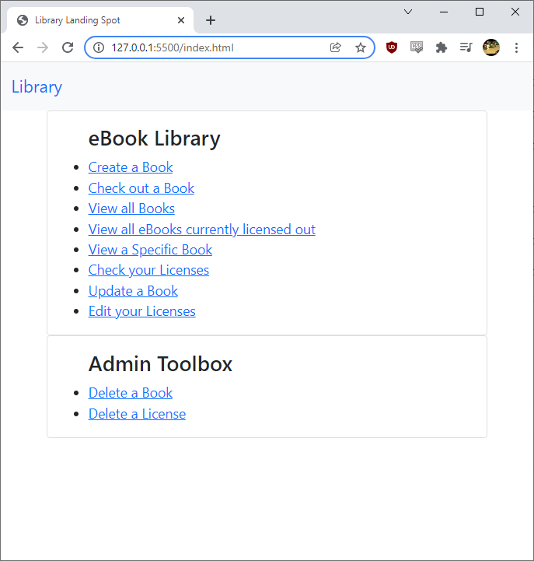
Demo
Both tables are interlinked, custom method in bookRepo used to bypass deletion constraints
Index page is a 'landing site', with the navbar allowing it to be returned to from anywhere on the site.
Ideally the delete methods would require authentication.

Slide 6
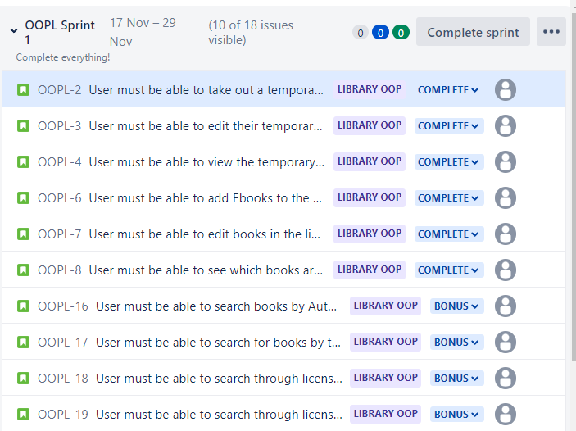
Review
All requirements of MVP Fulfilled
Optional user features incomplete but not required.
System design allows for them to be implemented without breaking the rest of the project.

Slide 7
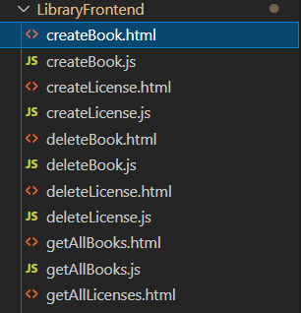
Retrospective
Personally happy with what I have completed.
Most difficulties involved Javascript and usability.
UI could be improved, and several pages could possibly be merged together in a future improvement.

Slide 8
Conclusions
User interface is imperfect, but functional and utilises all technologies required.
In a usable state books would be uploaded directly and stored as an additional field in the record, but this system would likely never work in practice due to copyright issues and just become another file-sharing site.
All design principles followed – direct improvement on previous project.

