Slide 1

Best location to set up Japanese restaurant in Clementi, Singapore

Slide 2
Clementi, Singapore as an opportunity
One of the affluent area in Singapore
Such opportunity is difficult to find, especially in Singapore
Due to its hyper competitive F&B Market
Lack of opportunity for young entrepreneur to grow

Slide 3
Data acquisition and Cleaning
Foursquared API data from Clementi, Singapore Japanese restaurants
Remove NULL and duplicate data

Slide 4
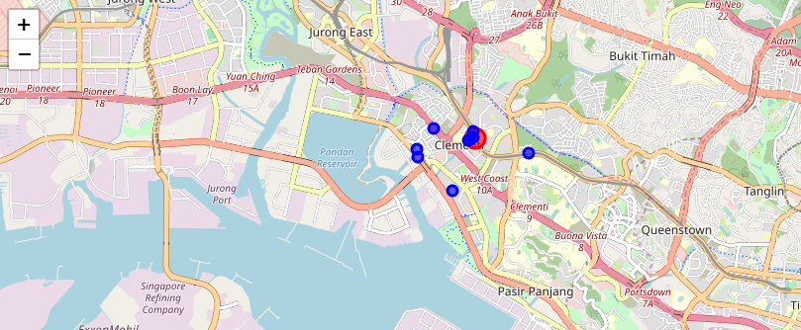
Japanese Restaurants in Clementi, Singapore

Slide 5
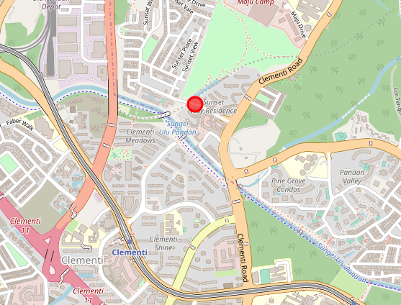
Japanese restaurants in Sunset Way, Clementi, Singapore

Slide 6
Conclusion
Best area to have a restaurant in Singapore at Clementi area is North-East, Sunset Way.
Accuracy has room for improvement
Take the opportunity to leverage on the studies collected

