Slide 1
What if Entity Framework fails?
Dapper to the rescue!
Lukasz Fliegel
June 2022
CONFIDENTIAL | © 2022 EPAM Systems, Inc.

Slide 2
Dapper - a simple object mapper for .Net
Dapper is a NuGet library that you can add into your project that will extend your IDbConnection interface:
public static IEnumerable<T> Query<T>(this IDbConnection cnn, string sql, object param = null, IDbTransaction transaction = null, bool buffered = true, int? commandTimeout = null, CommandType? commandType = null)
public static int Execute(this IDbConnection cnn, string sql, object param = null, IDbTransaction transaction = null, int? commandTimeout = null, CommandType? commandType = null)

Slide 3
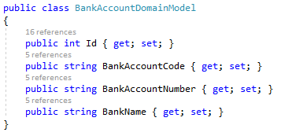

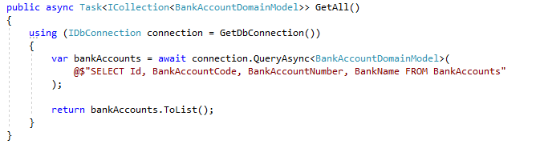
Dapper on one slide
Notes:
- pytania można zadawać wpisując je w sekcję Q&A a ja na nie odpowiem na koniec

Slide 4
And that’s all! Thank you for your attention!

Slide 5
Dapper – few facts
Extremelly simple
Used on production on StackOverflow
Open source (https://github.com/DapperLib/Dapper)
Very fast – performance comparable to pure ADO.NET
Created in 2011
Extends IDbConnection interface, so it’s easy to use Dapper with other libraries (like. EF)

Slide 6
demo

Slide 7
Conclusion
Dapper is simple and high parformance Micro-ORM
It has low entry level
It can be paired with another Db access aproach (like EF)

Slide 8
Thank you!

