Slide 1
Decorate or not to decorate?
The design pattern
CONFIDENTIAL | © 2020 EPAM Systems, Inc.

Slide 2

What is a decorator?

Slide 3
What is a decorator
Add behaviour dynamically
Adhere to the Single Responsibility Principle
Similiar to the chain of responsibilities
Is often described as a replacement for inheritance.

Slide 4
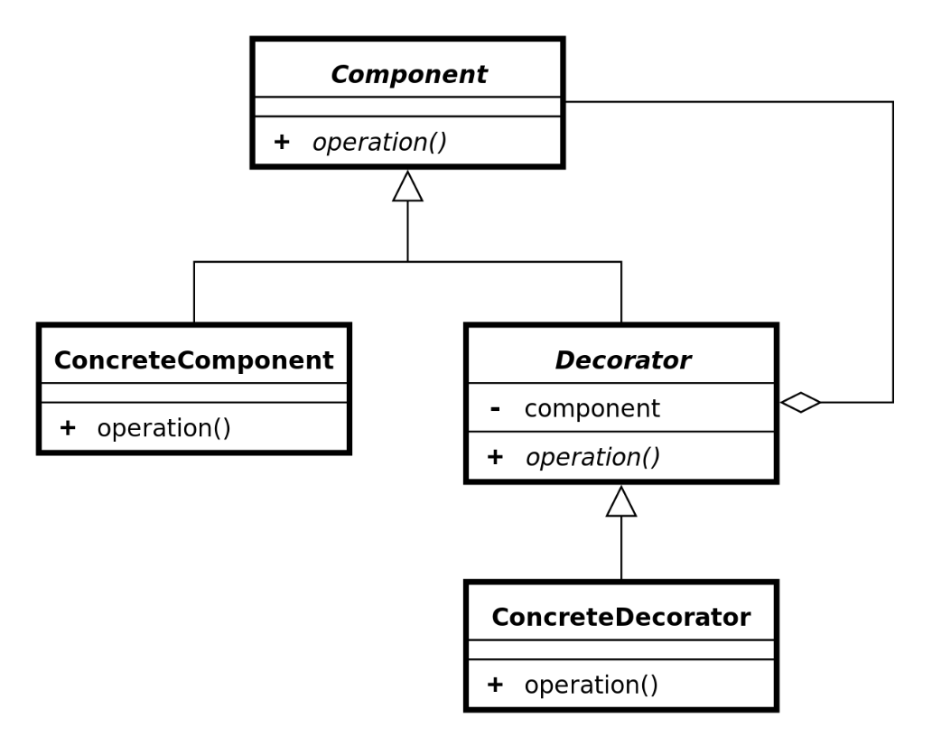
Decorator class diagram

Slide 5
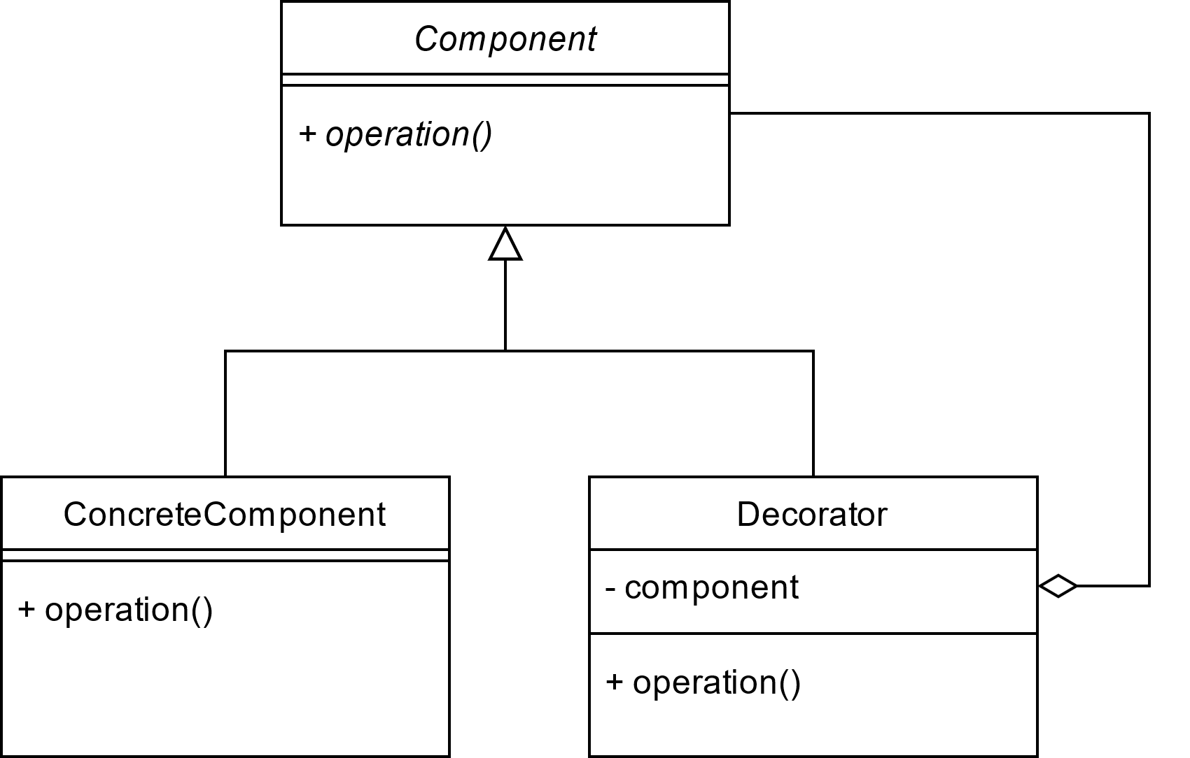
Decorator class diagram

Slide 6
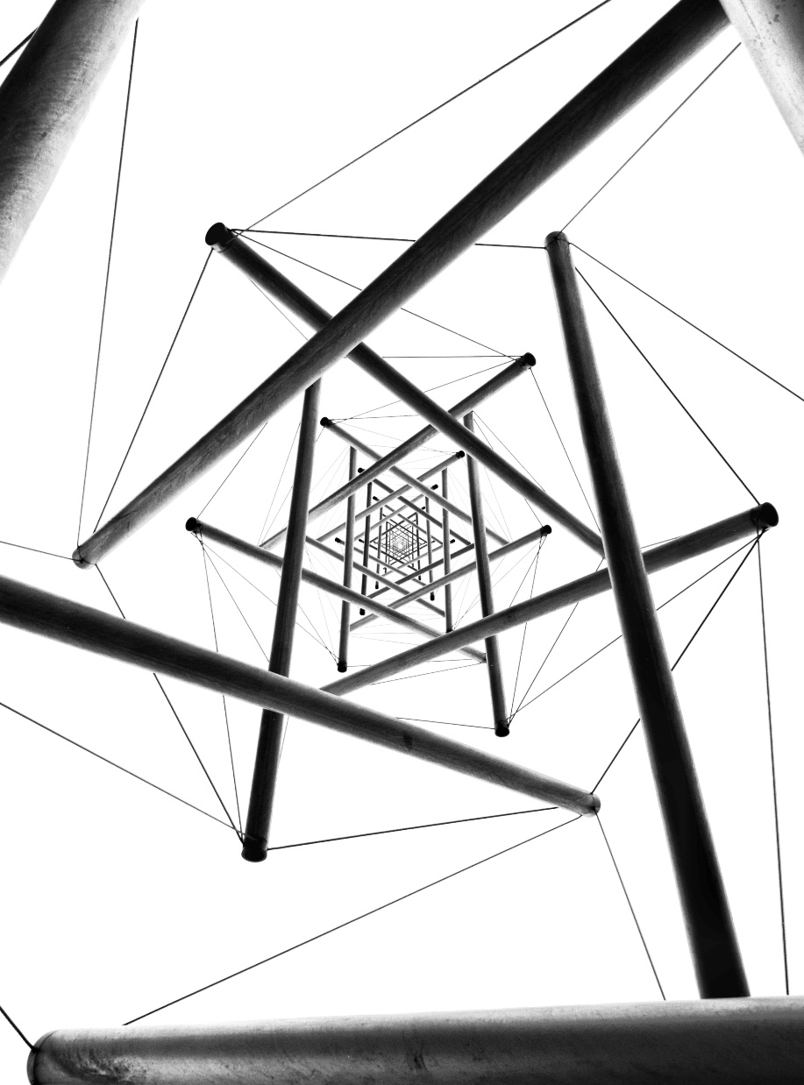
Decorator example

Slide 7
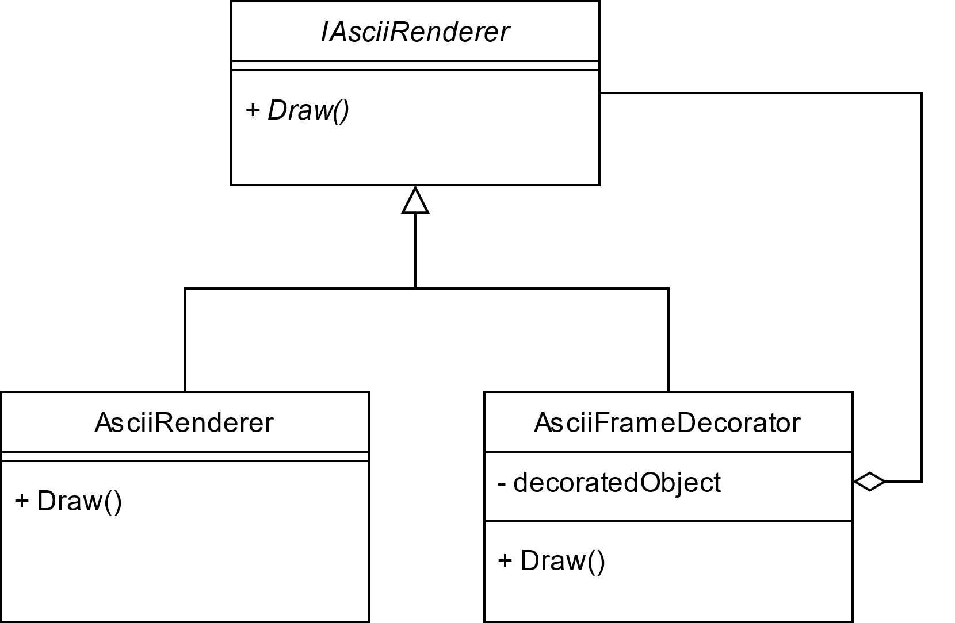
Example’s decorator class diagram

Slide 8
Pros and cons of using decorator
Pros
More flexible than inheritance
The lower number of methods in classes on top of the hierarchy
Separates functionality
Cons
Objects are not identical (can’t rely on a concrete type)
May introduce many small classes, not convenient to every developer
Complex object creation (especially with Inversion of Control)

Slide 9

Real life example

Slide 10

Questions

