Slide 1
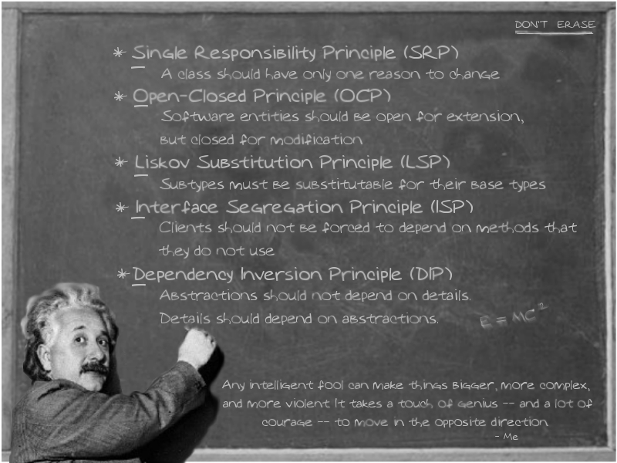

Slide 2
FRIVO – Impact of poorly managed cost of change
Fragility
changes cause breakage in conceptually unrelated parts of the system
Rigidity
every change forces change to other parts of the system
Immobility
hard to separate components for reuse (move to another system or part)
Viscosity
doing things right is harder than doing things wrong
Opacity
hard to read and understand; does not clearly express intent
Notes:
How can we refactor to improve Opacity: (“intention-revealing” refactorings)
Rename method; rename variable
Extract method
Introduce/remove variables

Slide 3
Core Evaluative Principles for Reducing the Cost of Change (COC)
Minimize Dependencies – (Keep un-related stuff apart)
Increase Cohesion (keep related stuff together)
KISS - Do the simplest thing possible that solves the problem
Write software for people first (computers last)
Don’t repeat yourself (DRY) – a.k.a. NO Duplication
Smaller and Fewer is usually better
All Tests Pass!!!
Notes:
Comment: When it comes to minimizing complexity – these are the “Other Gauges” on the dashboard we need to pay attention to!
Often these are competing constraints – we can do better in one area but make the other worse.
NOTE:
Mastery in software engineering is the discipline of improving ones skills in optimizing across the range of these constraints
The bad news – We’re guaranteed to get it ‘wrong’
We’re not cognitively equipped to mentally forecast the levels of play involved
We have to execute and learn – (that’s one reason why refactoring is necessary – we continually improve the design as we learn)

