Slide 1
MediChain
Patient records. Coordinated care.
Visible access history.
Patients need their care team to find the right information,
while knowing who accessed their medical records and why.
A patient portal and role-specific clinical workspaces
for routine care and controlled emergency access.
SA policy context: integrated records and a common patient identifier
National Department of Health, Digital Health Strategy 2019–2024
MediChain Geekulcha 2026 1 / 11
Notes:
0:00–0:25. I am Rakau Keorapetswe Lucas Kgoatlha, the solo developer of MediChain. Our problem is continuity and visibility: a patient needs the next authorised clinician to find the right information and needs to know who opened their record. The national strategy identifies integrated systems and a common patient identifier as priorities. This is policy context, not evidence of an achieved MediChain outcome. Source: https://knowledgehub.health.gov.za/elibrary/national-digital-health-strategy-south-africa-2019-2024 . Programme pp.2,5,8 requires problem, solution and a three-minute sales pitch.

Slide 2
Problem evidence from South Africa
When records are missing or incomplete, the next clinician
lacks reliable context and the patient cannot reconstruct their care.
15%
Missing or incomplete
records in the study’s
reviewed trauma cases.
Historical, single-hospital evidence: Khayelitsha, July 2012 records; study published 2016.
Percentages overlap. This is not a current national rate or a MediChain outcome.
MediChain Geekulcha 2026 2 / 11
Notes:
Source: Ohuabunwa et al., Electronic Medical Records in low to middle income countries: The case of Khayelitsha Hospital, South Africa, African Journal of Emergency Medicine 6(1), 2016, pp.38–43. https://pmc.ncbi.nlm.nih.gov/articles/PMC6233247/ and https://pubmed.ncbi.nlm.nih.gov/30456062/ . 354 July trauma cases were located; 46 under age 12 excluded, leaving 308 for this portion. Reported percentages are rounded and categories overlap. Do not infer a national prevalence or claim the problem is solved by software alone. Workflow completion and reliable recordkeeping must be tested with users.

Slide 3
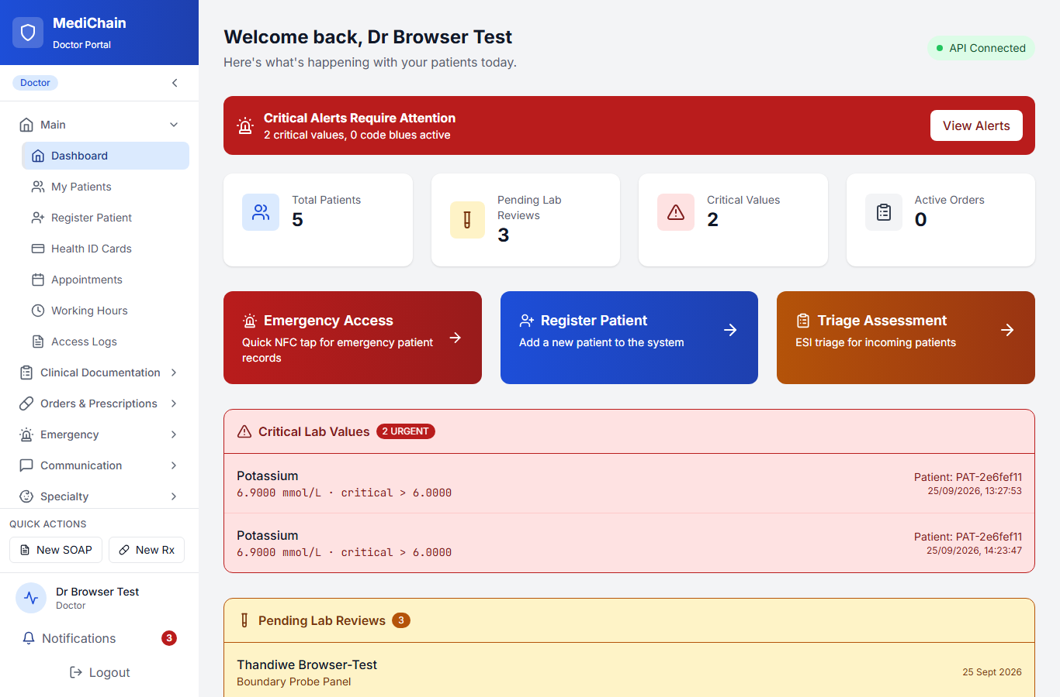
The solution in the application
Care team workspace
Patient chart and clinical notes
Orders and lab review
Prescriptions and dispensing
Controlled emergency access
Patient portal
Own records, medicines,
consent and access history.
MediChain Geekulcha 2026 3 / 11
Notes:
Actual product screenshot from the existing synthetic browser test environment, captured before this presentation. Numbers are fixture data, not adoption, outcome or current production metrics. Source: .browser-test/docker-sweep-data/doctor/_doctor_dashboard.png. Clinical routes: client/doctor-portal/src/config/navigation.ts. Patient routes: client/patient-app/src/App.tsx.

Slide 4
Seven roles, one patient care journey
Patient
View records and results, manage consent, review access history.
Doctor
Document consultations, order tests, prescribe and review results.
Nurse
Record vitals, triage, medication administration and shift handover.
Lab technician
Track specimens, enter results and escalate critical values.
Pharmacist
Review prescriptions, check drug safety and record dispensing.
Paramedic
Use controlled emergency access and record ambulance handover.
Administrator
Manage staff, approved devices, identity reviews and audit oversight.
MediChain Geekulcha 2026 4 / 11
Notes:
0:25–0:45. Each role sees a workspace that fits its job. A pharmacist records dispensing; a nurse records administration. Paramedics have emergency workflows rather than unrestricted chart navigation. A patient can view their own information and access history. Administrative powers do not imply unrestricted clinical access. Source: client/doctor-portal/src/config/navigation.ts, all seven role definitions and ADMIN_NAV through PARAMEDIC_NAV; client/patient-app/src/App.tsx routes; api/src/handlers/rbac.rs. Source review describes workflow scope, not end-to-end qualification of every screen.

Slide 5
A patient’s first visit and follow-up
01 Register and activate
Clinic registers the patient. Planned first-phone activation checks an ID, liveness and a matching face.
02 Receive care
Nurse records observations. Doctor reviews the chart, documents care and places orders.
03 Complete the orders
Lab technician returns results. Pharmacist reviews and dispenses the prescription.
04 Review and stay informed
Patient views records and medicines, manages consent and checks who accessed their data.
Emergency path: authorised responder + approved device + reason + time-limited access
MediChain Geekulcha 2026 5 / 11
Notes:
0:45–1:50, including a 50-second demo. Use one synthetic patient. Show the clinician chart, one documented clinical item and the patient’s corresponding view, then access history. Rehearse only workflows that work in the demo environment. The proposed ID/selfie/liveness onboarding is not a live capability claim. Explain that it binds the account to the patient record, and that knowing a medical ID never grants access. Emergency access is separate, restricted and audited. Sources: role navigation, patient App routes, api/src/handlers/general.rs, api/src/handlers/break_glass.rs and user-approved identity-engine design in this conversation.

Slide 6
First-phone identity verification
Implementation in progress
1. Capture evidence
Capture the ID and a live face in a short-lived session.
2. Check locally
OCR and document rules, liveness, then 1:1 face comparison.
3. Bind the account
Link the approved account to the correct patient medical ID.
4. Handle uncertainty
Route inconclusive checks to authorised manual review.
No external identity AI. No government-register claim. A medical ID does not grant access.
MediChain Geekulcha 2026 6 / 11
Notes:
Agreed target from the owner’s self-hosted identity design. Do not demonstrate this as completed. Evidence checks, authority confirmation and authentication are different. A new or replacement phone must not silently acquire another patient’s record. Manual and accessible alternatives remain necessary. Raw captures are temporary encrypted evidence, not permanent audit-log contents.

Slide 7
Architecture and patient-data protection
Application foundation
Security work in progress
React patient and staff portals
Rust / Actix API
PostgreSQL clinical records
Encrypted document storage
Private identity worker: local OCR,
liveness and 1:1 face matching.
Inconclusive checks go to review.
Hash-chained audit + Merkle proofs
Encrypted S3 Object Lock backups
Optional RFC 3161 timestamps
Server checks identity, role, patient
relationship and access purpose.
Required audit failure blocks disclosure.
Minimal evidence retention. No external
identity AI. Medical ID is not a password.
MediChain Geekulcha 2026 7 / 11
Notes:
1:50–2:20. The API remains the authorisation authority. The proposed identity worker has no internet egress and only compares one applicant to the document supplied. It cannot claim government-register verification. Raw biometric evidence does not belong in the permanent audit log. Apply informed consent, minimal collection, restricted review and retention/deletion rules; offer an accessible alternative. Identity verification, hash-chained checkpoints and locked S3 backup integration are in progress and not independently qualified. Source: api/src/middleware/phi_access_audit.rs; api/src/audit_merkle.rs; docs/HANDOFF.md; user-supplied SSDLC and identity design. Architecture represents the agreed target; it is not a complete inventory of all current deployment components.

Slide 8
Data privacy policies
Collection and purpose
Collect only information needed for care and identity checks.
Access and transparency
Check identity, role, patient relationship and access purpose.
Biometric evidence
Use restricted, encrypted temporary storage and defined deletion.
Patient safeguards
Show access history and provide a route to correct disputed details.
Retention and incidents
Confirm retention rules, processor agreements and incident duties.
Policy implementation and verification continue. Prototype uses synthetic data.
MediChain Geekulcha 2026 8 / 11
Notes:
Policy commitments and implementation requirements, not a compliance certification. The owner SSDLC requires privacy/security assessment, confirmed retention, processor review and incident-response responsibility before real patient use. No raw biometric data in immutable checkpoints. Consent is not a substitute for every applicable lawful basis. Source: user-provided SSDLC; POPIA official text https://www.justice.gov.za/legislation/acts/2013-004.pdf .

Slide 9
Competitive analysis
OpenMRS
Bahmni
MediChain
Patient registration, appointments,
queues, wards and clinical records.
Established EMR platform.
Integrated hospital workflows
with EMR and laboratory systems.
Can operate at a hospital site.
Patient-visible access history,
role-specific care workflows and
controlled emergency access.
Identity proofing in progress.
Our pilot must test whether this combination is easier to use and adopt.
No claim that existing platforms lack audit, privacy or patient-facing features.
MediChain Geekulcha 2026 9 / 11
Notes:
Official competitor sources accessed 26 September 2026: https://o3-docs.openmrs.org/en-US/docs/configure-o3/configure-patient-management/ ; https://www.bahmni.org/ ; https://www.bahmni.org/laboratory/ . This is a comparison of documented focus and maturity, not a scored benchmark. MediChain remains a prototype and does not claim feature exclusivity or validated superiority.

Slide 10
Pilot adoption and a sustainable service
Initial customer
Position among alternatives
A clinic partner with a named clinical lead.
Start with one care workflow and synthetic
training before an approved patient pilot.
Paper files: familiar local workflow.
Existing record systems: clinical operations.
MediChain focus: patient visibility linked
to role-specific care and emergency access.
Proposed business model
Readiness and pilot measures
Facility subscription plus onboarding
and support. Validate pricing with clinics.
Ask: a supervised pilot partnership.
TRL 3 framing: proof of concept.
Clinical validation remains outstanding.
Measure retrieval time, workflow completion
and patient understanding of access history.
MediChain Geekulcha 2026 10 / 11
Notes:
2:20–3:00. Proposed route to market: recruit one clinic partner, interview the clinical lead and patients, rehearse a narrow workflow and agree pilot safeguards before real data. Facility subscription and onboarding/support are business hypotheses; no price, revenue or funding figure has been confirmed. Establish baseline retrieval time and completion/error rates before claiming improvement. Comparison is by alternative category, not a verified competitor feature ranking. Do not claim other systems lack audit or patient portals. TRL 3 is conservative submission framing following programme p.2, not an independently certified rating. Existing local login/reload proof and frontend tests do not establish production readiness. The programme requests price and funding figures; replace the unpriced hypothesis once the owner confirms costs. Programme pp.4–5,12 lists final submission Sunday 27 September before 09:00 SAST and a separate demo video under 90 seconds. The page-5 slide-limit wording is contradictory; this five-slide deck is for Round 1.

Slide 11
Readiness, demonstration and pilot ask
Proof of concept
Local sign-in and session restoration verified.
Clinical workflows need pilot validation.
Identity and audit upgrades remain in progress.
The demonstration
One synthetic patient: clinician record, patient view, access history.
Separate submission video must be under 90 seconds.
Ask: a clinic partner for supervised workflow evaluation.
MediChain Geekulcha 2026 11 / 11
Notes:
Readiness is bounded by docs/HANDOFF.md: local login/reload and frontend gates do not prove a production release. Full Rust verification was blocked by disk capacity in the recorded run. TRL 3 framing follows the programme and is not certified. Pricing, monetary funding ask and a public demo-video URL are not provided; confirm them before final submission. Use this full deck as submission material and retain the existing five-slide deck for the three-minute Round 1 pitch. Programme wording on the count is ambiguous; owner quoted more than 10, so this full version has 11 slides.

