Slide 1
Submarine Mayhem
3rd Year Team project presentation
Luke Courtney, Ishka Yao, Adam Sheedy & Cillian Murphy

Slide 2
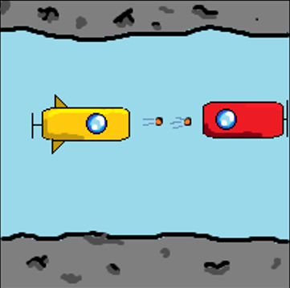
Introduction
Submarine Mayhem is a game in which a submarine ventures through an underwater cave battling other hostile subs, while collecting upgrades and powerups along the away

Slide 3
Overview
In this game you control a small submarine
The game takes place in an underwater cave
Your objective is to explore as far into the cave as possible
Along the way you will encounter enemy submarines
When destroyed, enemy submarines drop powerups, allowing you to upgrade your own submarine.

Slide 4
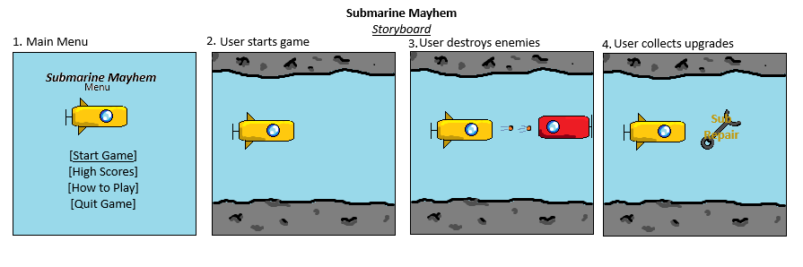
Concept art

Slide 5
Background
We chose this idea as we believe that it is a unique concept for a game and think that it will be a good way in which to build off what we have already learned in past projects.
The game shares elements with previous projects such as Zombie, and Thomas was Late.

Slide 6
Technical approach
The game is intended to be a PC only game.
We plan on using C++ and the SFML library.
The game will be single-player and will contain no networking elements.

Slide 7
Project/Team Management
We have scheduled meetings every Tuesday at 12:00 to discuss the project in-person. We additionally talk about our plans during the week on-campus, and in a Discord group chat.
We are using a GitHub remote repository for project management and version control.

Slide 8
Development method
For the project, we have chosen to follow Agile development methods.
We believe that this is best suited to us as we will be meeting on campus during the week and will be able to adapt to changes as they arise.
We chose this over the Waterfall methodology as the waterfall methodology may result in us being unable to adapt to any changes in the plan.

