Slide 1
GROUP 301- SPRINT RETROSPECTIVE
CIS*3760 SPRINT 9

Slide 2
SPRINT 9
Nikolas Beljo – 22pts
Robert Colanardi – 22pts
Luke Fischer – 20pts
Dawson MacPhee – 22pts
Jacob Wadsworth – 0pts
Nicholas Vinden – 20pts

Slide 3
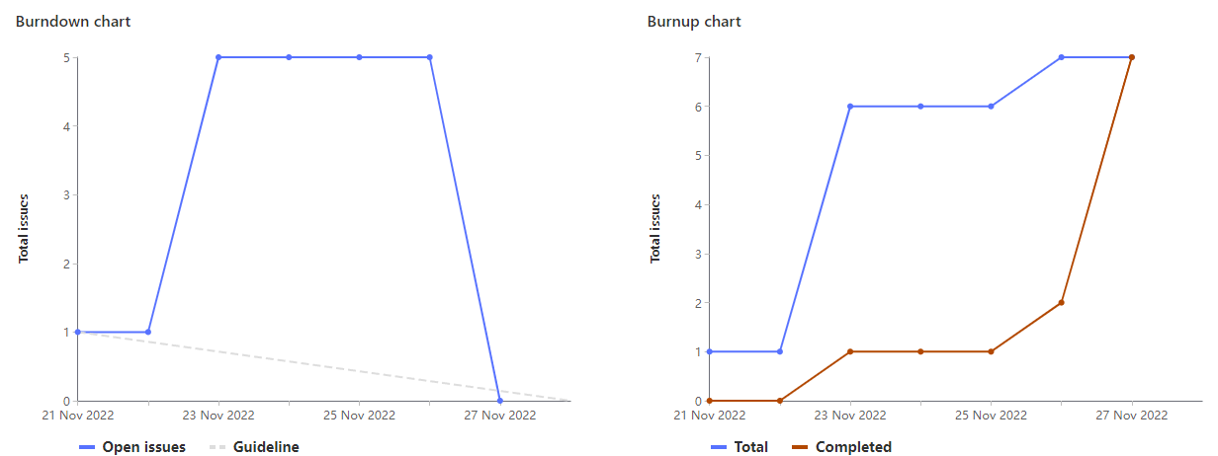
Burn Down/Up Chart

Slide 4
What Went Well/Bad?
Good
Built off the feedback from sprint 9 - were able to implement these new features in just one sprint
Really cleaned up the course calendar page
Intuitive autofill feature!
Rather than over extending our web app with more functionalities we focused on ensuring our core features worked well
Bad
In one instance, code was pushed that caused a minor delay in development (i.e had to revert some commits)

Slide 5
Nikolas Beljo
Planning + Meetings (2pts)
Testing + debugging (4pts)
Development (16pts)
Added More-Info Functionality to Course Cards (14pts)
Made visual changes to front-end (2pts)

Slide 6
Robert Colanardi
Planning meetings (2pts)
Testing + debugging (4pts)
Update Schedule View (16)

Slide 7
Luke Fischer (team lead)
Meeting + planning + tickets (3 pts)
Demo prep + retrospective (8 pts)
Testing (3 pts)
Use cases (2 pts)
Repo clean up + organizing course csv’s (2 pts)
Documentation (2 pts)
Readme
Wiki

Slide 8
Dawson MacPhee
Add autofill functionality (12pts)
Add semester filter (4pts)
Add back button to schedule (2pts)
Testing + debugging (2pts)
Planning meetings (2pts)

Slide 9
Jacob Wadsworth
Unavailable this week due to outside circumstances

Slide 10
Nicholas Vinden
Planning meetings (2pts)
Coding (16 pts)
Debugging (3 pts)
html, csv, json upload (8 pts)
Better room parse (5 pts)

Slide 11
Demo!

Slide 12
The End.
Thank you

