Slide 1
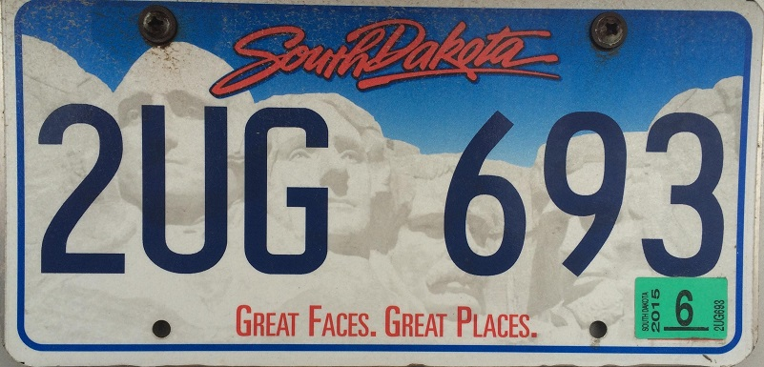
License Plate Sequence Extraction
Using Template Matching and
The Hough Transform
Lauren Keene, Kayhan Karatekeli, Luke Meyer

Slide 2
Project Premise
Extract the numbers and letters from a direct photo of a license plate using two different methods
Method 1: Template Matching
Method 2: Hough Transform
Each process will print to screen two things
1. the alphanumeric sequence extracted
2. the time needed to determine the sequence

Slide 3
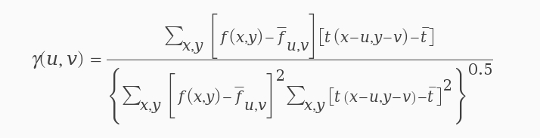
Template Matching General Description
What is template matching?
Process
  drag a template over every position in an image
  determine correlation coefficient
  if correlation is over a specific threshold, match found

Slide 4


Template Matching Implementation (part 1)
Templates
  system of 5 templates
  each was read in and
  “slid” across a license
  plate image
Correlation
if a correlation high it was recorded as a match
  each match had all information recorded in a system of arrays
Character Value | 'T' | '' | '' | '' | '' | '' | ''
Column | 46 | 0 | 0 | 0 | 0 | 0 | 0
Correlation | .813 | 1 | 1 | 1 | 1 | 1 | 1

Slide 5
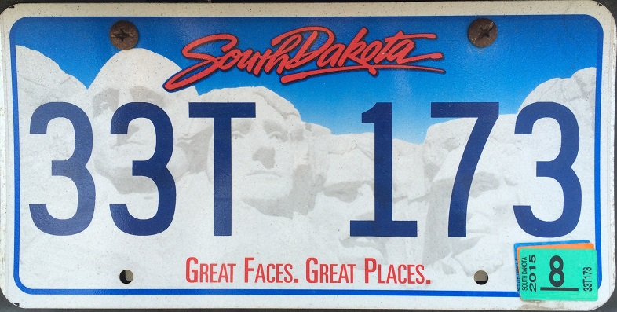
Template Matching Implementation (part 2)
Special Cases
Multiples
characters may have high correlations
in a neighborhood, not just one pixel
Character Value | '3' | '3' | '3' | '3' | '3' | '3' | '3'
Column | 6 | 7 | 6 | 6 | 112 | 113 | 113
Correlation | .813 | .790 | .836 | .804 | .752 | .891 | .810
Character Value | '3' | '3' | '3' | '' | '' | '' | ''
Column | 6 | 113 | 658 | 0 | 0 | 0 | 0
Correlation | .813 | .891 | .812 | 1 | 1 | 1 | 1

Slide 6
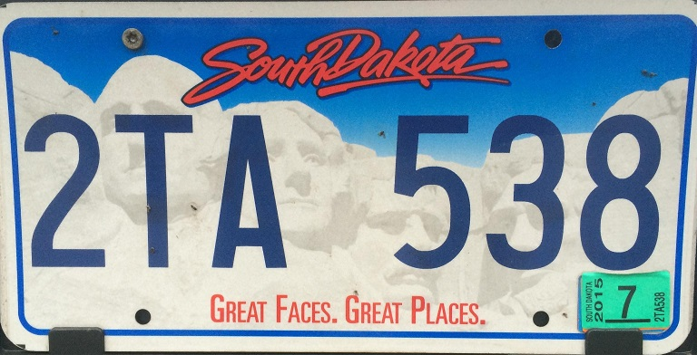
Template Matching Implementation (part 3)
Special Cases
Similar Characters
some characters may be
read as other characters
Character Value | '2' | '3' | '3' | '5' | '' | '' | ''
Column | 7 | 550 | 658 | 444 | 0 | 0 | 0
Correlation | .813 | .790 | .736 | .823 | 1 | 1 | 1
'8'
660
.853
Character Value | '2' | '3' | '8' | '5' | '' | '' | ''
Column | 7 | 550 | 660 | 444 | 0 | 0 | 0
Correlation | .813 | .790 | .853 | .823 | 1 | 1 | 1

Slide 7
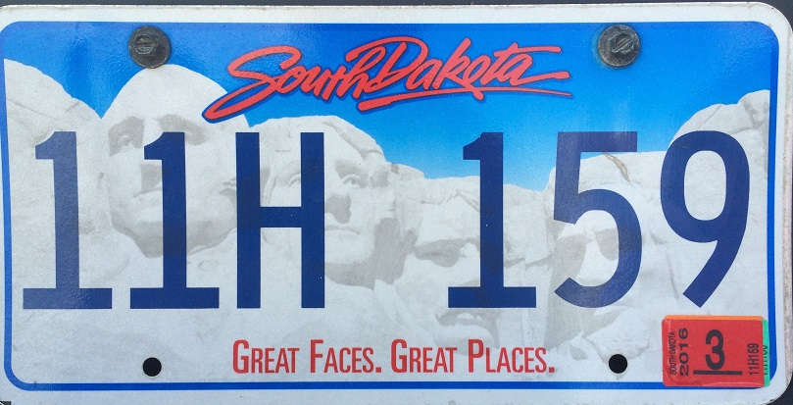
Template Matching Implementation (page 4)
After all templates have been run
Character Value | '5' | '9' | 'H' | '1' | '1' | '1' | ''
Column | 550 | 658 | 216 | 7 | 111 | 444 | 0
Correlation | .813 | .790 | .736 | .823 | .795 | .850 | 1
Character Value | '1' | '1' | 'H' | '1' | '5' | '9' | ''
Column | 7 | 111 | 216 | 444 | 550 | 658 | 0
Correlation | .823 | .795 | .736 | .850 | 550 | .790 | 1

Slide 8
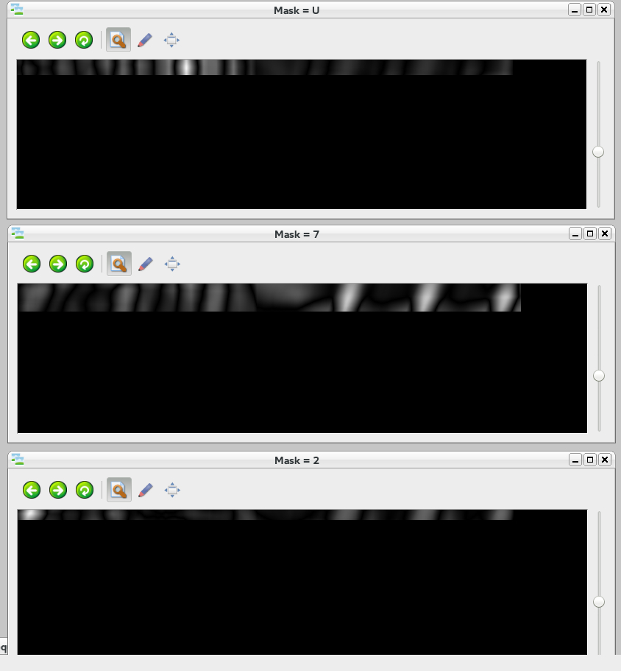
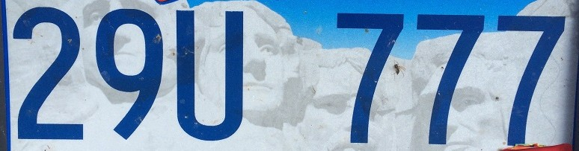
Template Matching Sample Results
Correlation Coefficient

Slide 9
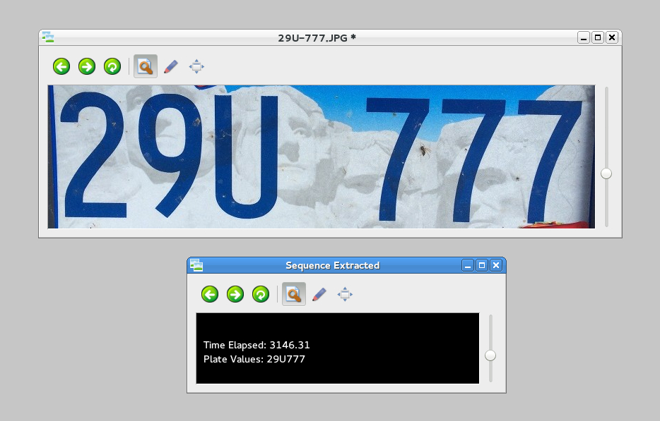
Template Matching Sample Results
Final Results

Slide 10
Generalized Hough Transform Description
What is the Generalized Hough Transform?
Process
  Analyze a template for
  centroid and key values
    Key values stored in r table
      Gradient Direction : ϴ
      Radius : r
      Alpha : α
  Create accumulator array
  Search for maxima

Slide 11
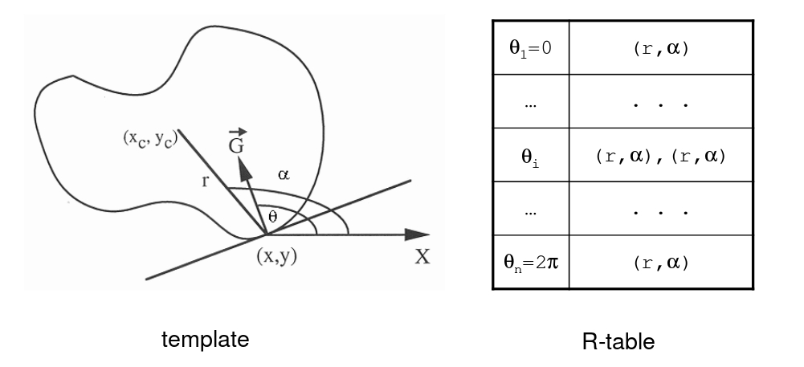
Hough Transform Implementation (part 1)
Dr. Weiss HoughSlides.pdf

Slide 12
Hough Method Implementation (part 2)
θ
0
1
2
3
.
.
.
.
359
r | α
R Table Struct
  struct RtableEntry
  {
  float alpha;
  float radius;
  RtableEntry *next;
  };
Accumulator Array
  Dynamic 2D array

Slide 13
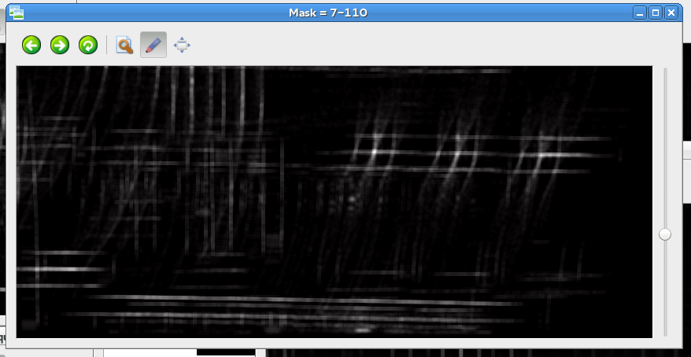
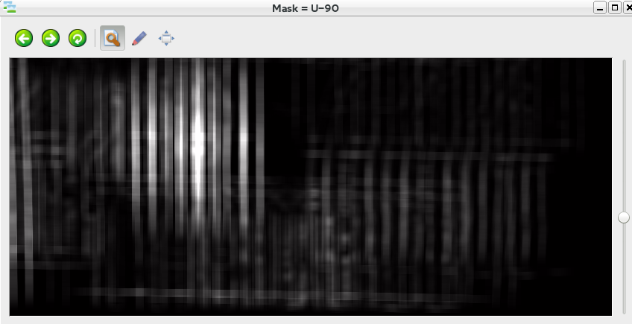
Hough Sample Results
Allocation Array

Slide 14
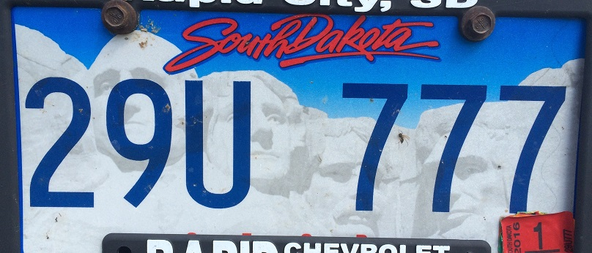
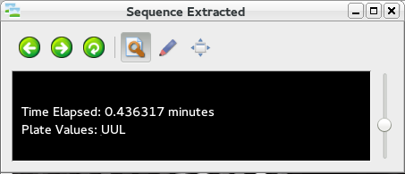
Hough Sample Results
Final Results

Slide 15
Comparison

Slide 16

Questions?

