Slide 1

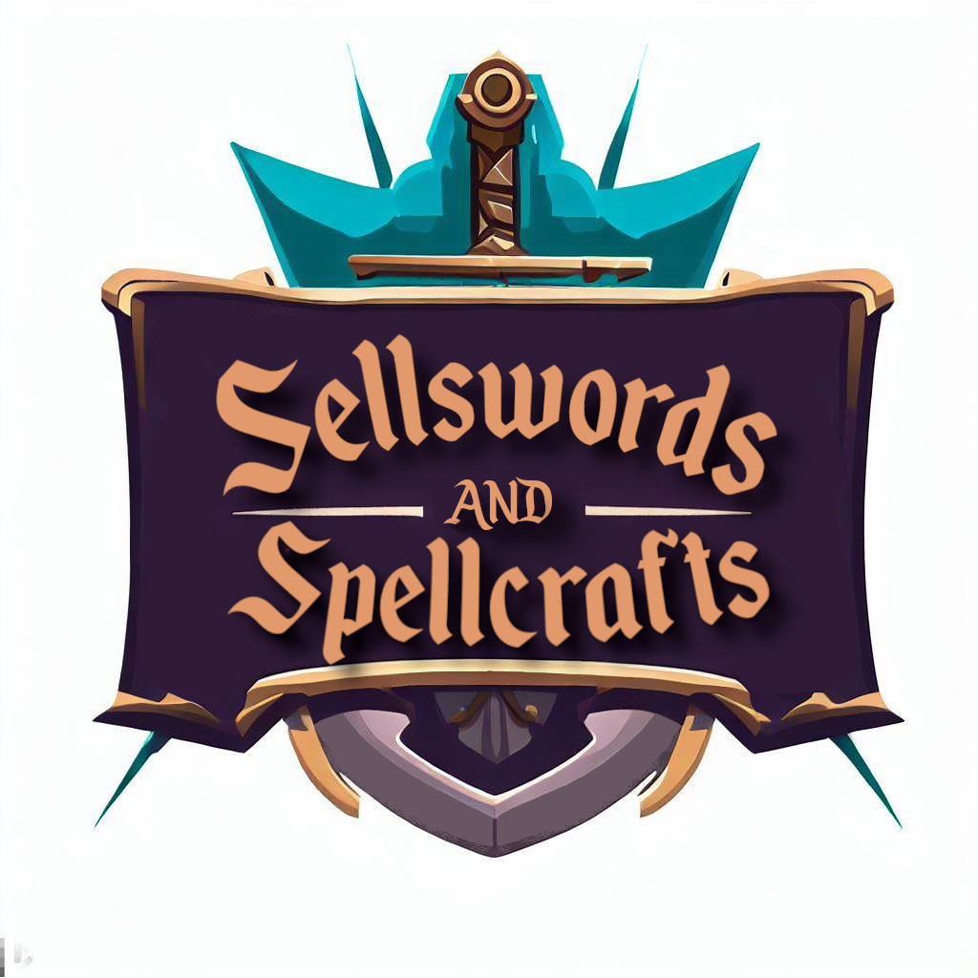
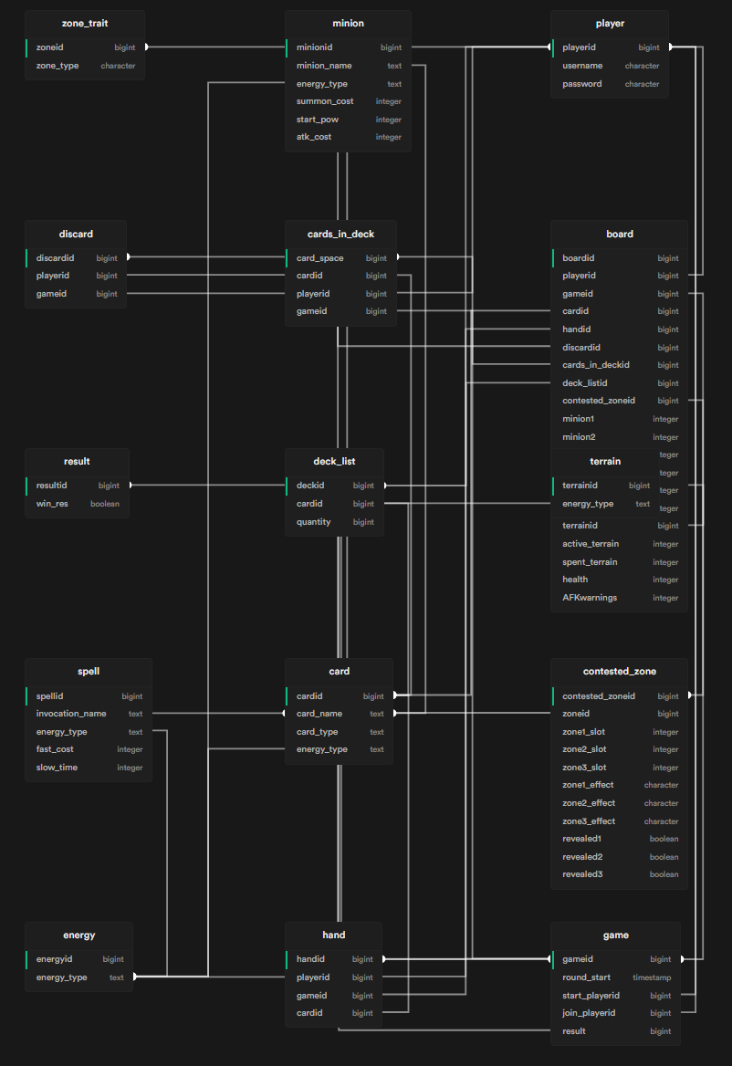
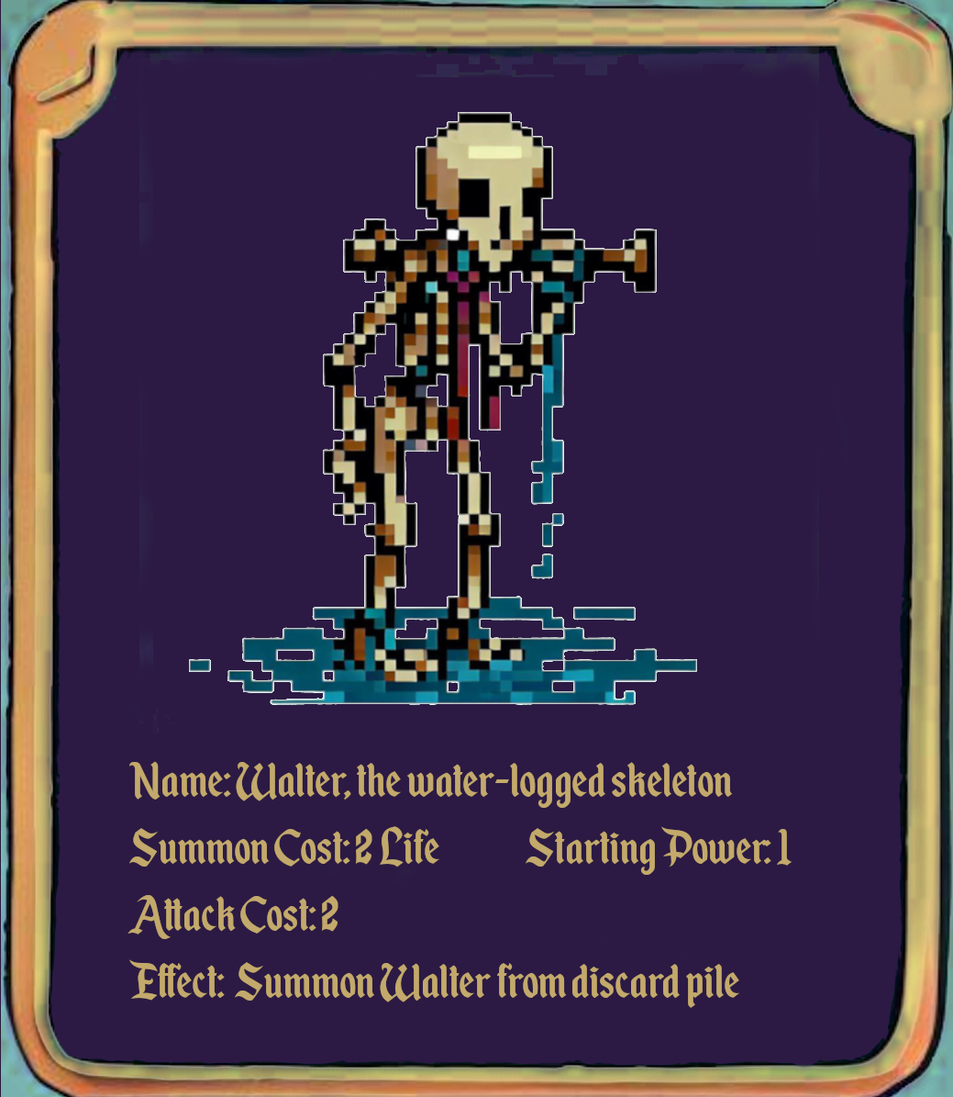
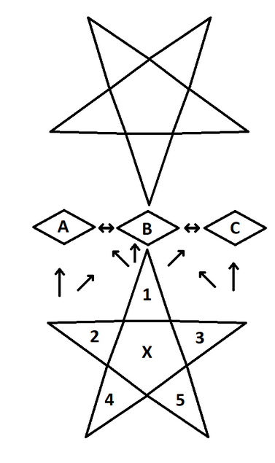
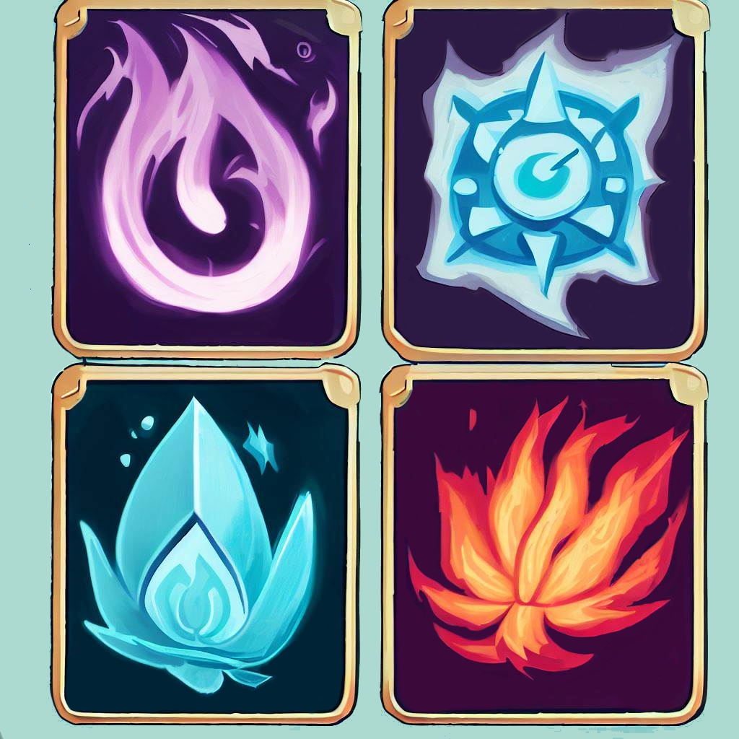
Sellswords and Spellcrafts
Luke Schnetlage, Mason Evans, Nicolas Towery
Dept. Of Computer Science and Information Technology
Background
Future Work
Abstract
Background
Design/Layout
Sellswords and Spellcrafts is an original, player versus player turn-based card game played in a web browser. Users connect to a central web server in which they are matched with other users. At the start of a game, a random player is selected to take the first turn. Once the initial turn has completed, the two players alternate turns until one player has reached zero life points or they have zero cards remaining in their deck. Each card consists of two attributes: type and energy. The main types are minion, invocation, and terrain. The energy attributes are void, wind, fire, and water. With these gameplay mechanics in mind, the system allows users to better understand the rules of the game and provide helpful tips as needed. We strive to provide players with a unique experience and a comfortable introduction to our game.
Sellswords and Spellcrafts, was inspired by the early era of magic the gathering and
Yu-Gi-Oh, placing the focus on turn based card combat with themes of primal energies and the occult. SaS serves as a self-contained game in contrast to Magic's ever expanding 25,514 card set, filling a niche for those not looking to learn 30+ years of complex mechanics and rules changes.
Synthesizing the limited board space of Yu-Gi-Oh, the time delayed resource system of magic, and the central contested zone of Xiangqi (Chinese chess) gives the game a feeling like no other.
Sellswords and Spellcrafts is a webhosted card game that uses Supabase to host its database and Replit to host the domain. Login Page Upon loading into website, the user will be greeted with the default Replit authentication page. Here, they can login to their Replit account, or sign up for Replit. Home Page
Once the user is successfully authenticated, they will be greeted with the homepage. It contains the logo as well as some basic information about the project.
Rules Page
The user will be able to select the Rules page from the navbar. Here, they can find an exhaustive list of information detailing how the game is to be played.
Game Page
The user will be able to select the Game page from the navbar. It is broken down into three parts: pre-game, active game, and post-game.
Pre-Game
Upon entering the game page, the window will default to the pre-game phase. Here, users will see a list of other users logged into the website and can join a game
Active Game
This is where the game is actually played. For information on how the game is played, please see the Rules section below.
Post-Game
Once the game has ended a message will be displayed to the user that is dependent on the win condition. After this, the user will enter the pre-game phase of the game page to join another game.
For the future of Sellswords and Spellcrafts, we will make it possible to have a deck-building element to the game. We will make this possible by creating a more in-depth account system, where a player’s game information, such as cards and win statistics, will be saved. This will provide users with the opportunity to explore new options or allow them to find a playstyle that suits them. In creating this system, we will first require users to link an email for account management or recovery purposes.
Another planned feature that we will implement is the ability to have an in-game chat. This is going to be a way for users to interact with their opponent. We will allow for preset messages to be sent, while also having the chat bar that allows for custom texts.
The final features that we have planned will work with each other, and it is a new energy type, which we will call Chaos, and a larger card library. In having a new type of energy, this will allow us to create and design more minion invocation card types. This will give users more variety and choice.
We will create and implement all these features in the order in which they were mentioned.
Technology
Replit was used as a means to authenticate users, host the website, and as an online real-time IDE for development. React was used as a front-end framework in order to streamline the development process. Node JS was used as a back-end framework to run the server. Probably the most critical library used by these frameworks was socket.IO. Socket.IO enabled the project to have the client's browser updated in real time without the need to refresh the page. This functionality is essential for an online in-browser game. Supabase was used as a host for the database and uses the PostgreSQL language for a relational database. GNU Image Manipulator (GIMP) was used to create the logo as well as all card designs. Documentation was created using Google Docs. GitHub was used as a means for version control.
Figure 4: The A card in the existing deck. This card and all other cards show various card-related information.
Figure 1: The structure of the database, created in PostgreSQL, using the Supabase service. This database securely stores all important user and game information.
Rules/Game Information
References
Figure 3: The general layout of the game board. Indicated features of the board are areas 1 through 5 where the Minion cards will be when first entering gameplay. Areas A through C are the Contested Zone, where players will take actions against the terrain or other players.
The gameplay loop will follow players taking turns trading life and energy to summon minions and cast invocations with the eventual goal of reducing their opponent's life total to zero. Minions may only be summoned to a player's summoning circle. From the summoning circle, a minion may attack one of the three contested zones shared by both players. Once a minion occupies a contested zone, it may attack your opponent directly. Invocations may be cast either for free over a period of multiple turns or quickly at the cost of more energy. Once cast, invocations provide varied effects ranging from destroying enemy minions to drawing additional cards.
Supabase: https://supabase.com/
Replit: https://replit.com/
Socket.IO: Socket.IO
React: https://react.dev/
Node.JS: Node.js (nodejs.org)
Figure 2: The back of each type of card, in order from top left to bottom right, is the Void type, Wind type, Water type, and Fire type.
Acknowledgements
We would like to thank Dr. Karen Meisch for her support of students in the College of Science, Technology, Engineering & Mathematics, and Dr. Leong Lee for his support of students in the Department of Computer Science and Information Technology.

