Slide 1

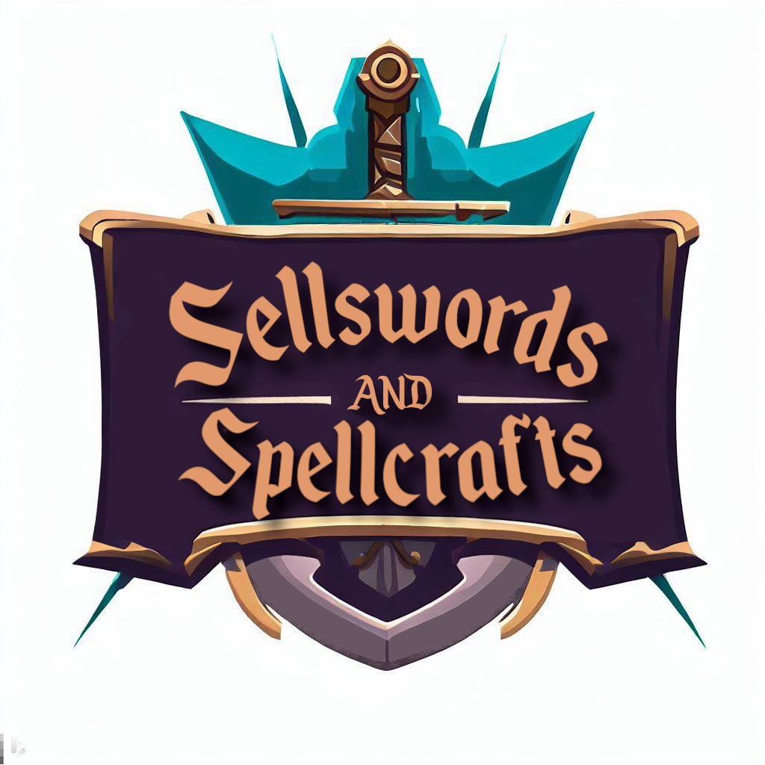
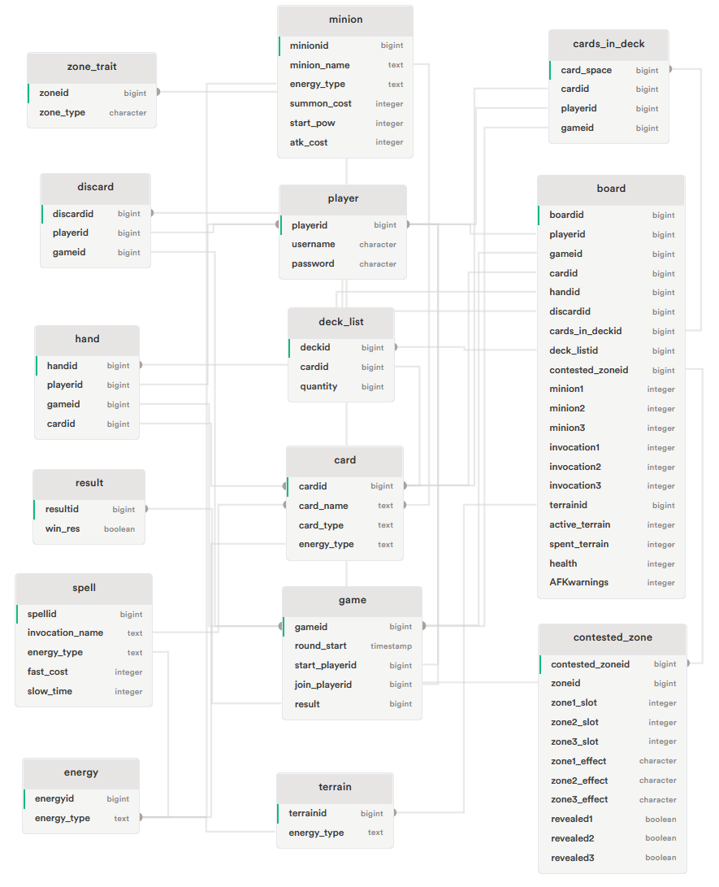
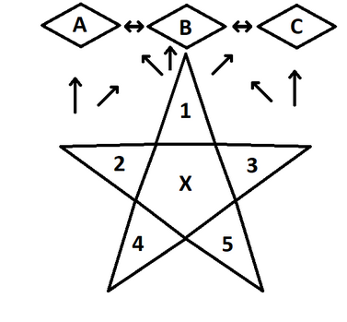
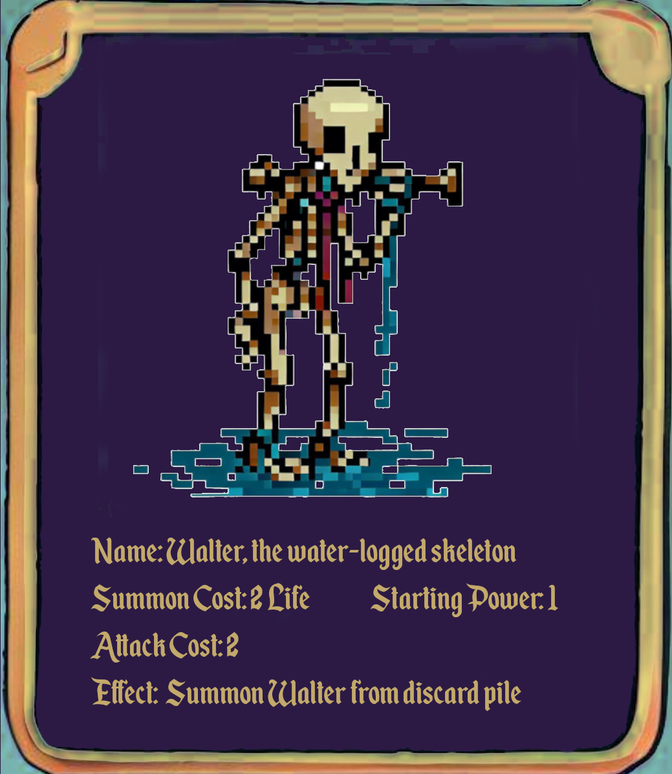
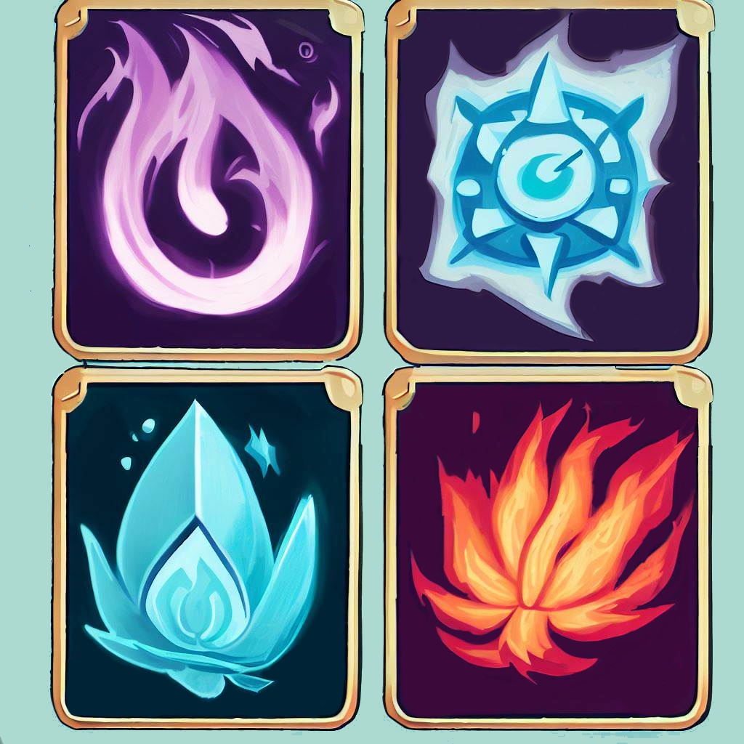
Sellswords and Spellcrafts
Luke Schnetlage, Mason Evans, Nicolas Towery
Dept. Of Computer Science and Information Technology
Abstract
Rules/Game Information
Technology
Future Work
Sellswords and Spellcrafts is a turn-based card game played in a web browser. Users connect to a central web server in which they are matched with other users. At the start of a game, a random player is selected to take the first turn. Once the initial turn has completed, the two players alternate turns until one player has reached zero life points or they have zero cards remaining in their deck. Each card consists of two attributes: type and energy. The main types are minion, invocation, and terrain. The energy attributes are void, wind, fire, and water. With these gameplay mechanics in mind, the system allows users to better understand the rules of the game and provide helpful tips. This provides players with a unique experience and a comfortable introduction to our game.
The gameplay loop follows two players taking turns trading life and energy to summon minions and cast invocations with the goal of reducing their opponent's life total to zero. Minions may only be summoned to a player's summoning circle. From the summoning circle, a minion may attack one of the three contested zones shared by both players. Once a minion occupies a contested zone, it may attack your opponent directly. Invocations may be cast, for free, over a period of multiple turns or quickly at the cost of more energy. Once cast, invocations provide varied effects ranging from destroying enemy minions to drawing additional cards.
Login Page Where user(s) arrive upon entry of URL. Home Page
Where user(s) learn basic information about the website.
Rules Page
Where user(s) can understand game rules.
Game Page
Where user(s) can partake in larger game
Pre-Game
Where user(s) see game sessions to join and play games.
Active Game
Where user(s) play the game.
Post-Game
Where user(s) are taken after game completion. Displays game results.
For the future of Sellswords and Spellcrafts, we will make it possible to have a deck-building element to the game. We will make this possible by creating a more in-depth account system, where a player’s game information, such as cards and win statistics, will be saved. This will provide users with the opportunity to explore new options or allow them to find a playstyle that suits them. In creating this system, we will first require users to link an email for account management or recovery purposes.
Another planned feature that we will implement is the ability to have an in-game chat. This is going to be a way for users to interact with their opponent. We will allow for preset messages to be sent, while also having the chat bar that allows for custom texts.
The final features that we have planned will work with each other, and it is a new energy type, which we will call Chaos, and a larger card library. In having a new type of energy, this will allow us to create and design more minion invocation card types. This will give users more variety and choice.
We will create and implement all these features in the order in which they were mentioned.
Background
Design/Layout
Sellswords and Spellcrafts, was inspired by the early era of Magic the Gathering and
Yu-Gi-Oh, placing the focus on turn-based card combat with themes of primal energies and the occult. SaS serves as a self-contained game in contrast to Magic's ever expanding 25,514 card set, filling a niche for those not looking to learn 30+ years of complex mechanics and rules changes.
Synthesizing the limited board space of Yu-Gi-Oh, the time delayed resource system of Magic, and the central contested zone of Xiangqi (Chinese chess) gives the game a feeling like no other.
Replit was used to authenticate users, host the website, and as an online real-time IDE for development. React was used as a front-end framework to streamline the development process. Node JS was used as a back-end framework to run the server. Probably the most critical library used by these frameworks was socket.IO. Socket.IO enabled the project to have the client's browser updated in real time without the need to refresh the page. This functionality is essential for an online in-browser game. Supabase was used as a host for the database and uses the PostgreSQL language for a relational database. GNU Image Manipulator (GIMP) was used to create the logo as well as all card designs. Documentation was created using Google Docs. GitHub was used as a means for version control.
Figure 1: ERD showing database structure.
Figure 3: Generic game board layout.
References
Acknowledgements
Supabase: https://supabase.com/
Replit: https://replit.com/
Socket.IO: Socket.IO
React: https://react.dev/
Node.JS: Node.js (nodejs.org)
We would like to thank Dr. Karen Meisch for her support of students in the College of Science, Technology, Engineering & Mathematics, and Dr. Leong Lee for his support of students in the Department of Computer Science and Information Technology.
Figure 4: Example card from deck.
Figure 2: Artwork for back of cards.

