Slide 1
COMPAS Recidivism Bias Audit
Bias Detection and Mitigation Report using AI Fairness 360

Slide 2
Introduction
This presentation summarizes the analysis of racial bias in the COMPAS dataset, focusing on African-American and Caucasian groups. The AI Fairness 360 toolkit was used to measure disparities and apply mitigation strategies such as Reweighing.

Slide 3
Dataset & Preprocessing
- Used compas-scores-two-years.csv
- Filtered records (valid screening dates, charge degree, and known recidivism)
- Focused on African-American and Caucasian individuals
- Engineered binary 'race' attribute and 'two_year_recid' label

Slide 4
Bias Metrics (Before Mitigation)
- Disparate Impact < 1 → Unfair outcome
- False Positive Rate (FPR) higher for African-Americans
- False Negative Rate (FNR) higher for Caucasians

Slide 5
Mitigation Technique
- Applied Reweighing to balance training data
- Trained logistic regression using instance weights
- Evaluated fairness and accuracy on test set

Slide 6
Results After Mitigation
- Equal Opportunity Difference ~ 0
- Average Odds Difference reduced
- Model retained reasonable accuracy

Slide 7
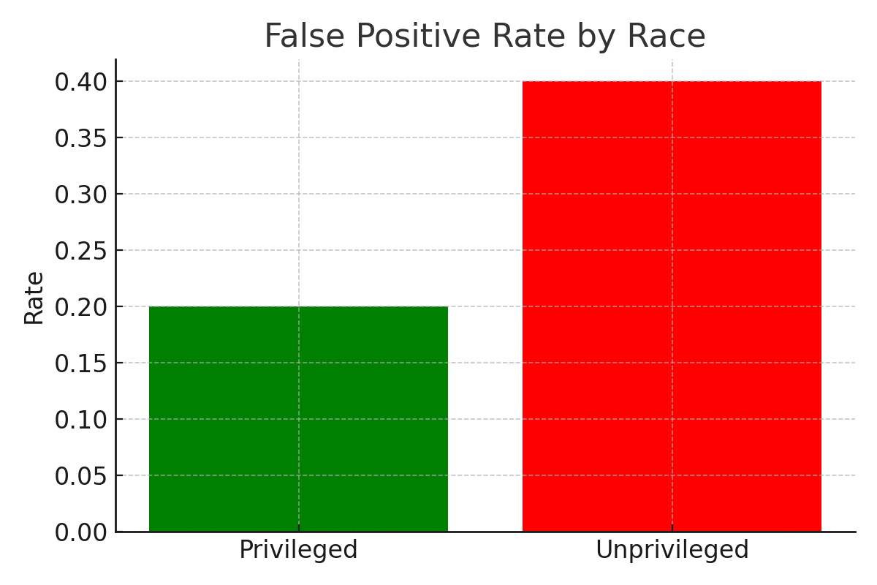
Disparity in Error Rates

Slide 8
Conclusion
The COMPAS algorithm showed clear racial bias in classification errors.
Applying Reweighing reduced disparities significantly.

Slide 9
Recommendations
Regular fairness audits and fairness-aware learning in sensitive domains.

