Slide 1

A multiple choice trivia game

Slide 2
Main features
Opens with ascii title graphic prompting user to press any key to continue..
Username is entered and validated and then option to change it or exit the app is given
Default setting is 6 general knowledge multiple choice questions on easy setting.
Quiz runs and then score is printed out in rainbow ascii graphic
Printout of results, including correct and incorrect. User prompted to press any key and results disappear before asking to play again or exit.

Slide 3
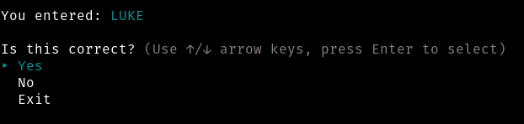

Validating Username >>

Slide 4
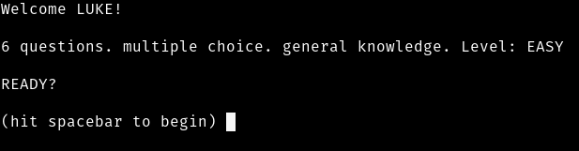
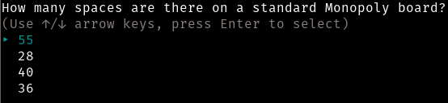
Quiz section >>

Slide 5
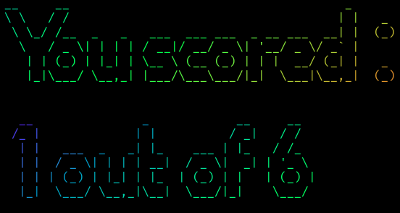
Score page >>

Slide 6
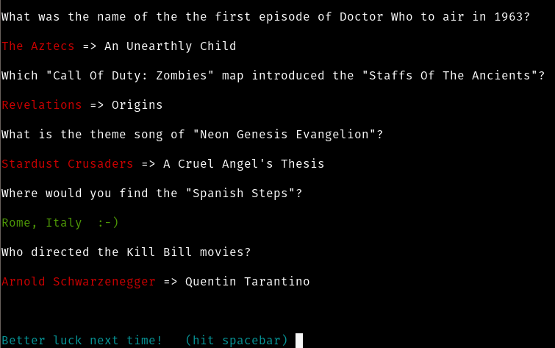
Results page >>

Slide 7
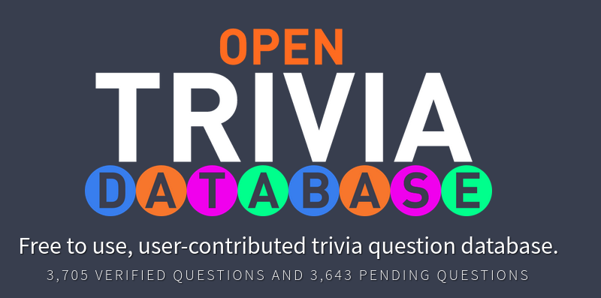
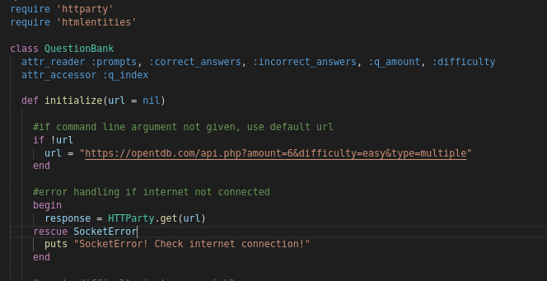
Working with the Open Trivia DB API >>
HTTParty to simplify API call
Error handling if issue with internet
Listed is the default url that asks for 6 random multiple choice questions from any category

Slide 8
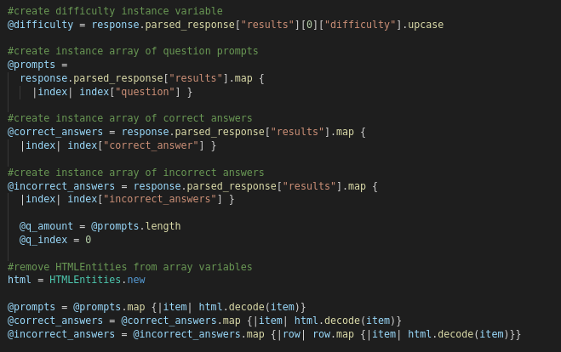
Decoding HTML Entities & populating quiz arrays >>
Created 2 arrays and 1 nested array of trivia data
Used HTMLEntities gem to easily decode the &quot? Etc from the data.

Slide 9
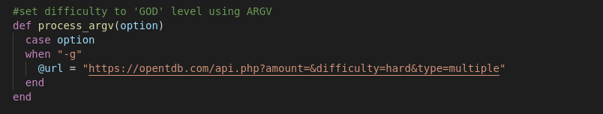
Using ARGVs >>
Provide an alternative API url calling 15 random ‘HARD’ level questions when ‘-g’ flag is used.

Slide 10
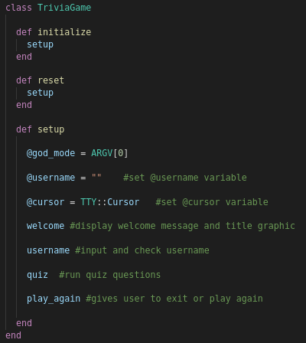
TriviaGame Class >>
Created an instance variable for the ARGV in a setup method in the main TriviaGame class.
Wrapping the game in a TriviaGame class like this was the solution I found to re-initialize the game instance

Slide 11
Features to implement later on >>
Export score results to file
Import score results to create top scores
Countdown timer for each question

Slide 12
Any Questions?

