Slide 1
Project 2: Maze Router for 2-terminal Nets Due Date:2021/04/29

Slide 2
Objective
Given
Routing region
Blockages
Net terminals
Goal
Connect all net terminals
Minimize grids usage

Slide 3
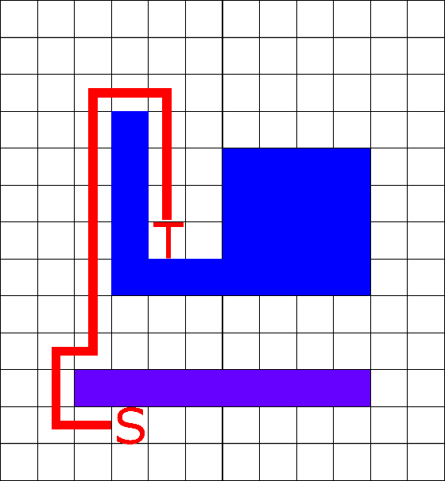
Example 1
Find a path from source to target, and minimized the number of wiring grids

Slide 4
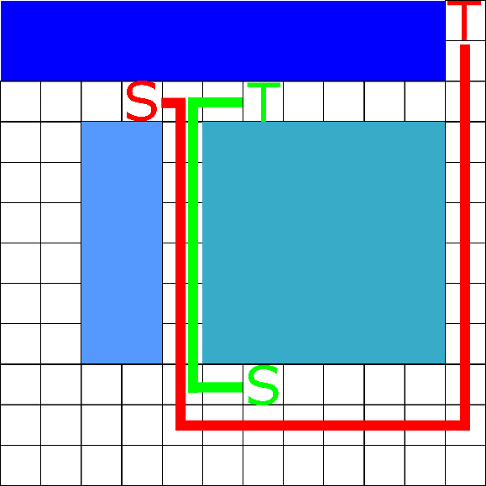
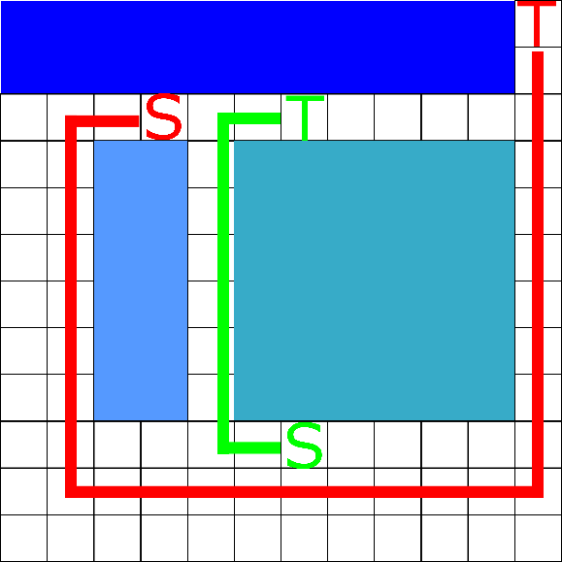
Example 2
If there exists any grid with two path passing, rip-up and re-route
Rip-up and
Re-route
Violation

Slide 5
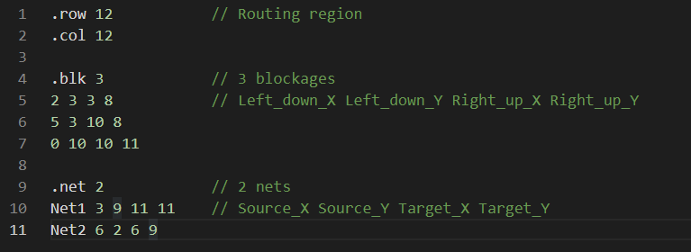
Input Format
Input file(*.in) is provided per case
Assume the lower-left corner of the table is the origin(0,0)

Slide 6
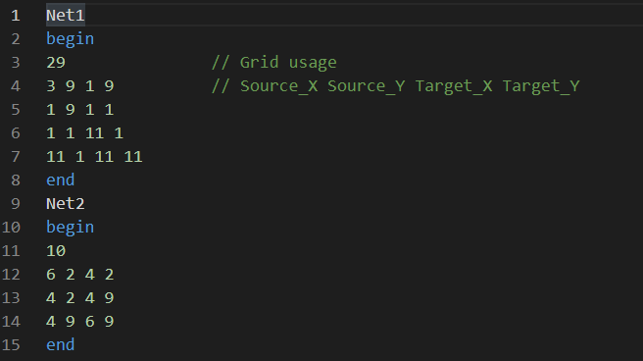
Output Format
Output file(*.out) should be generated per case
Calculate grid usage
Routing path should from source to target

Slide 7
Score
Scoring
If you connect all the terminals correctly, you can get at least 60 points
The fewer grids you use, the higher score you get
You must write your own code
Copying codes may result in zero point
Delay submission
Within 3 days: score * 0.7
More than 3 days: score = 0

Slide 8
Submission
Please upload the following materials in a “zip” file to New E3 by the deadline, specifying your student ID in the subject field
Source code (.cpp, .h)
Makefile
Executable binary
A Readme file (Information to how to make and execute your code)
If any question
Ask in E3 discussion forum

