Slide 1
Colorado University Decision Diagram (CUDD)
Course Materials
TA’s email: audrey1535.ee07g@nctu.edu.tw
yenchen1102.ee08g@nctu.edu.tw
TA: 宋伶彥, 鍾晏禎
May 6 , 2021

Slide 2
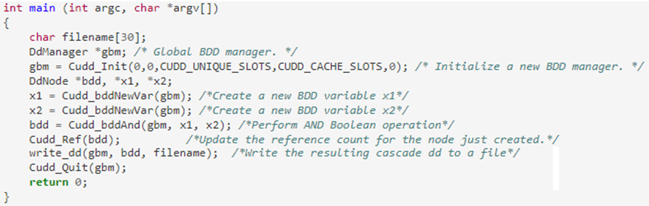
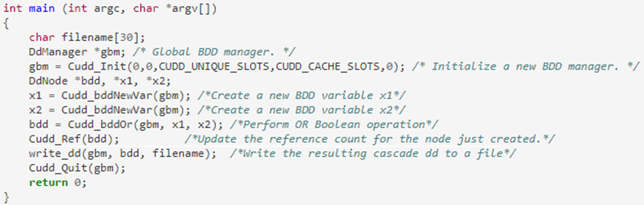
Colorado University Decision Diagram(CUDD)
The CUDD package provides functions to manipulate Binary Decision Diagrams (BDDs)
Cudd_bddAnd()
Cudd_bddOr()

Slide 3
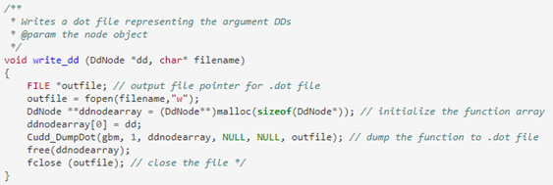
Dumpfile
Dump BDDs in .dot format, which can be visualized by Graphviz
WebGraphviz provides online visualization of .dot files
http://www.webgraphviz.com/
Cudd_DumpDot()

Slide 4
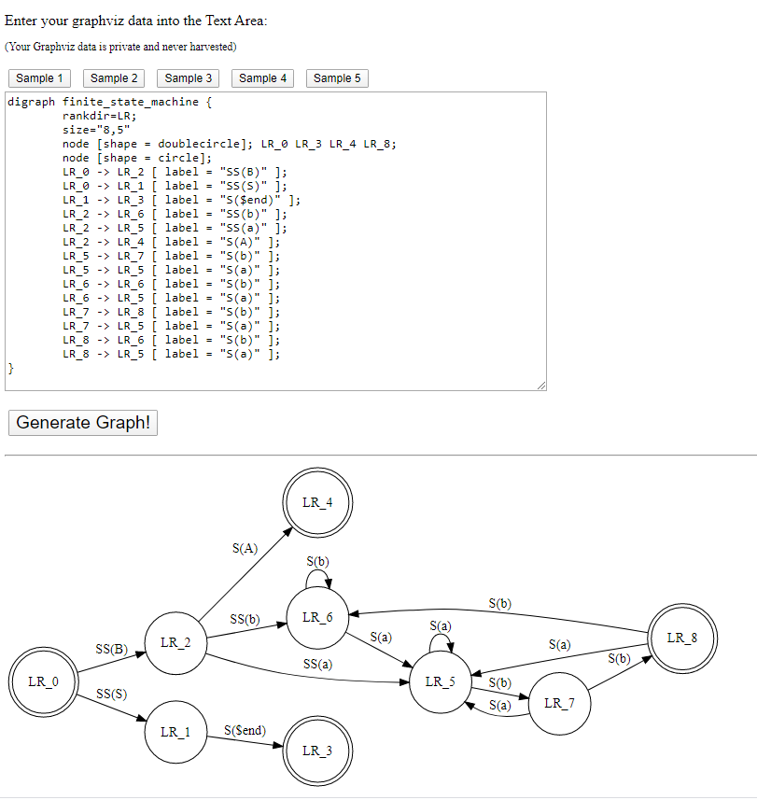
WebGraphviz
Paste your BDD here

Slide 5
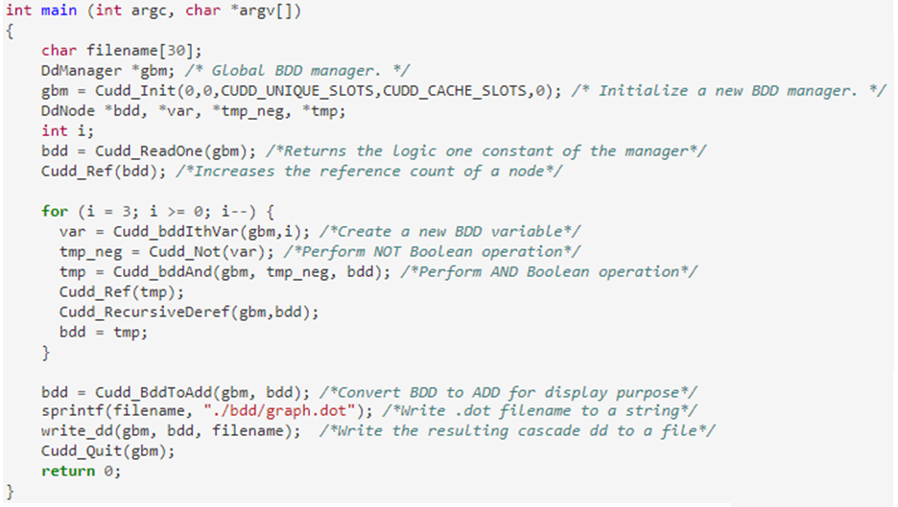
Example of BDD Construction
BDD for Boolean function f= x0’x1’x2’x3’

Slide 6
CUDD Reference
CUDD tutorials
https://davidkebo.com/cudd
The CUDD package
http://web.mit.edu/sage/export/tmp/y/usr/share/doc/polybori/cudd/cuddAllDet.html
Function set
https://www.cs.rice.edu/~lm30/RSynth/CUDD/cudd/doc/cuddAllFile.html
Example code
http://www.cs.cmu.edu/~emc/15817-s05/bdd-example.c
Function documentation
http://www.ece.ubc.ca/~eddieh/abc_dox/de/d7d/cuddReorder_8c.html#a02a5a86dfb8ebc7726d6cf56b6a7eec1

Slide 7
CUDD Package Installation

Slide 8
Download the Package
Download the cudd-3.0.0.tar package from:
https://davidkebo.com/source/cudd_versions/cudd-3.0.0.tar.gz
Uncompressing and installing
> tar -xvf cudd-3.0.0.tar.gz
> cd cudd-3.0.0
> ./configure
> make
> make check

Slide 9
Compile with CUDD Package
$CUDD = /…/cudd-3.0.0 (address)
Command: pwd
gcc -I $CUDD/cudd -I $CUDD/util -I $CUDD <file>.c $CUDD/cudd/.libs/libcudd.a –lm -O3 –o Lab3

Slide 10
Thank you

