Slide 1
Binary Decision Diagram Application
Lab3
TA’s email: audrey1535.ee07g@nctu.edu.tw
yenchen1102.ee08g@nctu.edu.tw
TA: 宋伶彥, 鍾晏禎
May 6 , 2021

Slide 2
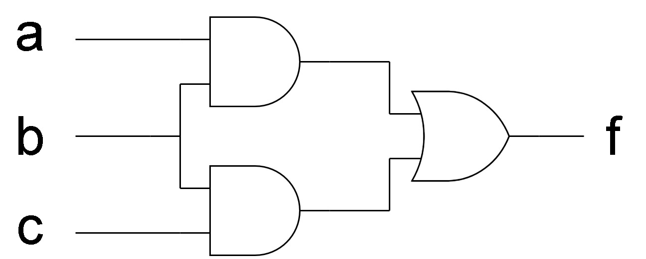

Probability of Signal(1/2)
How to calculate the probability of $f =1$ ?
f = ab+bc with P(a)=0.5 , P(b)=0.5, P(c)=0.5
0.25/1
0.5/1
0.75/0
0.5/1
P(f = 1) = 2*(0.75*0.25)+(0.25*0.25)
= 0.4375
0.5/1
0.25/1
0.75/0

Slide 3
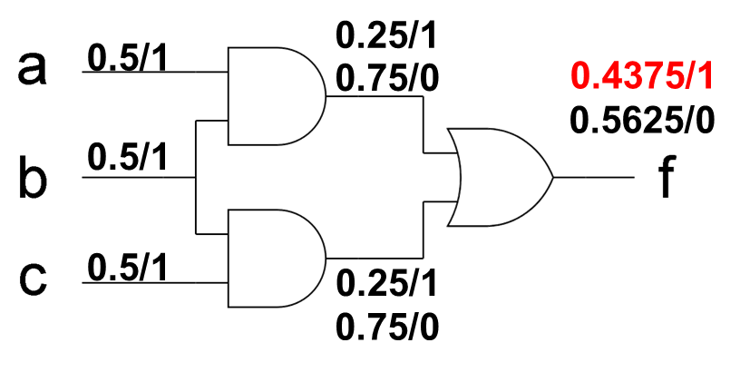
Probability of Signal(2/2)
How to calculate the probability of $f =1$ ?
f = ab+bc with P(a)=0.5 , P(b)=0.5, P(c)=0.5
a | b | c | f
0 | 0 | 0 | 0
0 | 0 | 1 | 0
0 | 1 | 0 | 0
0 | 1 | 1 | 1
1 | 0 | 0 | 0
1 | 0 | 1 | 0
1 | 1 | 0 | 1
1 | 1 | 1 | 1
concurrent signal !
P(f = 1) = 0.375

Slide 4
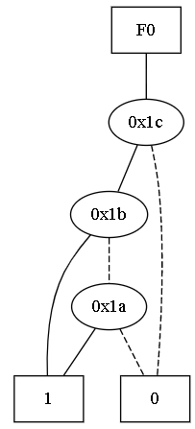
Probability of Signal in BDD
Binary Decision Diagram can solve the concurrent signal problem
f
0.375/1
b
0.75/1
a
0.5/1
c

Slide 5
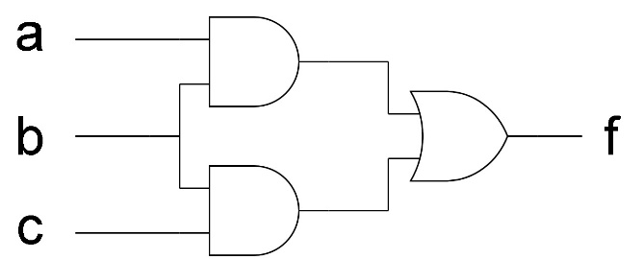

Lab3
Please implement a power estimator, which can calculate the signal probability of output function, $f=1$, of the given Boolean equation in sum-of-product (SOP) form.
Input
Output
Construct BDDs
f = ab+bc
P(a)=0.5 , P(b)=0.5, P(c)=0.5
probability of output function
P(f = 1)
Calculate the probability with BDDs

Slide 6
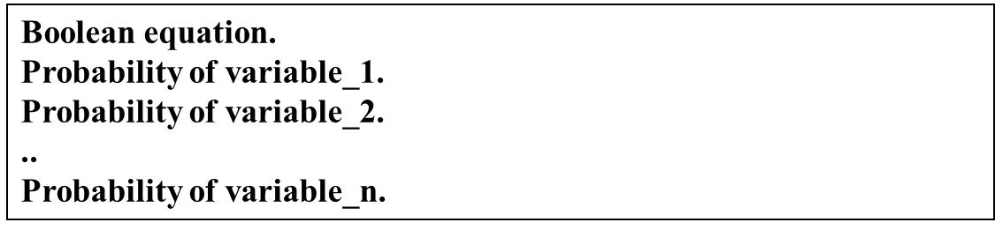
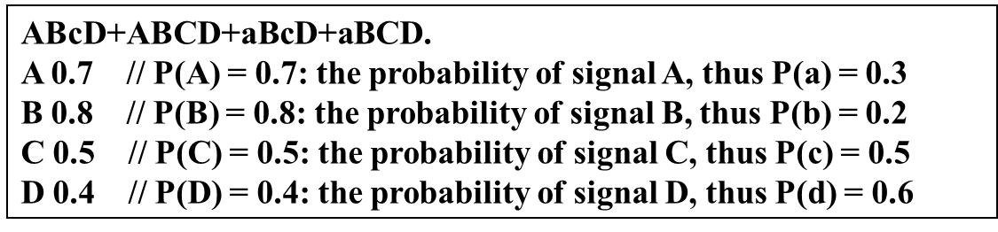
Input & Output Format
Input
Output
※Please round off to the third decimal place.

Slide 7
Submission
A zip file (Student_ID.zip)
Source code (Student_ID_lab3.cpp/.h)
Executable binary (Lab3)
A Readme file (Information to how to compile and execute your code)
Due Date : 2021/05/24 Mon. 23:55
You’ll get 0 grade if failing to hand in on time

Slide 8
Thank you

