Slide 1
Two-way Partition Mar. 18, 2021
TA: Cheng-Yu Chiang (姜承佑)
Email: chfrank9807@gmail.com
Advisor: Hung-Ming Cheng

Slide 2
Outline
lab1
Workstation
Problem Formulation
hMETIS introduction
Evaluation
Program Submission

Slide 3
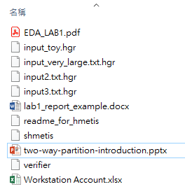
lab1
Two-way partition
lab1.zip (on new E3)
EDA_LAB1.pdf
Workstation.xlsx
This ppt
Input_testcases*4
shmetis
readme_for_hmetis
verifier
lab1_report_example.docx
Notes:
可以用FM、KL、或其他你們知道的partitioning algorithm

Slide 4
Workstation
Host: 140.113.225.204
Port: 22
Account: 2021EDAXXX (see the excel file in this folder)
Password: 2021eda

Slide 5
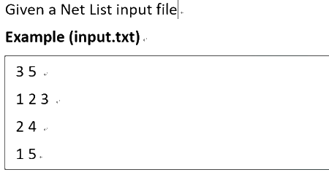
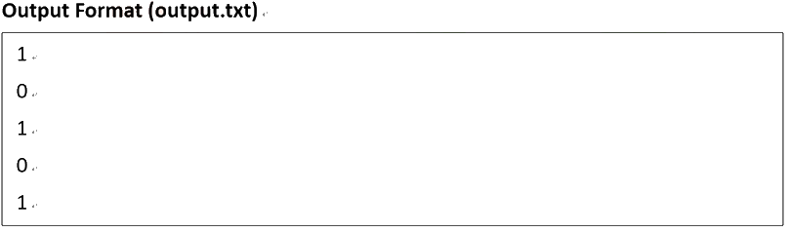
Problem Formulation (1/2)
Input
The first line represents how many nets and how many nodes there are.
And the next line to the last line
defines the nodes to which the net is connected.
Output
The first line to the last line defines the groups to which the node belongs.
Notes:
可以用FM、KL、或其他你們知道的partitioning algorithm

Slide 6
Problem Formulation (2/2)
Input
output
first line: # of nets and # of nodes
rest of lines: defined the nodes (named as 1 ~ n)
which the net is connected
The n-th line: group to the n-th node belongs
Notes:
可以用FM、KL、或其他你們知道的partitioning algorithm

Slide 7
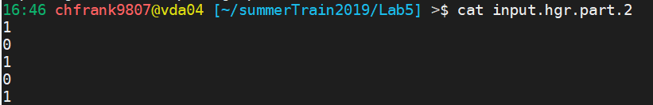
hMETIS introduction
An exe file which is dealing K-way partitioning
Usage: ./shmetis [input] [ # of groups ] [ balance factor ]
Ex: ./shmetis input.hgr 2 5
And there will be a output file named input.hgr.part.2
Reference:
hMETIS web
Karypis, George, and Vipin Kumar. "Multilevel k-way hypergraph partitioning." VLSI design 11.3 (2000): 285-300.

Slide 8
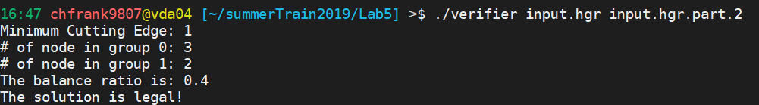
Evaluation
Your program:
./lab1 [input]
Ex: ./lab1 input.hgr
Output: output.txt
Verifier
It will verify your output file and show the balance ratio
Usage: ./verifier [input] [output]
Ex: verifier input.hgr input.hgr.part.2

Slide 9

Upload binary file to workstation
If there is an error message “permission denied” when you run the binary files, use command ‘chmod’ to turn on the permission of execution.
chmod 755 <binary_file>
Or: chmod +x <binary_file>

Slide 10
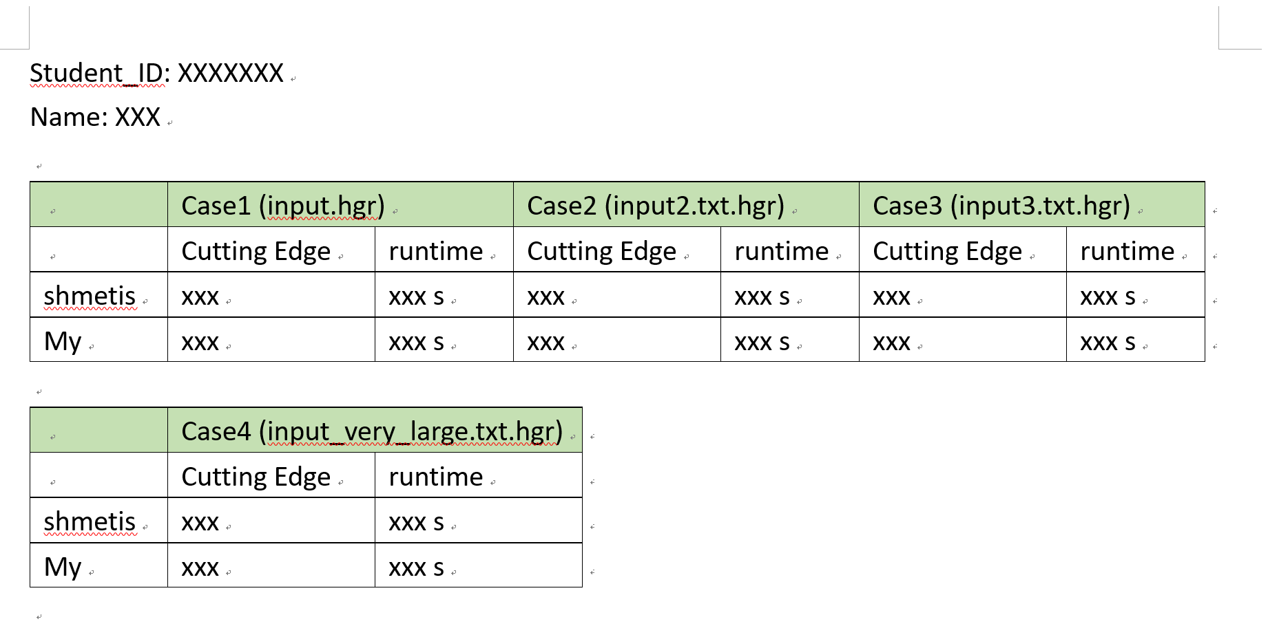
Report
Student_ID.pdf
(這邊如果有90s內run不出來的case 請run到出來為止, 重點是要比較cutting edge)

Slide 11
Program Submission
A zip file (Student_ID.zip)
Source code (.cpp, .h)
Makefile (up to you)
A Readme file (Information to how to compile and execute your code.)
A report pdf file (Comparison of your result to shmetis. Note that the result won’t affect your grade.)
Due Date : 2021/04/05 Fir. 23:55:00
You’ll get origin grade*0.7 if you be late to submit.

Slide 12
Thank you

