Slide 1

Debug and Fix
Simply The Best 2007 All Rights Reserved

Slide 2
Objectives
To identify the errors that exist within the utility classes of the architecture that supports the HRS Application.
To identify the errors that exist within the form classes of the HRS Application.
Simply The Best 2007 All Rights Reserved

Slide 3
Utility Classes
CalendarConstants.java
CalendarToIntArray.java
CalendarToString.java
IntArrayToCalendar.java
StringArrayToCalendar.java
StringIsBoolean.java
StringIsEmpty.java
StringIsLong.java
StringLengthIsValid.java
Simply The Best 2007 All Rights Reserved

Slide 4
Description for CalendarConstants
This class defines constants used as a reference for converting the values returned by Calendar.get(Calendar.MONTH) to appropriate values.
After we run the JUnit test we discovered that it doesn’t contain errors.
Simply The Best 2007 All Rights Reserved

Slide 5
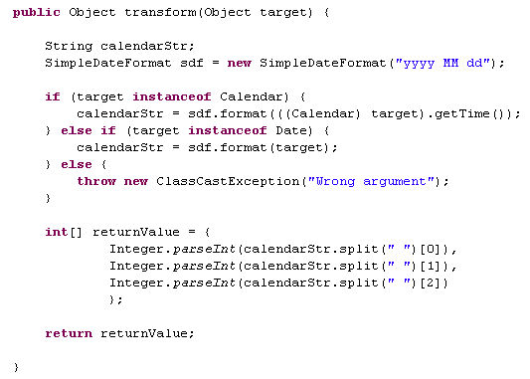
Description for CalendarToIntArray
Returns an equivalent integer array representation of argument Calendar instance
Simply The Best 2007 All Rights Reserved

Slide 6
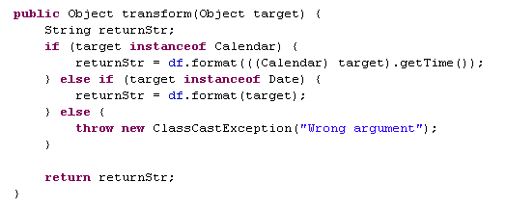
Description for CalendarToString
Returns the specified argument Calendar instance as a string
Simply The Best 2007 All Rights Reserved

Slide 7
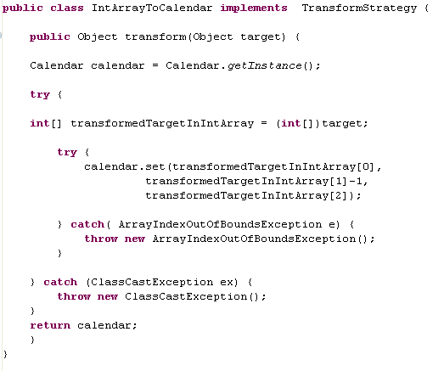
Description for IntArrayToCalendar
Returns an equivalent Calendar object representation of the input array of integers {year, month, date}.
Simply The Best 2007 All Rights Reserved

Slide 8
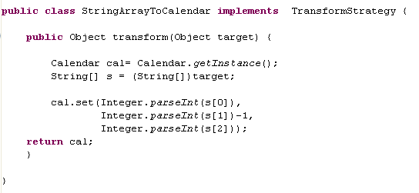
Description for StringArrayToCalendar
Returns an instance of a Calendar with values based on the object
array argument.
Simply The Best 2007 All Rights Reserved

Slide 9
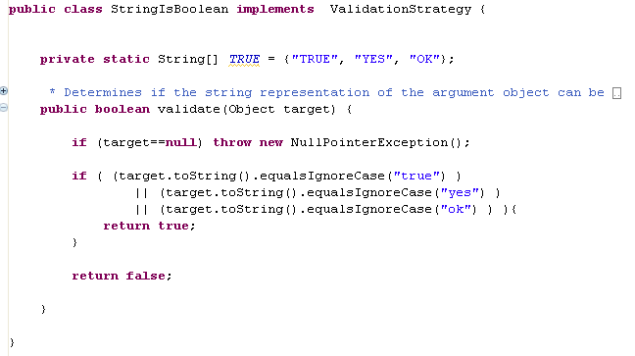
Description for StringIsBoolean
Determines if the string representation of the argument object can be translated as a boolean using standards set by the JDS architecture.
Simply The Best 2007 All Rights Reserved

Slide 10
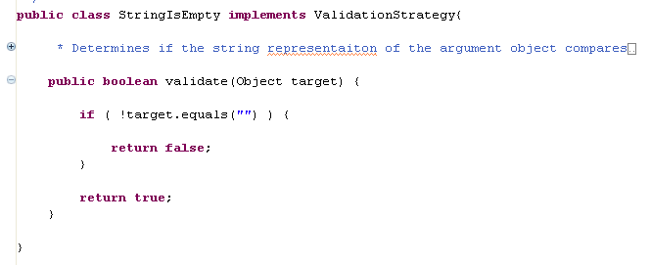
Description for StringIsEmpty
Determines if the string representation of the argument object compares to an empty string "".
Simply The Best 2007 All Rights Reserved

Slide 11
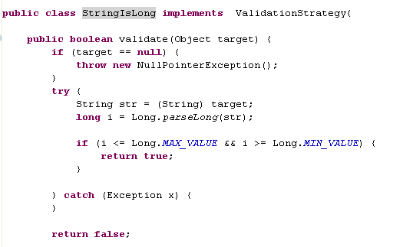
Description for StringIsLong
Determines if the string representation of the argument object can be translated as a long.
Simply The Best 2007 All Rights Reserved

Slide 12
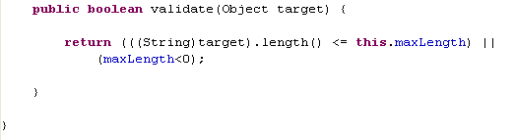
Description for StringLengthIsValid
Determines if the object argument's string representation complies with the length restriction as specified by this validation strategy.
Simply The Best 2007 All Rights Reserved

Slide 13
Form Classes
    ProjectForm.java
    SearchProjectForm.java
    SkillForm.java
    SearchSkillForm.java
Simply The Best 2007 All Rights Reserved

Slide 14
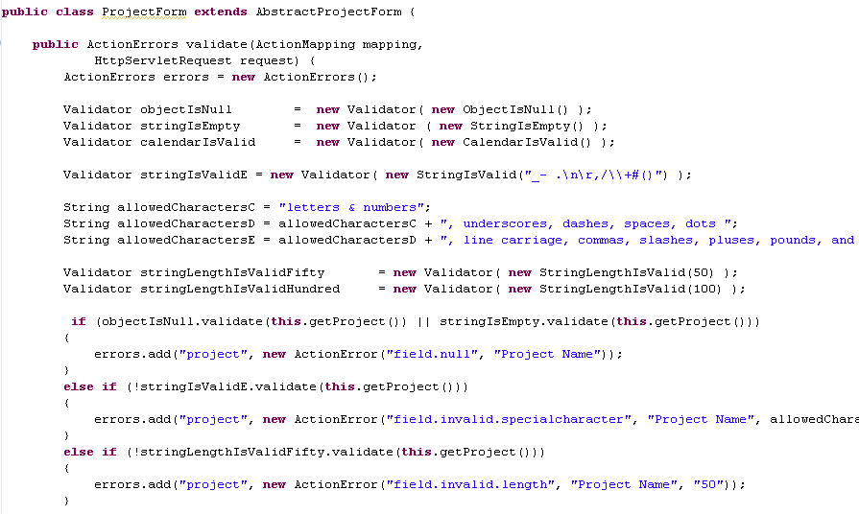
Description for ProjectForm(1)
Simply The Best 2007 All Rights Reserved

Slide 15
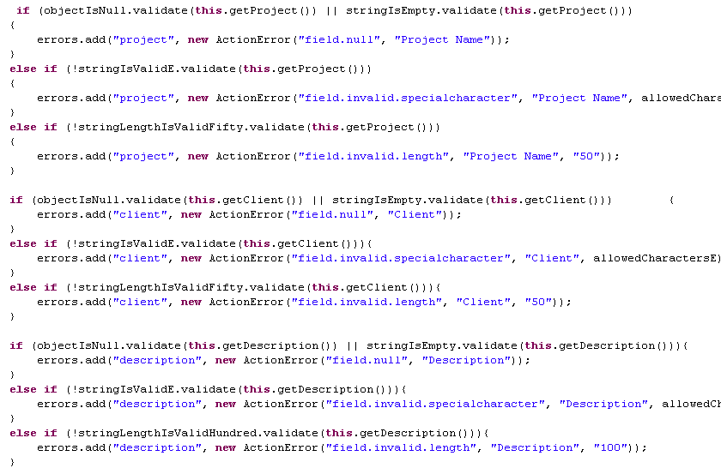
Description for ProjectForm(2)
Simply The Best 2007 All Rights Reserved

Slide 16
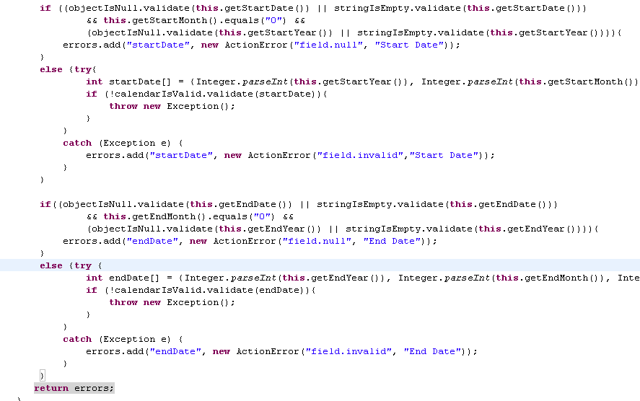
Description for ProjectForm(3)
Simply The Best 2007 All Rights Reserved

Slide 17
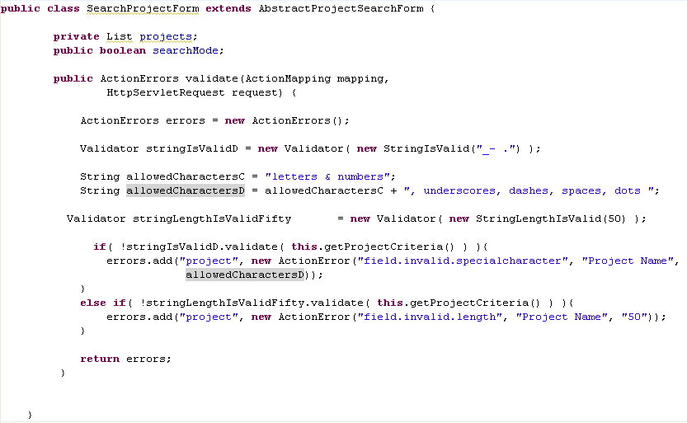
Description for SearchProjectForm
Simply The Best 2007 All Rights Reserved

Slide 18
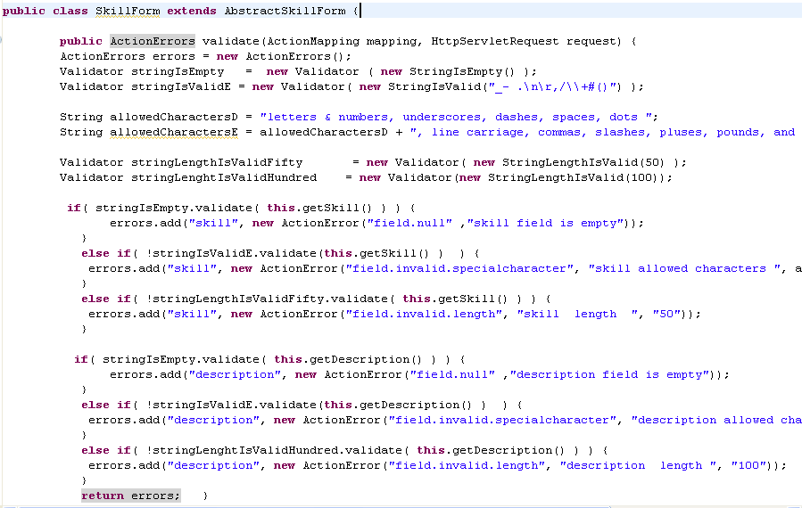
Description for SkillForm
Simply The Best 2007 All Rights Reserved

Slide 19
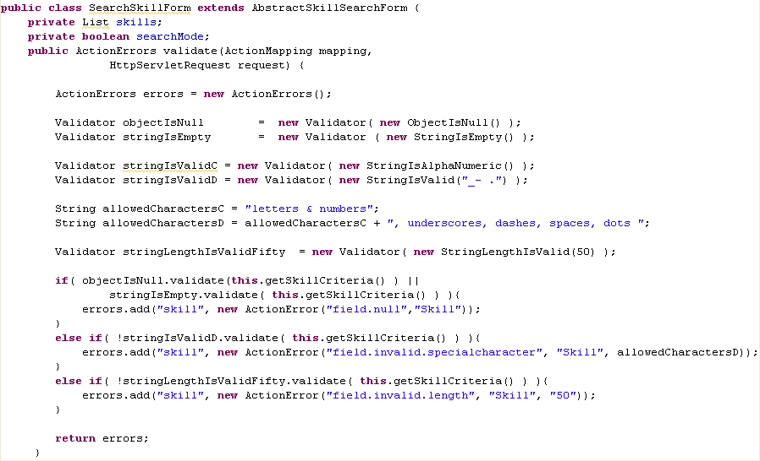
Description for SearchSkillForm
Simply The Best 2007 All Rights Reserved

Slide 20
Thank you for attention :-)
Simply The Best 2007 all Rights Reserved

