Slide 1
FTC on-bot java coding and best practices
Buckle in this is a long one

Slide 2
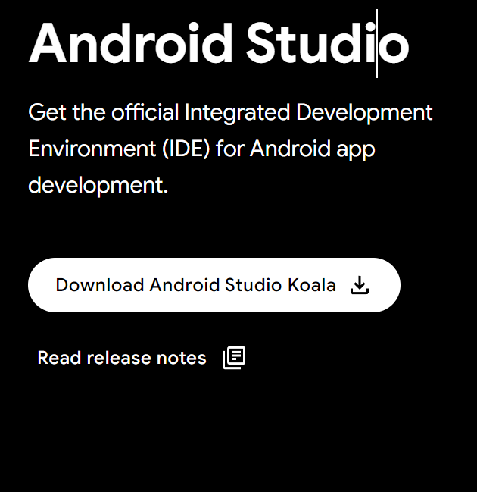

Android studio
Go here: https://developer.android.com/studio
Click this:
Run this: (it will have a slightly different name)

Slide 3


Git
Go here: https://git-scm.com/download/win
Click this:
Run this:
Click next a bunch of times. Then click install when it appears.
Press the windows key and type “cmd”, hit enter.
Copy the following commands and run them in the Command prompt (replace with your details):
git config --global user.name "John Doe"
git config --global user.email johndoe@example.com
From now on you can mostly ignore the git commands, your IDE (android studio) and GitHub will handle all of it for you (how helpful :)).

Slide 4
GitHub
Go here: https://github.com/
Click sign up and follow the prompts.
Make sure to make your password memorable to you and secure (you will need to remember it) USE THE SAME EMAIL AS YOU DID FOR GIT.

Slide 5
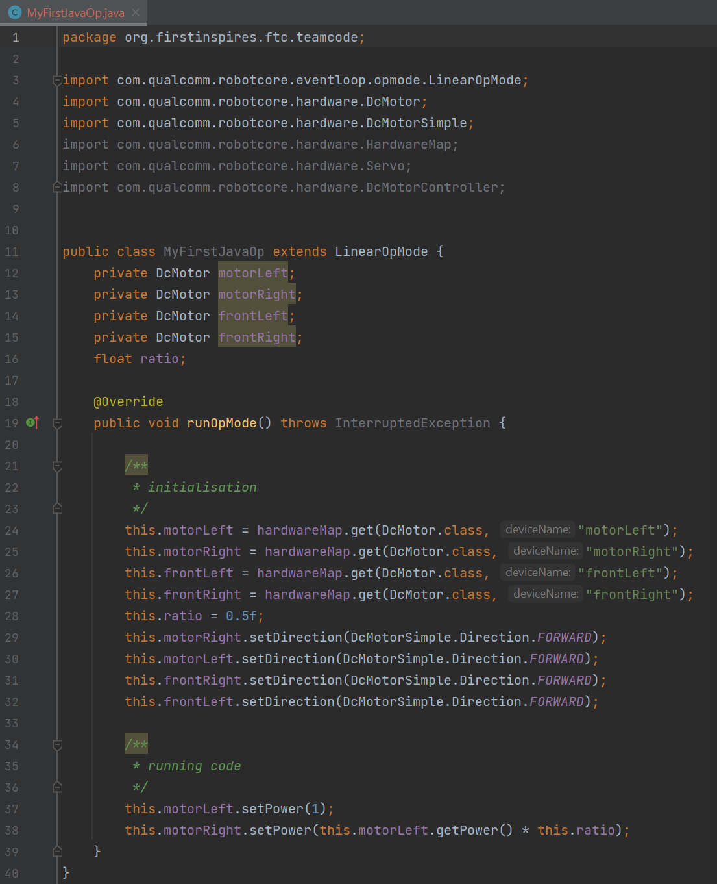
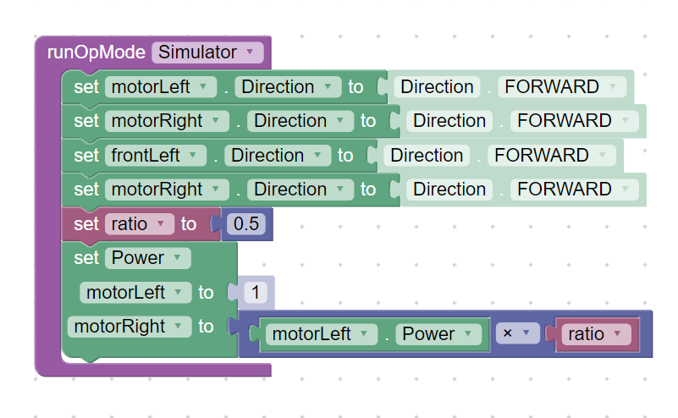
Step 1: no stress
Text coding is incredibly similar to block coding (just with a bunch of extra boilerplate)
Block: Java:

Slide 6
Block coding is helpful because it does all of the background stuff for you. You don’t need to worry about initialization, API or interfacing.
Text coding is is strict because it forces you to do this yourself.
HOWEVER, this means that text coding can be far more flexible and allows you to do far more complex operations without cluttering your workspace nearly as much.

Slide 7
Basic OpMode file setup/boilerplate
package org.firstinspires.ftc.teamcode.Sarters;
import com.qualcomm.robotcore.eventloop.opmode.TeleOp;
import com.qualcomm.robotcore.eventloop.opmode.OpMode;
@TeleOp (group = "Starters", name = "AutoStarter")
public class TeleOpStart extends OpMode {
/**
* define the motors, servos, sensors and so forth that you will use throughout your OpMode here
* remember to import
*/
/**
* this is where you should initialise all of your variables you just defined, this is what runs
* when you press the init button
*/
@Override
public void init() {
}
/**
* this is the "main" function. it runs when you press the play button for this OpMode
* it is a loop so will run continuously until you press stop
*/
@Override
public void loop() {
}
/**
* this is where you should define helper functions for your main code
*/
}

Slide 8
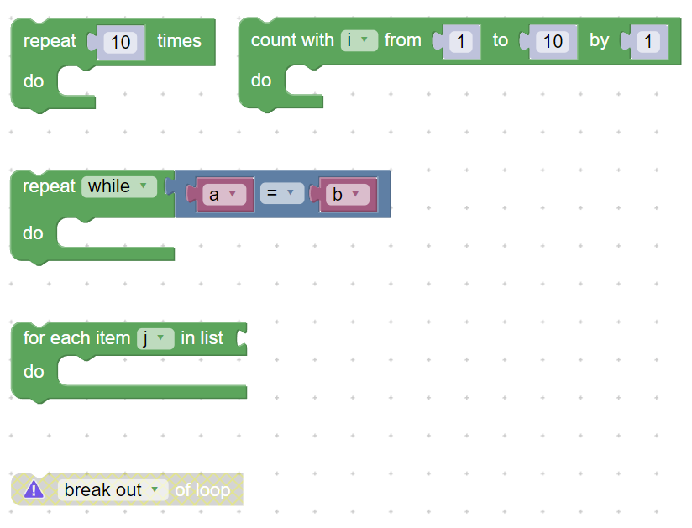
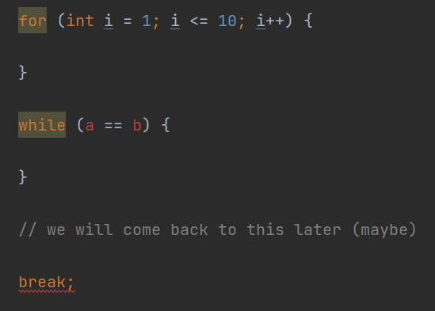
loops

Slide 9
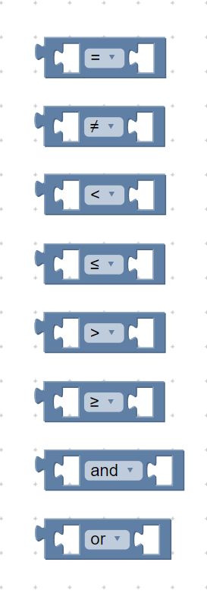
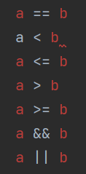
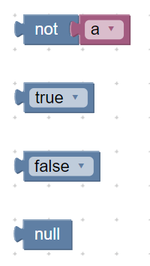

Conditions a <condition> b

Slide 10
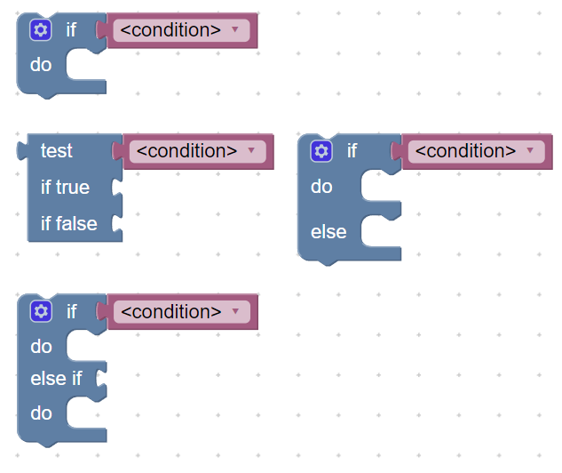
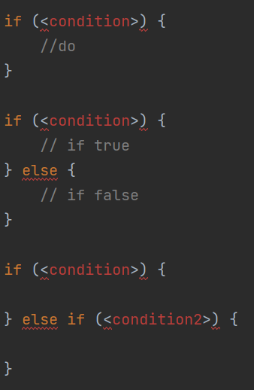
Branches / if

Slide 11
If you have questions about how to do things specific to FTC (like use motors, servos and such) there is tons of documentation online, all you need to do is search it up.
Pro tip: functions to do things that you want are very likely to be named exactly what you would expect them to be. E.g. to set the power of a motor you use:
<motorName>.setPower(<powerLevel>);

Slide 12

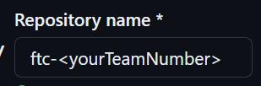
Setting up your IDE and Git repository for your team
ONE PERSON PER TEAM!!
Log into GitHub.
Go here: https://github.com/WizardMorpheus/FTC_stPeters_ExampleTeamCode/tree/master
Click on this button:
Change the repository name to something useful like:
Click create fork.
The page you are now on should look like the one you were just on, but your username will be on the top left instead of “FIRST-Tech-Challenge”.
EVERYONE (but preferably one person at a time per team)
Create a file directory where you would like your code to be. Something useful like:
C:\Users\<yourName>\Documents\FTC_team_<yourTeamNumber>
Now, in the file explorer click on the directory path: now type “cmd” and hit enter

Slide 13
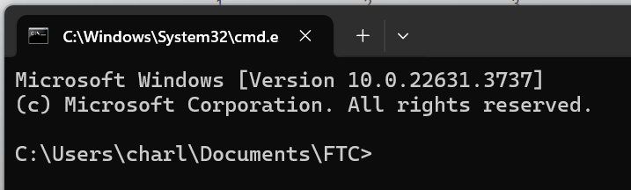
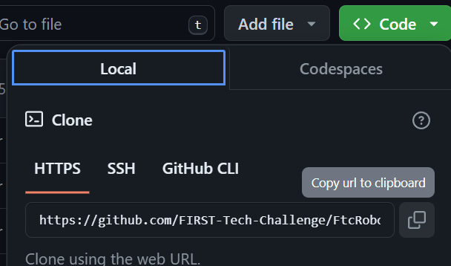
This will open a Command Prompt that is “aimed” at that file directory:
Now go to your GitHub repository (repo) and get the link under the code menu:
Now go back to the cmd and type this command:
Wait for it to copy and viola, now you have all of that code, on your machine, ready for you to edit.

Slide 14

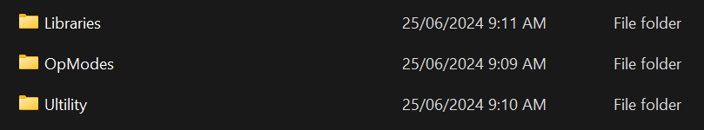
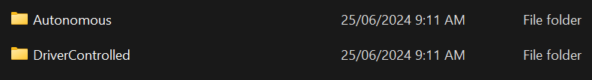
Open Android Studio, then hit file, open folder, and open the folder where all of that code is.
Your code goes here:
Be neat! Use folders, useful naming conventions and so forth. It WILL help you and your team locate the files you want later.
I would suggest a file structure similar to this:

Slide 15
Welcome to the lecture

Slide 16
Data types
Data types can be thought of as containers for different types of information. These include:
Type | Meaning | Size (in java) | Examples
int | An integer (whole number) | 4 bytes | 0, 1, 56, 2173, -759
char | Either, A character (letter or symbol) Or, An integer | 2 bytes | A, b, p, |, 0, 2, -153, \n (this is a special one)
byte | In some languages the same as char (NOT IN JAVA). | 1 byte (8 bits) | -127, 128, 0, 64, -9
float | A floating point (decimal point) number | 4 bytes | 0.5, 135.54, -29.68
double | Twice the accuracy and twice the storage size of float | 8 bytes | ^^ (larger range)

Slide 17
Classes
A class is a group of variables and functions that should encapsulate and abstract an aspect of your program, to make it more readable, maintainable (debugable) and extensible.
In less big words, this means that a class should provide useful and common functionality that you will use throughout your program, and does not exist otherwise. It should also improve the quality of your code.
A great example of a class is a ‘String’. These are classes that are normally already present in a languages core. A string is a variable length, immutable (we might come back to that) list of characters (chars), that is regularly used to encapsulate text. A string therefore also has some useful related functions such as: format(), join(), split(), indexOf(), charAt(), and length()

Slide 18
Classes cont…
Java is an interesting language in the way that it uses classes.
Everything (almost) that you implement in java will be within a class. Most other languages aren’t like this.
Unfortunately for you, this means that you will likely be write a lot of code that doesn’t do anything in particular, except tell the computer about what you are about to write code for.
This type of code is called “boilerplate”. And i have tried to reduce the amount that you will need to write in the github repo.

Slide 19
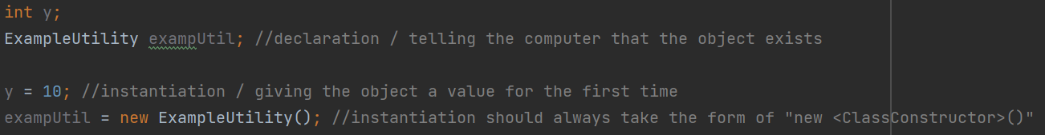
Classes cont…
Some important terminology you will probably hear me say a LOT.
The code you write for a class acts only as a definition of that class. Some of this code will be inaccessible until you INSTANTIATE an instance of that class. A.k.a you create an instance of a class.
An instance of a class is called an OBJECT. E.g. an instance of a String is a String Object
Objects can be DECLARED, before they are instantiated. E.g.

Slide 20
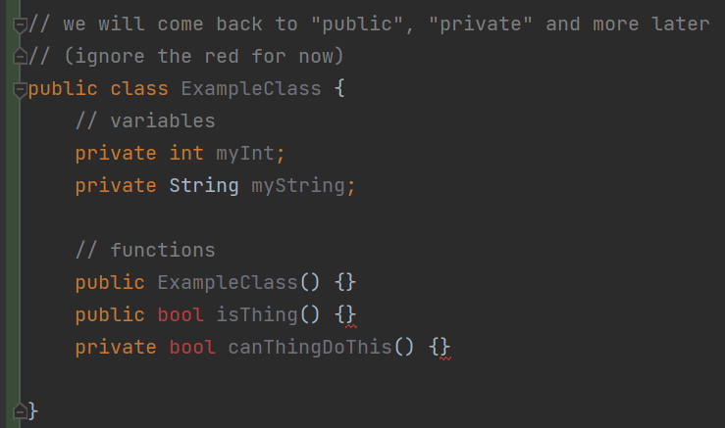
Classes cont… (last little bit i swear)
Technically the data types that i showed you earlier are NOT classes.
But as far as you are concerned they are, because they act in the exact same way and do very similar things.
This is how you will DEFINE a class:
I have given a more in depth explanation within the “ExampleUtility” file in the repo.
Please check that out

Slide 21
Dot syntax
You may have seen some examples of code that look something like this:
person.getAge(), or
phone.callNumber(“0484675208”)
This is dot syntax. (syntax is a term that refers to the proper usage of articles like {}, ?, |, &, *, or .)
Much like how you need to know where to put commas and apostrophes in sentences (which could be referred to as comma or apostrophe syntax), you need to know how and when to use dots.

Slide 22
Dot syntax cont…
Dots can be thought of as a way to tell the computer that you are about to do something within a class.
For example, if you define a class, say “MyClass”, and in that class you define a function, say “func()”, in order to run the function “func()” which exists within the class “MyClass”, you would use dot syntax like this:
MyClass.func();
There are some caveats to how/when you are able to ACCESS functions and variables that are within classes. I’m hoping that I have adequately explained these caveats in the “ExampleUtility” file (it involves the public and private words you saw earlier). If you have any questions, please ask.

Slide 23
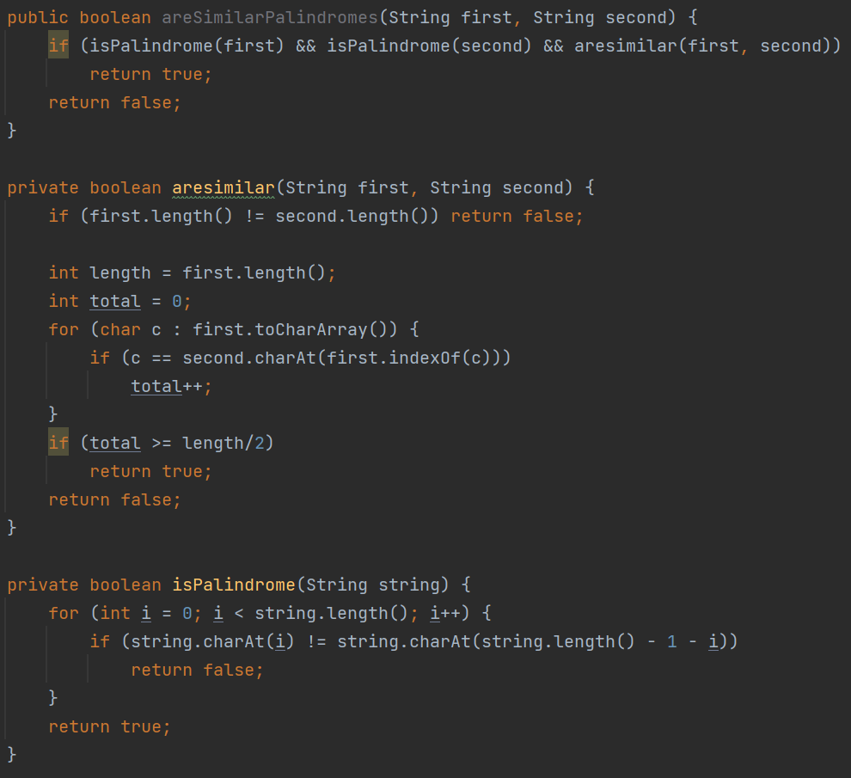
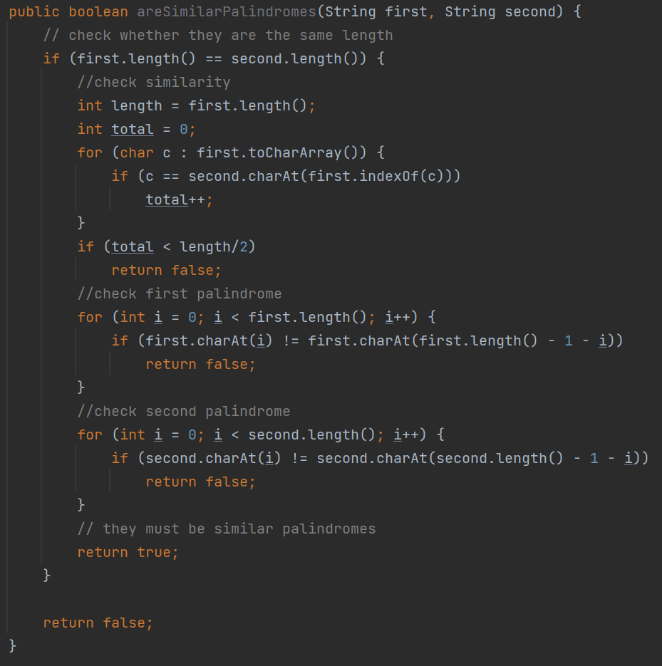
Helper functions
“No function should be more than 100 lines”
A string is considered a palindrome if it can be read the same way forwards and backwards. Two strings are similar if half or more of their characters match in position and value, and they have the same length. Therefore, two strings are similar palindromes if they are both palindromes and are similar.
This: is better than this:

Slide 24
Naming conventions
Picking and sticking to a naming convention is very important in maintaining the readability of your code.
The most important part of this is that you use detailed names for everything. For example, a variable called “p” could mean: place, person, point, pointer etcetera.
You only know what it is and therefore what it is used for through context, which we do not want. Prefer longer, more detailed names.
Second to this, is the way in which you capitalise your names. The industry standard is called Camel Case. Camel case uses no spaces or underscores, instead capitalising the first letter of each word (excluding the first), if a name contains multiple words. The exception to this is for classes, which capitalise the first letter of the first word as well. For example:
A variable could be called: firstName, fileDescription, leftMotor
A function could be called: calculateOffset, isActive, getPower
A class could be called: ExampleUtility, MechanumDrive, PathPlotter

Slide 25
Important remarks
Functions can also be called methods.
From now on, google is you best friend. If you don’t know how to, or whether you can do something with a class or otherwise, look it up, the information age is incredible like that. If you can’t understand what the internet is telling you or can’t find the right information, just ask, please. It is not your fault and you should not feel bad for not being able to figure stuff out, programming can be very hard and diving in is a monumental task, well done.
Programming is the same as any other discipline, it is not a dark art known to the few, but it will require you to practice and actively research to get better at it.
I will be updating the github repo. Not all the information you will need is on there yet, but i will do my best to add more and more examples and explanations into it.
The FTC starter code comes with a plethora of examples for how to use their classes. These exist under “FtcRobotController/src/main/java/org/firstinspires/ftc/robotcontroller/external/samples”, or (in android studio)
“FtcRobotController/java/org.firstinspires.ftc.robotcontroller/external.sampes”

