Slide 1
Week Report
Zhuo Chen
10/3/2019

Slide 2
Painterly Harmonization of Video (date 3.3-3.10)
Ideas:
Face Swap -> stylized face swap(artwork, cartoon…) -> painterly harmonization
Problem Definition:
Fine-level face stylization
Solving the problem of frame blurring and jittering for video
Schedule
Re-implement NST[1] (completed): basic work of style transfer
Re-implement CNNRMF[2] (completed): synthesis more details based on nearest patches
Re-implement DPH[3] (next week): state-of –the-art partially style transfer technology
[1] Gatys L A, Ecker A S, Bethge M, et al. Controlling perceptual factors in neural style transfer[C]//Proceedings of the IEEE Conference on Computer Vision and Pattern Recognition. 2017: 3985-3993.
[2] Li C, Wand M. Combining markov random fields and convolutional neural networks for image synthesis[C]//Proceedings of the IEEE Conference on Computer Vision and Pattern Recognition. 2016: 2479-2486.
[3] Luan F, Paris S, Shechtman E, et al. Deep painterly harmonization[C]//Computer Graphics Forum. 2018, 37(4): 95-106.

Slide 3
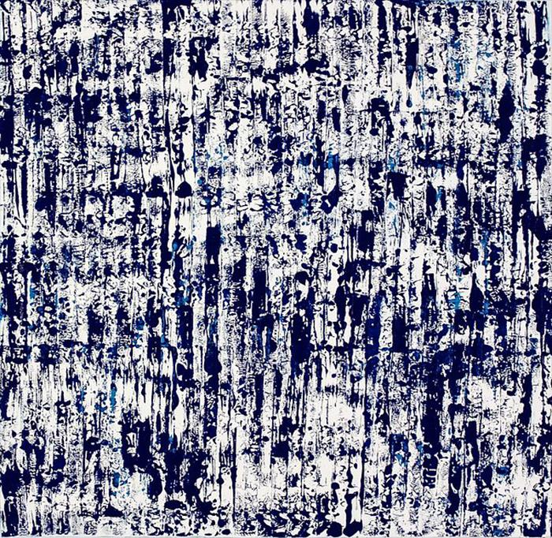
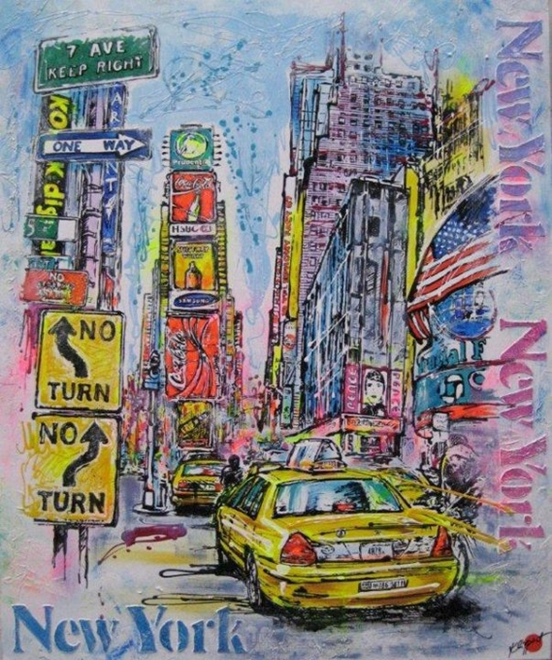
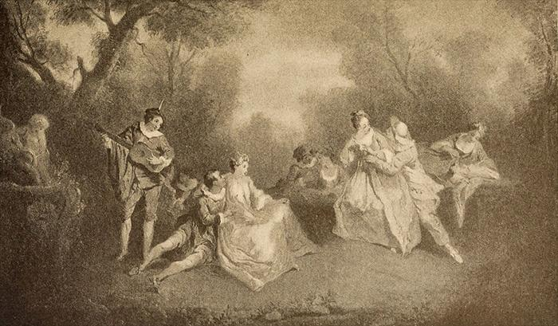
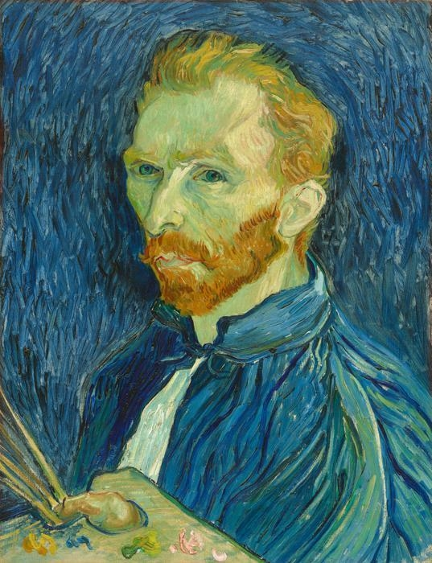
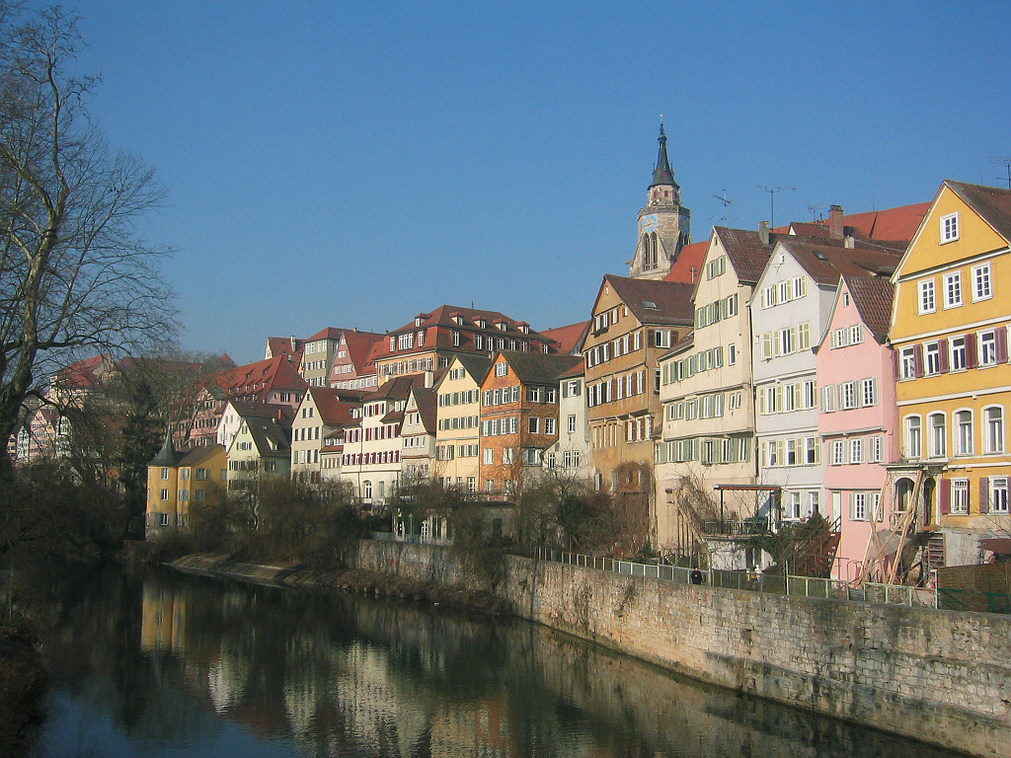
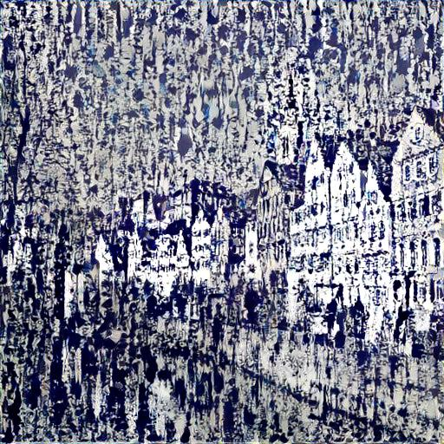
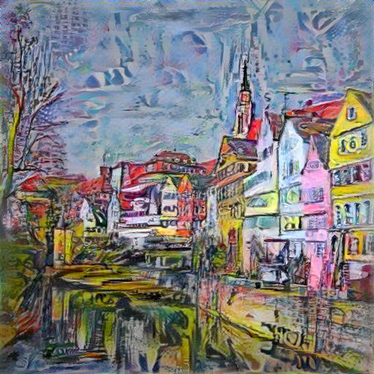
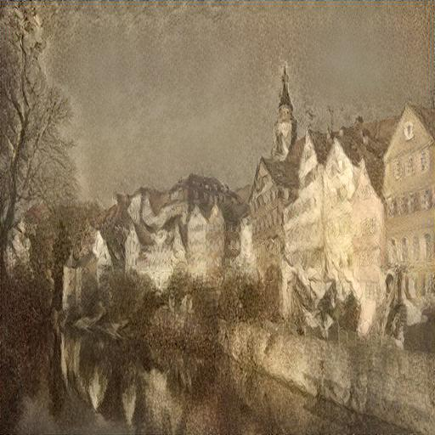
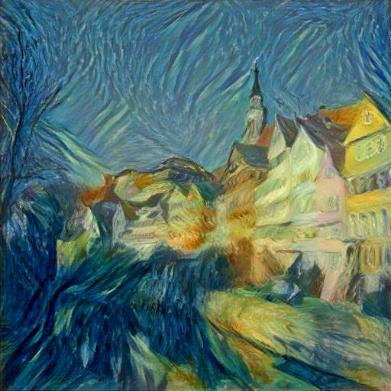
Re-implement NST
Controlling Perceptual Factors in Neural Style Transfer[1]
Feature extractor: extract 6 layers from VGG19
Content loss: MSE loss of the synthesized image and the content image
Style loss: MSE loss of the Gram Matrix of the extracted features
Optimizer: Limited-memory BFGS
Result:

Slide 4
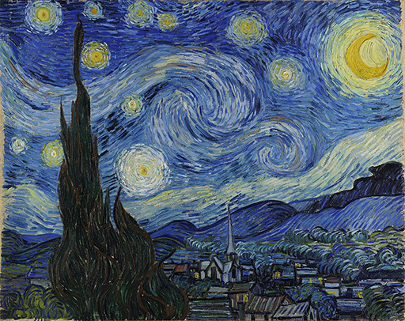
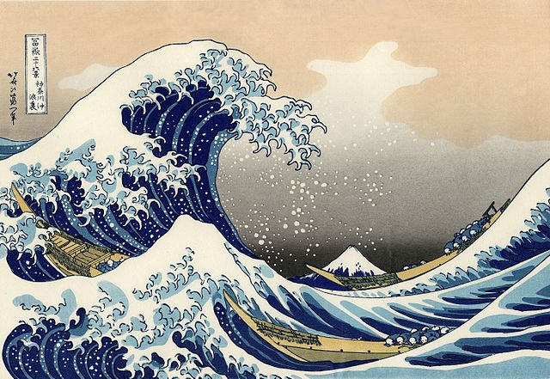
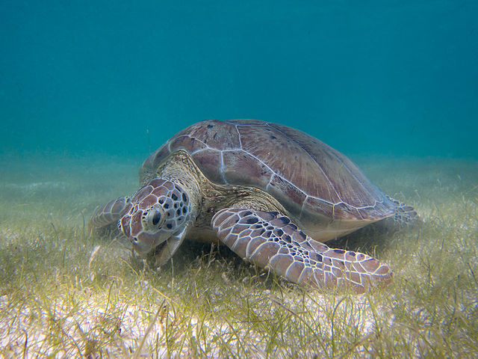
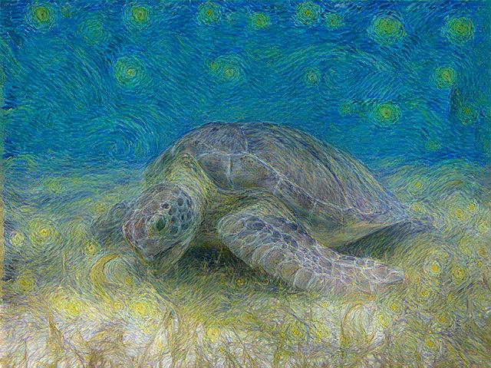
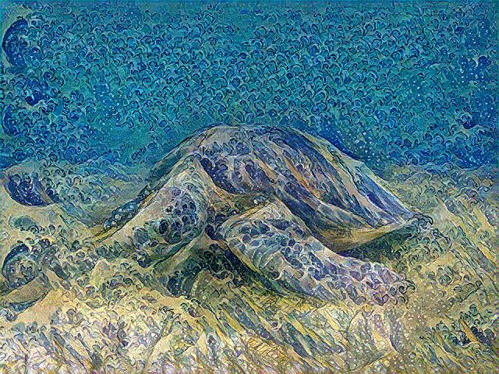

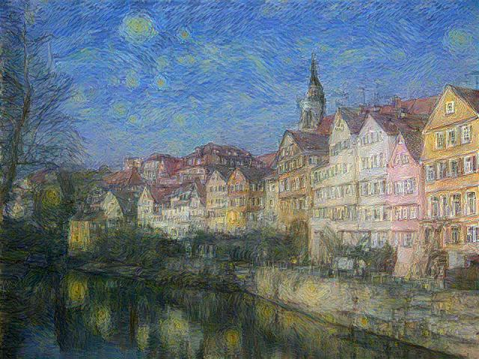
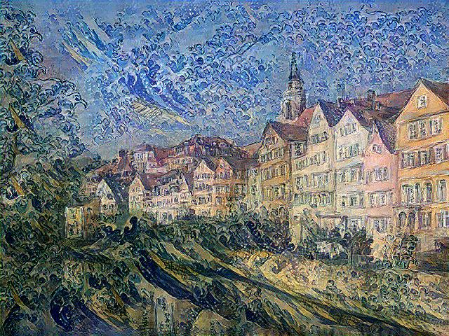
Re-implement CNNRMF
Combining Markov Random Fields and Convolutional Neural Networks for Image Synthesis[2]
Feature extractor: extract 3 layers from VGG19
Content loss: MSE loss of the synthesized image and the content image
Style loss: MSE loss of the nearest patch pairs of the synthesized image and the style image
TV loss: penalize the squared gradient norm to encourage smoothness
Optimizer: Limited-memory BFGS
Result:

