Slide 1
Impact Analysis of Botnet Infection on Networked Systems using Timed Automata
SYSC 5500
Group 8
Alvi Jawad
Luke Newton

Slide 2
Outline
Brief Overview
Previous Work
Extending the Botnet
Major Changes
Extension Efforts
Hardware and OS limitations
Rebooting as a Solution
Device Type 2 – Reboot Capable
Why Rebooting?
Results
Reboot Frequency
“Active” vs “Stealthy” bots
Network Speed Variation
Next steps!
1

Slide 3
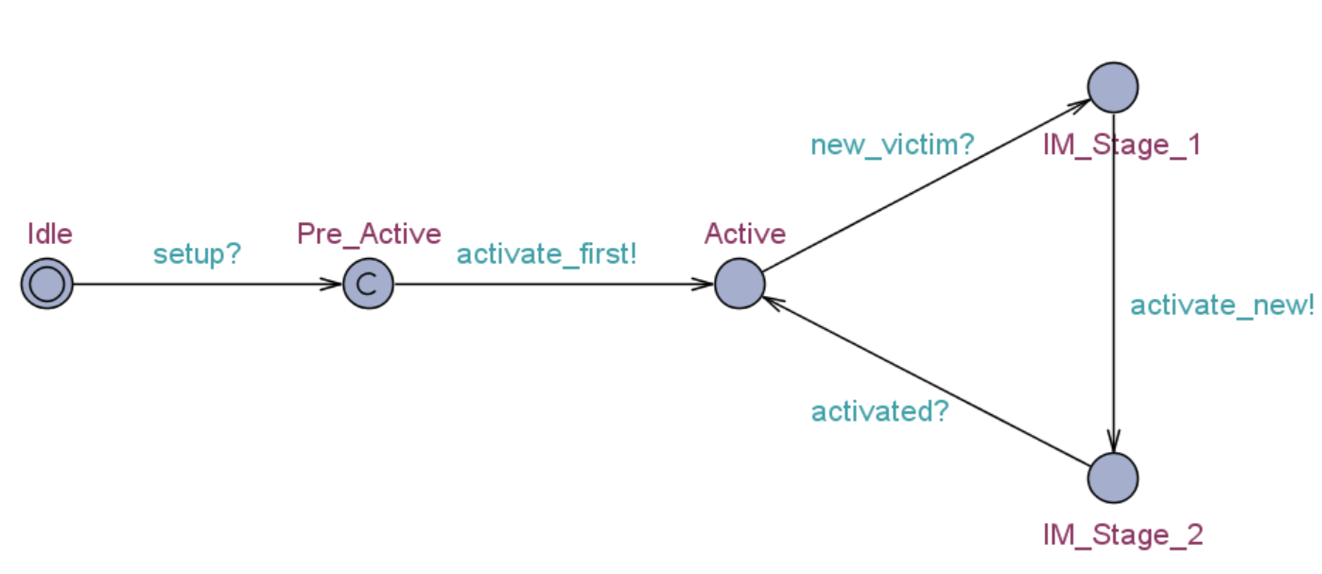
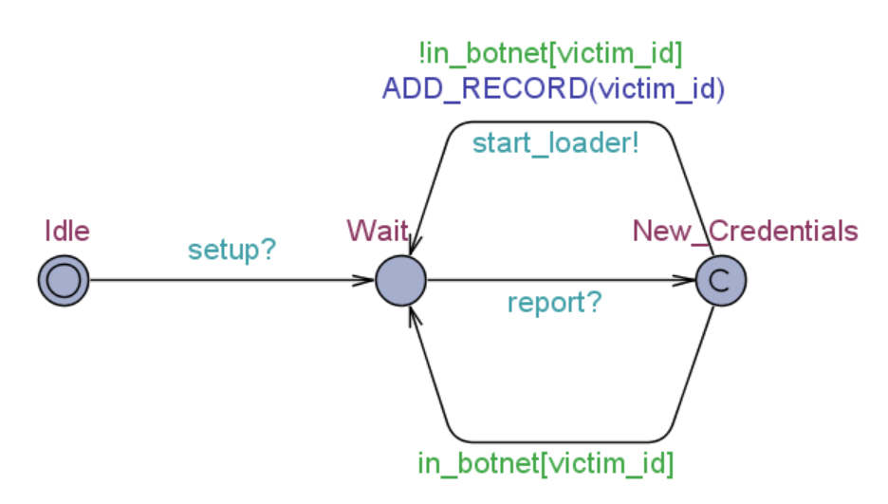
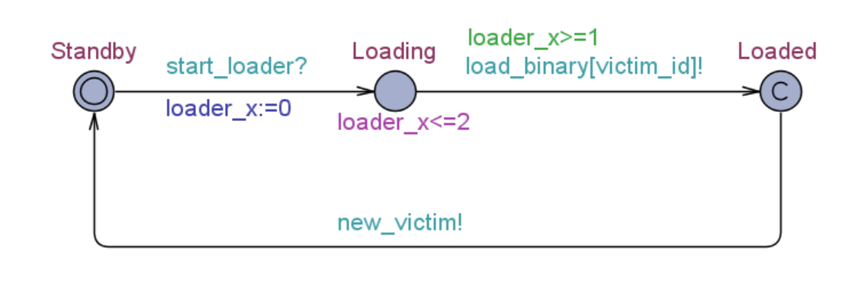
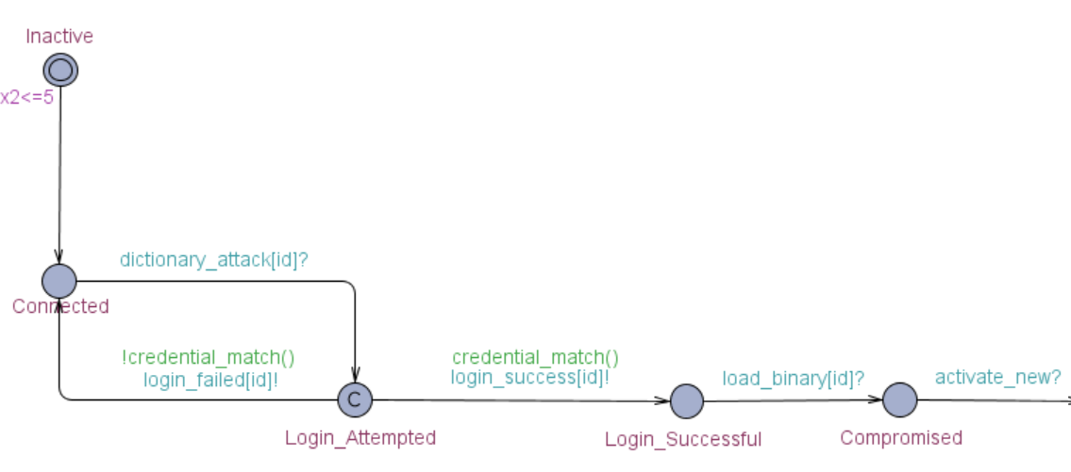
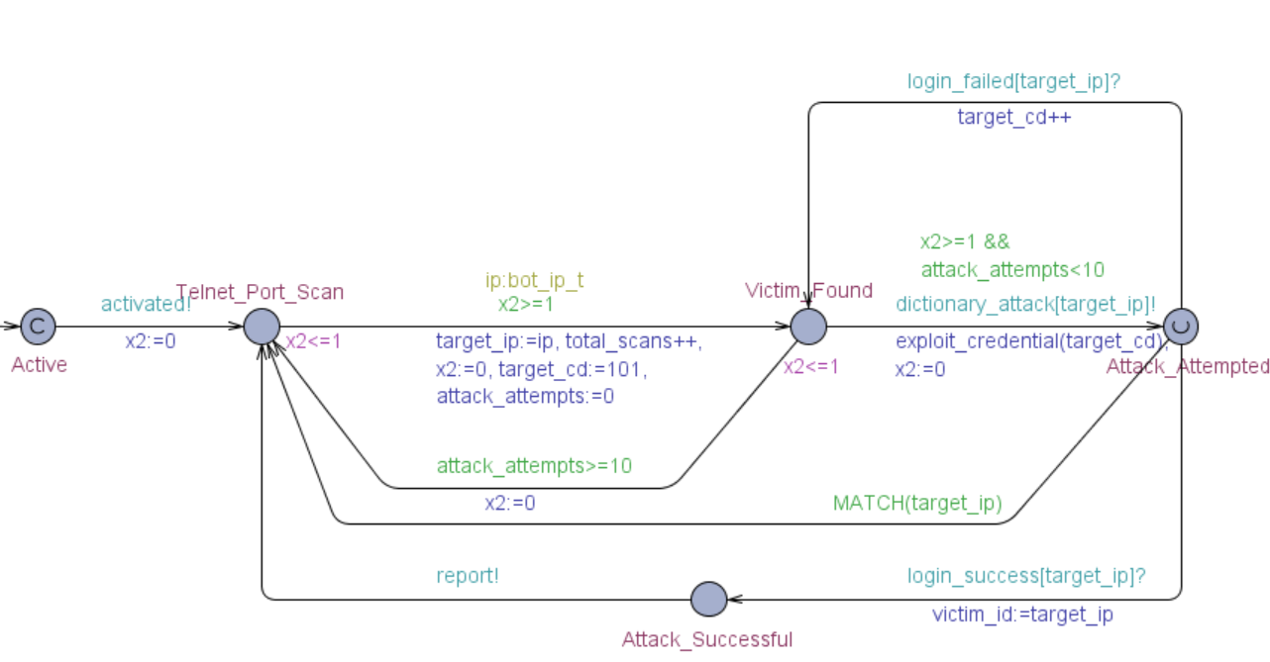
Previous Work
Modeling
Modeling the Mirai botnet infrastructure and individual device behavior
Modeling Formalism
Timed Automata
Modeling Tool
UPPAAL 4.1.24
Objective
Observing the behavior of individual entities in the botnet
Perform experiments to examine the infection rate and generated network traffic
2

Slide 4
Major Changes
Extended Dictionary
Bots now make use of the full dictionary of the original Mirai codebase
Each device has a pseudo-randomly generated ID (IP, credentials) at the start
Modeling Workarounds
Extreme state-space reduction
Compact data structure
Removal of a few secondary committed states
Target
Extend the network to simulate thousands of devices simultaneously
3

Slide 5
Extension Efforts
Extending the Botnet
Initial efforts focused on extending the size of the botnet by a small margin
20 Devices
100 Devices
Simulations were extremely fast
Simulation time (10 runs): ~2 seconds
Very low resource consumption
Verification memory: ~17 MB/29 MB
Very small network; not representative of the IoT
Simulations were relatively fast
Simulation time (10 runs): ~3 minutes
Very low resource consumption
Verification memory: ~157 MB/188 MB
Small network; still not representative of the IoT
4

Slide 6
Extension Efforts
Extending the Botnet
Subsequent efforts emphasized creating networks of over a hundred devices
500 Devices
250 Devices
Simulation times were infeasible
Simulation time (10 runs): ~ 11 hours
Highest resource consumption
Verification memory: ~ 3500 MB/3700 MB
A good representation of a small IoT network
Simulations were still rather slow
Simulation time (10 runs): 75 minutes
Moderate resource consumption
Verification memory: ~580 MB/650 MB
The best overall compromise in terms of simulation speed and network size
We chose to use networks of 250 and 100 devices for most simulations
5

Slide 7
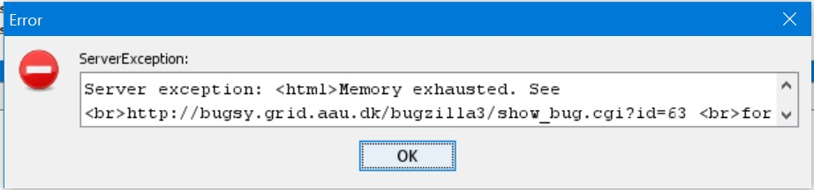
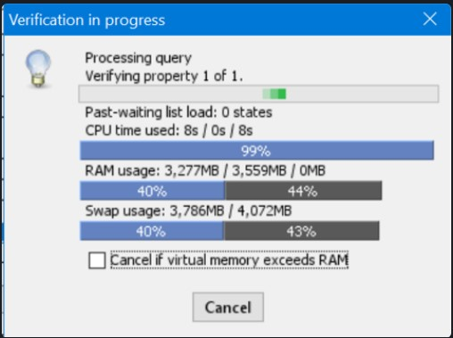
Limitations
Extending the Botnet
Extending the network beyond 500 devices would never work
Hardware Limitations
Verification memory: ~ 3500 MB/3800 MB -> 40%
Graphical simulator: ~ 3600 MB/4072 MB -> 44%
OS Restrictions
Only 32-bit version of UPPAAL available for MS Windows
The verifier can only access at most 4 GB of memory
We decided to leave extending the network further as part of our future work
6

Slide 8
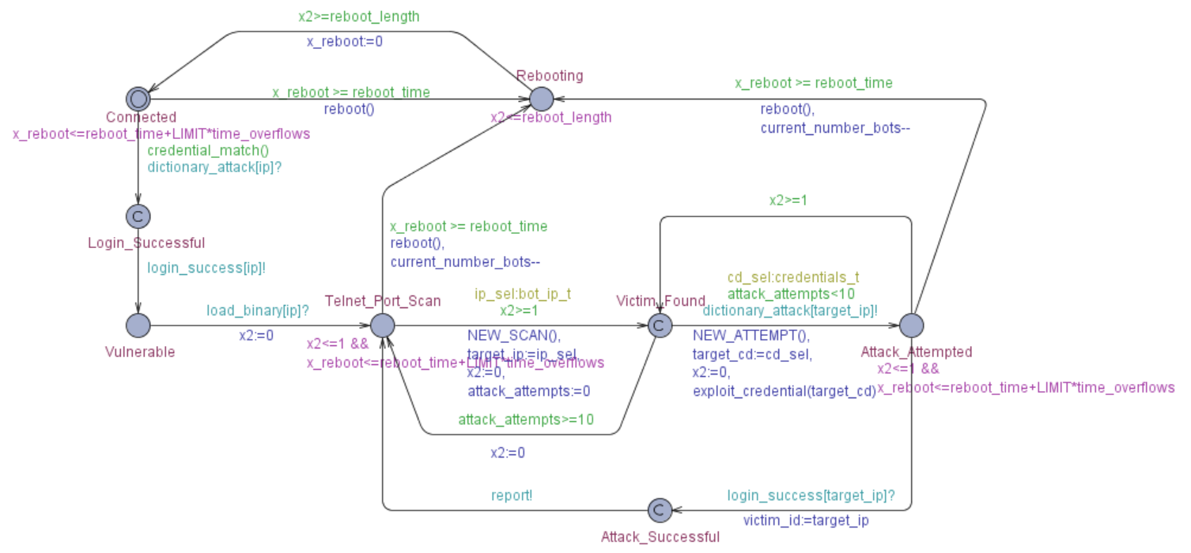
Device type 2 – Reboot Capable
Rebooting
Activation
Scan and Report
7

Slide 9
Why Rebooting?
Removing the Infection
Mirai lives in the dynamic memory; cleared when the device is rebooted
Device credentials must be changed to prevent secondary infection
Target Clusters
Devices that reboot either periodically or manually by the user
Class E1 - Devices with a periodic battery (primary) replacement interval
Class P0 – Devices that are normally off and only reattached to the network when needed
New Objective
Can rebooting prevent the accumulation of a large-enough botnet?
If so, what rate of frequency is needed to achieve such results?
Is the rate feasible?
C. Bormann and A. Keranen. Terminology for Constrained-Node Networks. https://www.ietf.org/rfc/rfc7228.txt
8

Slide 10
Simulation Parameters
Parameter | Default Value | Other values used
Number of devices | 100 | 250, 500
Round Trip Delay | 100ms | 1s
Simulation time | 1 day | 1 week
Dictionary length | 62 | -
Percentage of devices with weak credentials | 100% | -
Reboot frequency | Hourly | Daily, every 30 minutes, every 10 minutes, every 5 minutes
Duration of device reboot | 60s | -
Percentage of time bots propagate malware | 100% | 50%, 10%, 1%
Proportion of “always connected” devices to rebooting devices | 0:100 | 100:0
9

Slide 11
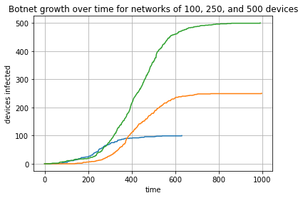
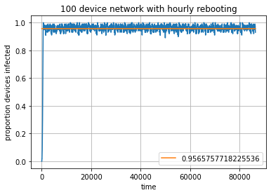
“Always-Connected” vs “Reboot Capable”
Periodic reboots randomly shifted
10

Slide 12
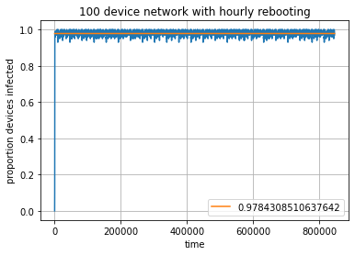
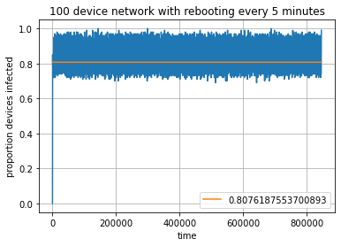
How does period affect botnet size?
100 device network
1 minute to reboot a device
Once a device is infected, it only propagates malware
Hourly reboots over one day
Reboot Frequency | Uptime | Average botnet size
Daily | 99.93% | 99.9%
Hourly | 98.33% | 97.8%
Every 30 minutes | 96.67% | 96.0%
Every 10 minutes | 90% | 89.6%
Every 5 minutes | 80% | 80.7%
Reboot every 5 minutes over one day
11

Slide 13
“Active” vs “Stealthy” bots
100 device network
1 minute to reboot a device
Vary the percentage of time a bot propagates malware
Percentage of time propagating malware | Percentage of time stealthing | Reboot Frequency | Average botnet size
100% | 0% | Hourly | 97.8%
50% | 50% | Hourly | 97.7%
10% | 90% | Hourly | 95.8%
1% | 99% | Hourly | 71.5%
100% | 0% | Daily | 99.9%
50% | 50% | Daily | 99.7%
10% | 90% | Daily | 99.4%
1% | 99% | Daily | 97.4%
12

Slide 14
How does network speed affect botnet size?
Reboot Frequency | Uptime | Average botnet size (100ms RTT) | Average botnet size (1s RTT)
Daily | 99.93% | 99.9% | 99.0%
Hourly | 98.33% | 97.8% | 95.6%
Every 30 minutes | 96.67% | 96.0% | 92.1%
Every 10 minutes | 90% | 89.6% | 76.3%
Every 5 minutes | 80% | 80.7% | 46.9%
13

Slide 15
How does network speed affect botnet size?
Percentage of time propagating malware | Percentage of time stealthing | Reboot Frequency | Average botnet size (100ms RTT) | Average botnet size (1s RTT)
100% | 0% | Hourly | 97.8% | 95.6%
50% | 50% | Hourly | 97.7% | 93.2%
10% | 90% | Hourly | 95.8% | 69.6%
1% | 99% | Hourly | 71.5% | 0.0067%
100% | 0% | Daily | 99.9% | 99.0%
50% | 50% | Daily | 99.7% | 98.7%
10% | 90% | Daily | 99.4% | 97.8%
1% | 99% | Daily | 97.4% | 86.0%
14

Slide 16
Conclusion
Rebooting and slowing the network down can reduce botnet size, but are only effective at levels that would deteriorate functionality
The most effective strategy is to change default credentials
A botnet’s level of stealthing can be very high before it’s ability to grow is severely impacted
Even a botnet of relatively small size can still send 10 000s of messages over a network hourly
15

Slide 17
Thank You!

Slide 18
Questions?

