Slide 1
Impact Analysis of Botnet Infection on Networked Systems using Timed Automata
SYSC 5500
Group 8
Alvi Jawad
Luke Newton
1

Slide 2
Outline
Preliminaries
Botnets in the IoT Network
Timed Automata & UPPAAL
Modeling
Overview of the Mirai Botnet
Modeling The Botnet Infrastructure
Modeling devices in the network
Simulations
The Concrete Simulator
Results
Data Collection
Device Infection Rate
Network Traffic Generation
Next steps!
2

Slide 3
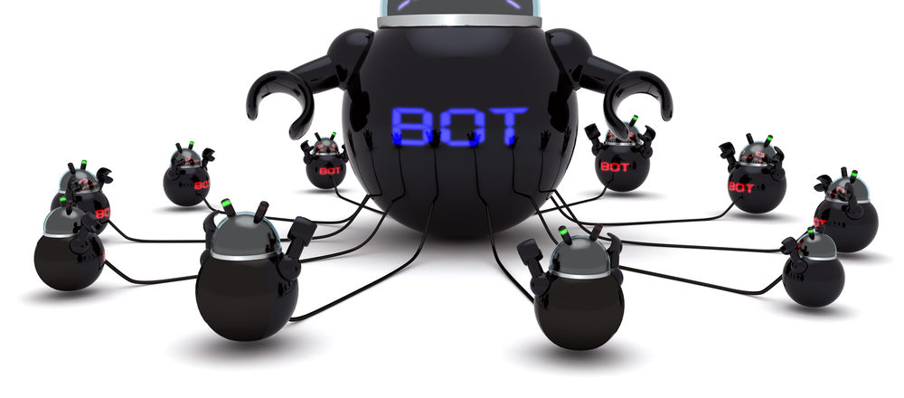
What are Botnets?
Botnets
A network of compromised devices
Compromised devices are called bots
Bots infect other vulnerable hosts in the network
Infection rarely requires user interaction
The Internet of Things
Vulnerable networked infrastructure
IoT devices
have low computational resources
are poorly secured
have poor maintenance
IoT devices can generate huge amounts of attack traffic in a botnet
3

Slide 4
Why use Timed Automata?
Timed Automata
PROS
Finite State Machines extended with Clock variables
A timed automaton is a 6-tuple (L, l_{o}, C, A, E, I) ▪ L is a set of locations ▪ l_{o} ∈ L is the initial location ▪ C is the set of clocks ▪ A is a set of actions, co-actions, and the internal τ-action ▪ E ⊆ L x A x B(C) x 2^{c} x L is a set of edges ▪ I : L → B(C) assigns invariants to locations
Timed representation
Hybrid-view of the system
State Detection
Behavior Prediction
Formal verification
UPPAAL
Verification of real-time systems modeled as networks of Timed Automata
Query language: TCTL (Timed Computation Tree Logic)
4

Slide 5
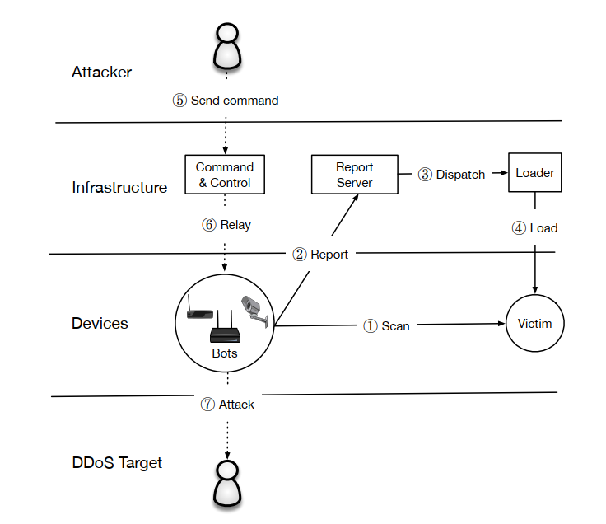
Overview of the Mirai Botnet
1. Scan
2. Report
Command & Control
Report Server
Loader
3. Dispatch
4. Load
5. Send command
6. Relay
7. Attack
M. Antonakakis, T. April, M. Bailey, M. Bernhard, E. Bursztein, J. Cochran, Z. Durumeric, J. A. Halderman, L. Invernizzi, M. Kallitsis, D. Kumar, C. Lever, Z. Ma, J. Mason, D. Menscher, C. Seaman, N. Sullivan, K. Thomas, and Y. Zhou, “Understanding the mirai botnet,” in 26th USENIX Security Symposium (USENIX Security 17), (Vancouver, BC), pp. 1093–1110, USENIX Association, Aug. 2017.
5

Slide 6
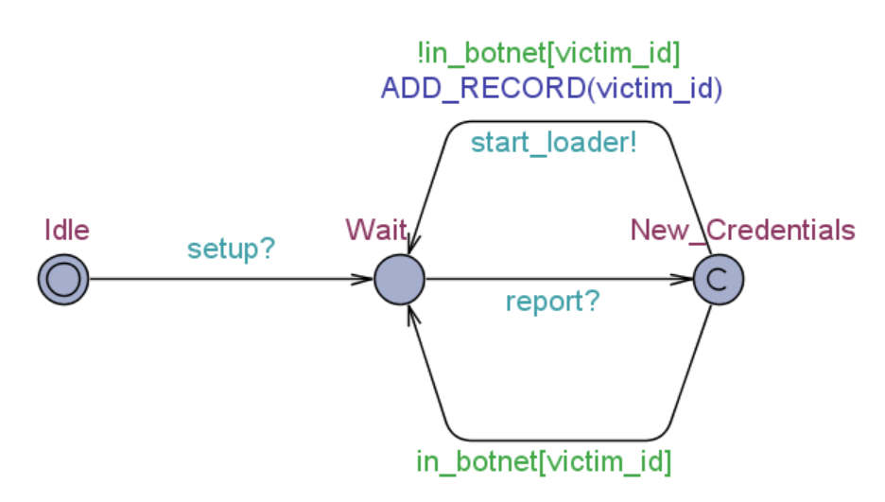
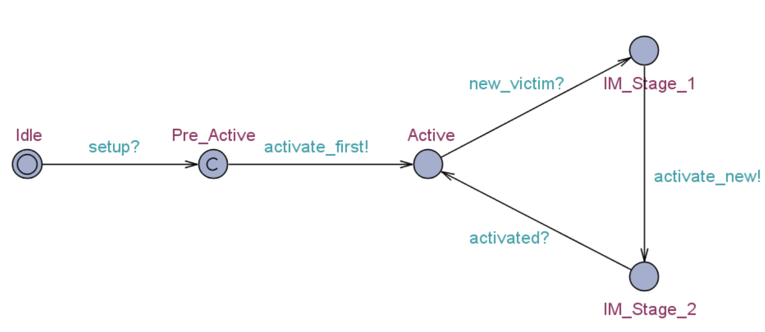
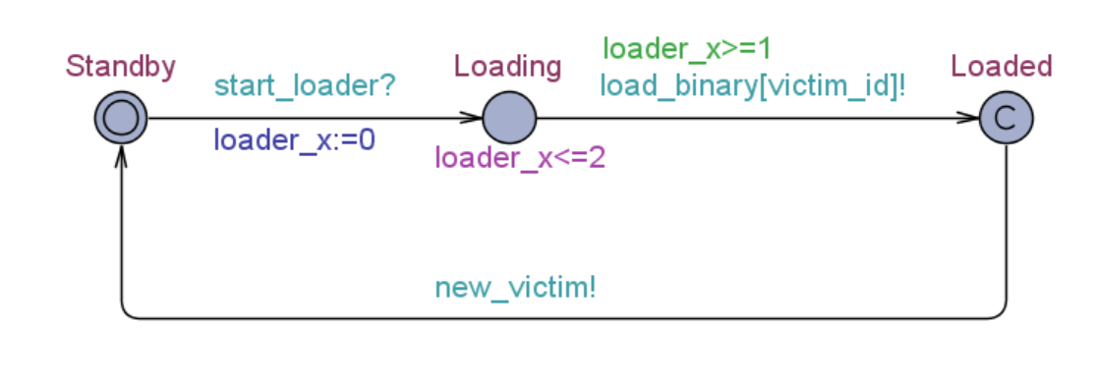
Modeling the Botnet Infrastructure
Command and Control Sever
Report Server
Loader
6

Slide 7
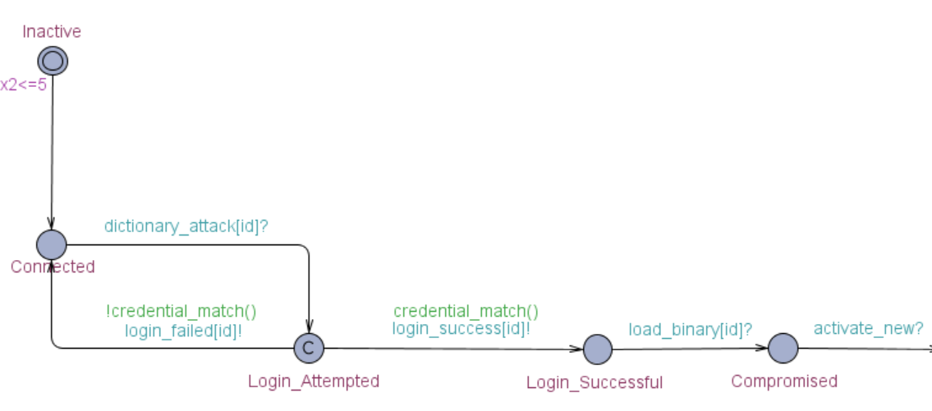
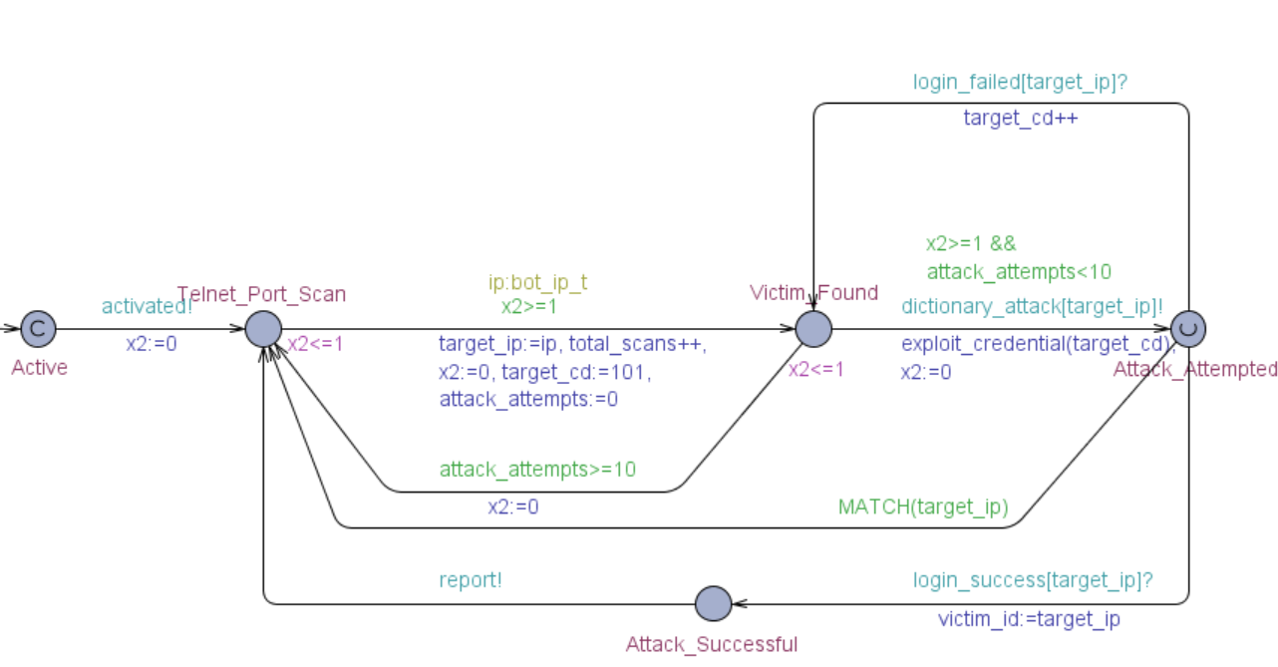
Modeling the Devices
Activation
Device type 1 – Always Connected
Scan and Report
G. Kambourakis, C. Kolias and A. Stavrou, "The Mirai botnet and the IoT Zombie Armies," MILCOM 2017 - 2017 IEEE Military Communications Conference (MILCOM), Baltimore, MD, 2017, pp. 267-272, doi: 10.1109/MILCOM.2017.8170867.
7

Slide 8
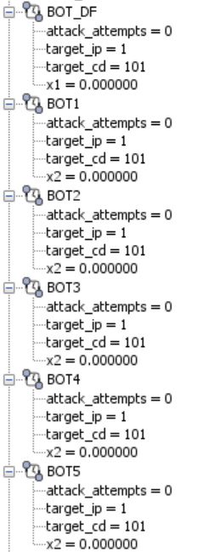
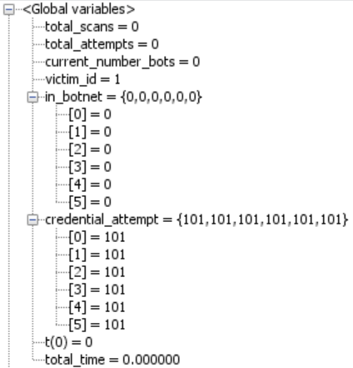
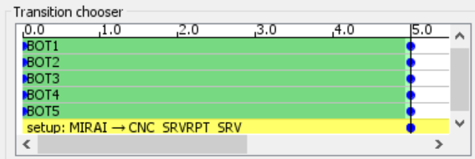
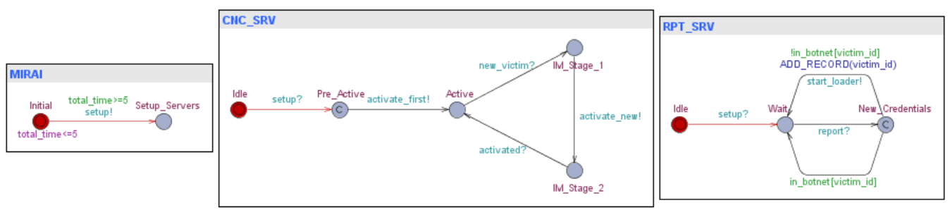
The Concrete Simulator – Initial State
State Variables
Choosing Transitions
8

Slide 9
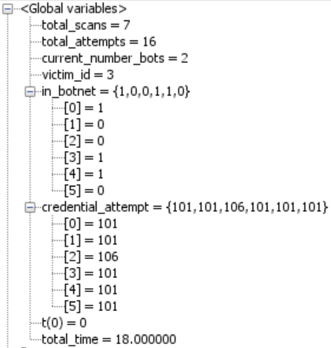
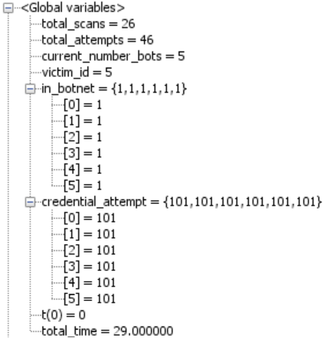
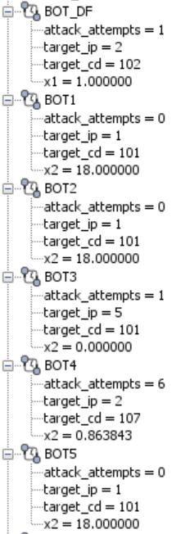
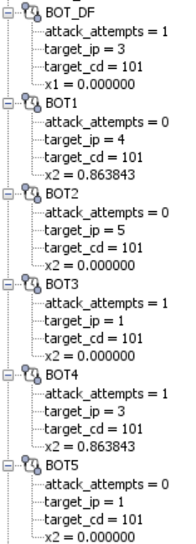
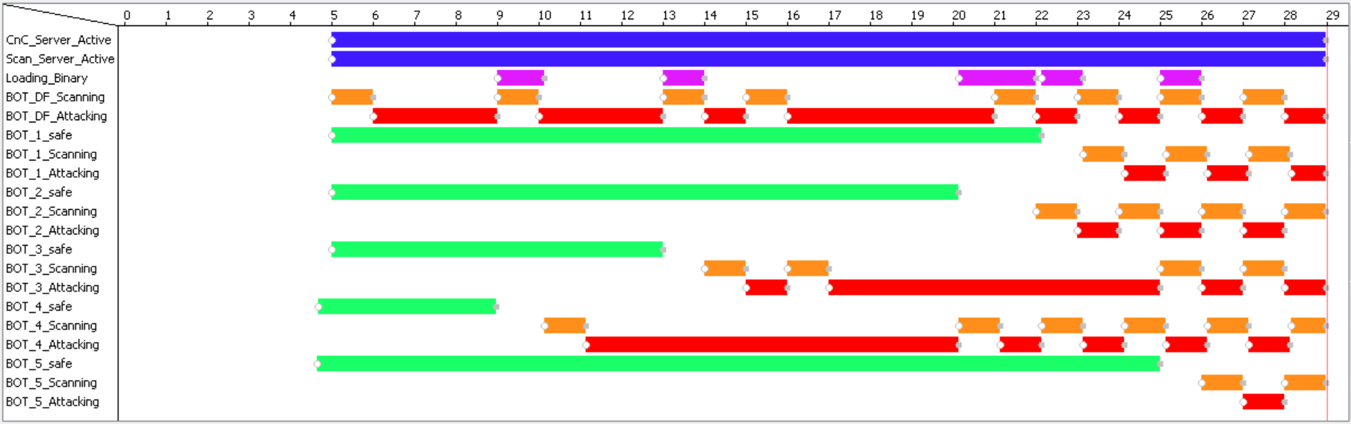
The Concrete Simulator – in Action
State at 18 minutes
State at 29 minutes
Gantt Chart
9

Slide 10
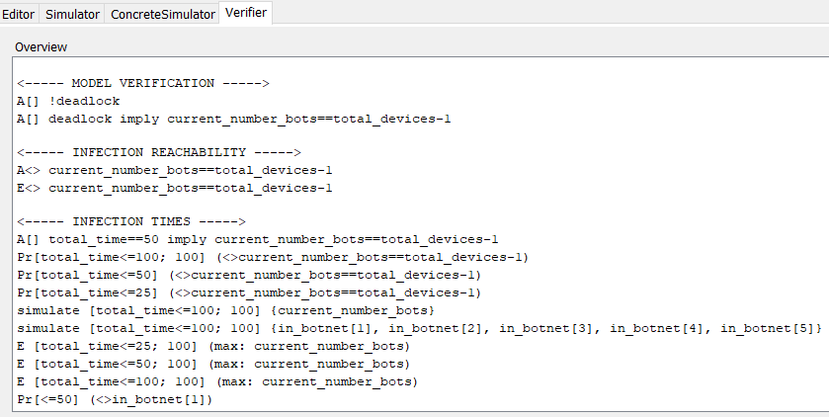
How do we collect data?
Concrete Simulator
Run individual simulations and log data yourself
See each run in great detail
Slow, manual process
Verifier
Formally check properties with temporal logic
Exhaustive state space exploration
Beware of state space explosion!
Automate several simulation runs
Graph frequencies and probability distributions
Specify required confidence levels
Export data for further analysis
For now, we mainly produce results for a network of 5 devices
10

Slide 11
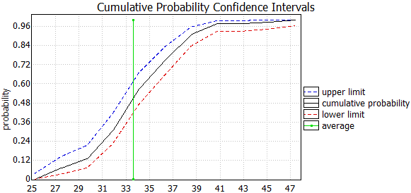
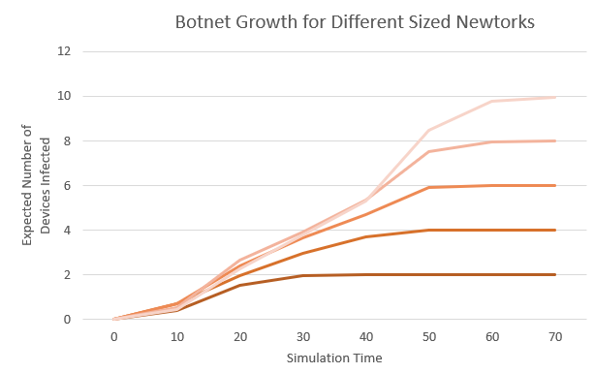
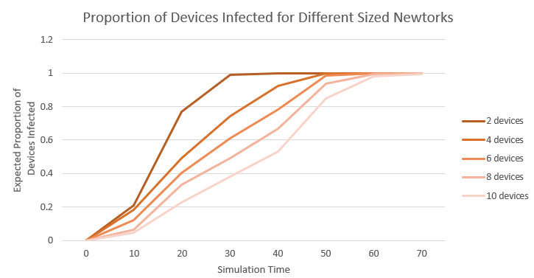
How quickly are devices infected?
Expected devices infected
After 10 time units: 0.59 ± 0.0981
After 25 time units: 2.93 ± 0.185
After 50 time units: 4.99 ± 0.0198
After 100 time units: 5 ± 0
Summary
The model accurately depicts expected botnet growth
Network size does not have a huge impact on expected time to infect all devices (so far)
11

Slide 12
Is network propagation “random”?
Devices are randomly targeted
The order devices are infected should not matter
Infection time distributions should be similar for each device
Devices with different passwords
Device | 2 | 3 | 4 | 5
1 | 0.37 | 0.23 | 0.23 | 0.29
2 |  | 0.29 | 0.32 | 0.17
3 |  |  | 0.10 | 0.18
4 |  |  |  | 0.28
Kolmogorov-Smirnov Test
Determine if two empirical distributions are sampled from the same distribution
With confidence level 0.05 and 100 samples, threshold value for the test is 0.192
Pairwise comparisons
All devices with same password:
Device | 2 | 3 | 4 | 5
1 | 0.06 | 0.11 | 0.09 | 0.12
2 |  | 0.11 | 0.09 | 0.11
3 |  |  | 0.07 | 0.08
4 |  |  |  | 0.11
What does this mean?
Location on the botnet password list significantly affects infection time
12

Slide 13
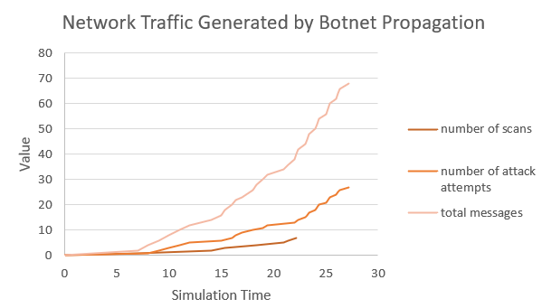
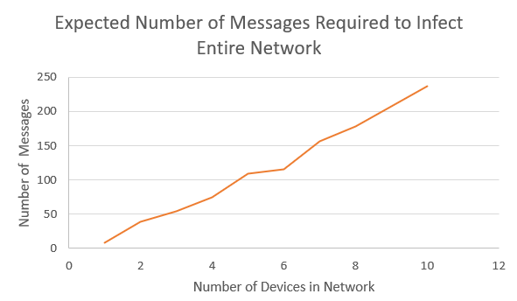
How much network traffic is generated?
Messages sent by a botnet use resources that would otherwise be used for legitimate network traffic
Expected number of port scans: 16 ± 12.5
Expected number of password attempts: 38.5 ± 15.4
Expected total messages: 109 ± 54.4
Summary
Total traffic generated by the botnet increases exponentially over time
Required messages to infect whole network increases linearly with network size
13

Slide 14
What comes next?
Rebooting and Patching
New Questions
Rebooting a device clears any infection
Consider device types that reboot periodically and following some distribution
Model reinfectivity of devices after patching and subsequent reboots
With rebooting and patching, is it possible to infect all devices?
With rebooting, does the botnet size reach a steady state?
How many times will a device be infected before the whole network is infected?
How do these new considerations affect the amount of network traffic produced?
Network Stability
Adjust timing on transitions
Password Scheme
Widen the range of possible credentials a device can have
14

Slide 15
Thank You!

Slide 16
Questions?

