Slide 1

Alvi Jawad
John Jegede
Isaac Wiebe
Felix Elugbaju
SYSC 5709
Group B

Slide 2
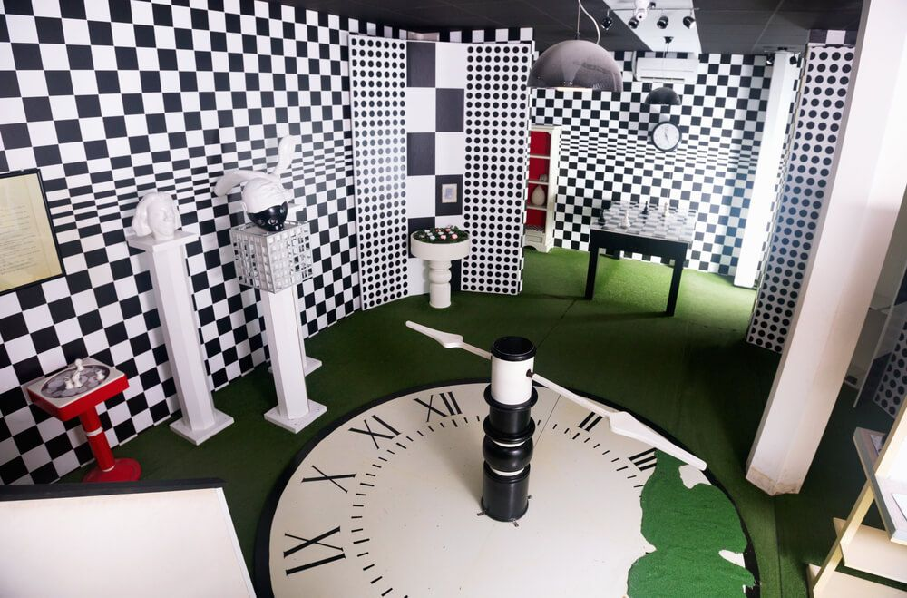
What is an Escape Room?
You are imprisoned in
A room filled with challenges
Multiple objects to interact with
You can
Inspect your surroundings
Identify key objectives
Decipher secret messages
Solve puzzles and riddles
Activate hidden mechanisms
Why?
Get access to a key or a code
Open the lock on the door
Your goal?
Escape The Room by any means possible
Get your reward!
1

Slide 3














What will our software do?
Allow the user to interact with the objects using the command line interface (CLI)
Return an imaginative response in a text-based environment
Present puzzles, riddles, and hidden messages as challenges
Solving all challenges in a room will allow access to a key or code
Open the door to get a reward!
Move to an even more challenging room
Escape from the final room to get the GRAND REWARD!!
2

Slide 4
What’s the plan?
Four distinct phases:
Input handling
Command Execution
Challenge Creation
Passage Connection
{
Release 1
}
Release 2
3

Slide 5
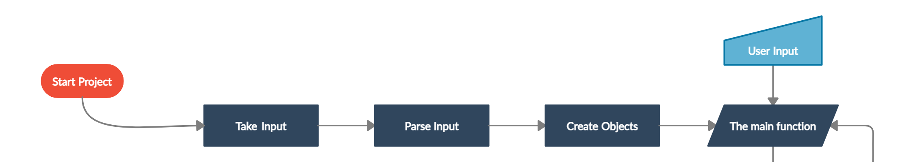
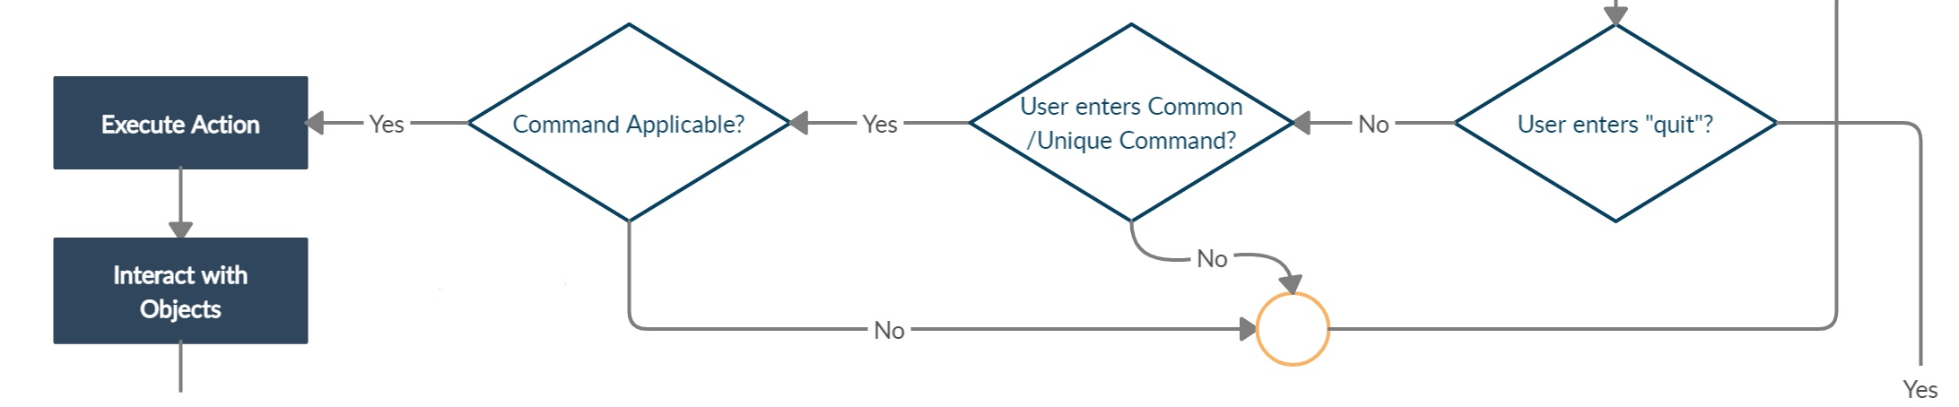

How to execute?
Input Handling
<command> <arg>
Take and parse user input
Create some initial objects
Test the main function
examine <object>
Command Execution
Check for valid commands
Create Execution functions
Test some user interaction
read <table>
4

Slide 6
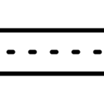
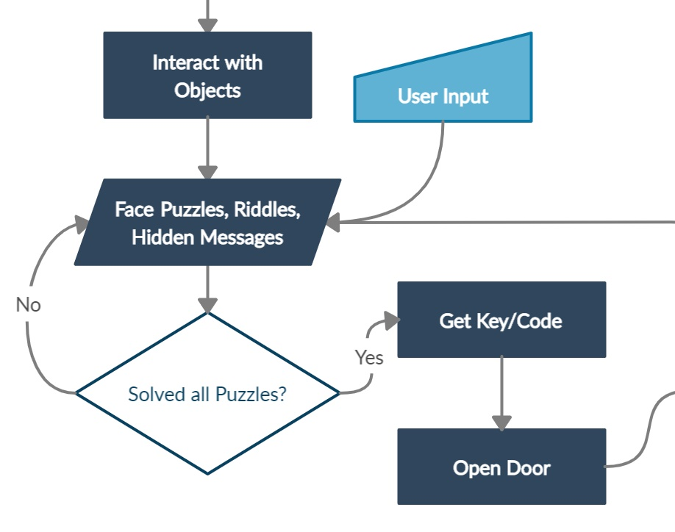
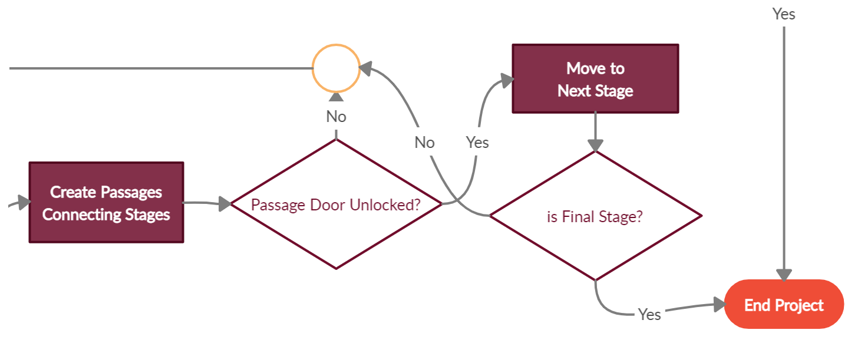
When do we stop?
Challenge Creation
Stage 1
Stage 2
Passage Connection
Create challenges for Stage 1
Award a key to open doors after solving all challenges
Create passages to connect two stages
Create challenges for stages 2 and 3
Passages allow moving to the
next stage
Escape from the final room and get the Mystery Prize!
?
5

Slide 7
Thank You!

Slide 8
Questions?

