Slide 1

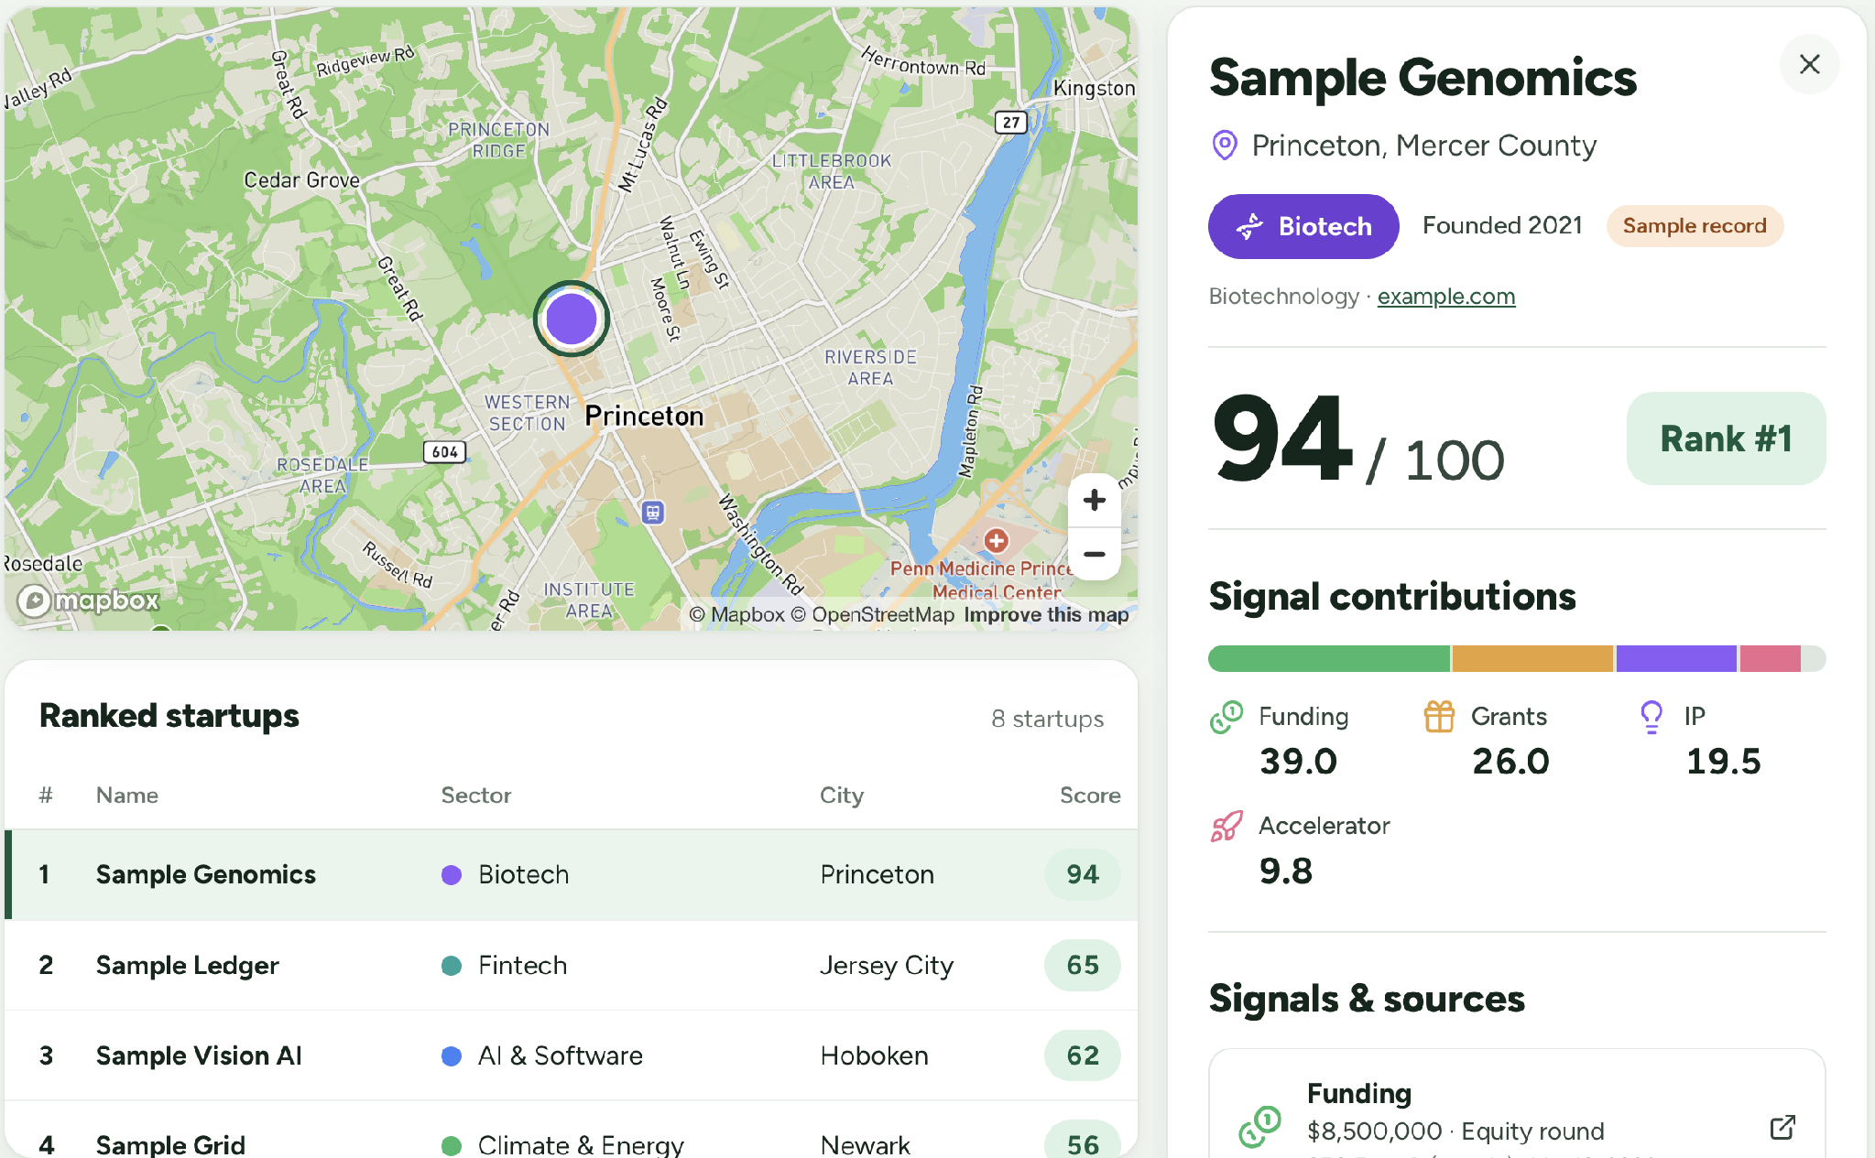
1435 CAPITAL CHALLENGE
NJ Startup
Signals
Discover New Jersey’s next wave of startups.
A map and ranked view of early momentum.
Mighty Ducks
Phil Rodriguez
YiChin Ho
Concept preview · Sample data
Luke Daniel
Tewan Pothibutt
Notes:
NJ Startup Signals helps investors and ecosystem teams discover promising New Jersey startups earlier. We bring together the signals that are usually scattered across funding records, grants, hiring, intellectual property, and accelerator programs. The result is a map and ranked view of startup momentum, with company profiles that show the signals behind each opportunity.
Source: User-approved solution. NJ Startup Signals is a provisional project name.

Slide 2






The problem
02
Promising startups are
hard to spot early.
Grants
Funding
Hiring
IP filings
Finding the signals still means searching across sources.
That makes it harder to see which companies and sectors are gaining traction.
Accelerators
Public support
6
separate places to look
before evaluation can begin
Scattered across funding records, grant databases, job boards, IP registries and program listings
Notes:
The challenge is seeing momentum early. One startup may have received a grant, another may be adding technical roles, and another may have filed new intellectual property. Those signals sit in different places. Investors and ecosystem teams have to collect and compare them manually before they can begin evaluating the company. That makes it difficult to identify which companies, and which sectors, are gaining real traction across New Jersey.
Source: User-approved solution and presentation outline.

Slide 3




Solution overview
03
A map of startups.
A ranked view of momentum.
0–100
Map
Leaderboard
Locate companies across New Jersey
Compare startups by score
Startup Score
Built from six types of ecosystem signals
Company profiles
Sector clusters
Explore the signals behind each company
See momentum across industries
Notes:
Our MVP connects an interactive map with a ranked list of New Jersey startups. Every company receives a Startup Score from zero to one hundred, based on six types of signals. Users can locate companies, compare their scores, and open a profile to see the detected signals. They can also move from individual companies to sector clusters, giving them a broader view of where momentum is building.
Source: User-approved solution and presentation outline.

Slide 4



Why now
04
Discover earlier.
Evaluate faster.
Build relationships before the opportunity is widely known.
01
02
03
Competing for access
Fragmented information
Earlier assessment
Other investors may reach promising companies first.
Gathering signals takes time before evaluation can begin.
Combined signals help teams start evaluating sooner.
Notes:
Discover earlier. Evaluate faster. Build relationships before the opportunity is widely known. This is why speed matters. Other investors may be looking for the same promising companies. While one team is still collecting information, another may already have started a conversation. By combining the signals, we help users begin assessing opportunities sooner and create a chance to build relationships earlier.
Source: User-approved Why Now message. This is a competitive rationale, not a claim that competition has recently increased or a guarantee of investment outcomes.

Slide 5



Target users
05
Built for those who spot and support growth.
Investors
Ecosystem builders
Economic development groups
Find and compare emerging opportunities.
Start evaluating companies earlier.
Connect startups with programs and networks.
See companies and sectors across the ecosystem.
Understand growth by location and industry.
Inform regional development priorities.
Shared signals. Different views and scoring weights for each group.
Notes:
We serve three groups. Investors use the platform to find and compare emerging opportunities. Ecosystem builders use it to identify companies and connect them with programs, networks, and support. Economic development groups use it to understand growth by geography and industry. The underlying signals are shared, while the views and scoring weights let each group focus on its own priorities.
Source: User-approved solution and presentation outline.

Slide 6

Ecosystem signals
06
The signals behind the score.
Funding
Grants
Hiring
Capital raised and funding rounds
Award dollars and program participation
Open roles and technical-role share
SEC Form D
SBIR · NIH · NSF · NJEDA
Job posting platforms
Intellectual property
Accelerators
Public support
Recent patent and trademark filings
Accelerator or incubator participation
Programs, awards, and press
Patent & trademark records
Program & event listings
NJEDA & other public sources
Public and permissioned data, with sample data clearly labeled.
Notes:
We organize the data into six signal types. Funding comes from sources such as SEC Form D. Grants include SBIR, NIH, NSF, and publicly available NJEDA awards. Hiring captures open roles and the share of technical roles. IP captures recent patent and trademark filings. Accelerator listings and public support provide further context. For the hackathon, we use real data where it is quick to obtain, permissioned data where available, and clearly labeled samples where needed.
Source: User-approved solution and presentation outline.

Slide 7
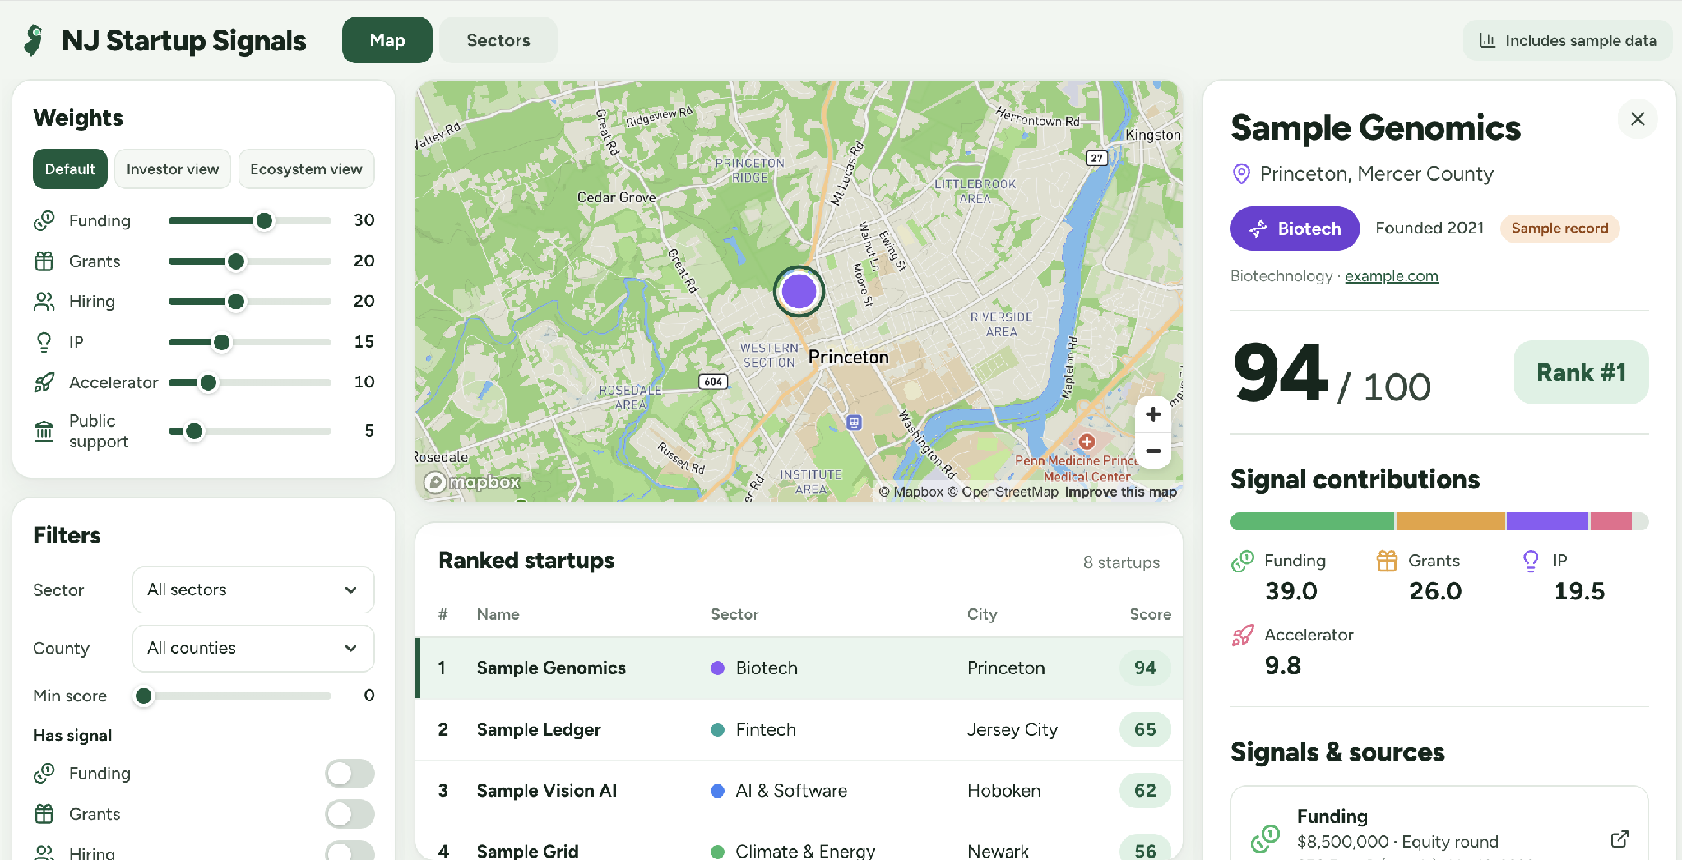


Map & ranked list
07
Explore the ecosystem.
Mapbox map
Pin color = sector
Pin size = score
Ranked list
Rank, name, sector,
city, and score
Zoom & layers
Cluster pins on zoom-out.
Optional county heatmap.
Concept preview · Sample data
Notes:
This concept screen shows the main experience. The map places one startup pin at each geocoded address. Color identifies the sector, and size reflects the Startup Score. Pins cluster when the user zooms out so dense areas such as Newark, Princeton, and Jersey City remain readable. The ranked list sits beside the map. Clicking either a company row or a pin opens its profile. A county-level score-density heatmap is an optional layer.
Source: User-approved product specification. Screen generated with the built-in image_gen tool. Fictional company names and sample scores. Concept visualization, not a completed or live application. Map geometry is illustrative.

Slide 8



Discovery & company profiles
08
A closer look at each company.
STEP 01
STEP 02
STEP 03
Filter
Select
Explore
Sector and county
Minimum score
Funding, grants, hiring, IP, and accelerator signals
Click a company in the list.
The map flies to its pin.
Or select the pin directly.
Company overview and location
Sector and Startup Score
Detected ecosystem signals
Notes:
The user journey is straightforward. Start by filtering for a sector, a county, a minimum score, or specific signal types. Select a company in the ranked list, and the map flies to its location while the profile opens. Users can also select the map pin directly. The profile brings the company overview, location, sector, score, and detected signals together so they can decide what to investigate next.
Source: User-approved solution and presentation outline.

Slide 9
Startup scoring model
09
How the Startup Score is built.
Funding
Amount raised and number of rounds
Grants
Award dollars, with SBIR Phase II weighted 2× Phase I
Hiring
Open roles and share of technical roles
94
IP
Recent patent and trademark filings
Startup Score
Accelerator / incubator
Participation, with a boost for selective programs
Public support & other
NJEDA programs, awards, and press
Normalize each signal. Combine using the selected weights.
Boost companies with several independent signal types.
Notes:
The default score is a weighted sum of six normalized signals. Funding contributes thirty percent. Grants and hiring contribute twenty percent each. IP contributes fifteen percent, accelerator participation ten percent, and public support five percent. Within grants, SBIR Phase II counts twice Phase I. Accelerator participation can receive a boost for selective programs. Companies with several independent signal types receive an additional boost. This is the scoring structure behind the zero-to-one-hundred ranking.
Source: User-approved scoring model. The original specification does not define normalization functions, recency windows, bonus size, or final score capping. No additional formulas have been invented.

Slide 10

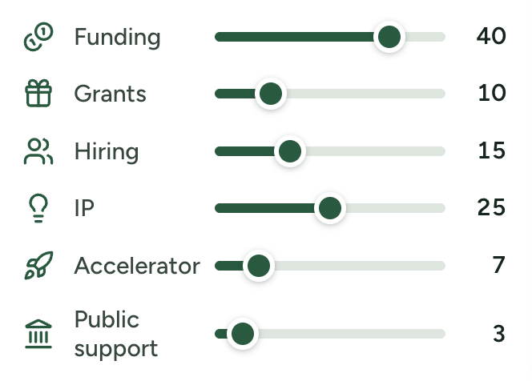
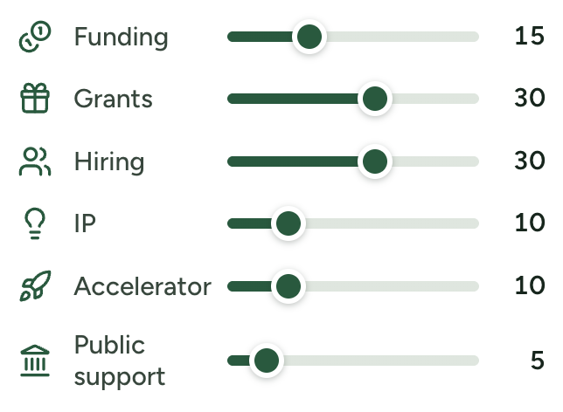
Weights & presets
10
Rank opportunities
through your lens.
Investor view
Ecosystem view
Funding + IP
Hiring + Grants
Emphasize capital activity and intellectual property.
Emphasize workforce expansion and grant support.
Funding
Funding
Adjust one slider per signal.
Grants
Grants
Rankings update live.
Hiring
Hiring
Same signal base, different evaluation priorities.
IP
IP
Accelerator
Accelerator
Slider positions are illustrative.
Notes:
The platform also supports different evaluation priorities. Users can adjust one slider per signal and see the rankings update live. Investor view increases the emphasis on funding and IP. Ecosystem view increases the emphasis on hiring and grants. Both views work from the same signal base, allowing users to explore the ecosystem through a lens that matches their role.
Source: User-approved presets. Exact preset percentages were not supplied and are not asserted.

Slide 11
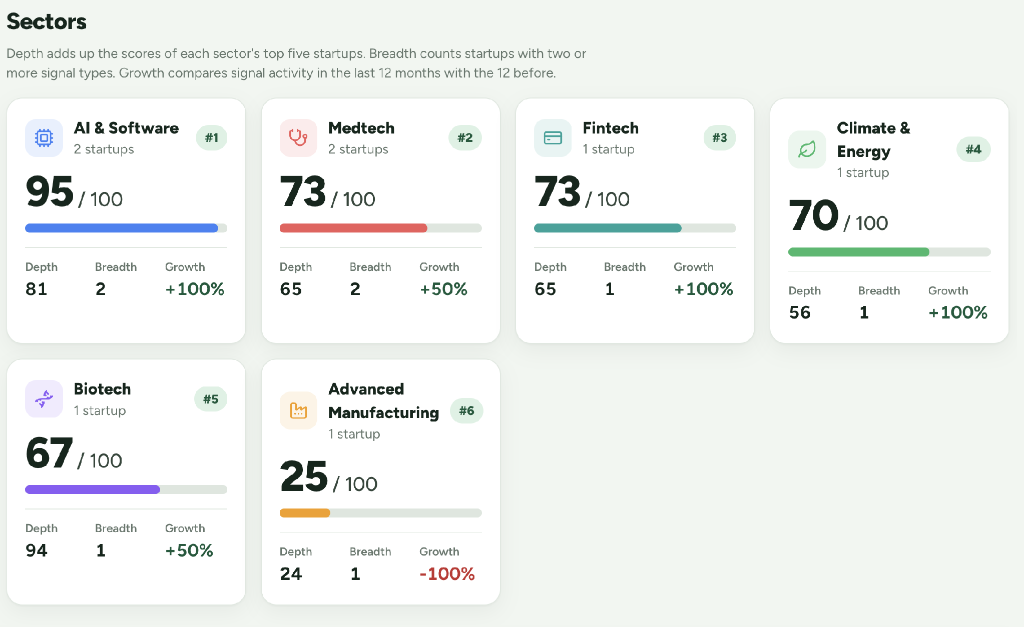

Sector clusters & trends
11
Momentum across industries.
COMPARE SECTORS BY
Company count by sector
Illustrative data
Depth
Breadth
Year-over-year growth
Sample data demonstrates the view, not actual New Jersey sector performance.
Notes:
The same signals also support an industry-level view. We group companies into sector clusters and compare depth, breadth, and year-over-year growth through sector cards or a bar chart. This helps users look beyond one company and explore where activity is concentrated across New Jersey. The chart here illustrates the presentation of company counts only. Its values are sample data, not evidence of actual sector performance.
Source: User-approved sector view. Sample values: Life sciences 48, Climate 35, Fintech 28, Technology 22. Definitions of depth and breadth are not expanded beyond the approved scope.

Slide 12



Hackathon MVP
12
See the opportunity early.
A few hundred
New Jersey companies.
01
02
03
Working prototype
Startup scoring
Sector intelligence
Map, ranked list, and company profiles
Signal filters and adjustable weights
Clusters and trends across the state
Real data where quick to access. Clearly labeled samples where needed.
Notes:
For the hackathon, we are keeping the scope focused: a few hundred New Jersey companies, real data where it is quick to access, and clearly labeled sample data where needed. We will deliver a working prototype that aggregates and displays the signals, a Startup Score with filters and adjustable weights, and a view of sector clusters and trends. The outcome is simple: see which companies deserve attention, where they are, and what signals support that assessment, so the next conversation can begin earlier.
Source: User-approved solution and presentation outline.

