Slide 1
Ground State Preparation Data
Luke Bell

Slide 2
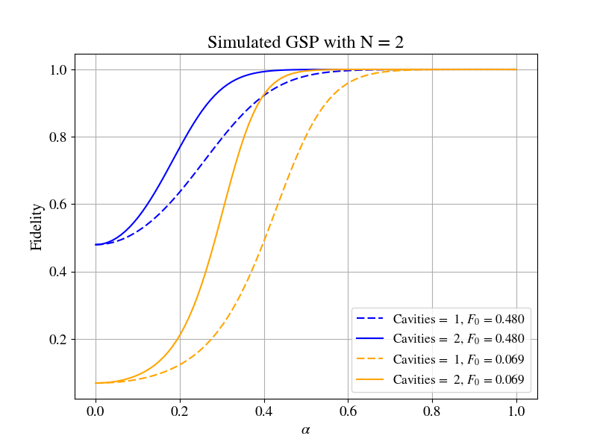
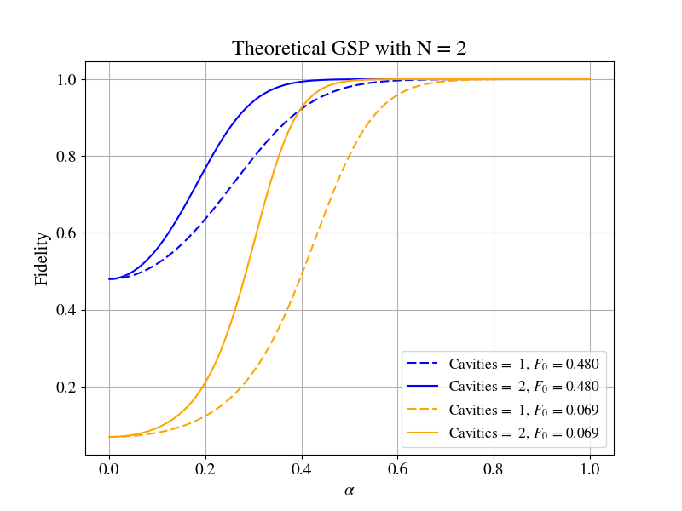
Two Sites, Two States

Slide 3
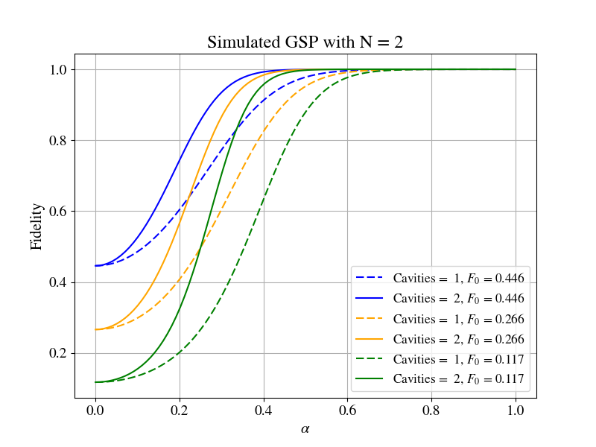

Two Sites, 3 States

Slide 4
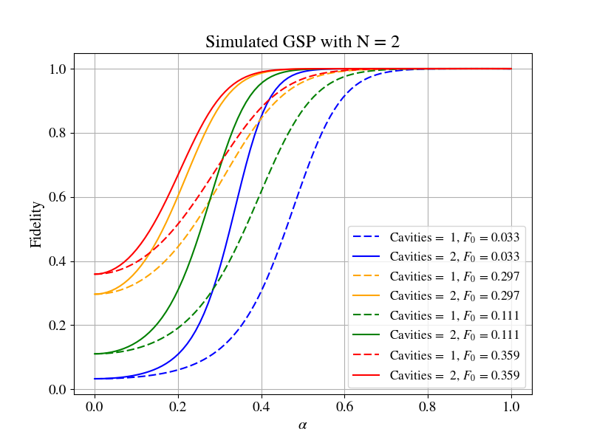

Two Sites, Four States

Slide 5


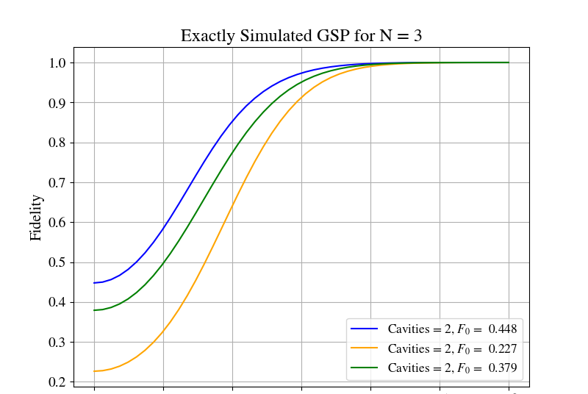
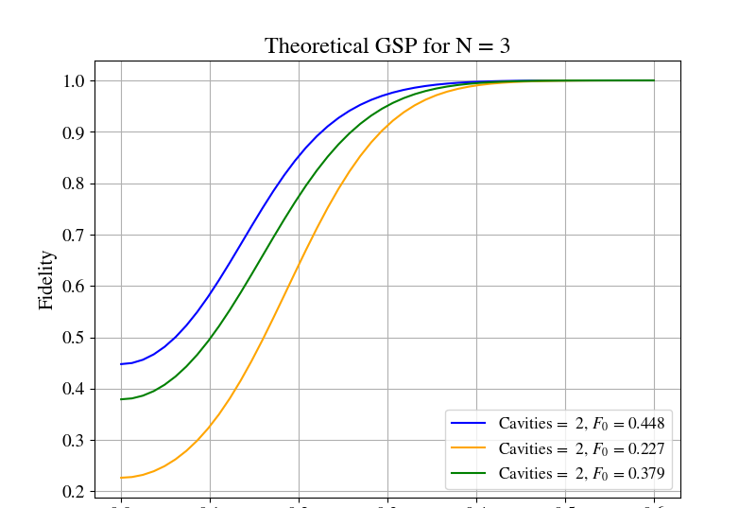
Three Sites

Slide 6
Trotterization Scheme
The following data is simulated according to this Trotterization method derived and explained in Section IV. E of the Boson Gang Document

Slide 7
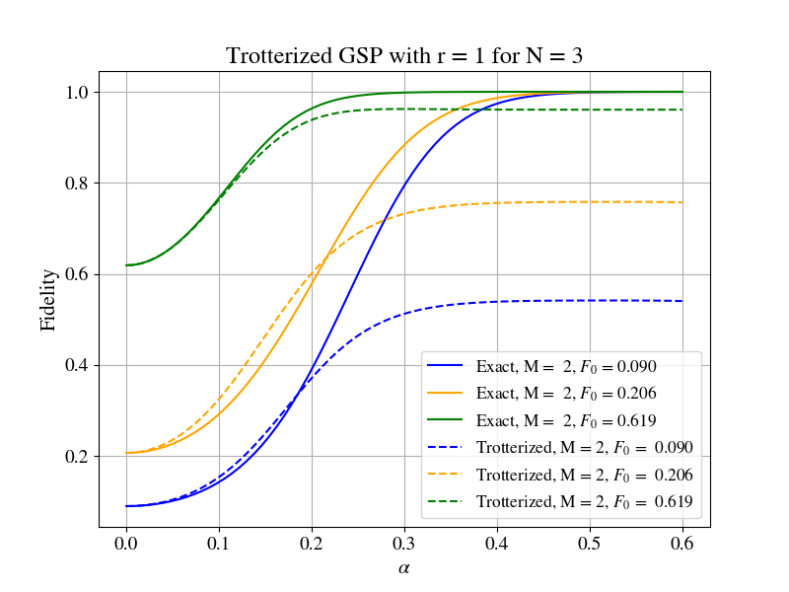
N is the number of sites and M is the number of cavities projected onto vacuum

Slide 8
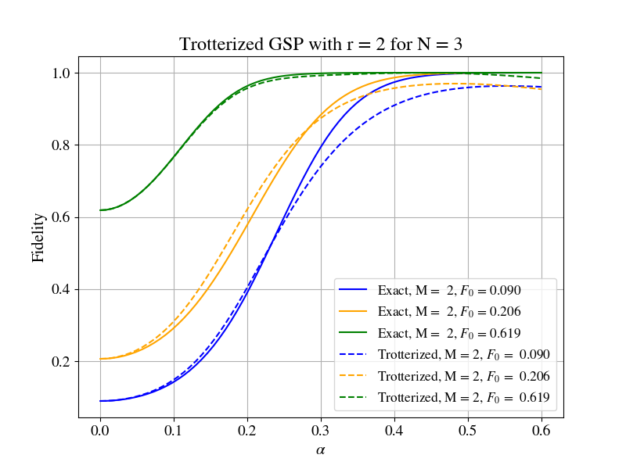

Slide 9
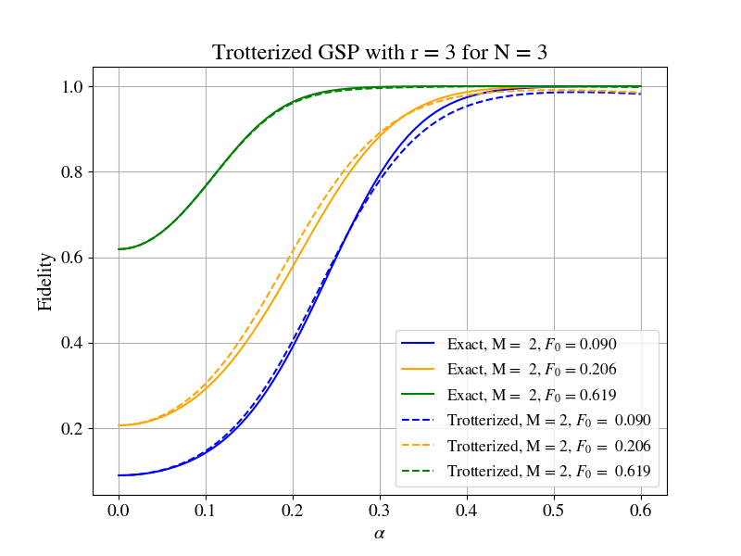

Slide 10


Slide 11
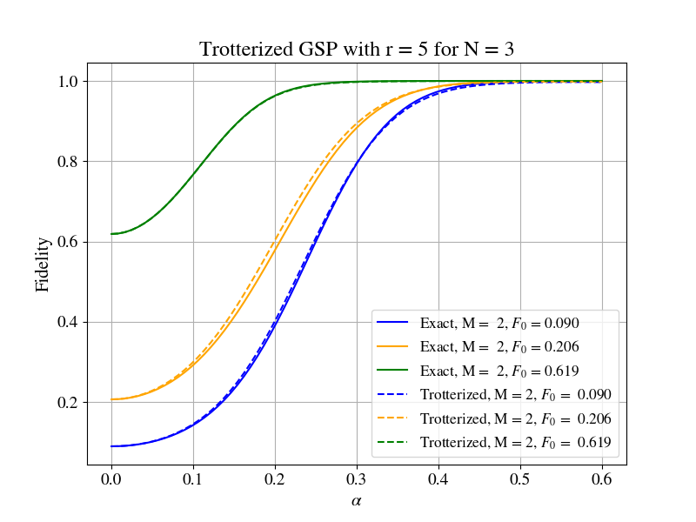

Slide 12
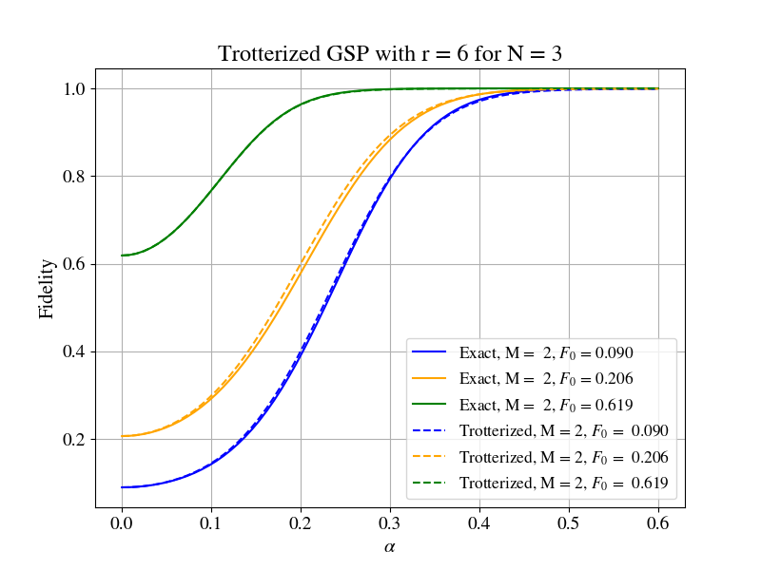

Slide 13
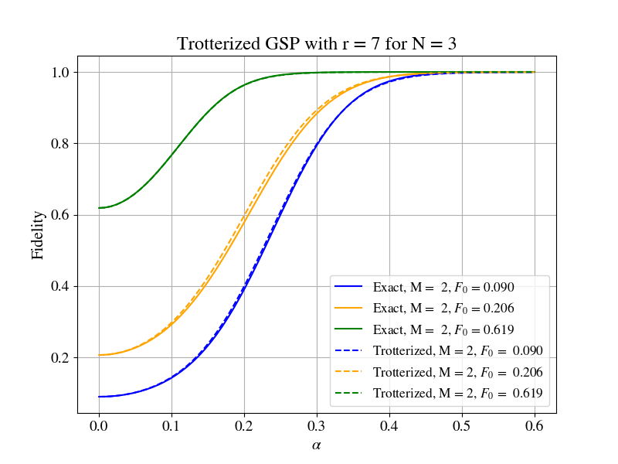

Slide 14


Slide 15


Slide 16


Slide 17
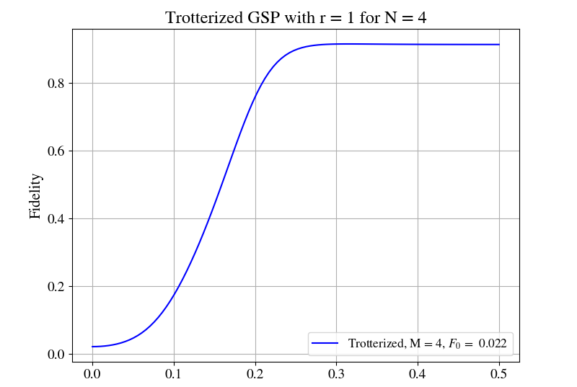
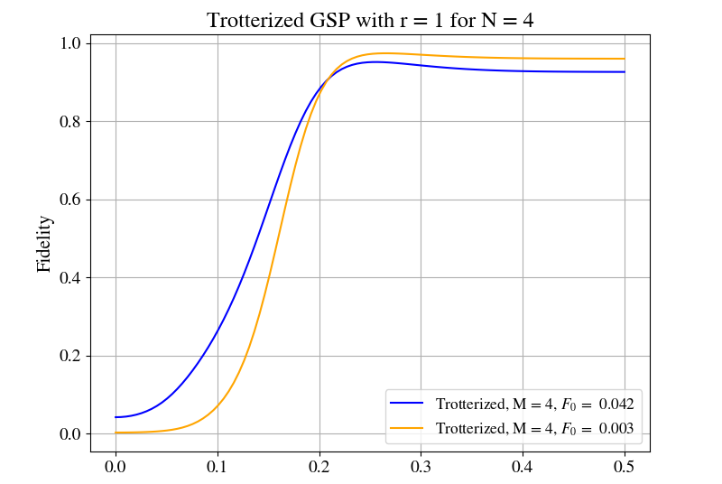
N = 4, 1 and 2 states

Slide 18
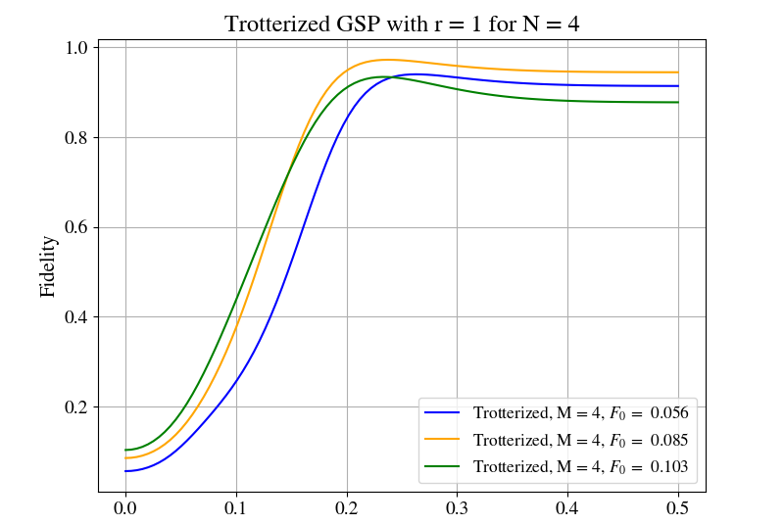
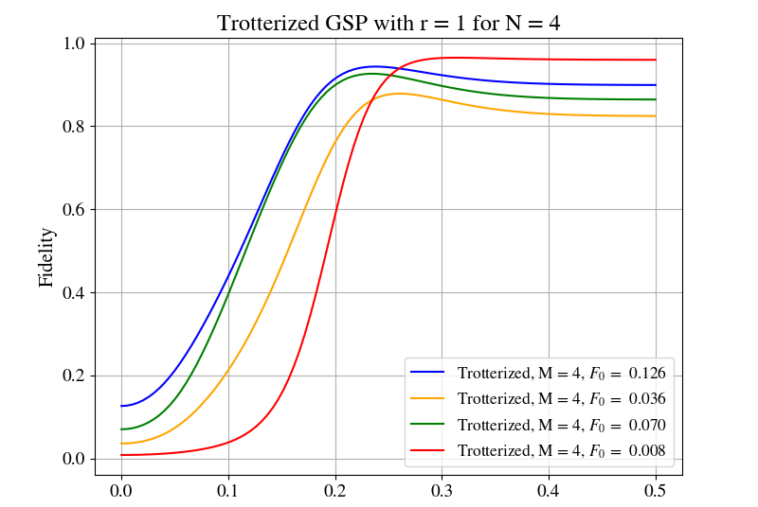
N = 4, 3 and 4 states

