Slide 1




April 26 Meeting
Luke Bell, Yan Wang, Eugene Dumitrescu

Slide 2
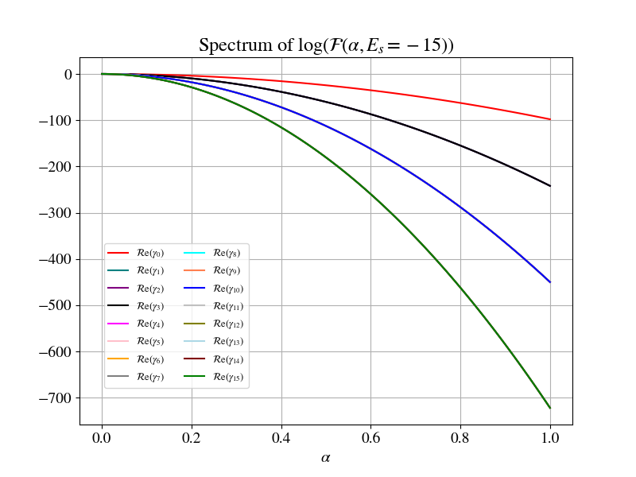
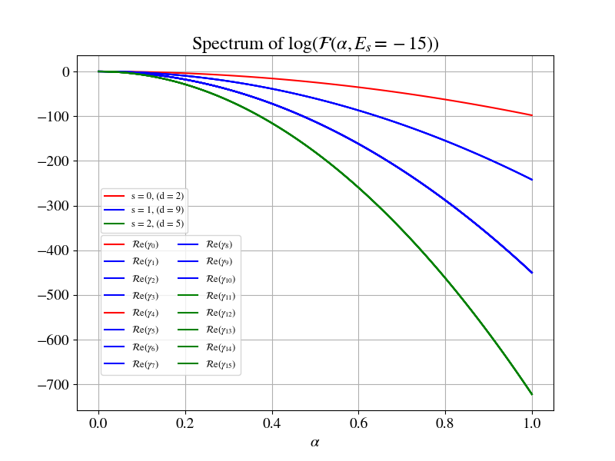
Spectrum of Log(VTA) when λ=1, E₀ = -15

Slide 3
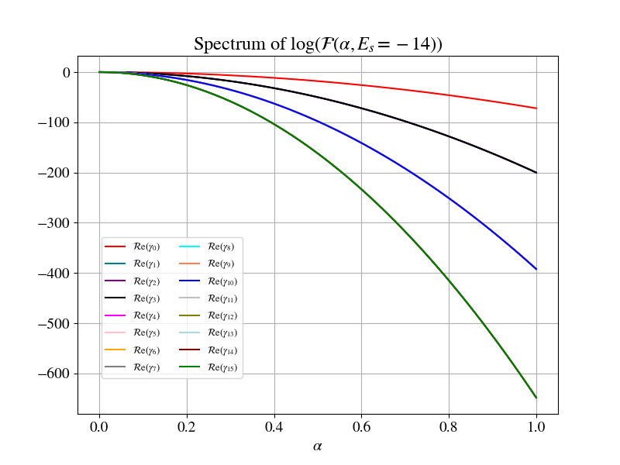
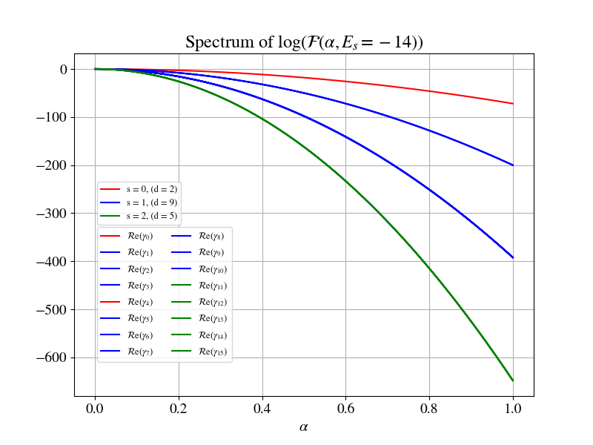
Spectrum of Log(VTA) when λ=1, E₀ = -14

Slide 4
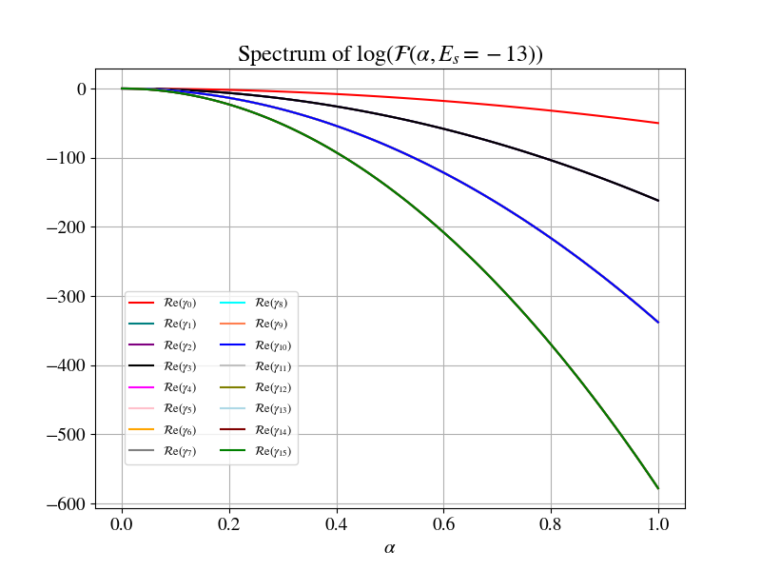
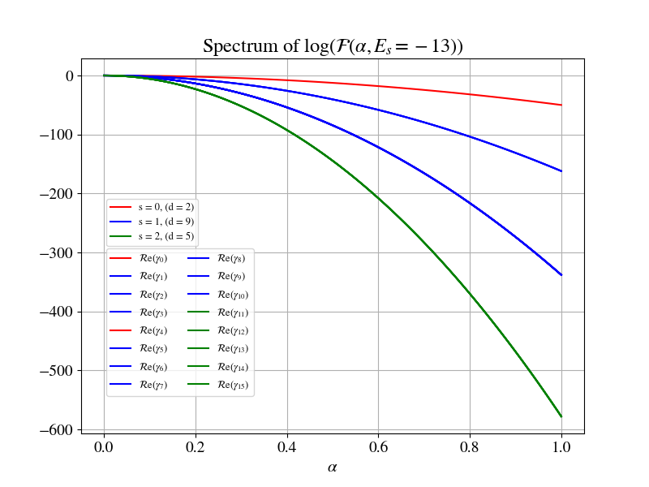
Spectrum of Log(VTA) when λ=1, E₀ = -13

Slide 5
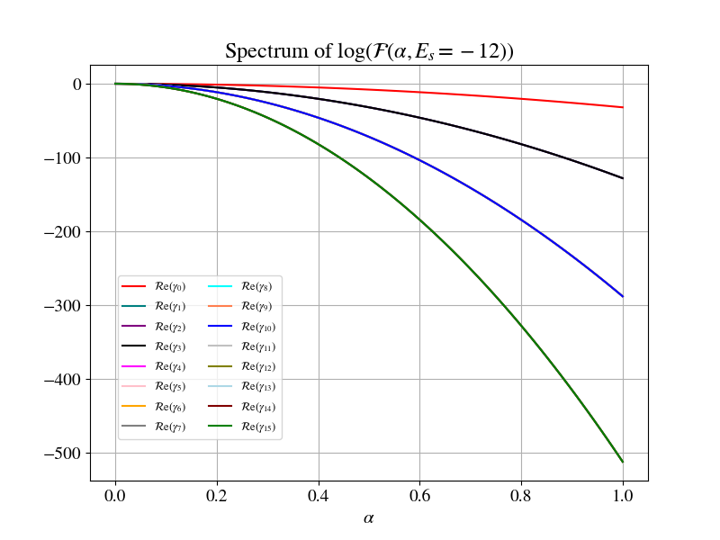
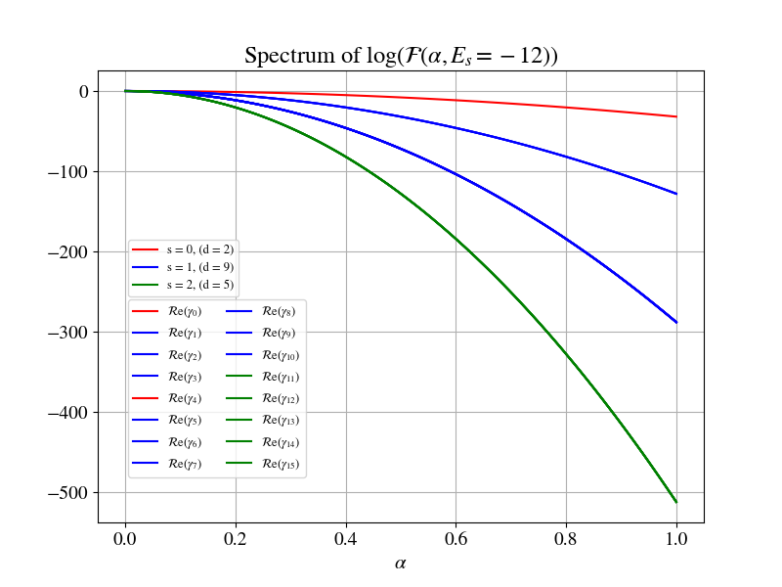
Spectrum of Log(VTA) when λ=1, E₀ = -12

Slide 6
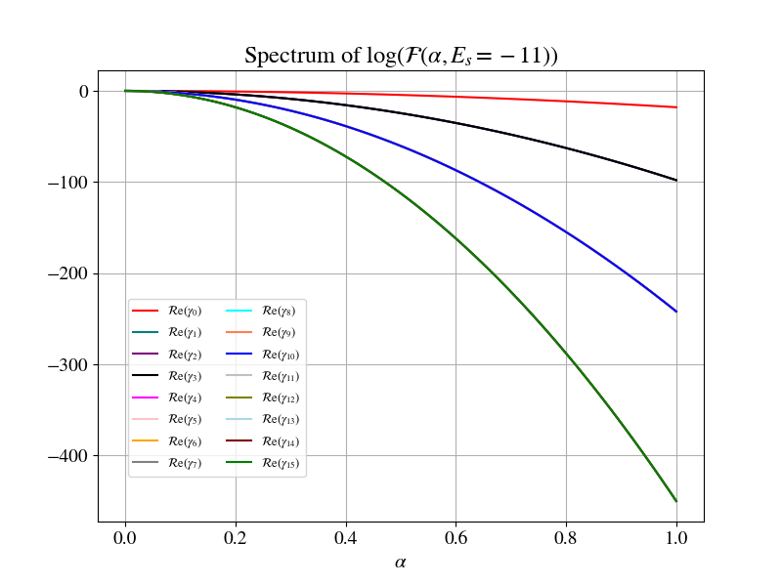
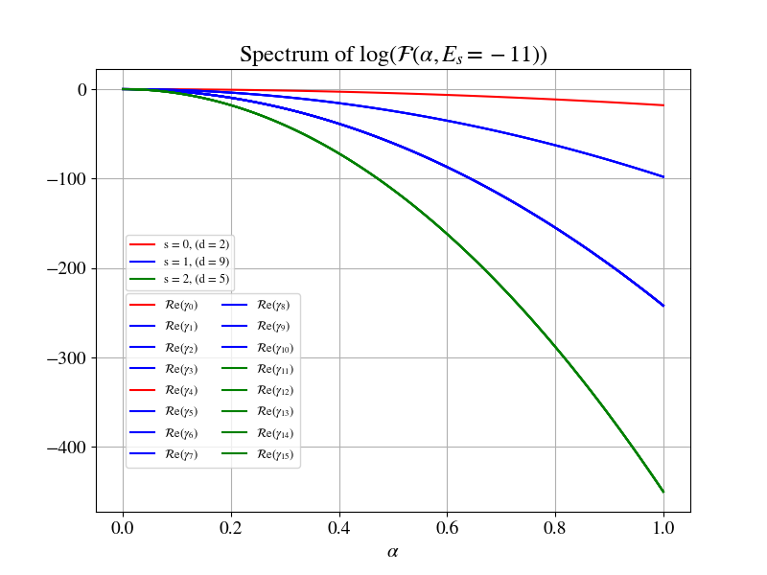
Spectrum of Log(VTA) when λ=1, E₀ = -11

Slide 7
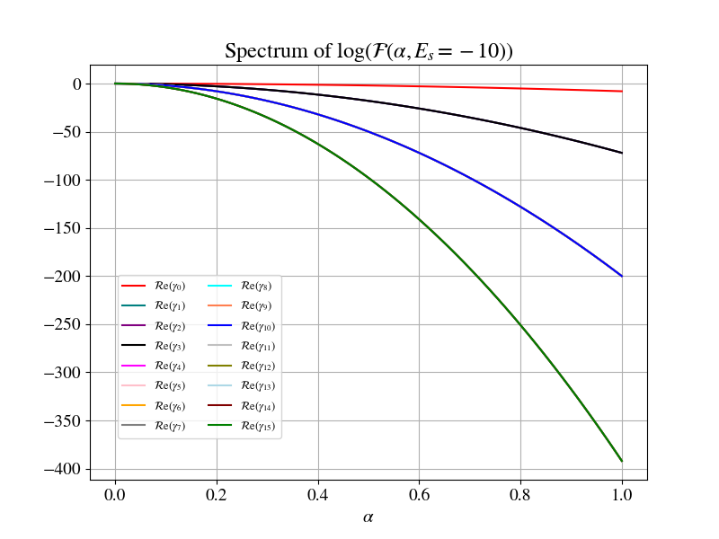
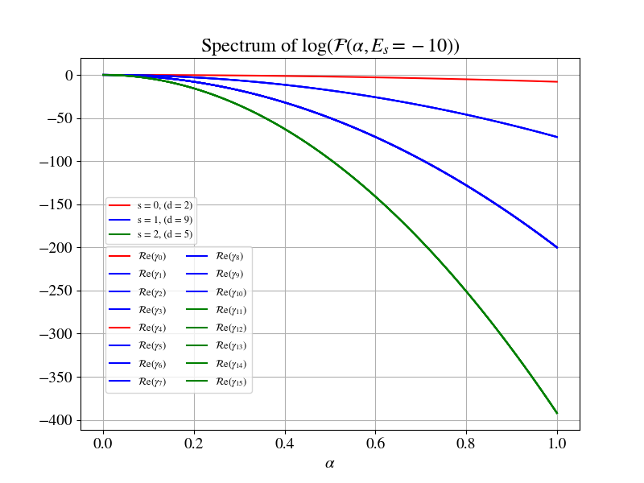
Spectrum of Log(VTA) when λ=1, E₀ = -10

Slide 8
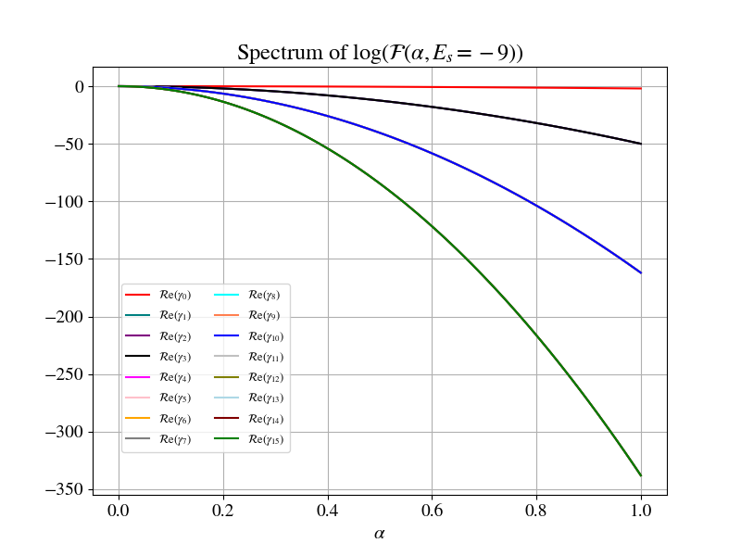
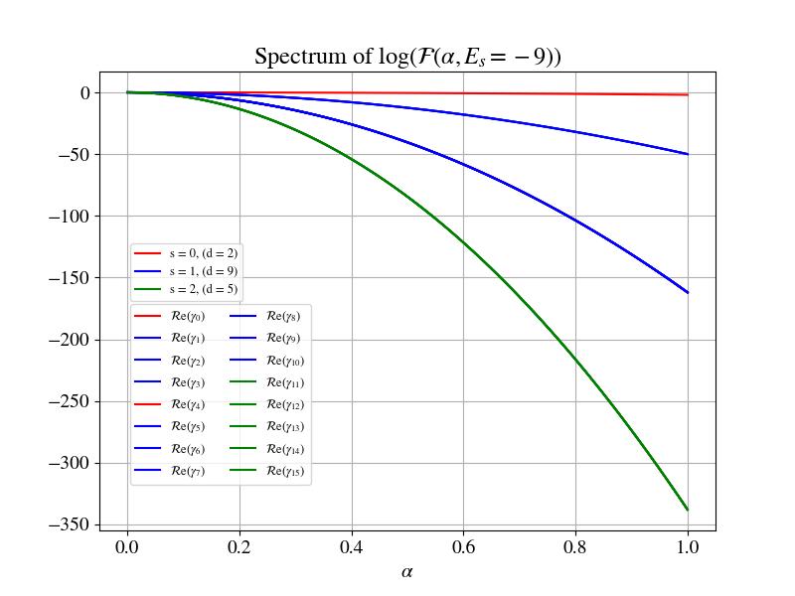
Spectrum of Log(VTA) when λ=1, E₀ = -9

Slide 9
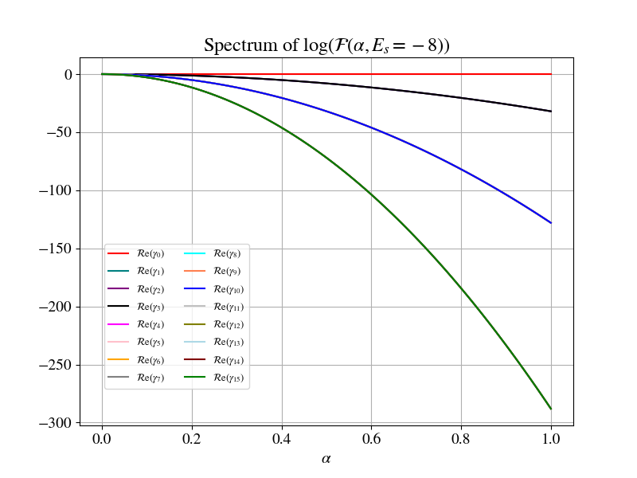
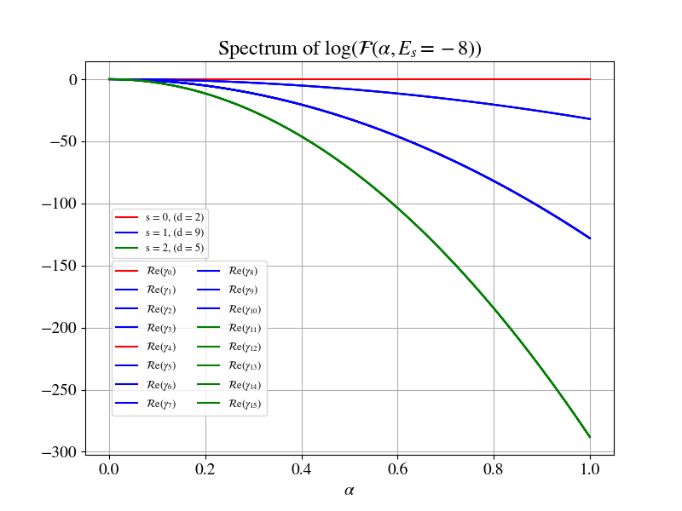
Spectrum of Log(VTA) when λ=1, E₀ = -8

Slide 10
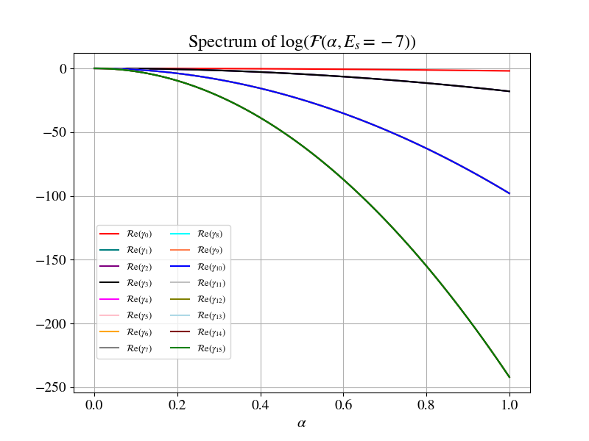
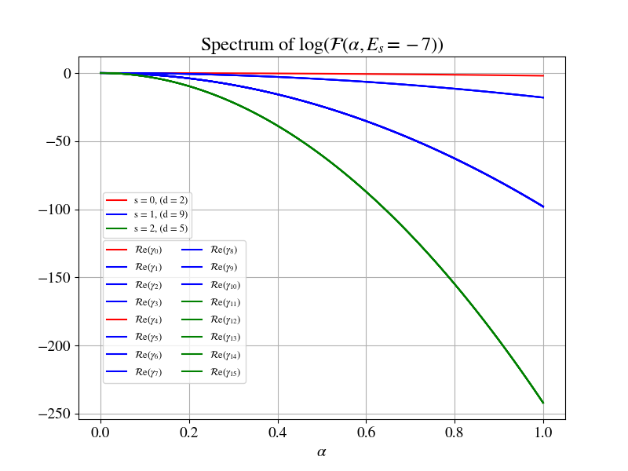
Spectrum of Log(VTA) when λ=1, E₀ = -7

Slide 11
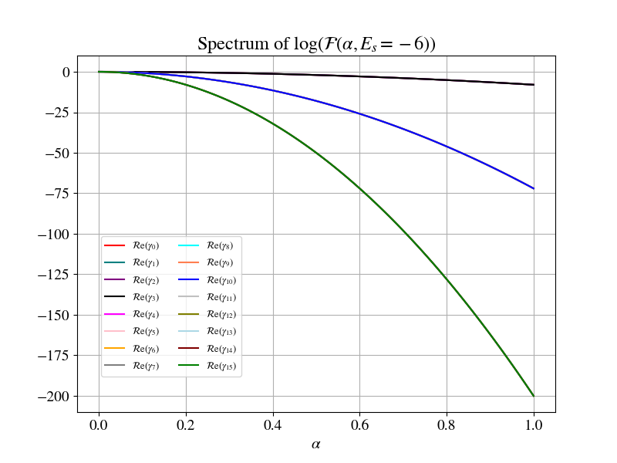
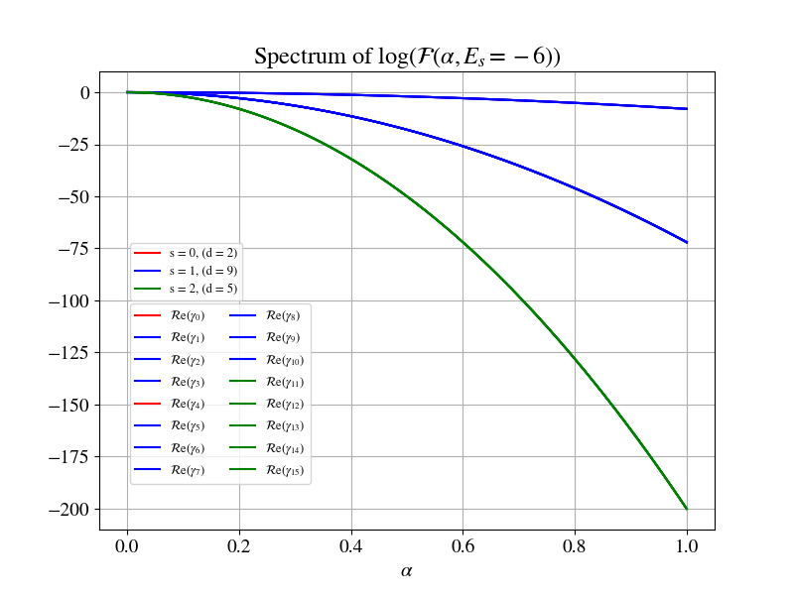
Spectrum of Log(VTA) when λ=1, E₀ = -6

Slide 12
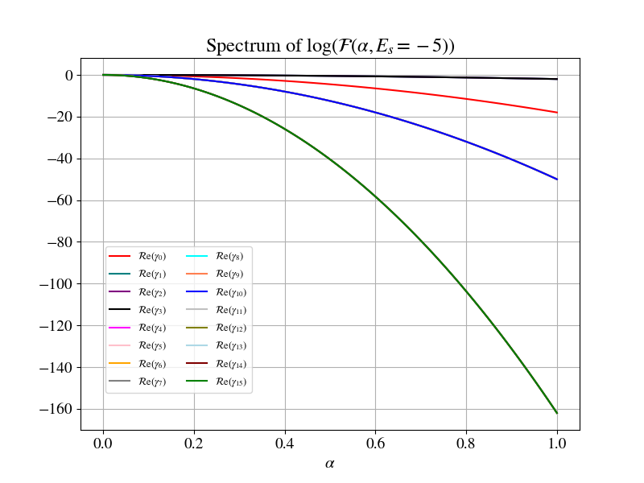
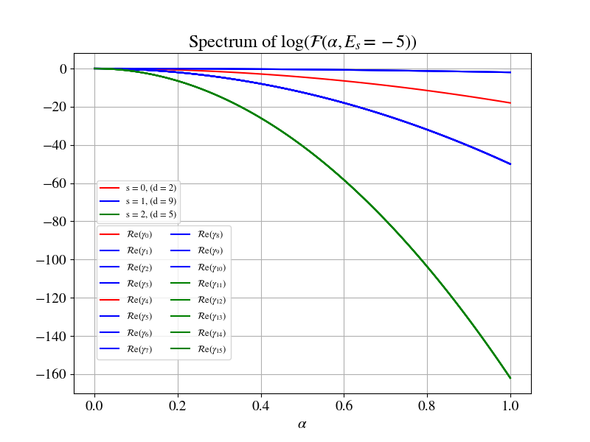
Spectrum of Log(VTA) when λ=1, E₀ = -5

Slide 13
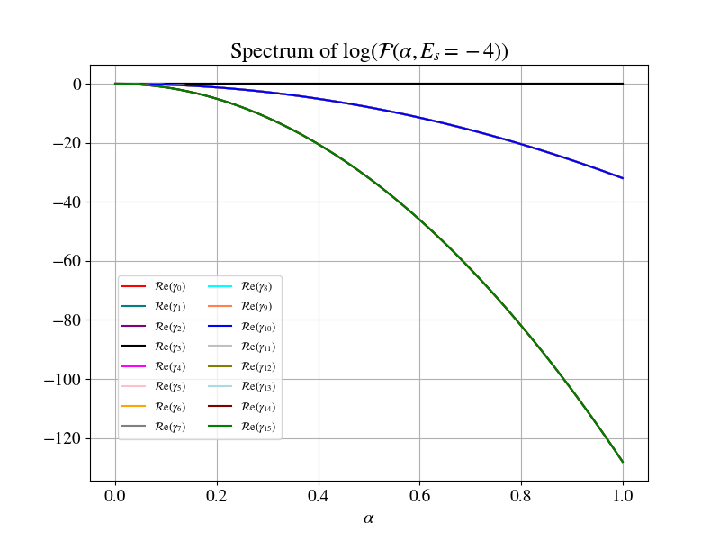
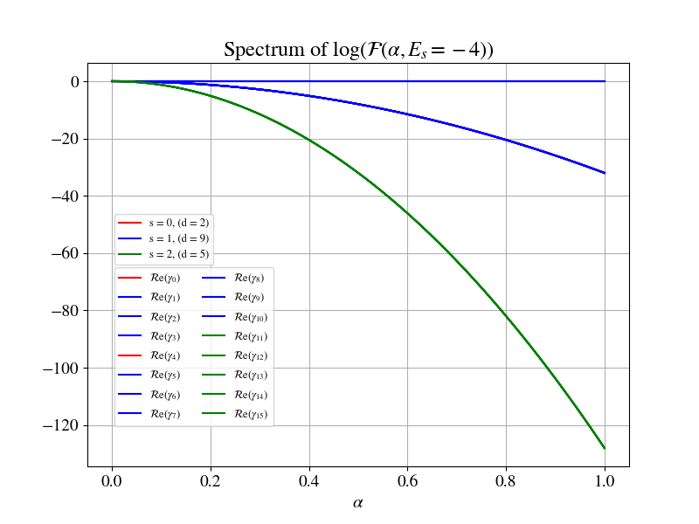
Spectrum of Log(VTA) when λ=1, E₀ = -4

Slide 14
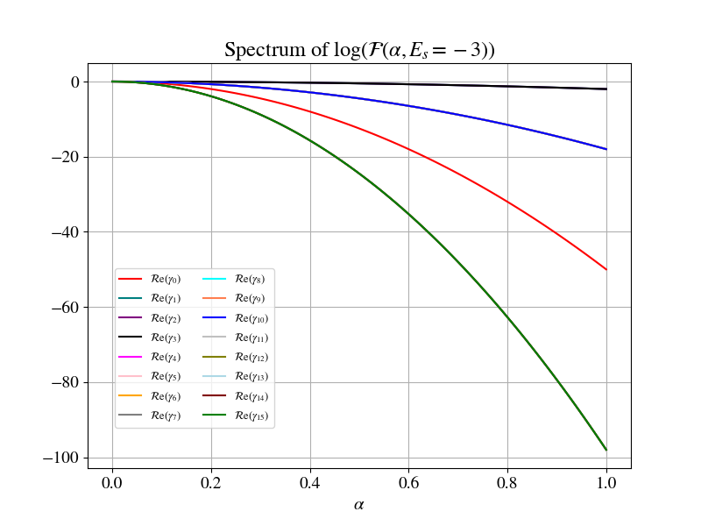
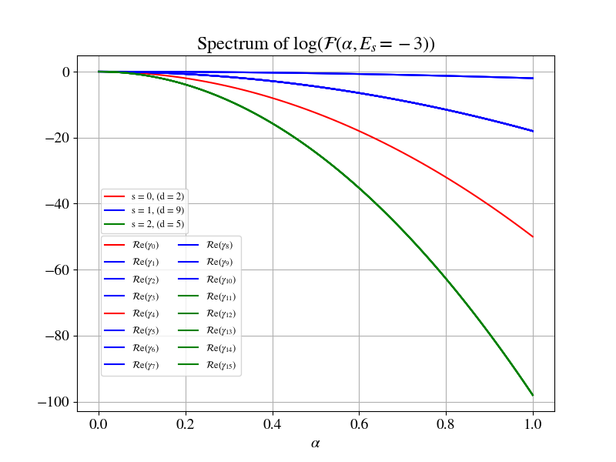
Spectrum of Log(VTA) when λ=1, E₀ = -3

Slide 15
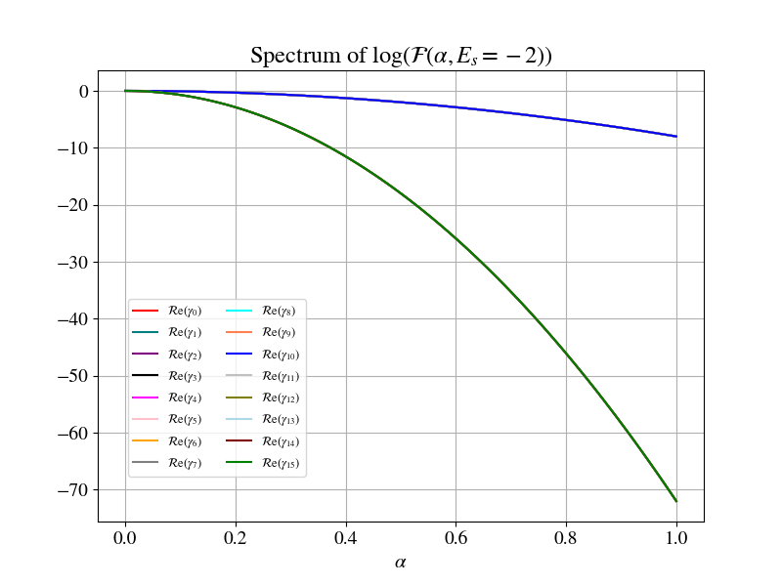
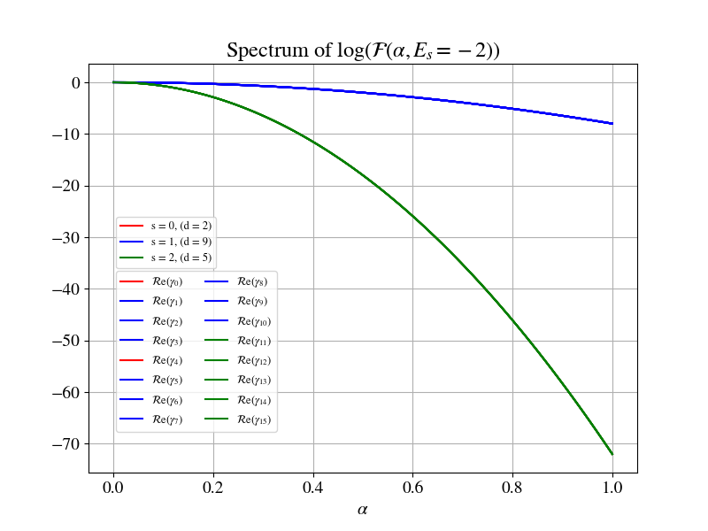
Spectrum of Log(VTA) when λ=1, E₀ = -2

Slide 16
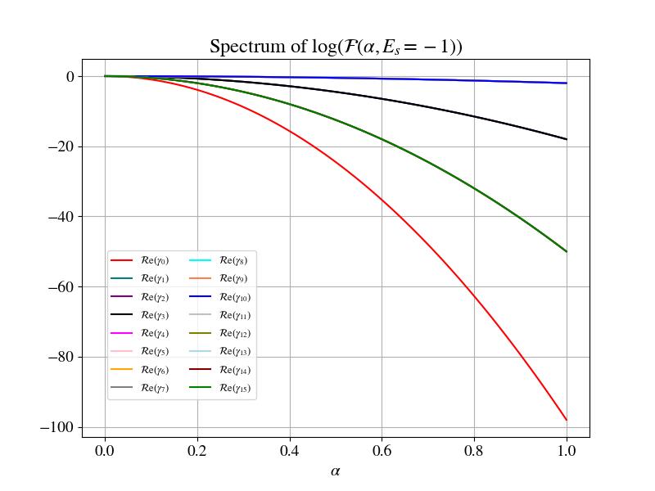
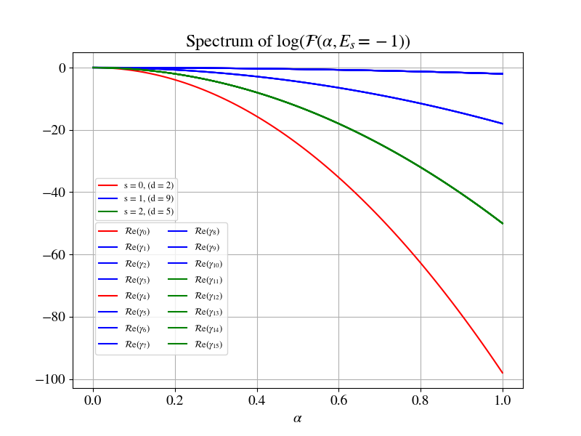
Spectrum of Log(VTA) when λ=1, E₀ = -1

Slide 17
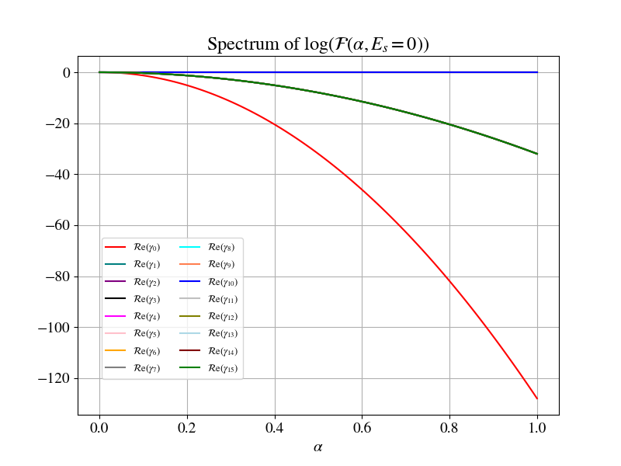
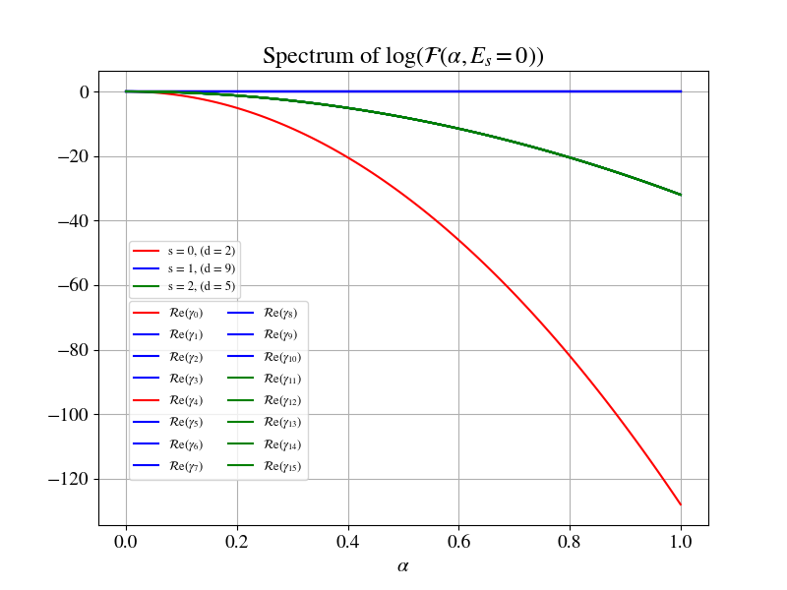
Spectrum of Log(VTA) when λ=1, E₀ = 0

Slide 18
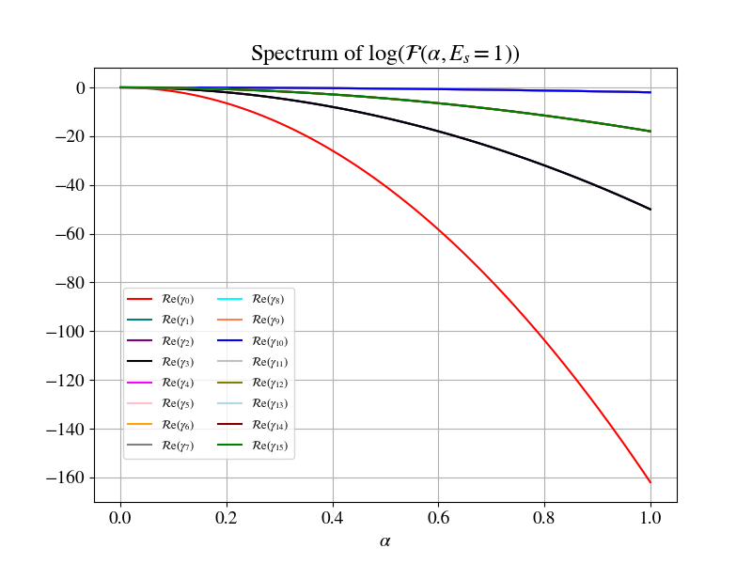
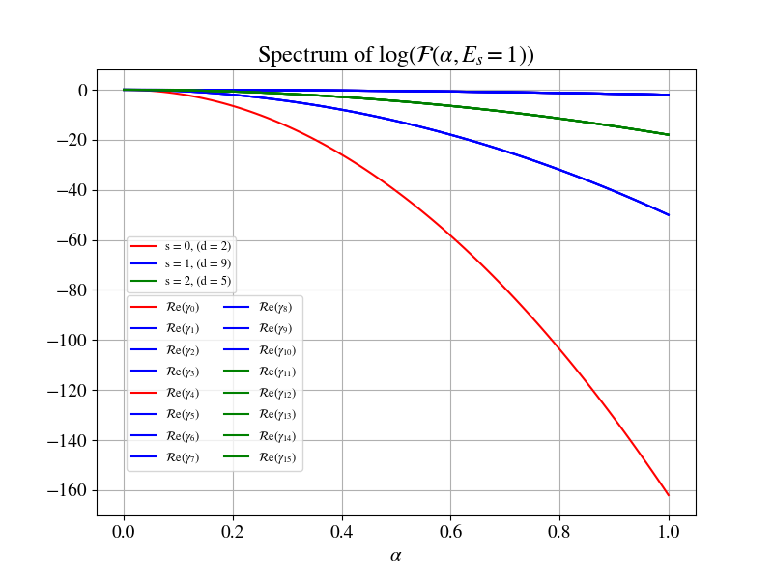
Spectrum of Log(VTA) when λ=1, E₀ = 1

Slide 19
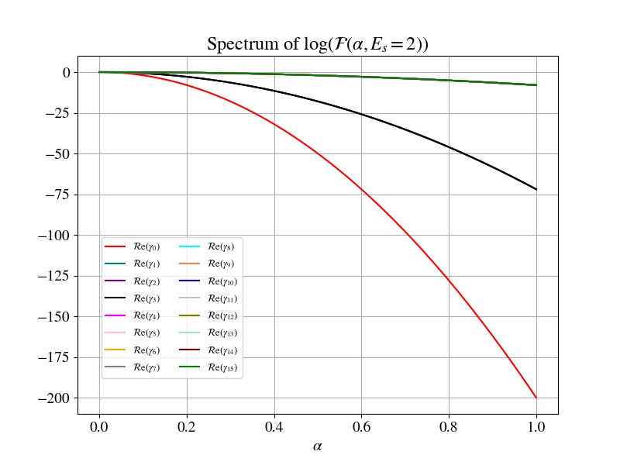
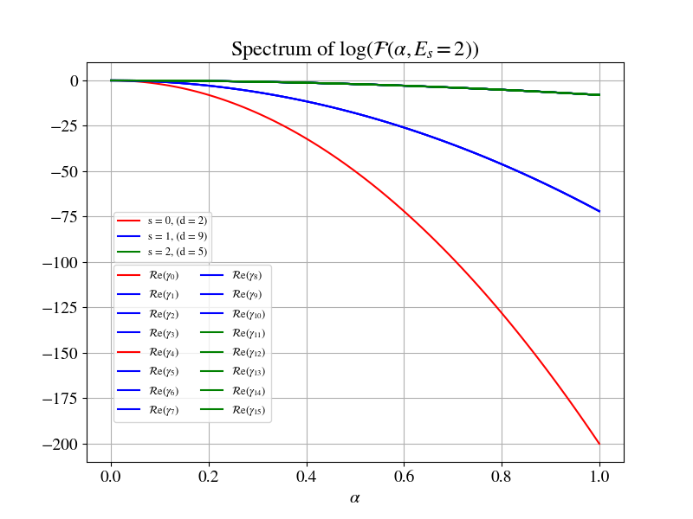
Spectrum of Log(VTA) when λ=1, E₀ = 2

Slide 20
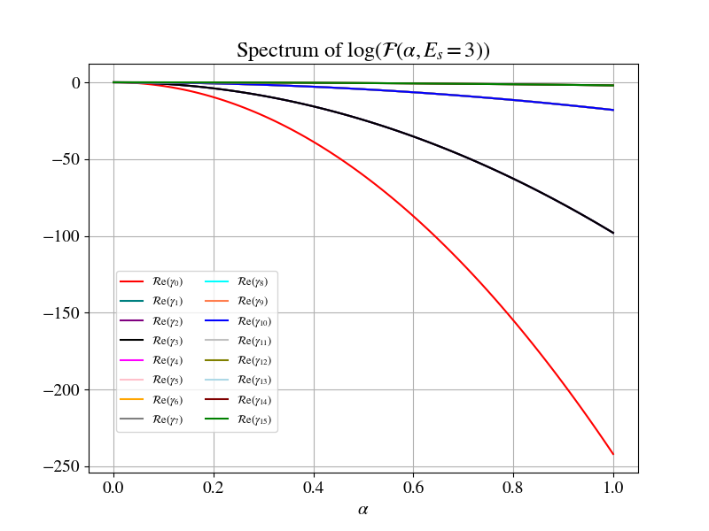
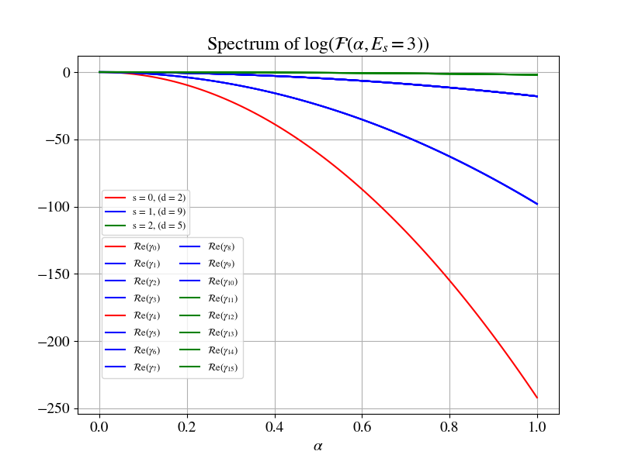
Spectrum of Log(VTA) when λ=1, E₀ = 3

Slide 21
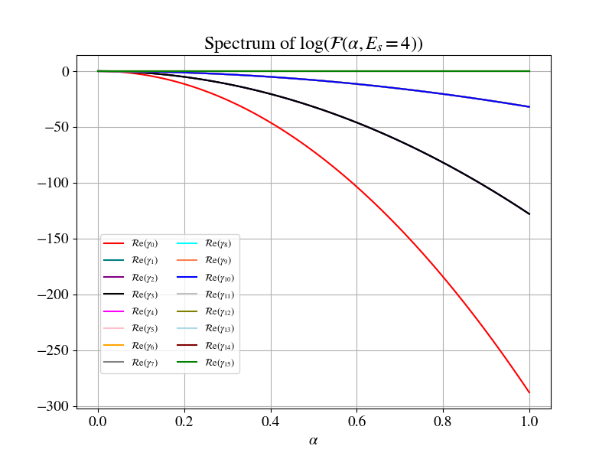
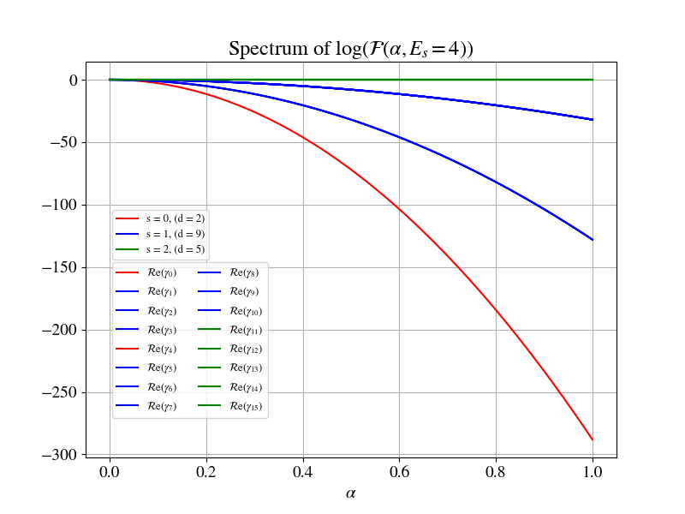
Spectrum of Log(VTA) when λ=1, E₀ = 4

Slide 22
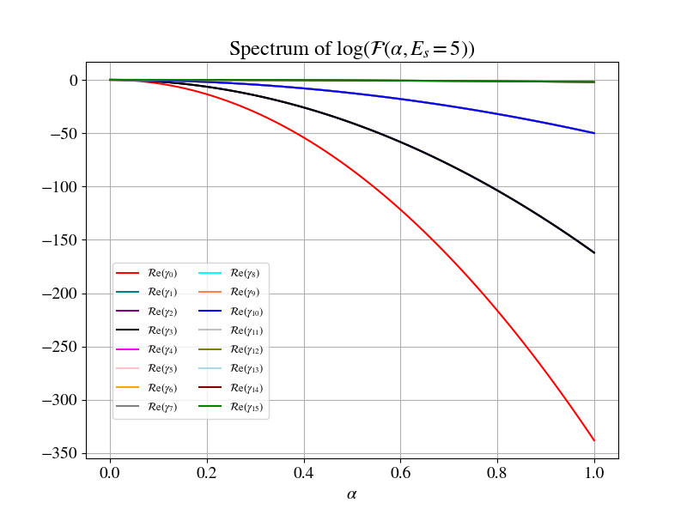
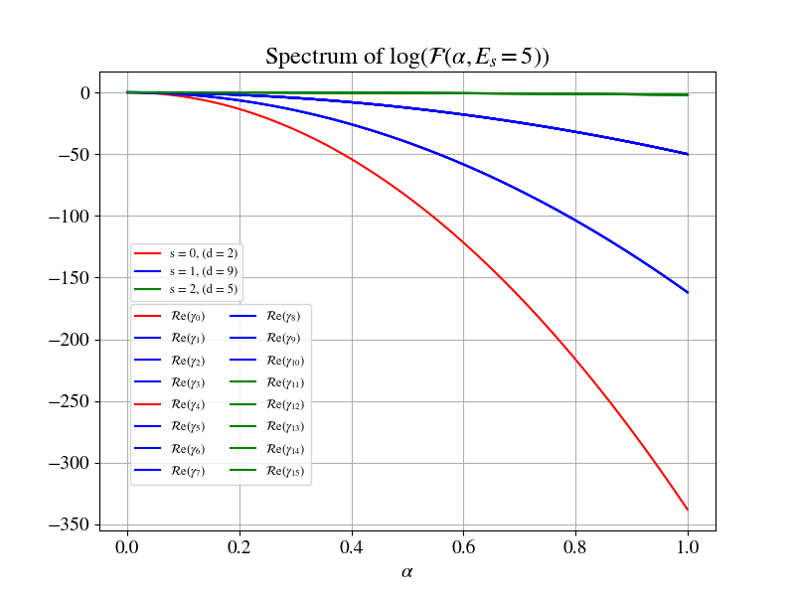
Spectrum of Log(VTA) when λ=1, E₀ = 5

Slide 23
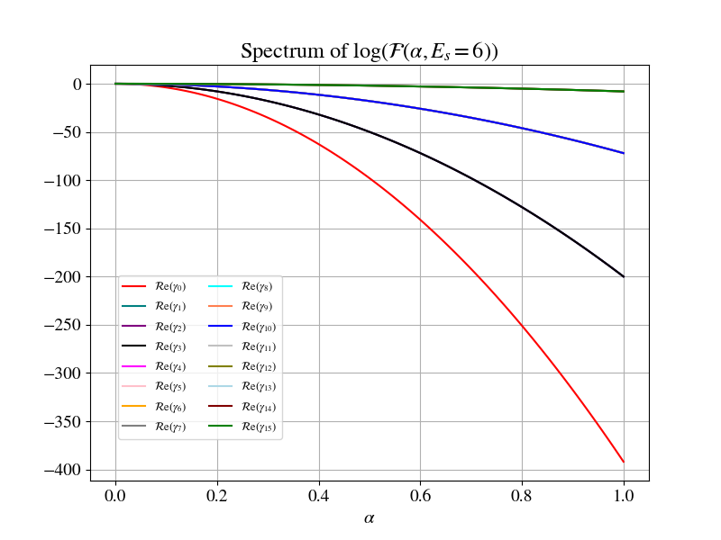
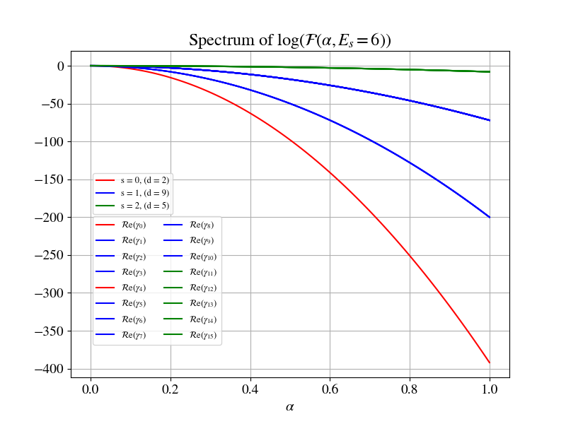
Spectrum of Log(VTA) when λ=1, E₀ = 6

Slide 24
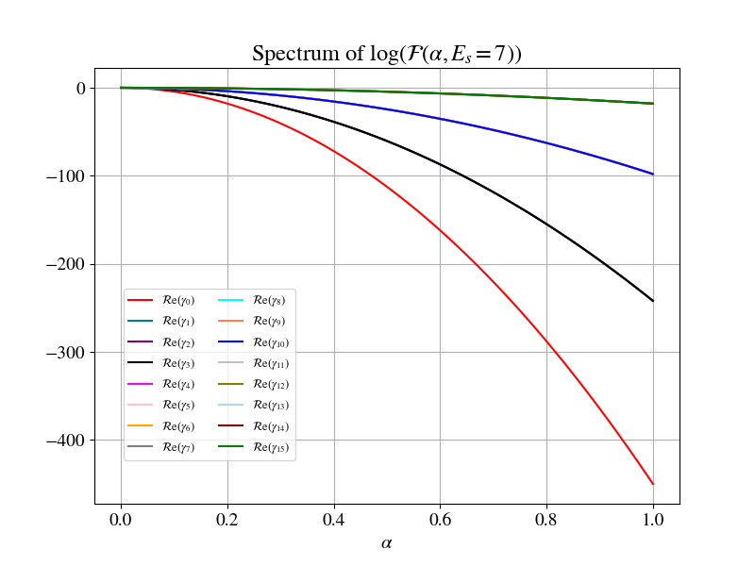
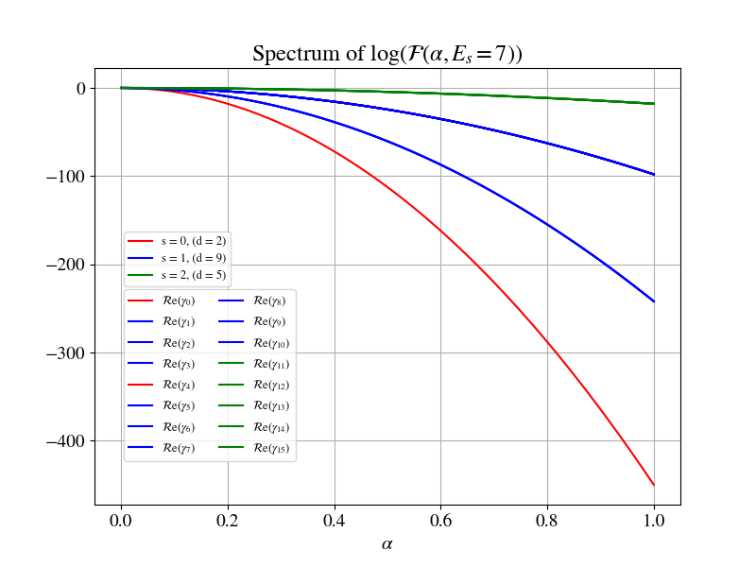
Spectrum of Log(VTA) when λ=1, E₀ = 7

